Slide 1


Computational Theories of Collaboration
Mohammad Shayganfar
PhD Comprehensive Exam
Summer 2015
Professor Charles Rich
Professor Candace L. Sidner
Professor Stacy C. Marsella
Professor John E. Laird

Slide 2
Collaboration is a special type of coordinated activity in which the participants work jointly, together performing a task or carrying out the activities needed to satisfy a shared goal.
Collaboration Theories > Introduction
Notes:
Some of the key points about collaboration.

Slide 3
Collaboration is a special type of coordinated activity in which the participants work jointly, together performing a task or carrying out the activities needed to satisfy a shared goal.
Collaboration Theories > Introduction
Participants possess:
different beliefs and capabilities,
Notes:
Some of the key points about collaboration.

Slide 4
Collaboration is a special type of coordinated activity in which the participants work jointly, together performing a task or carrying out the activities needed to satisfy a shared goal.
Collaboration Theories > Introduction
Participants possess:
different beliefs and capabilities,
partial knowledge of the collaborative activities.
Notes:
Some of the key points about collaboration.

Slide 5
Collaboration is a special type of coordinated activity in which the participants work jointly, together performing a task or carrying out the activities needed to satisfy a shared goal.
Collaboration Theories > Introduction
Participants possess:
different beliefs and capabilities,
partial knowledge of the collaborative activities.
Collaborators need to:
maintain mutual beliefs about their shared goal throughout the collaboration,
Notes:
Some of the key points about collaboration.

Slide 6
Collaboration is a special type of coordinated activity in which the participants work jointly, together performing a task or carrying out the activities needed to satisfy a shared goal.
Collaboration Theories > Introduction
Participants possess:
different beliefs and capabilities,
partial knowledge of the collaborative activities.
Collaborators need to:
maintain mutual beliefs about their shared goal throughout the collaboration,
be able to communicate with others effectively,
Notes:
Some of the key points about collaboration.

Slide 7
Collaboration is a special type of coordinated activity in which the participants work jointly, together performing a task or carrying out the activities needed to satisfy a shared goal.
Collaboration Theories > Introduction
Participants possess:
different beliefs and capabilities,
partial knowledge of the collaborative activities.
Collaborators need to:
maintain mutual beliefs about their shared goal throughout the collaboration,
be able to communicate with others effectively,
commit to the group activities and to their role in it,
Notes:
Some of the key points about collaboration.

Slide 8
Collaboration is a special type of coordinated activity in which the participants work jointly, together performing a task or carrying out the activities needed to satisfy a shared goal.
Collaboration Theories > Introduction
Participants possess:
different beliefs and capabilities,
partial knowledge of the collaborative activities.
Collaborators need to:
maintain mutual beliefs about their shared goal throughout the collaboration,
be able to communicate with others effectively,
commit to the group activities and to their role in it,
commit to the success of others,
Notes:
Some of the key points about collaboration.

Slide 9
Collaboration is a special type of coordinated activity in which the participants work jointly, together performing a task or carrying out the activities needed to satisfy a shared goal.
Collaboration Theories > Introduction
Participants possess:
different beliefs and capabilities,
partial knowledge of the collaborative activities.
Collaborators need to:
maintain mutual beliefs about their shared goal throughout the collaboration,
be able to communicate with others effectively,
commit to the group activities and to their role in it,
commit to the success of others,
reconcile between commitments to the existing collaboration and their other activities.
Notes:
Some of the key points about collaboration.

Slide 10
Collaboration is a special type of coordinated activity in which the participants work jointly, together performing a task or carrying out the activities needed to satisfy a shared goal.
Collaboration Theories > Introduction
Participants possess:
different beliefs and capabilities,
partial knowledge of the collaborative activities.
Collaborators need to:
maintain mutual beliefs about their shared goal throughout the collaboration,
be able to communicate with others effectively,
commit to the group activities and to their role in it,
commit to the success of others,
reconcile between commitments to the existing collaboration and their other activities.
Collaborative plans are more than the sum of individual plans.
Notes:
Some of the key points about collaboration.
(N) I found commitment as an essential issue in collaborative activities.
(N) Commitment and other fundamental concepts of collaboration such as mutual beliefs, joint intentions, shared goals, and shared plans mutually support each other to establish a collaborative activity.
Prominent collaboration theories are based on BDI paradigm (Bratman):
- SharedPlans (Grosz & Sidner),
- Joint Intentions (Cohen & Levesque)
- Hybrid (Tambe)
Bratman’s view of commitment:
- Mutual commitment to joint activity
- Mutual support
- Mutual responsiveness

Slide 11
Collaboration Theories > SharedPlans Theory: Overview
Shared Plans & Recipes:
Shows how a group of agents can incrementally form and execute a shared plan,
Notes:
(1.1) A general theory of collaborative planning.
(1.1) Accommodates multi-level action decomposition hierarchies.
(1.2) Shared plan is an essential concept in SharedPlans theory.
(1.2) Based on Pollack’s definition of plans (relations between actions & beliefs and intentions about those actions)
(1.2) But, not just for a single agent.
(1.2) Further improvements:
- Decomposing activities into multiple agents’ actions.
- Commitment of agents to joint activity,
- Partial recipes
(1.2) Intention-that as the notion of commitment.
(1.3) Recipes: Knowing how to accomplish a goal (vs. plans -- structured collection of beliefs and intentions).
(1.3) When there is a shared plan, agents hold mutual beliefs about actions specified in the recipe.
(1.3) Recipes can be partial (i.e., can be expand over time).
(3) Agents’ communication leads to the construction of a shared plan.

Slide 12
Collaboration Theories > SharedPlans Theory: Overview
Shared Plans & Recipes:
Shows how a group of agents can incrementally form and execute a shared plan,
Allows the process of expanding partial plans into full plans,
Notes:
(1.1) A general theory of collaborative planning.
(1.1) Accommodates multi-level action decomposition hierarchies.
(1.2) Shared plan is an essential concept in SharedPlans theory.
(1.2) Based on Pollack’s definition of plans (relations between actions & beliefs and intentions about those actions)
(1.2) But, not just for a single agent.
(1.2) Further improvements:
- Decomposing activities into multiple agents’ actions.
- Commitment of agents to joint activity,
- Partial recipes
(1.2) Intention-that as the notion of commitment.
(1.3) Recipes: Knowing how to accomplish a goal (vs. plans -- structured collection of beliefs and intentions).
(1.3) When there is a shared plan, agents hold mutual beliefs about actions specified in the recipe.
(1.3) Recipes can be partial (i.e., can be expand over time).
(3) Agents’ communication leads to the construction of a shared plan.

Slide 13
Collaboration Theories > SharedPlans Theory: Overview
Shared Plans & Recipes:
Shows how a group of agents can incrementally form and execute a shared plan,
Allows the process of expanding partial plans into full plans,
Describes how a shared plan coordinates agents’ activities towards achieving a shared goal,
Notes:
(1.1) A general theory of collaborative planning.
(1.1) Accommodates multi-level action decomposition hierarchies.
(1.2) Shared plan is an essential concept in SharedPlans theory.
(1.2) Based on Pollack’s definition of plans (relations between actions & beliefs and intentions about those actions)
(1.2) But, not just for a single agent.
(1.2) Further improvements:
- Decomposing activities into multiple agents’ actions.
- Commitment of agents to joint activity,
- Partial recipes
(1.2) Intention-that as the notion of commitment.
(1.3) Recipes: Knowing how to accomplish a goal (vs. plans -- structured collection of beliefs and intentions).
(1.3) When there is a shared plan, agents hold mutual beliefs about actions specified in the recipe.
(1.3) Recipes can be partial (i.e., can be expand over time).
(3) Agents’ communication leads to the construction of a shared plan.

Slide 14
Collaboration Theories > SharedPlans Theory: Overview
Shared Plans & Recipes:
Shows how a group of agents can incrementally form and execute a shared plan,
Allows the process of expanding partial plans into full plans,
Describes how a shared plan coordinates agents’ activities towards achieving a shared goal,
Agents have a library of how to do their actions (recipes),
Notes:
(1.1) A general theory of collaborative planning.
(1.1) Accommodates multi-level action decomposition hierarchies.
(1.2) Shared plan is an essential concept in SharedPlans theory.
(1.2) Based on Pollack’s definition of plans (relations between actions & beliefs and intentions about those actions)
(1.2) But, not just for a single agent.
(1.2) Further improvements:
- Decomposing activities into multiple agents’ actions.
- Commitment of agents to joint activity,
- Partial recipes
(1.2) Intention-that as the notion of commitment.
(1.3) Recipes: Knowing how to accomplish a goal (vs. plans -- structured collection of beliefs and intentions).
(1.3) When there is a shared plan, agents hold mutual beliefs about actions specified in the recipe.
(1.3) Recipes can be partial (i.e., can be expand over time).
(3) Agents’ communication leads to the construction of a shared plan.

Slide 15
Collaboration Theories > SharedPlans Theory: Overview
Shared Plans & Recipes:
Shows how a group of agents can incrementally form and execute a shared plan,
Allows the process of expanding partial plans into full plans,
Describes how a shared plan coordinates agents’ activities towards achieving a shared goal,
Agents have a library of how to do their actions (recipes),
Beliefs & Intentions:
Emphasizes that collaborative plans are an interleaving of mutual beliefs and intentions about the actions in the plan,
Notes:
(1.1) A general theory of collaborative planning.
(1.1) Accommodates multi-level action decomposition hierarchies.
(1.2) Shared plan is an essential concept in SharedPlans theory.
(1.2) Based on Pollack’s definition of plans (relations between actions & beliefs and intentions about those actions)
(1.2) But, not just for a single agent.
(1.2) Further improvements:
- Decomposing activities into multiple agents’ actions.
- Commitment of agents to joint activity,
- Partial recipes
(1.2) Intention-that as the notion of commitment.
(1.3) Recipes: Knowing how to accomplish a goal (vs. plans -- structured collection of beliefs and intentions).
(1.3) When there is a shared plan, agents hold mutual beliefs about actions specified in the recipe.
(1.3) Recipes can be partial (i.e., can be expand over time).
(3) Agents’ communication leads to the construction of a shared plan.

Slide 16
Collaboration Theories > SharedPlans Theory: Overview
Shared Plans & Recipes:
Shows how a group of agents can incrementally form and execute a shared plan,
Allows the process of expanding partial plans into full plans,
Describes how a shared plan coordinates agents’ activities towards achieving a shared goal,
Agents have a library of how to do their actions (recipes),
Beliefs & Intentions:
Emphasizes that collaborative plans are an interleaving of mutual beliefs and intentions about the actions in the plan,
Communication:
Agents communicate their beliefs and intentions about the actions they can contribute to the shared plan,
Notes:
(1.1) A general theory of collaborative planning.
(1.1) Accommodates multi-level action decomposition hierarchies.
(1.2) Shared plan is an essential concept in SharedPlans theory.
(1.2) Based on Pollack’s definition of plans (relations between actions & beliefs and intentions about those actions)
(1.2) But, not just for a single agent.
(1.2) Further improvements:
- Decomposing activities into multiple agents’ actions.
- Commitment of agents to joint activity,
- Partial recipes
(1.2) Intention-that as the notion of commitment.
(1.3) Recipes: Knowing how to accomplish a goal (vs. plans -- structured collection of beliefs and intentions).
(1.3) When there is a shared plan, agents hold mutual beliefs about actions specified in the recipe.
(1.3) Recipes can be partial (i.e., can be expand over time).
(3) Agents’ communication leads to the construction of a shared plan.

Slide 17
Collaboration Theories > SharedPlans Theory: Overview
Shared Plans & Recipes:
Shows how a group of agents can incrementally form and execute a shared plan,
Allows the process of expanding partial plans into full plans,
Describes how a shared plan coordinates agents’ activities towards achieving a shared goal,
Agents have a library of how to do their actions (recipes),
Beliefs & Intentions:
Emphasizes that collaborative plans are an interleaving of mutual beliefs and intentions about the actions in the plan,
Communication:
Agents communicate their beliefs and intentions about the actions they can contribute to the shared plan,
Communication makes the agents mutually believe that:
there is an agent responsible to execute an action in the plan,
Notes:
(1.1) A general theory of collaborative planning.
(1.1) Accommodates multi-level action decomposition hierarchies.
(1.2) Shared plan is an essential concept in SharedPlans theory.
(1.2) Based on Pollack’s definition of plans (relations between actions & beliefs and intentions about those actions)
(1.2) But, not just for a single agent.
(1.2) Further improvements:
- Decomposing activities into multiple agents’ actions.
- Commitment of agents to joint activity,
- Partial recipes
(1.2) Intention-that as the notion of commitment.
(1.3) Recipes: Knowing how to accomplish a goal (vs. plans -- structured collection of beliefs and intentions).
(1.3) When there is a shared plan, agents hold mutual beliefs about actions specified in the recipe.
(1.3) Recipes can be partial (i.e., can be expand over time).
(3) Agents’ communication leads to the construction of a shared plan.

Slide 18
Collaboration Theories > SharedPlans Theory: Overview
Shared Plans & Recipes:
Shows how a group of agents can incrementally form and execute a shared plan,
Allows the process of expanding partial plans into full plans,
Describes how a shared plan coordinates agents’ activities towards achieving a shared goal,
Agents have a library of how to do their actions (recipes),
Beliefs & Intentions:
Emphasizes that collaborative plans are an interleaving of mutual beliefs and intentions about the actions in the plan,
Communication:
Agents communicate their beliefs and intentions about the actions they can contribute to the shared plan,
Communication makes the agents mutually believe that:
there is an agent responsible to execute an action in the plan,
that agent has intention to do so,
Notes:
(1.1) A general theory of collaborative planning.
(1.1) Accommodates multi-level action decomposition hierarchies.
(1.2) Shared plan is an essential concept in SharedPlans theory.
(1.2) Based on Pollack’s definition of plans (relations between actions & beliefs and intentions about those actions)
(1.2) But, not just for a single agent.
(1.2) Further improvements:
- Decomposing activities into multiple agents’ actions.
- Commitment of agents to joint activity,
- Partial recipes
(1.2) Intention-that as the notion of commitment.
(1.3) Recipes: Knowing how to accomplish a goal (vs. plans -- structured collection of beliefs and intentions).
(1.3) When there is a shared plan, agents hold mutual beliefs about actions specified in the recipe.
(1.3) Recipes can be partial (i.e., can be expand over time).
(3) Agents’ communication leads to the construction of a shared plan.

Slide 19
Collaboration Theories > SharedPlans Theory: Overview
Shared Plans & Recipes:
Shows how a group of agents can incrementally form and execute a shared plan,
Allows the process of expanding partial plans into full plans,
Describes how a shared plan coordinates agents’ activities towards achieving a shared goal,
Agents have a library of how to do their actions (recipes),
Beliefs & Intentions:
Emphasizes that collaborative plans are an interleaving of mutual beliefs and intentions about the actions in the plan,
Communication:
Agents communicate their beliefs and intentions about the actions they can contribute to the shared plan,
Communication makes the agents mutually believe that:
there is an agent responsible to execute an action in the plan,
that agent has intention to do so,
the actions in the plan contribute to the goal.
Notes:
(1.1) A general theory of collaborative planning.
(1.1) Accommodates multi-level action decomposition hierarchies.
(1.2) Shared plan is an essential concept in SharedPlans theory.
(1.2) Based on Pollack’s definition of plans (relations between actions & beliefs and intentions about those actions)
(1.2) But, not just for a single agent.
(1.2) Further improvements:
- Decomposing activities into multiple agents’ actions.
- Commitment of agents to joint activity,
- Partial recipes
(1.2) Intention-that as the notion of commitment.
(1.3) Recipes: Knowing how to accomplish a goal (vs. plans -- structured collection of beliefs and intentions).
(1.3) When there is a shared plan, agents hold mutual beliefs about actions specified in the recipe.
(1.3) Recipes can be partial (i.e., can be expand over time).
(3) Agents’ communication leads to the construction of a shared plan.

Slide 20
Collaboration Theories > SharedPlans Theory: Full & Partial Shared Plans
Full Shared Plan (FSP): A complete plan in which agents have fully determined how to perform an action.
Notes:
- Intention-to: Models the intention of an agent to do any single-agent action.
- The agent believes that it is able to execute that action,
- The agent commits to doing so.
- Intention-that: It is directed towards agent’s collaborators' action or towards a group's joint action. It guides an agent to take actions (including communication), that enable or facilitate other collaborators to perform assigned tasks.
- In SP focus is on plans that underlie a discourse in which the agents collaborate to achieve a shared goal.
- Components of discourse structure:
Linguistic structure: a sequence of utterances aggregating into discourse segments.
Intentions structure: the intention that underlies engagement in the particular discourse (discourse purpose).
Attention state: an abstraction of the agent's focus of attention.

Slide 21
Collaboration Theories > SharedPlans Theory: Full & Partial Shared Plans
Full Shared Plan (FSP): A complete plan in which agents have fully determined how to perform an action.
The required conditions for FSP:
All collaborators mutually believe that they have intention to do an action.
Notes:
- Intention-to: Models the intention of an agent to do any single-agent action.
- The agent believes that it is able to execute that action,
- The agent commits to doing so.
- Intention-that: It is directed towards agent’s collaborators' action or towards a group's joint action. It guides an agent to take actions (including communication), that enable or facilitate other collaborators to perform assigned tasks.
- In SP focus is on plans that underlie a discourse in which the agents collaborate to achieve a shared goal.
- Components of discourse structure:
Linguistic structure: a sequence of utterances aggregating into discourse segments.
Intentions structure: the intention that underlies engagement in the particular discourse (discourse purpose).
Attention state: an abstraction of the agent's focus of attention.

Slide 22
Collaboration Theories > SharedPlans Theory: Full & Partial Shared Plans
Full Shared Plan (FSP): A complete plan in which agents have fully determined how to perform an action.
The required conditions for FSP:
All collaborators mutually believe that they have intention to do an action.
All collaborators mutually believe that they have a recipe for that action.
Notes:
- Intention-to: Models the intention of an agent to do any single-agent action.
- The agent believes that it is able to execute that action,
- The agent commits to doing so.
- Intention-that: It is directed towards agent’s collaborators' action or towards a group's joint action. It guides an agent to take actions (including communication), that enable or facilitate other collaborators to perform assigned tasks.
- In SP focus is on plans that underlie a discourse in which the agents collaborate to achieve a shared goal.
- Components of discourse structure:
Linguistic structure: a sequence of utterances aggregating into discourse segments.
Intentions structure: the intention that underlies engagement in the particular discourse (discourse purpose).
Attention state: an abstraction of the agent's focus of attention.

Slide 23
Collaboration Theories > SharedPlans Theory: Full & Partial Shared Plans
Full Shared Plan (FSP): A complete plan in which agents have fully determined how to perform an action.
The required conditions for FSP:
All collaborators mutually believe that they have intention to do an action.
All collaborators mutually believe that they have a recipe for that action.
For each individual action in the recipe:
A subgroup has an FSP for that step using the corresponding part of the recipe.
Notes:
- Intention-to: Models the intention of an agent to do any single-agent action.
- The agent believes that it is able to execute that action,
- The agent commits to doing so.
- Intention-that: It is directed towards agent’s collaborators' action or towards a group's joint action. It guides an agent to take actions (including communication), that enable or facilitate other collaborators to perform assigned tasks.
- In SP focus is on plans that underlie a discourse in which the agents collaborate to achieve a shared goal.
- Components of discourse structure:
Linguistic structure: a sequence of utterances aggregating into discourse segments.
Intentions structure: the intention that underlies engagement in the particular discourse (discourse purpose).
Attention state: an abstraction of the agent's focus of attention.

Slide 24
Collaboration Theories > SharedPlans Theory: Full & Partial Shared Plans
Full Shared Plan (FSP): A complete plan in which agents have fully determined how to perform an action.
The required conditions for FSP:
All collaborators mutually believe that they have intention to do an action.
All collaborators mutually believe that they have a recipe for that action.
For each individual action in the recipe:
A subgroup has an FSP for that step using the corresponding part of the recipe.
Other members of the group believe that there is a recipe for this particular step that the above subgroup can use and have an FSP for the corresponding set of actions.
Notes:
- Intention-to: Models the intention of an agent to do any single-agent action.
- The agent believes that it is able to execute that action,
- The agent commits to doing so.
- Intention-that: It is directed towards agent’s collaborators' action or towards a group's joint action. It guides an agent to take actions (including communication), that enable or facilitate other collaborators to perform assigned tasks.
- In SP focus is on plans that underlie a discourse in which the agents collaborate to achieve a shared goal.
- Components of discourse structure:
Linguistic structure: a sequence of utterances aggregating into discourse segments.
Intentions structure: the intention that underlies engagement in the particular discourse (discourse purpose).
Attention state: an abstraction of the agent's focus of attention.

Slide 25
Collaboration Theories > SharedPlans Theory: Full & Partial Shared Plans
Full Shared Plan (FSP): A complete plan in which agents have fully determined how to perform an action.
The required conditions for FSP:
All collaborators mutually believe that they have intention to do an action.
All collaborators mutually believe that they have a recipe for that action.
For each individual action in the recipe:
A subgroup has an FSP for that step using the corresponding part of the recipe.
Other members of the group believe that there is a recipe for this particular step that the above subgroup can use and have an FSP for the corresponding set of actions.
Other members of the group have intention that the above subgroup can do the mentioned set of action using the associated recipe.
Notes:
- Intention-to: Models the intention of an agent to do any single-agent action.
- The agent believes that it is able to execute that action,
- The agent commits to doing so.
- Intention-that: It is directed towards agent’s collaborators' action or towards a group's joint action. It guides an agent to take actions (including communication), that enable or facilitate other collaborators to perform assigned tasks.
- In SP focus is on plans that underlie a discourse in which the agents collaborate to achieve a shared goal.
- Components of discourse structure:
Linguistic structure: a sequence of utterances aggregating into discourse segments.
Intentions structure: the intention that underlies engagement in the particular discourse (discourse purpose).
Attention state: an abstraction of the agent's focus of attention.

Slide 26
Collaboration Theories > SharedPlans Theory: Full & Partial Shared Plans
Full Shared Plan (FSP): A complete plan in which agents have fully determined how to perform an action.
The required conditions for FSP:
All collaborators mutually believe that they have intention to do an action.
All collaborators mutually believe that they have a recipe for that action.
For each individual action in the recipe:
A subgroup has an FSP for that step using the corresponding part of the recipe.
Other members of the group believe that there is a recipe for this particular step that the above subgroup can use and have an FSP for the corresponding set of actions.
Other members of the group have intention that the above subgroup can do the mentioned set of action using the associated recipe.
Partial Shared Plan (PSP): used as a snapshot of the collaborators’ mental states to modify and evolve the partial plan, which leads to communication and planning to fulfill the above (FSP’s) conditions.
Notes:
- Intention-to: Models the intention of an agent to do any single-agent action.
- The agent believes that it is able to execute that action,
- The agent commits to doing so.
- Intention-that: It is directed towards agent’s collaborators' action or towards a group's joint action. It guides an agent to take actions (including communication), that enable or facilitate other collaborators to perform assigned tasks.
- In SP focus is on plans that underlie a discourse in which the agents collaborate to achieve a shared goal.
- Components of discourse structure:
Linguistic structure: a sequence of utterances aggregating into discourse segments.
Intentions structure: the intention that underlies engagement in the particular discourse (discourse purpose).
Attention state: an abstraction of the agent's focus of attention.

Slide 27
Collaboration Theories > Joint Intention Theory: Overview
Based on the idea of individual and joint intentions to act as a team member.
Notes:
Another formal theory of collaboration.
Joint intention cannot be defined simply as individual intention with the team regarded as an individual.

Slide 28
Collaboration Theories > Joint Intention Theory: Overview
Based on the idea of individual and joint intentions to act as a team member.
Joint Intentions theory describes how a team of agents can jointly act together by sharing mental states about their actions while an intention is viewed as a commitment to perform an action.
Notes:
Another formal theory of collaboration.
Joint intention cannot be defined simply as individual intention with the team regarded as an individual.

Slide 29
Collaboration Theories > Joint Intention Theory: Overview
Based on the idea of individual and joint intentions to act as a team member.
Joint Intentions theory describes how a team of agents can jointly act together by sharing mental states about their actions while an intention is viewed as a commitment to perform an action.
A joint intention is a shared commitment to perform an action while in a group mental state.
Notes:
Another formal theory of collaboration.
Joint intention cannot be defined simply as individual intention with the team regarded as an individual.

Slide 30
Collaboration Theories > Joint Intention Theory: Overview
Based on the idea of individual and joint intentions to act as a team member.
Joint Intentions theory describes how a team of agents can jointly act together by sharing mental states about their actions while an intention is viewed as a commitment to perform an action.
A joint intention is a shared commitment to perform an action while in a group mental state.
Once an agent entered into a joint commitment with other agents, the agent should communicate its private beliefs with other team members.
Notes:
Another formal theory of collaboration.
Joint intention cannot be defined simply as individual intention with the team regarded as an individual.

Slide 31
Collaboration Theories > Joint Intention Theory: Overview
Based on the idea of individual and joint intentions to act as a team member.
Joint Intentions theory describes how a team of agents can jointly act together by sharing mental states about their actions while an intention is viewed as a commitment to perform an action.
A joint intention is a shared commitment to perform an action while in a group mental state.
Once an agent entered into a joint commitment with other agents, the agent should communicate its private beliefs with other team members.
Team members are committed to inform other team members when they reach the conclusion that a goal is achievable, impossible, or irrelevant.
Notes:
Another formal theory of collaboration.
Joint intention cannot be defined simply as individual intention with the team regarded as an individual.

Slide 32
Collaboration Theories > Joint Intention Theory: Joint Commitment & Joint Intention
Weak Achievement Goal (WAG): shows the state of a team member nominally working on a goal. An agent has a WAG about p if either of the following conditions holds:
Notes:
An agent has an individual commitment (persistent goal) to achieve a p when:
Agent believes that the p is currently false;
agent wants p to be true;
it is true (and agent knows it) that (2) will continue to hold until the agent comes to believe either that p is true, or that it will never be true.

Slide 33
Collaboration Theories > Joint Intention Theory: Joint Commitment & Joint Intention
Weak Achievement Goal (WAG): shows the state of a team member nominally working on a goal. An agent has a WAG about p if either of the following conditions holds:
The agent does not yet believe that p is true and wants p to be true as a goal.
Notes:
An agent has an individual commitment (persistent goal) to achieve a p when:
Agent believes that the p is currently false;
agent wants p to be true;
it is true (and agent knows it) that (2) will continue to hold until the agent comes to believe either that p is true, or that it will never be true.

Slide 34
Collaboration Theories > Joint Intention Theory: Joint Commitment & Joint Intention
Weak Achievement Goal (WAG): shows the state of a team member nominally working on a goal. An agent has a WAG about p if either of the following conditions holds:
The agent does not yet believe that p is true and wants p to be true as a goal.
The agent believes that p is true, will never be true, or is irrelevant, but has as a goal that the status of p be mutually believed by all the team members.
Notes:
An agent has an individual commitment (persistent goal) to achieve a p when:
Agent believes that the p is currently false;
agent wants p to be true;
it is true (and agent knows it) that (2) will continue to hold until the agent comes to believe either that p is true, or that it will never be true.

Slide 35
Collaboration Theories > Joint Intention Theory: Joint Commitment & Joint Intention
Weak Achievement Goal (WAG): shows the state of a team member nominally working on a goal. An agent has a WAG about p if either of the following conditions holds:
The agent does not yet believe that p is true and wants p to be true as a goal.
The agent believes that p is true, will never be true, or is irrelevant, but has as a goal that the status of p be mutually believed by all the team members.
Joint commitment or Joint Persistent Goal (JPG) requires all team members to mutually believe that p is currently false and want p to eventually be true.
Notes:
An agent has an individual commitment (persistent goal) to achieve a p when:
Agent believes that the p is currently false;
agent wants p to be true;
it is true (and agent knows it) that (2) will continue to hold until the agent comes to believe either that p is true, or that it will never be true.

Slide 36
Collaboration Theories > Joint Intention Theory: Joint Commitment & Joint Intention
Weak Achievement Goal (WAG): shows the state of a team member nominally working on a goal. An agent has a WAG about p if either of the following conditions holds:
The agent does not yet believe that p is true and wants p to be true as a goal.
The agent believes that p is true, will never be true, or is irrelevant, but has as a goal that the status of p be mutually believed by all the team members.
Joint commitment or Joint Persistent Goal (JPG) requires all team members to mutually believe that p is currently false and want p to eventually be true.
A JPG guarantees that team members cannot decommit until p is mutually known to be achieved, unachievable or irrelevant.
Notes:
An agent has an individual commitment (persistent goal) to achieve a p when:
Agent believes that the p is currently false;
agent wants p to be true;
it is true (and agent knows it) that (2) will continue to hold until the agent comes to believe either that p is true, or that it will never be true.

Slide 37
Collaboration Theories > Joint Intention Theory: Joint Commitment & Joint Intention
Weak Achievement Goal (WAG): shows the state of a team member nominally working on a goal. An agent has a WAG about p if either of the following conditions holds:
The agent does not yet believe that p is true and wants p to be true as a goal.
The agent believes that p is true, will never be true, or is irrelevant, but has as a goal that the status of p be mutually believed by all the team members.
Joint commitment or Joint Persistent Goal (JPG) requires all team members to mutually believe that p is currently false and want p to eventually be true.
A JPG guarantees that team members cannot decommit until p is mutually known to be achieved, unachievable or irrelevant.
JPG requires team members to each hold p as a WAG.
Notes:
An agent has an individual commitment (persistent goal) to achieve a p when:
Agent believes that the p is currently false;
agent wants p to be true;
it is true (and agent knows it) that (2) will continue to hold until the agent comes to believe either that p is true, or that it will never be true.

Slide 38
Collaboration Theories > Joint Intention Theory: Joint Commitment & Joint Intention
Weak Achievement Goal (WAG): shows the state of a team member nominally working on a goal. An agent has a WAG about p if either of the following conditions holds:
The agent does not yet believe that p is true and wants p to be true as a goal.
The agent believes that p is true, will never be true, or is irrelevant, but has as a goal that the status of p be mutually believed by all the team members.
Joint commitment or Joint Persistent Goal (JPG) requires all team members to mutually believe that p is currently false and want p to eventually be true.
A JPG guarantees that team members cannot decommit until p is mutually known to be achieved, unachievable or irrelevant.
JPG requires team members to each hold p as a WAG.
A team of agents jointly intends to do an action if and only if the members have a JPG of them having the action completed, and having it completed knowingly.
Notes:
An agent has an individual commitment (persistent goal) to achieve a p when:
Agent believes that the p is currently false;
agent wants p to be true;
it is true (and agent knows it) that (2) will continue to hold until the agent comes to believe either that p is true, or that it will never be true.

Slide 39
Collaboration Theories > STEAM – A Hybrid Approach
Uses joint intentions as the basic building block of teamwork (formalizes commitment):
Notes:
(0) STEAM is founded on the Joint Intentions theory.
(2) Unreconciled case in SharedPlans (handled by replanning and communication to assign unachieved/unassigned tasks).
(3) Team operator: Team members instantiate joint intention (when agents select team operator to execuate).

Slide 40
Collaboration Theories > STEAM – A Hybrid Approach
Uses joint intentions as the basic building block of teamwork (formalizes commitment):
Reasoning about coordination and communication in a team.
Notes:
(0) STEAM is founded on the Joint Intentions theory.
(2) Unreconciled case in SharedPlans (handled by replanning and communication to assign unachieved/unassigned tasks).
(3) Team operator: Team members instantiate joint intention (when agents select team operator to execuate).

Slide 41
Collaboration Theories > STEAM – A Hybrid Approach
Uses joint intentions as the basic building block of teamwork (formalizes commitment):
Reasoning about coordination and communication in a team.
Guidance for monitoring and maintenance of a team activity.
Notes:
(0) STEAM is founded on the Joint Intentions theory.
(2) Unreconciled case in SharedPlans (handled by replanning and communication to assign unachieved/unassigned tasks).
(3) Team operator: Team members instantiate joint intention (when agents select team operator to execuate).

Slide 42
Collaboration Theories > STEAM – A Hybrid Approach
Uses joint intentions as the basic building block of teamwork (formalizes commitment):
Reasoning about coordination and communication in a team.
Guidance for monitoring and maintenance of a team activity.
Reasoning about team activity and member’s contribution.
Notes:
(0) STEAM is founded on the Joint Intentions theory.
(2) Unreconciled case in SharedPlans (handled by replanning and communication to assign unachieved/unassigned tasks).
(3) Team operator: Team members instantiate joint intention (when agents select team operator to execuate).

Slide 43
Collaboration Theories > STEAM – A Hybrid Approach
Uses joint intentions as the basic building block of teamwork (formalizes commitment):
Reasoning about coordination and communication in a team.
Guidance for monitoring and maintenance of a team activity.
Reasoning about team activity and member’s contribution.
To reinforce the teamwork coherency to build team members’ mental states.
Notes:
(0) STEAM is founded on the Joint Intentions theory.
(2) Unreconciled case in SharedPlans (handled by replanning and communication to assign unachieved/unassigned tasks).
(3) Team operator: Team members instantiate joint intention (when agents select team operator to execuate).

Slide 44
Collaboration Theories > STEAM – A Hybrid Approach
Uses joint intentions as the basic building block of teamwork (formalizes commitment):
Reasoning about coordination and communication in a team.
Guidance for monitoring and maintenance of a team activity.
Reasoning about team activity and member’s contribution.
To reinforce the teamwork coherency to build team members’ mental states.
It is informed by key concepts from SharedPlans theory (formulates team’s attitude):
Notes:
(0) STEAM is founded on the Joint Intentions theory.
(2) Unreconciled case in SharedPlans (handled by replanning and communication to assign unachieved/unassigned tasks).
(3) Team operator: Team members instantiate joint intention (when agents select team operator to execuate).

Slide 45
Collaboration Theories > STEAM – A Hybrid Approach
Uses joint intentions as the basic building block of teamwork (formalizes commitment):
Reasoning about coordination and communication in a team.
Guidance for monitoring and maintenance of a team activity.
Reasoning about team activity and member’s contribution.
To reinforce the teamwork coherency to build team members’ mental states.
It is informed by key concepts from SharedPlans theory (formulates team’s attitude):
Mutual belief in a shared recipe and shared plans (adds coherency within the teamwork).
Notes:
(0) STEAM is founded on the Joint Intentions theory.
(2) Unreconciled case in SharedPlans (handled by replanning and communication to assign unachieved/unassigned tasks).
(3) Team operator: Team members instantiate joint intention (when agents select team operator to execuate).

Slide 46
Collaboration Theories > STEAM – A Hybrid Approach
Uses joint intentions as the basic building block of teamwork (formalizes commitment):
Reasoning about coordination and communication in a team.
Guidance for monitoring and maintenance of a team activity.
Reasoning about team activity and member’s contribution.
To reinforce the teamwork coherency to build team members’ mental states.
It is informed by key concepts from SharedPlans theory (formulates team’s attitude):
Mutual belief in a shared recipe and shared plans (adds coherency within the teamwork).
The limited required information about recipe to perform an action (only tracking who is responsible).
Notes:
(0) STEAM is founded on the Joint Intentions theory.
(2) Unreconciled case in SharedPlans (handled by replanning and communication to assign unachieved/unassigned tasks).
(3) Team operator: Team members instantiate joint intention (when agents select team operator to execuate).

Slide 47
Collaboration Theories > STEAM – A Hybrid Approach
Uses joint intentions as the basic building block of teamwork (formalizes commitment):
Reasoning about coordination and communication in a team.
Guidance for monitoring and maintenance of a team activity.
Reasoning about team activity and member’s contribution.
To reinforce the teamwork coherency to build team members’ mental states.
It is informed by key concepts from SharedPlans theory (formulates team’s attitude):
Mutual belief in a shared recipe and shared plans (adds coherency within the teamwork).
The limited required information about recipe to perform an action (only tracking who is responsible).
Uses the concept of intention-that for communication.
Notes:
(0) STEAM is founded on the Joint Intentions theory.
(2) Unreconciled case in SharedPlans (handled by replanning and communication to assign unachieved/unassigned tasks).
(3) Team operator: Team members instantiate joint intention (when agents select team operator to execuate).

Slide 48
Collaboration Theories > STEAM – A Hybrid Approach
Uses joint intentions as the basic building block of teamwork (formalizes commitment):
Reasoning about coordination and communication in a team.
Guidance for monitoring and maintenance of a team activity.
Reasoning about team activity and member’s contribution.
To reinforce the teamwork coherency to build team members’ mental states.
It is informed by key concepts from SharedPlans theory (formulates team’s attitude):
Mutual belief in a shared recipe and shared plans (adds coherency within the teamwork).
The limited required information about recipe to perform an action (only tracking who is responsible).
Uses the concept of intention-that for communication.
Novel aspects:
Has team (expressing joint activities) vs. individual (individual’s activities) operators.
Notes:
(0) STEAM is founded on the Joint Intentions theory.
(2) Unreconciled case in SharedPlans (handled by replanning and communication to assign unachieved/unassigned tasks).
(3) Team operator: Team members instantiate joint intention (when agents select team operator to execuate).

Slide 49
Collaboration Theories > STEAM – A Hybrid Approach
Uses joint intentions as the basic building block of teamwork (formalizes commitment):
Reasoning about coordination and communication in a team.
Guidance for monitoring and maintenance of a team activity.
Reasoning about team activity and member’s contribution.
To reinforce the teamwork coherency to build team members’ mental states.
It is informed by key concepts from SharedPlans theory (formulates team’s attitude):
Mutual belief in a shared recipe and shared plans (adds coherency within the teamwork).
The limited required information about recipe to perform an action (only tracking who is responsible).
Uses the concept of intention-that for communication.
Novel aspects:
Has team (expressing joint activities) vs. individual (individual’s activities) operators.
Team synchronization protocol.
Notes:
(0) STEAM is founded on the Joint Intentions theory.
(2) Unreconciled case in SharedPlans (handled by replanning and communication to assign unachieved/unassigned tasks).
(3) Team operator: Team members instantiate joint intention (when agents select team operator to execuate).

Slide 50
Collaboration Theories > STEAM – A Hybrid Approach
Uses joint intentions as the basic building block of teamwork (formalizes commitment):
Reasoning about coordination and communication in a team.
Guidance for monitoring and maintenance of a team activity.
Reasoning about team activity and member’s contribution.
To reinforce the teamwork coherency to build team members’ mental states.
It is informed by key concepts from SharedPlans theory (formulates team’s attitude):
Mutual belief in a shared recipe and shared plans (adds coherency within the teamwork).
The limited required information about recipe to perform an action (only tracking who is responsible).
Uses the concept of intention-that for communication.
Novel aspects:
Has team (expressing joint activities) vs. individual (individual’s activities) operators.
Team synchronization protocol.
Constructs to monitoring team performance.
Notes:
(0) STEAM is founded on the Joint Intentions theory.
(2) Unreconciled case in SharedPlans (handled by replanning and communication to assign unachieved/unassigned tasks).
(3) Team operator: Team members instantiate joint intention (when agents select team operator to execuate).

Slide 51
Collaboration Theories > STEAM – A Hybrid Approach
Uses joint intentions as the basic building block of teamwork (formalizes commitment):
Reasoning about coordination and communication in a team.
Guidance for monitoring and maintenance of a team activity.
Reasoning about team activity and member’s contribution.
To reinforce the teamwork coherency to build team members’ mental states.
It is informed by key concepts from SharedPlans theory (formulates team’s attitude):
Mutual belief in a shared recipe and shared plans (adds coherency within the teamwork).
The limited required information about recipe to perform an action (only tracking who is responsible).
Uses the concept of intention-that for communication.
Novel aspects:
Has team (expressing joint activities) vs. individual (individual’s activities) operators.
Team synchronization protocol.
Constructs to monitoring team performance.
Communication’s (based on joint intention) overhead and risks.
Notes:
(0) STEAM is founded on the Joint Intentions theory.
(2) Unreconciled case in SharedPlans (handled by replanning and communication to assign unachieved/unassigned tasks).
(3) Team operator: Team members instantiate joint intention (when agents select team operator to execuate).

Slide 52
Collaboration Theories > Similarities: SharedPlans & Joint Intentions
Both specify executing actions as a team.

Slide 53
Collaboration Theories > Similarities: SharedPlans & Joint Intentions
Both specify executing actions as a team.
Both based on BDI model and Bratman’s view of intention.

Slide 54
Collaboration Theories > Similarities: SharedPlans & Joint Intentions
Both specify executing actions as a team.
Both based on BDI model and Bratman’s view of intention.
In both joint actions are not collection of individual actions (agents need to share beliefs).

Slide 55
Collaboration Theories > Similarities: SharedPlans & Joint Intentions
Both specify executing actions as a team.
Both based on BDI model and Bratman’s view of intention.
In both joint actions are not collection of individual actions (agents need to share beliefs).
Both emphasize on communication.

Slide 56
Collaboration Theories > Similarities: SharedPlans & Joint Intentions
Both specify executing actions as a team.
Both based on BDI model and Bratman’s view of intention.
In both joint actions are not collection of individual actions (agents need to share beliefs).
Both emphasize on communication.
Both are concerned about commitment.

Slide 57
Collaboration Theories > Differences: SharedPlans & Joint Intentions
SharedPlans theory is based on mutual beliefs and notion of intention-that, while Joint Intentions theory is based on joint intentions.

Slide 58
Collaboration Theories > Differences: SharedPlans & Joint Intentions
SharedPlans theory is based on mutual beliefs and notion of intention-that, while Joint Intentions theory is based on joint intentions.
In SharedPlans theory teammates agree on the shared plan, whereas in Joint Intentions theory teammates agree on intentions.

Slide 59
Collaboration Theories > Differences: SharedPlans & Joint Intentions
SharedPlans theory is based on mutual beliefs and notion of intention-that, while Joint Intentions theory is based on joint intentions.
In SharedPlans theory teammates agree on the shared plan, whereas in Joint Intentions theory teammates agree on intentions.
SharedPlans theory employs hierarchical structures over intentions (in contrast to Joint Intentions theory).

Slide 60
Collaboration Theories > Differences: SharedPlans & Joint Intentions
SharedPlans theory is based on mutual beliefs and notion of intention-that, while Joint Intentions theory is based on joint intentions.
In SharedPlans theory teammates agree on the shared plan, whereas in Joint Intentions theory teammates agree on intentions.
SharedPlans theory employs hierarchical structures over intentions (in contrast to Joint Intentions theory).
SharedPlans theory describe a way to achieve a shared goal whereas Joint Intentions theory only describes the shared goal.

Slide 61
Collaboration Theories > Differences: SharedPlans & Joint Intentions
SharedPlans theory is based on mutual beliefs and notion of intention-that, while Joint Intentions theory is based on joint intentions.
In SharedPlans theory teammates agree on the shared plan, whereas in Joint Intentions theory teammates agree on intentions.
SharedPlans theory employs hierarchical structures over intentions (in contrast to Joint Intentions theory).
SharedPlans theory describe a way to achieve a shared goal whereas Joint Intentions theory only describes the shared goal.
Joint Intentions theory assumes knowledge about the teammates is always available (in contrast to partial plan in SharedPlans theory).

Slide 62
Collaboration Theories > Differences: SharedPlans & Joint Intentions
SharedPlans theory is based on mutual beliefs and notion of intention-that, while Joint Intentions theory is based on joint intentions.
In SharedPlans theory teammates agree on the shared plan, whereas in Joint Intentions theory teammates agree on intentions.
SharedPlans theory employs hierarchical structures over intentions (in contrast to Joint Intentions theory).
SharedPlans theory describe a way to achieve a shared goal whereas Joint Intentions theory only describes the shared goal.
Joint Intentions theory assumes knowledge about the teammates is always available (in contrast to partial plan in SharedPlans theory).
In SharedPlans theory communication requirements are derived from intention-that concept whereas it is “hard-wired” in Joint Intentions theory.

Slide 63
Collaboration Theories > Applications
Assistant robots
Emotional awareness (COCHI)
Communication
Joint actions and commitments
Task-based planning
Discourse generation and interpretation (COLLAGEN)
Conversational agents
Network management
Proactive behaviors and information exchange (CAST)
Instructional systems
Group decision support systems
Authors’ assistant
Sociable robots
Combat air missions
Robot soccer
Rescue responses

Slide 64
Collaboration Theories > Conclusion
SharedPlans is more convincing than the others.

Slide 65
Collaboration Theories > Conclusion
SharedPlans is more convincing than the others.
Inclusive explanation of collaboration structure.

Slide 66
Collaboration Theories > Conclusion
SharedPlans is more convincing than the others.
Inclusive explanation of collaboration structure.
Association to discourse structure (improve communicative aspects).

Slide 67
Collaboration Theories > Conclusion
SharedPlans is more convincing than the others.
Inclusive explanation of collaboration structure.
Association to discourse structure (improve communicative aspects).
Joint Intentions theory is clearly defined and fulfills most of the key collaboration requirements.

Slide 68
Collaboration Theories > Conclusion
SharedPlans is more convincing than the others.
Inclusive explanation of collaboration structure.
Association to discourse structure (improve communicative aspects).
Joint Intentions theory is clearly defined and fulfills most of the key collaboration requirements.
Hybrid approaches are valuable and make the theories closer to applications.

Slide 69
Collaboration Theories > Conclusion
SharedPlans is more convincing than the others.
Inclusive explanation of collaboration structure.
Association to discourse structure (improve communicative aspects).
Joint Intentions theory is clearly defined and fulfills most of the key collaboration requirements.
Hybrid approaches are valuable and make the theories closer to applications.
The lack of underlying domain-independent collaboration processes which can construct and evolve the collaboration structure.

Slide 70
Affective Computing
Mohammad Shayganfar
PhD Comprehensive Exam
Summer 2015
Professor Charles Rich
Professor Candace L. Sidner
Professor Stacy C. Marsella
Professor John E. Laird

Slide 71
Affective Computing > Introduction
Four categories of computational emotion modeling:
Detecting and recognizing human emotions,
Interpreting and understanding human emotions,
Generating artificial emotions,
Expressing human-perceivable emotions.

Slide 72
Affective Computing > Introduction
Four categories of computational emotion modeling:
Detecting and recognizing human emotions,
Interpreting and understanding human emotions,
Generating artificial emotions,
Expressing human-perceivable emotions.
Major emotion theories:
Appraisal
Dimensional
Discrete (basic)

Slide 73
Affective Computing > Introduction
Four categories of computational emotion modeling:
Detecting and recognizing human emotions,
Interpreting and understanding human emotions,
Generating artificial emotions,
Expressing human-perceivable emotions.
Major emotion theories:
Appraisal
Dimensional
Discrete (basic)
We majorly focus on Appraisal and Dimensional theories.

Slide 74
Affective Computing > Appraisal Theory: Overview
Appraisal theory describes the cognitive process by which an individual evaluates the situation in the environment with respect to the individual's well-being and triggers emotions to control internal changes and external actions.
Notes:
- First formulated by psychologists Arnold, Lazarus, and later by Scherer.

Slide 75
Affective Computing > Appraisal Theory: Overview
Appraisal theory describes the cognitive process by which an individual evaluates the situation in the environment with respect to the individual's well-being and triggers emotions to control internal changes and external actions.
Cognitive appraisal process:
Distinct components of emotions,
Notes:
- First formulated by psychologists Arnold, Lazarus, and later by Scherer.

Slide 76
Affective Computing > Appraisal Theory: Overview
Appraisal theory describes the cognitive process by which an individual evaluates the situation in the environment with respect to the individual's well-being and triggers emotions to control internal changes and external actions.
Cognitive appraisal process:
Distinct components of emotions,
Components are called appraisal variables,
Notes:
- First formulated by psychologists Arnold, Lazarus, and later by Scherer.

Slide 77
Affective Computing > Appraisal Theory: Overview
Appraisal theory describes the cognitive process by which an individual evaluates the situation in the environment with respect to the individual's well-being and triggers emotions to control internal changes and external actions.
Cognitive appraisal process:
Distinct components of emotions,
Components are called appraisal variables,
Agent Evaluates the stimuli with respect to their consequences;
Notes:
- First formulated by psychologists Arnold, Lazarus, and later by Scherer.

Slide 78
Affective Computing > Appraisal Theory: Overview
Appraisal theory describes the cognitive process by which an individual evaluates the situation in the environment with respect to the individual's well-being and triggers emotions to control internal changes and external actions.
Cognitive appraisal process:
Distinct components of emotions,
Components are called appraisal variables,
Agent Evaluates the stimuli with respect to their consequences;
According to Scherer’s appraisal objectives (i.e., relevance, implication, coping, and normative significance),
Notes:
- First formulated by psychologists Arnold, Lazarus, and later by Scherer.

Slide 79
Affective Computing > Appraisal Theory: Overview
Appraisal theory describes the cognitive process by which an individual evaluates the situation in the environment with respect to the individual's well-being and triggers emotions to control internal changes and external actions.
Cognitive appraisal process:
Distinct components of emotions,
Components are called appraisal variables,
Agent Evaluates the stimuli with respect to their consequences;
According to Scherer’s appraisal objectives (i.e., relevance, implication, coping, and normative significance),
Objectives include different appraisal variables,
Notes:
- First formulated by psychologists Arnold, Lazarus, and later by Scherer.

Slide 80
Affective Computing > Appraisal Theory: Overview
Appraisal theory describes the cognitive process by which an individual evaluates the situation in the environment with respect to the individual's well-being and triggers emotions to control internal changes and external actions.
Cognitive appraisal process:
Distinct components of emotions,
Components are called appraisal variables,
Agent Evaluates the stimuli with respect to their consequences;
According to Scherer’s appraisal objectives (i.e., relevance, implication, coping, and normative significance),
Objectives include different appraisal variables,
Specific values will be assigned to appraisal variables,
Notes:
- First formulated by psychologists Arnold, Lazarus, and later by Scherer.

Slide 81
Affective Computing > Appraisal Theory: Overview
Appraisal theory describes the cognitive process by which an individual evaluates the situation in the environment with respect to the individual's well-being and triggers emotions to control internal changes and external actions.
Cognitive appraisal process:
Distinct components of emotions,
Components are called appraisal variables,
Agent Evaluates the stimuli with respect to their consequences;
According to Scherer’s appraisal objectives (i.e., relevance, implication, coping, and normative significance),
Objectives include different appraisal variables,
Specific values will be assigned to appraisal variables,
Determined appraisal variables are mapped onto a particular emotion,
Appraisal variables are the semantic primitives for representing emotions.
Notes:
- First formulated by psychologists Arnold, Lazarus, and later by Scherer.

Slide 82
Affective Computing > Appraisal Theory: Appraisal & Coping processes
Appraisals are separable antecedents of emotions.

Slide 83
Affective Computing > Appraisal Theory: Appraisal & Coping processes
Appraisals are separable antecedents of emotions.
Overall process:
Evaluation of the environment according to the internalized goals,
Systematic assessment of several elements.

Slide 84
Affective Computing > Appraisal Theory: Appraisal & Coping processes
Appraisals are separable antecedents of emotions.
Overall process:
Evaluation of the environment according to the internalized goals,
Systematic assessment of several elements.
Outcome triggers emotions and coping strategies.

Slide 85
Affective Computing > Appraisal Theory: Appraisal & Coping processes
Appraisals are separable antecedents of emotions.
Overall process:
Evaluation of the environment according to the internalized goals,
Systematic assessment of several elements.
Outcome triggers emotions and coping strategies.
Appraisal variables, e.g., relevance, desirability, expectedness, controllability.

Slide 86
Affective Computing > Appraisal Theory: Appraisal & Coping processes
Appraisals are separable antecedents of emotions.
Overall process:
Evaluation of the environment according to the internalized goals,
Systematic assessment of several elements.
Outcome triggers emotions and coping strategies.
Appraisal variables, e.g., relevance, desirability, expectedness, controllability.
Coping process:
Determines whether and how agent should respond to an event.

Slide 87
Affective Computing > Appraisal Theory: Appraisal & Coping processes
Appraisals are separable antecedents of emotions.
Overall process:
Evaluation of the environment according to the internalized goals,
Systematic assessment of several elements.
Outcome triggers emotions and coping strategies.
Appraisal variables, e.g., relevance, desirability, expectedness, controllability.
Coping process:
Determines whether and how agent should respond to an event.
Coping strategies control (enable or suppress) cognitive processes operate on causal interpretation of the appraisals.

Slide 88
Affective Computing > Appraisal Theory: Appraisal & Coping processes
Appraisals are separable antecedents of emotions.
Overall process:
Evaluation of the environment according to the internalized goals,
Systematic assessment of several elements.
Outcome triggers emotions and coping strategies.
Appraisal variables, e.g., relevance, desirability, expectedness, controllability.
Coping process:
Determines whether and how agent should respond to an event.
Coping strategies control (enable or suppress) cognitive processes operate on causal interpretation of the appraisals.
Coping strategies can be grouped into different categories:
Problem-focused (e.g., planning)
Emotion-focused (seeking social support for instrumental reasons)

Slide 89
Affective Computing > Appraisal Theory: OCC – A structural Appraisal Theory
The model categorizes emotions based on their underlying appraisal patterns.
Notes:
(0) Similar to Lazarus and Scherer’s cognitive views.
(3) All emotion types (i.e., six) in a group share the same cognitive pattern.

Slide 90
Affective Computing > Appraisal Theory: OCC – A structural Appraisal Theory
The model categorizes emotions based on their underlying appraisal patterns.
Patterns are fundamental criteria and involve:
One’s focus of attention,
One’s concern,
One’s appraisals.
Notes:
(0) Similar to Lazarus and Scherer’s cognitive views.
(3) All emotion types (i.e., six) in a group share the same cognitive pattern.

Slide 91
Affective Computing > Appraisal Theory: OCC – A structural Appraisal Theory
The model categorizes emotions based on their underlying appraisal patterns.
Patterns are fundamental criteria and involve:
One’s focus of attention,
One’s concern,
One’s appraisals.
OCC model introduces some global variables of an emotion's intensity to distinguish all types of emotions (e.g., sense of reality, and arousal).
Notes:
(0) Similar to Lazarus and Scherer’s cognitive views.
(3) All emotion types (i.e., six) in a group share the same cognitive pattern.

Slide 92
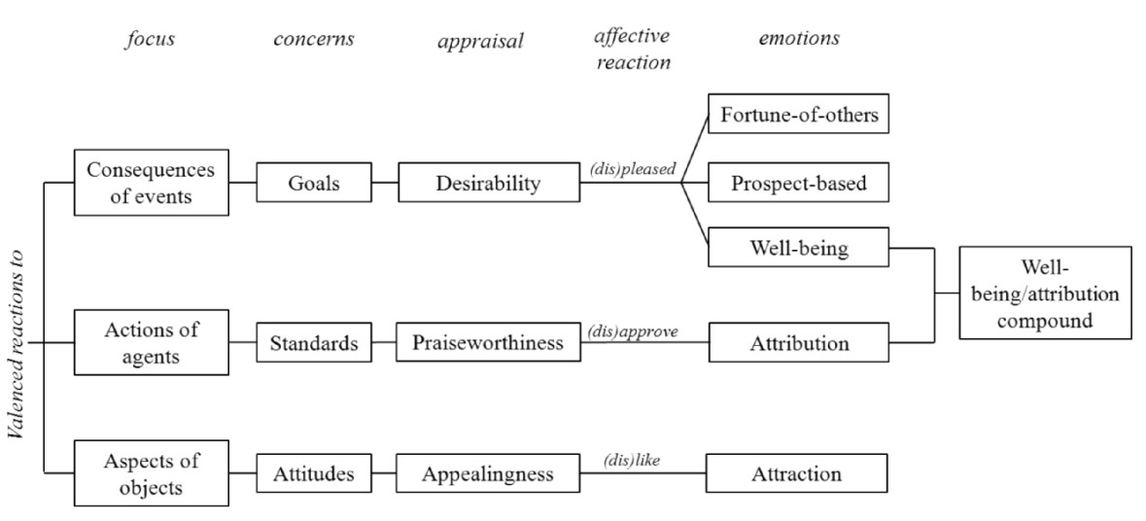
Affective Computing > Appraisal Theory: OCC – A structural Appraisal Theory
The model categorizes emotions based on their underlying appraisal patterns.
Patterns are fundamental criteria and involve:
One’s focus of attention,
One’s concern,
One’s appraisals.
OCC model introduces some global variables of an emotion's intensity to distinguish all types of emotions (e.g., sense of reality, and arousal).
Notes:
(0) Similar to Lazarus and Scherer’s cognitive views.
(3) All emotion types (i.e., six) in a group share the same cognitive pattern.

Slide 93
Affective Computing > Dimensional Emotion Theories
They conceptualize emotions by defining where they lie in two or three dimensions.
Notes:
(2) One dimension is valence or how good or bad objects and events are for a being ranging from pleasant to unpleasant. The other dimension is arousal, ranging from calm to excited.
- Two dimensions that are commonly proposed to describe emotions are valence and physiological arousal.
Russell suggested that affective states are all related to each other systematically through what is called core affect which is describable as a point in a space between two bipolar dimensions.
Emotions are describable by core affect.
Problem: Sometimes two-dimensional space cannot easily differentiate among emotions. Hence, some models incorporate another dimension.

Slide 94
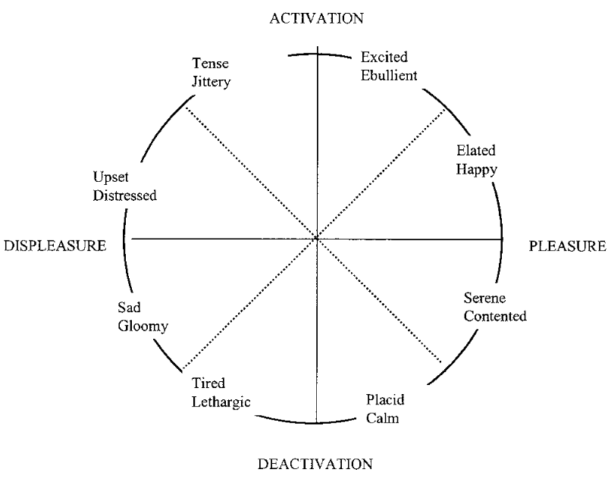
Affective Computing > Dimensional Emotion Theories
They conceptualize emotions by defining where they lie in two or three dimensions.
Russell’s Circumplex model (Valence and Arousal).
Notes:
(2) One dimension is valence or how good or bad objects and events are for a being ranging from pleasant to unpleasant. The other dimension is arousal, ranging from calm to excited.
- Two dimensions that are commonly proposed to describe emotions are valence and physiological arousal.
Russell suggested that affective states are all related to each other systematically through what is called core affect which is describable as a point in a space between two bipolar dimensions.
Emotions are describable by core affect.
Problem: Sometimes two-dimensional space cannot easily differentiate among emotions. Hence, some models incorporate another dimension.

Slide 95
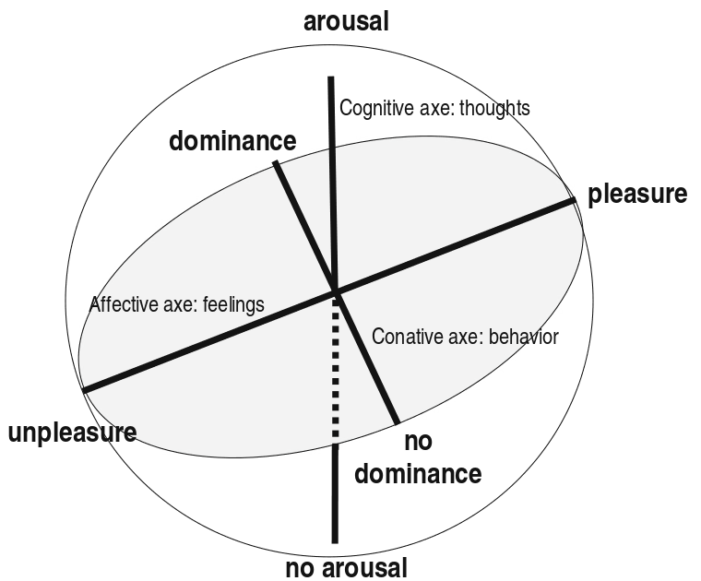
Affective Computing > Dimensional Emotion Theories
They conceptualize emotions by defining where they lie in two or three dimensions.
Russell’s Circumplex model (Valence and Arousal).
Mehrabian and Russell’s PAD model (Pleasure, Arousal, Dominance).
Notes:
(2) One dimension is valence or how good or bad objects and events are for a being ranging from pleasant to unpleasant. The other dimension is arousal, ranging from calm to excited.
- Two dimensions that are commonly proposed to describe emotions are valence and physiological arousal.
Russell suggested that affective states are all related to each other systematically through what is called core affect which is describable as a point in a space between two bipolar dimensions.
Emotions are describable by core affect.
Problem: Sometimes two-dimensional space cannot easily differentiate among emotions. Hence, some models incorporate another dimension.

Slide 96
Affective Computing > Discrete Emotion Theories
These theories emphasize a small set of discrete and fundamental emotions.
Notes:
(0) First by Tomkin (as rediscovery of Darwin’s work), later by Ekman, Izard.

Slide 97
Affective Computing > Discrete Emotion Theories
These theories emphasize a small set of discrete and fundamental emotions.
The underlying assumption is that these emotions are mediated by associated neural circuitry, with a hardwired component.
Notes:
(0) First by Tomkin (as rediscovery of Darwin’s work), later by Ekman, Izard.

Slide 98
Affective Computing > Discrete Emotion Theories
These theories emphasize a small set of discrete and fundamental emotions.
The underlying assumption is that these emotions are mediated by associated neural circuitry, with a hardwired component.
Different emotions are characterized by stable patterns of triggers, behavioral expression, and associated distinct subjective experiences.
Notes:
(0) First by Tomkin (as rediscovery of Darwin’s work), later by Ekman, Izard.

Slide 99
Affective Computing > Discrete Emotion Theories
These theories emphasize a small set of discrete and fundamental emotions.
The underlying assumption is that these emotions are mediated by associated neural circuitry, with a hardwired component.
Different emotions are characterized by stable patterns of triggers, behavioral expression, and associated distinct subjective experiences.
The emotions are called basic emotions: happiness, sadness, fear, anger, surprise, and disgust.
Notes:
(0) First by Tomkin (as rediscovery of Darwin’s work), later by Ekman, Izard.

Slide 100
Affective Computing > Discrete Emotion Theories
These theories emphasize a small set of discrete and fundamental emotions.
The underlying assumption is that these emotions are mediated by associated neural circuitry, with a hardwired component.
Different emotions are characterized by stable patterns of triggers, behavioral expression, and associated distinct subjective experiences.
The emotions are called basic emotions: happiness, sadness, fear, anger, surprise, and disgust.
This universality has a production side and a recognition side.
Notes:
(0) First by Tomkin (as rediscovery of Darwin’s work), later by Ekman, Izard.

Slide 101
Affective Computing > Discrete Emotion Theories
These theories emphasize a small set of discrete and fundamental emotions.
The underlying assumption is that these emotions are mediated by associated neural circuitry, with a hardwired component.
Different emotions are characterized by stable patterns of triggers, behavioral expression, and associated distinct subjective experiences.
The emotions are called basic emotions: happiness, sadness, fear, anger, surprise, and disgust.
This universality has a production side and a recognition side.
Computational models focus on low-level perceptual-motor tasks (fast and automatic vs. slower, reasoning-based).
Notes:
(0) First by Tomkin (as rediscovery of Darwin’s work), later by Ekman, Izard.

Slide 102
Affective Computing > Similarities & Differences: Dimensional Vs. Discrete
In contrast to basic emotions, dimensional theory is compatible with the differences in the behavioral responses to the stimuli.

Slide 103
Affective Computing > Similarities & Differences: Dimensional Vs. Discrete
In contrast to basic emotions, dimensional theory is compatible with the differences in the behavioral responses to the stimuli.
Dimensional theories can represent instances of basic emotions.

Slide 104
Affective Computing > Similarities & Differences: Dimensional Vs. Discrete
In contrast to basic emotions, dimensional theory is compatible with the differences in the behavioral responses to the stimuli.
Dimensional theories can represent instances of basic emotions.
In contrast to basic emotions, dimensional theory argues that emotion may not necessarily be aimed at a particular object.

Slide 105
Affective Computing > Similarities & Differences: Dimensional Vs. Discrete
In contrast to basic emotions, dimensional theory is compatible with the differences in the behavioral responses to the stimuli.
Dimensional theories can represent instances of basic emotions.
In contrast to basic emotions, dimensional theory argues that emotion may not necessarily be aimed at a particular object.
Dimensional models of emotion are capable of accounting for a wider range of affective phenomena.

Slide 106
Affective Computing > Similarities & Differences: Dimensional Vs. Discrete
In contrast to basic emotions, dimensional theory is compatible with the differences in the behavioral responses to the stimuli.
Dimensional theories can represent instances of basic emotions.
In contrast to basic emotions, dimensional theory argues that emotion may not necessarily be aimed at a particular object.
Dimensional models of emotion are capable of accounting for a wider range of affective phenomena.
In contrast to dimensional theory, basic emotion theory’s categorization of emotions captures elicitation of a facial expression of the emotion.

Slide 107
Affective Computing > Similarities & Differences: Appraisal & Dimensional
Dimensional theories might struggle to adequately distinguish emotions because of the existence of limited dimensions.

Slide 108
Affective Computing > Similarities & Differences: Appraisal & Dimensional
Dimensional theories might struggle to adequately distinguish emotions because of the existence of limited dimensions.
Pleasure dimension roughly maps onto appraisal dimensions that characterize the valence of an appraisal-eliciting event (e.g., desirability).

Slide 109
Affective Computing > Similarities & Differences: Appraisal & Dimensional
Dimensional theories might struggle to adequately distinguish emotions because of the existence of limited dimensions.
Pleasure dimension roughly maps onto appraisal dimensions that characterize the valence of an appraisal-eliciting event (e.g., desirability).
Dominance roughly maps onto the appraisal dimension of coping potential.

Slide 110
Affective Computing > Similarities & Differences: Appraisal & Dimensional
Dimensional theories might struggle to adequately distinguish emotions because of the existence of limited dimensions.
Pleasure dimension roughly maps onto appraisal dimensions that characterize the valence of an appraisal-eliciting event (e.g., desirability).
Dominance roughly maps onto the appraisal dimension of coping potential.
Arousal can be considered as a measure of intensity.

Slide 111
Affective Computing > Similarities & Differences: Appraisal & Dimensional
Dimensional theories might struggle to adequately distinguish emotions because of the existence of limited dimensions.
Pleasure dimension roughly maps onto appraisal dimensions that characterize the valence of an appraisal-eliciting event (e.g., desirability).
Dominance roughly maps onto the appraisal dimension of coping potential.
Arousal can be considered as a measure of intensity.
Appraisals are relational constructs (between an event and one’s mental states), whereas emotions in dimensional are non-relational and just a unique overall state of individual.

Slide 112
Affective Computing > Similarities & Differences: Appraisal & Dimensional
Dimensional theories might struggle to adequately distinguish emotions because of the existence of limited dimensions.
Pleasure dimension roughly maps onto appraisal dimensions that characterize the valence of an appraisal-eliciting event (e.g., desirability).
Dominance roughly maps onto the appraisal dimension of coping potential.
Arousal can be considered as a measure of intensity.
Appraisals are relational constructs (between an event and one’s mental states), whereas emotions in dimensional are non-relational and just a unique overall state of individual.
Dimensional emotion theory does not address affects’ antecedents like appraisal and they question the causal linkage between appraisal and emotion.

Slide 113
Affective Computing > Similarities & Differences: OCC & Dimensional
Both consider emotions to descend from valenced reactions to the stimuli.

Slide 114
Affective Computing > Similarities & Differences: OCC & Dimensional
Both consider emotions to descend from valenced reactions to the stimuli.
Both acknowledge the role of arousal in determining emotional reactions (as intensity in OCC model – as coping potential by Scherer).

Slide 115
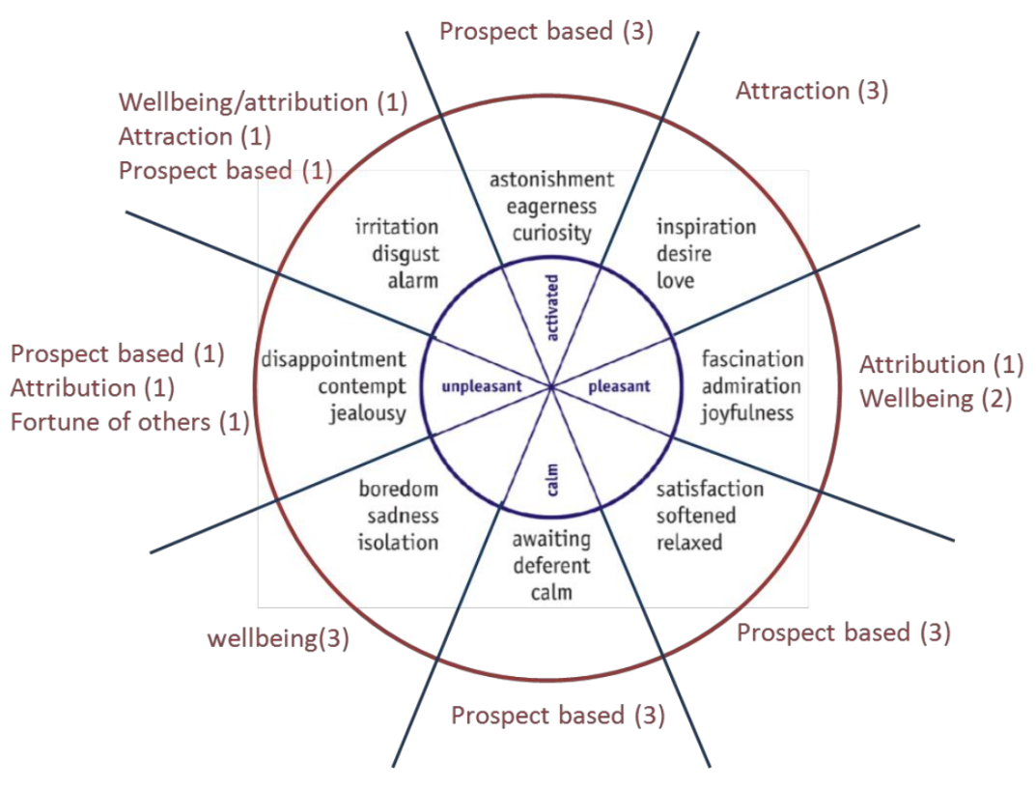
Affective Computing > Similarities & Differences: OCC & Dimensional
Both consider emotions to descend from valenced reactions to the stimuli.
Both acknowledge the role of arousal in determining emotional reactions (as intensity in OCC model – as coping potential by Scherer).
Dimensional theories and OCC model can relate to each other in terms of categorization of emotions.

Slide 116
Affective Computing > Applications
Companion robots
Expressive robots
Robots with affective behaviors
Robots with affect recognition capability
Robots with adaptive behaviors
Interactive robots
Learning in robots
Service robots
Decision-making in robots
Human-computer interaction

Slide 117
Affective Computing > Conclusion
It is good to follow well-established computational models with theoretical foundations.
Notes:
- Different aspects of models can represent different theories.

Slide 118
Affective Computing > Conclusion
It is good to follow well-established computational models with theoretical foundations.
They can explain more details of the structure or the processes involved in affective situations.
Notes:
- Different aspects of models can represent different theories.

Slide 119
Affective Computing > Conclusion
It is good to follow well-established computational models with theoretical foundations.
They can explain more details of the structure or the processes involved in affective situations.
It is not necessary to exactly follow only one theory and its descriptions.
Notes:
- Different aspects of models can represent different theories.

Slide 120
Affective Computing > Conclusion
It is good to follow well-established computational models with theoretical foundations.
They can explain more details of the structure or the processes involved in affective situations.
It is not necessary to exactly follow only one theory and its descriptions.
We believe the interpersonal functions of emotions should be our first concern.
Notes:
- Different aspects of models can represent different theories.

Slide 121
Affective Computing > Conclusion
It is good to follow well-established computational models with theoretical foundations.
They can explain more details of the structure or the processes involved in affective situations.
It is not necessary to exactly follow only one theory and its descriptions.
We believe the interpersonal functions of emotions should be our first concern.
We can see the importance of interpretive, communicative and regulatory aspects of emotion functions in our proposed work.
Notes:
- Different aspects of models can represent different theories.

Slide 122
Uncertainty in Modeling and Reasoning about Beliefs
Mohammad Shayganfar
PhD Comprehensive Exam
Summer 2015
Professor Charles Rich
Professor Candace L. Sidner
Professor Stacy C. Marsella
Professor John E. Laird

Slide 123
Uncertainty in AI > Introduction
Bayesian Belief Networks (probabilistic reasoning)
Dempster-Shafer theory (evidential reasoning)
Fuzzy logic (reasoning under ambiguity)

Slide 124
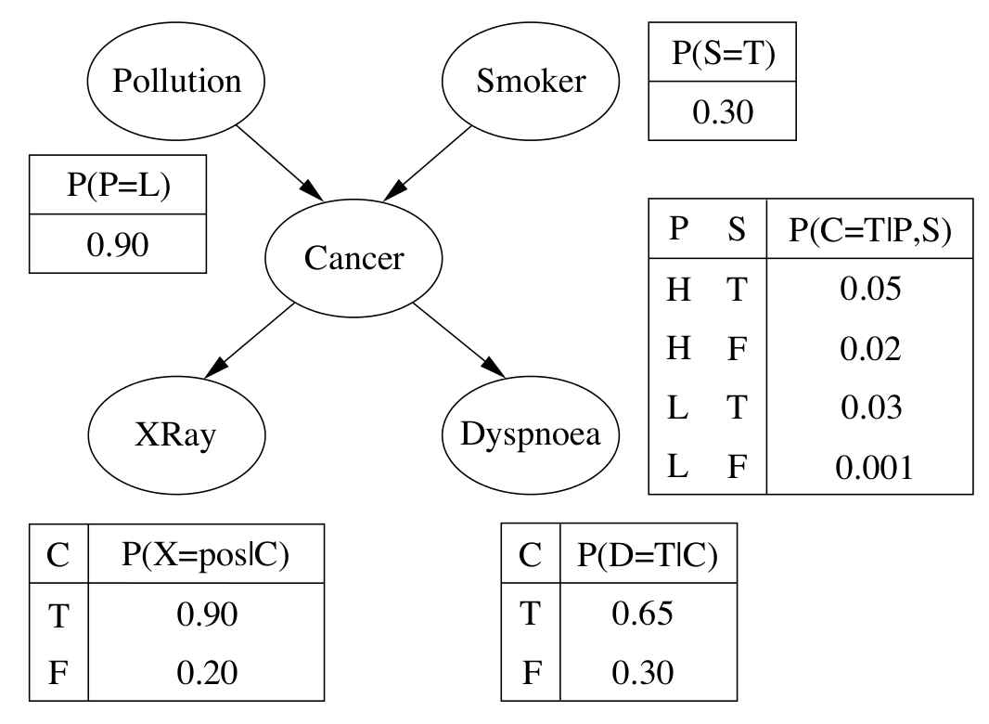
Uncertainty in AI > Bayesian Belief Networks: Overview
Notes:
A DAG to provide a graphical model for reasoning under uncertainty.
Each node in the network represents a random variable from the domain.
The state of each node is called belief, which based on the prior evidence reflects the posterior probability distribution of the other values associated with that node.
Each node also has an associated Conditional Probability Table (CPT) which represents the conditional probability of the variable given the value of its parents in the graph.
Each individual edge between two variables represents the relation or conditional dependence between those two variables.
Also, the explicit directions represented by arrows as directional edges indicate the notion of causality in the network.
a) Causal structure, b) conditional probabilities.
Structure: First, a) what are the nodes/variables to represent in the structure, and b) what are their possible values? Then, causal relationship.
Conditional Probability Table (CPT):
Each row in a CPT will contain the value of a conditional probability of a node for each case of the possible combination of values for the parent node.
The probabilities in a CPT are typically acquired from experts on the subject, but they can also be learned automatically using machine learning approaches.
Markov property: In Bayesian networks, each variable is independent of its non-descendants given its parent variables.

Slide 125
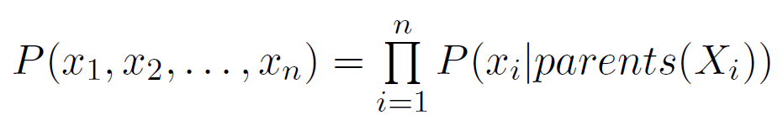
Uncertainty in AI > Bayesian Belief Networks: Joint Probability Distribution
Given Markov property, the product of only the appropriate elements (parent nodes) of the CPTs in the network represents the value of each individual entry in the joint probability distribution.
Notes:
(1) In the following formula P(x_1, x_2, …, x_n) is an abbreviation for the conjunction of n assignments to each variable.
- where parents(X) denotes the specific values of the variables in Parents(X).

Slide 126
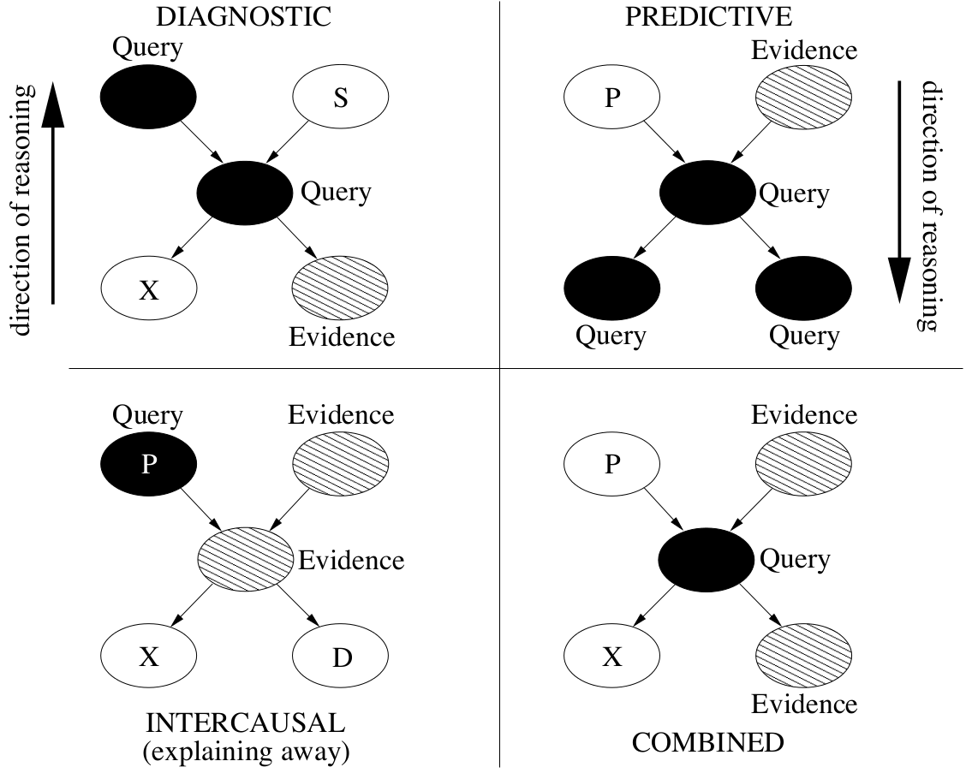
Uncertainty in AI > Bayesian Belief Networks: Reasoning in BBNs
Notes:
Reasoning in Bayesian networks is the process of updating beliefs in the face of evidence.
It is the process of efficiently deducing the belief distribution over a particular subset of random variables given that we know the states of some other variables in the network.
Diagnostic reasoning: This is the reasoning from symptoms (effects) to cause.
Predictive reasoning: This is the reasoning based on new information about the causes to new beliefs about the corresponding effects.
Intercausal reasoning: This is the reasoning about the mutual causes of a common effect. The first explanatory cause explains away the alternative one.
Conditional Independence:
(a) This means that if one already knows that C has occurred, knowing that A occurred doesn’t make a difference to one's beliefs about C.
(b) This means that if one already knows about B, then an additional information that A provides, will not give more information about the chances of C.
(c) This means that if one knows about B (the effect), then finds out that for example A (one of two causes) is absent, this increases the probability of C (alternative cause).
d-separated: The concepts of conditional dependencies and independencies can apply not only between pairs of nodes, but also between sets of nodes.
If the two sets of nodes X and Y are d-separated (directional-dependent separation) by an evidence set of nodes E, then (given the Markov property) the two sets of nodes X and Y are conditionally independent given E.

Slide 127
Uncertainty in AI > Dempster-Shafer Theory: Overview
Dempster-Shafer theory is designed to deal with the distinction between uncertainty and ignorance.
Notes:
Based on Shafer's formalism, each piece of evidence may support a subset containing several hypotheses.
Dempster-Shafer theory is the generalization of the Bayesian theory of subjective probability to combine accumulative evidence or to change prior opinions in the light of new evidence.

Slide 128
Uncertainty in AI > Dempster-Shafer Theory: Overview
Dempster-Shafer theory is designed to deal with the distinction between uncertainty and ignorance.
Rather than computing the probability of a proposition, it computes the probability that the evidence supports the proposition.
Notes:
Based on Shafer's formalism, each piece of evidence may support a subset containing several hypotheses.
Dempster-Shafer theory is the generalization of the Bayesian theory of subjective probability to combine accumulative evidence or to change prior opinions in the light of new evidence.

Slide 129
Uncertainty in AI > Dempster-Shafer Theory: Overview
Dempster-Shafer theory is designed to deal with the distinction between uncertainty and ignorance.
Rather than computing the probability of a proposition, it computes the probability that the evidence supports the proposition.
The set of hypotheses (frame of discernment) represent all of the possible states of the system considered.
Notes:
Based on Shafer's formalism, each piece of evidence may support a subset containing several hypotheses.
Dempster-Shafer theory is the generalization of the Bayesian theory of subjective probability to combine accumulative evidence or to change prior opinions in the light of new evidence.

Slide 130
Uncertainty in AI > Dempster-Shafer Theory: Overview
Dempster-Shafer theory is designed to deal with the distinction between uncertainty and ignorance.
Rather than computing the probability of a proposition, it computes the probability that the evidence supports the proposition.
The set of hypotheses (frame of discernment) represent all of the possible states of the system considered.
The relation between a piece of evidence and a hypothesis corresponds to a cause-effect chain.
Notes:
Based on Shafer's formalism, each piece of evidence may support a subset containing several hypotheses.
Dempster-Shafer theory is the generalization of the Bayesian theory of subjective probability to combine accumulative evidence or to change prior opinions in the light of new evidence.

Slide 131
Uncertainty in AI > Dempster-Shafer Theory: Overview
Dempster-Shafer theory is designed to deal with the distinction between uncertainty and ignorance.
Rather than computing the probability of a proposition, it computes the probability that the evidence supports the proposition.
The set of hypotheses (frame of discernment) represent all of the possible states of the system considered.
The relation between a piece of evidence and a hypothesis corresponds to a cause-effect chain.
There are three basic functions required for modeling purposes: mass function, belief function, and plausibility function.
Notes:
Based on Shafer's formalism, each piece of evidence may support a subset containing several hypotheses.
Dempster-Shafer theory is the generalization of the Bayesian theory of subjective probability to combine accumulative evidence or to change prior opinions in the light of new evidence.

Slide 132

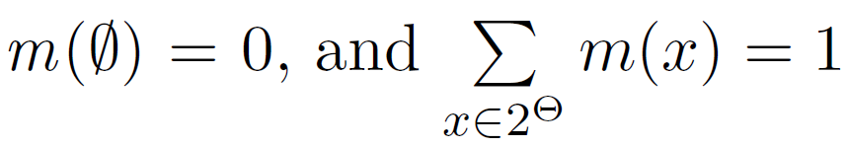
Uncertainty in AI > Dempster-Shafer Theory: important functions
Mass Function: A Basic Probability Assignment (BPA) or mass function is a function such that:
Notes:
The value 0 indicates no belief and the value 1 indicates total belief, and any value between these two indicate partial belief.
(1) Any subset x of the frame of discernment for which m(x) is non-zero is called a focal element and represents the exact belief in the proposition depicted by x.
(2) Belief function is sometimes called a support function.
(2) It is the measure of total belief committed to A (a subset of frame of discernment) that can be obtained by simply adding up the mass of all the subsets of A.
(2) The belief in A, denoted Belief(A), is a number in the interval [0, 1].
(2) Belief in a set of elements, say A, represents the total belief that one has based on the evidence obtained.
(2) Belief(A) = 0 → Lack of evidence, p(A)=0 → impossibility of A.
(3) Plausible(A) in a subset A is defined to be the sum of all mass functions for the subsets B that have non-zero intersections with A.
(3) Plausible(A) corresponds to the total belief that does not contradict A.

Slide 133



Uncertainty in AI > Dempster-Shafer Theory: important functions
Mass Function: A Basic Probability Assignment (BPA) or mass function is a function such that:
Belief Function: It is the measure of total belief committed to that can be obtained by simply adding up the mass of all the subsets of A, denoted by . It is a function :
Notes:
The value 0 indicates no belief and the value 1 indicates total belief, and any value between these two indicate partial belief.
(1) Any subset x of the frame of discernment for which m(x) is non-zero is called a focal element and represents the exact belief in the proposition depicted by x.
(2) Belief function is sometimes called a support function.
(2) It is the measure of total belief committed to A (a subset of frame of discernment) that can be obtained by simply adding up the mass of all the subsets of A.
(2) The belief in A, denoted Belief(A), is a number in the interval [0, 1].
(2) Belief in a set of elements, say A, represents the total belief that one has based on the evidence obtained.
(2) Belief(A) = 0 → Lack of evidence, p(A)=0 → impossibility of A.
(3) Plausible(A) in a subset A is defined to be the sum of all mass functions for the subsets B that have non-zero intersections with A.
(3) Plausible(A) corresponds to the total belief that does not contradict A.

Slide 134


Uncertainty in AI > Dempster-Shafer Theory: important functions
Mass Function: A Basic Probability Assignment (BPA) or mass function is a function such that:
Belief Function: It is the measure of total belief committed to that can be obtained by simply adding up the mass of all the subsets of A, denoted by . It is a function :
Plausibility Function: It represents the maximum possibility that a set A is true given all the evidences. It is a function :
Notes:
The value 0 indicates no belief and the value 1 indicates total belief, and any value between these two indicate partial belief.
(1) Any subset x of the frame of discernment for which m(x) is non-zero is called a focal element and represents the exact belief in the proposition depicted by x.
(2) Belief function is sometimes called a support function.
(2) It is the measure of total belief committed to A (a subset of frame of discernment) that can be obtained by simply adding up the mass of all the subsets of A.
(2) The belief in A, denoted Belief(A), is a number in the interval [0, 1].
(2) Belief in a set of elements, say A, represents the total belief that one has based on the evidence obtained.
(2) Belief(A) = 0 → Lack of evidence, p(A)=0 → impossibility of A.
(3) Plausible(A) in a subset A is defined to be the sum of all mass functions for the subsets B that have non-zero intersections with A.
(3) Plausible(A) corresponds to the total belief that does not contradict A.

Slide 135
Uncertainty in AI > Dempster-Shafer Theory
The plausibility and belief functions have the following relationship:
Notes:
~A is A’s complement.
Belief(A)=0 does not imply Belief(~A)>0
However, Belief(A)=1 implies Belief(~A)=0
Here, we also note that in the case of each of the focal elements being singletons, we return back to traditional Bayesian analysis incorporating normal probability theory.
Lack of belief does not imply disbelief, since the complements of belief and plausibility are doubt and disbelief, respectively.
Combination Rule: When we have two pieces of uncertain evidence relevant to the same frame of discernment.
The rule assumes that the sources are independent.
The numerator represents the accumulated evidence for the sets A and B, which supports the given hypothesis y.
The denominator is an important normalization factor denoted by K which can be interpreted as a measure of conflict between the sources.

Slide 136
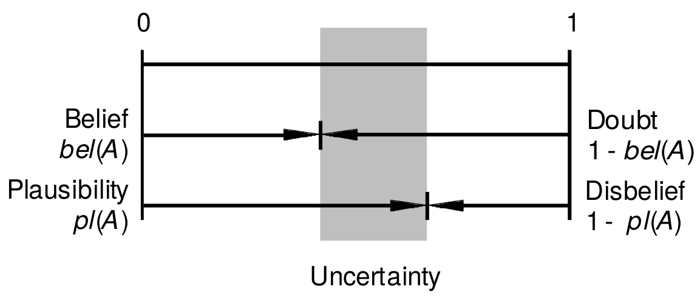


Uncertainty in AI > Dempster-Shafer Theory
The plausibility and belief functions have the following relationship:
Uncertainty measure (belief interval):
Where:
Notes:
~A is A’s complement.
Belief(A)=0 does not imply Belief(~A)>0
However, Belief(A)=1 implies Belief(~A)=0
Here, we also note that in the case of each of the focal elements being singletons, we return back to traditional Bayesian analysis incorporating normal probability theory.
Lack of belief does not imply disbelief, since the complements of belief and plausibility are doubt and disbelief, respectively.
Combination Rule: When we have two pieces of uncertain evidence relevant to the same frame of discernment.
The rule assumes that the sources are independent.
The numerator represents the accumulated evidence for the sets A and B, which supports the given hypothesis y.
The denominator is an important normalization factor denoted by K which can be interpreted as a measure of conflict between the sources.

Slide 137
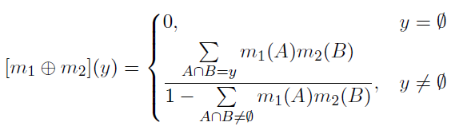
Uncertainty in AI > Dempster-Shafer Theory
The plausibility and belief functions have the following relationship:
Uncertainty measure (belief interval):
Where:
Dempster's Rule of Combination:
A method to combine the measures of evidence from different sources.
Notes:
~A is A’s complement.
Belief(A)=0 does not imply Belief(~A)>0
However, Belief(A)=1 implies Belief(~A)=0
Here, we also note that in the case of each of the focal elements being singletons, we return back to traditional Bayesian analysis incorporating normal probability theory.
Lack of belief does not imply disbelief, since the complements of belief and plausibility are doubt and disbelief, respectively.
Combination Rule: When we have two pieces of uncertain evidence relevant to the same frame of discernment.
The rule assumes that the sources are independent.
The numerator represents the accumulated evidence for the sets A and B, which supports the given hypothesis y.
The denominator is an important normalization factor denoted by K which can be interpreted as a measure of conflict between the sources.

Slide 138
Uncertainty in AI > Fuzzy Logic Theory: Overview
Fuzzy Logic’s ultimate goal is to provide foundations for approximate reasoning using imprecise propositions based on fuzzy set theory.
Notes:
(0) Fuzzy Logic provides a mathematical framework to capture uncertainty.
Fuzziness manipulates uncertainty by dealing with the boundaries of a set that are not clearly defined.
Fuzzy Logic is a multivalued logic, that allows intermediate values to be defined between conventional evaluations like ``true'' and ``false''.
Logic as a base for reasoning can be essentially distinguished by three items: truth values, operators, and reasoning procedures (e.g., tautologies).
The transition from membership to non-membership is gradual rather than abrupt.

Slide 139
Uncertainty in AI > Fuzzy Logic Theory: Overview
Fuzzy Logic’s ultimate goal is to provide foundations for approximate reasoning using imprecise propositions based on fuzzy set theory.
In order to deal with such imprecise inference, Fuzzy Logic allows the imprecise linguistic terms such as:
fuzzy predicates (e.g., old, expensive),
fuzzy quantifiers (e.g., many, little),
and fuzzy truth values (e.g., unlikely false or unlikely true).
Notes:
(0) Fuzzy Logic provides a mathematical framework to capture uncertainty.
Fuzziness manipulates uncertainty by dealing with the boundaries of a set that are not clearly defined.
Fuzzy Logic is a multivalued logic, that allows intermediate values to be defined between conventional evaluations like ``true'' and ``false''.
Logic as a base for reasoning can be essentially distinguished by three items: truth values, operators, and reasoning procedures (e.g., tautologies).
The transition from membership to non-membership is gradual rather than abrupt.

Slide 140
Uncertainty in AI > Fuzzy Logic Theory: Overview
Fuzzy Logic’s ultimate goal is to provide foundations for approximate reasoning using imprecise propositions based on fuzzy set theory.
In order to deal with such imprecise inference, Fuzzy Logic allows the imprecise linguistic terms such as:
fuzzy predicates (e.g., old, expensive),
fuzzy quantifiers (e.g., many, little),
and fuzzy truth values (e.g., unlikely false or unlikely true).
Fuzzy Sets: A fuzzy set is a class of objects with a continuum of degrees of membership.
Notes:
(0) Fuzzy Logic provides a mathematical framework to capture uncertainty.
Fuzziness manipulates uncertainty by dealing with the boundaries of a set that are not clearly defined.
Fuzzy Logic is a multivalued logic, that allows intermediate values to be defined between conventional evaluations like ``true'' and ``false''.
Logic as a base for reasoning can be essentially distinguished by three items: truth values, operators, and reasoning procedures (e.g., tautologies).
The transition from membership to non-membership is gradual rather than abrupt.

Slide 141


Uncertainty in AI > Fuzzy Logic Theory: Overview
Fuzzy Logic’s ultimate goal is to provide foundations for approximate reasoning using imprecise propositions based on fuzzy set theory.
In order to deal with such imprecise inference, Fuzzy Logic allows the imprecise linguistic terms such as:
fuzzy predicates (e.g., old, expensive),
fuzzy quantifiers (e.g., many, little),
and fuzzy truth values (e.g., unlikely false or unlikely true).
Fuzzy Sets: A fuzzy set is a class of objects with a continuum of degrees of membership.
A fuzzy set A is defined by a membership function from the universe of discourse X to the closed unit interval [0,1]. We interpret as the degree of membership of x in A.
Notes:
(0) Fuzzy Logic provides a mathematical framework to capture uncertainty.
Fuzziness manipulates uncertainty by dealing with the boundaries of a set that are not clearly defined.
Fuzzy Logic is a multivalued logic, that allows intermediate values to be defined between conventional evaluations like ``true'' and ``false''.
Logic as a base for reasoning can be essentially distinguished by three items: truth values, operators, and reasoning procedures (e.g., tautologies).
The transition from membership to non-membership is gradual rather than abrupt.

Slide 142
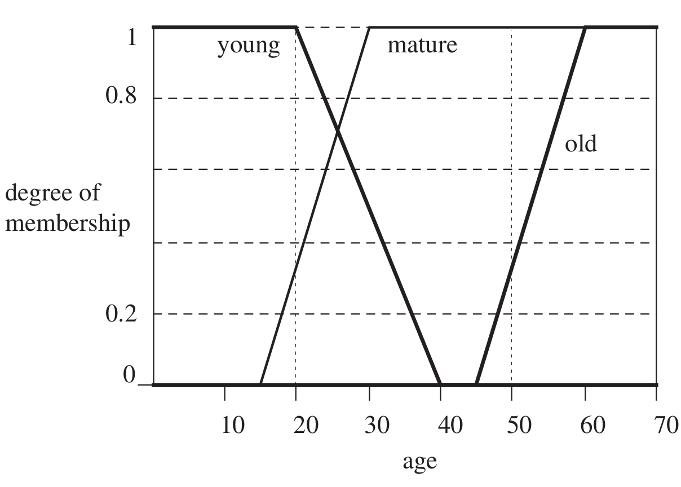
Uncertainty in AI > Fuzzy Logic Theory: Membership Functions
Membership functions are mathematical tools for indicating flexible membership to a set, modeling, and quantifying the meaning of symbols.
Notes:
A value can belong to multiple sets at the same time.

Slide 143
Uncertainty in AI > Fuzzy Logic Theory: Membership Functions
Membership functions are mathematical tools for indicating flexible membership to a set, modeling, and quantifying the meaning of symbols.
Membership functions are used in the fuzzification and defuzzification steps of a Fuzzy Logic system.
Notes:
A value can belong to multiple sets at the same time.

Slide 144
Uncertainty in AI > Fuzzy Logic Theory: Membership Functions
Membership functions are mathematical tools for indicating flexible membership to a set, modeling, and quantifying the meaning of symbols.
Membership functions are used in the fuzzification and defuzzification steps of a Fuzzy Logic system.
A membership function is used to quantify a linguistic term.
Notes:
A value can belong to multiple sets at the same time.

Slide 145
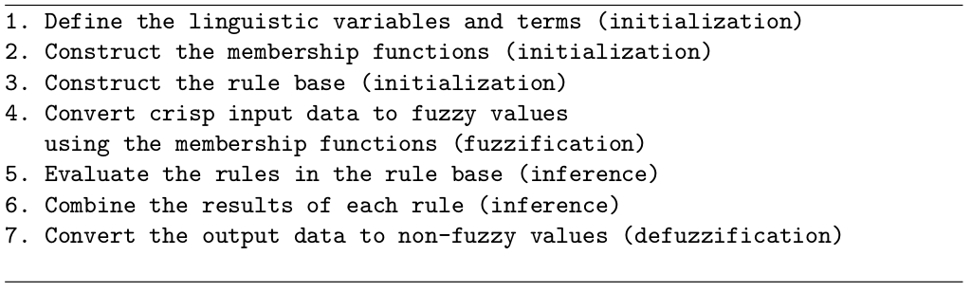
Uncertainty in AI > Fuzzy Logic Theory: Algorithm
Linguistic Variables:
Linguistic variables are the input or output variables of the system whose values (linguistic terms) are words or sentences from a natural language.
Notes:
Fuzzy operators are used in order to manipulate fuzzy sets, and to evaluate the constructed fuzzy rules, and ultimately to combine the results of the individual rules.

Slide 146
Uncertainty in AI > Fuzzy Logic Theory: Algorithm
Linguistic Variables:
Linguistic variables are the input or output variables of the system whose values (linguistic terms) are words or sentences from a natural language.
Fuzzy Rules:
A rule-base is constructed to determine and control the output variable.
Notes:
Fuzzy operators are used in order to manipulate fuzzy sets, and to evaluate the constructed fuzzy rules, and ultimately to combine the results of the individual rules.

Slide 147
Uncertainty in AI > Fuzzy Logic Theory: Algorithm
Fuzzification: The process of obtaining one fuzzy value for each crisp input.

Slide 148
Uncertainty in AI > Fuzzy Logic Theory: Algorithm
Fuzzification: The process of obtaining one fuzzy value for each crisp input.
Reasoning: The process of combining the results of the rules to obtain a final result.

Slide 149
Uncertainty in AI > Fuzzy Logic Theory: Algorithm
Fuzzification: The process of obtaining one fuzzy value for each crisp input.
Reasoning: The process of combining the results of the rules to obtain a final result.
Defuzzification: The process of obtaining a crisp value by defuzzifying the final fuzzy result using the membership function of the output variable.

Slide 150
Uncertainty in AI > Advantages & Disadvantages: Bayesian Networks
Advantages:
Transparent representation of causal relationships between variables.

Slide 151
Uncertainty in AI > Advantages & Disadvantages: Bayesian Networks
Advantages:
Transparent representation of causal relationships between variables.
Relatively easy recognition of dependencies and independencies between various nodes.

Slide 152
Uncertainty in AI > Advantages & Disadvantages: Bayesian Networks
Advantages:
Transparent representation of causal relationships between variables.
Relatively easy recognition of dependencies and independencies between various nodes.
The ability to handle situations where the data set is incomplete since the model accounts for dependencies between all variables.

Slide 153
Uncertainty in AI > Advantages & Disadvantages: Bayesian Networks
Advantages:
Transparent representation of causal relationships between variables.
Relatively easy recognition of dependencies and independencies between various nodes.
The ability to handle situations where the data set is incomplete since the model accounts for dependencies between all variables.
Capable of being readily updated when a new evidence becomes available.

Slide 154
Uncertainty in AI > Advantages & Disadvantages: Bayesian Networks
Advantages:
Transparent representation of causal relationships between variables.
Relatively easy recognition of dependencies and independencies between various nodes.
The ability to handle situations where the data set is incomplete since the model accounts for dependencies between all variables.
Capable of being readily updated when a new evidence becomes available.
Both predictive/deductive and diagnostic/abductive reasonings are possible.

Slide 155
Uncertainty in AI > Advantages & Disadvantages: Bayesian Networks
Advantages:
Transparent representation of causal relationships between variables.
Relatively easy recognition of dependencies and independencies between various nodes.
The ability to handle situations where the data set is incomplete since the model accounts for dependencies between all variables.
Capable of being readily updated when a new evidence becomes available.
Both predictive/deductive and diagnostic/abductive reasonings are possible.
Computational tractability exists for most practical applications.

Slide 156
Uncertainty in AI > Advantages & Disadvantages: Bayesian Networks
Disadvantages:
A high level of effort is required to build network models where a significant amount of probability data is required due to an increasing number of nodes and links in the structure (possible large CPT sizes).

Slide 157
Uncertainty in AI > Advantages & Disadvantages: Bayesian Networks
Disadvantages:
A high level of effort is required to build network models where a significant amount of probability data is required due to an increasing number of nodes and links in the structure (possible large CPT sizes).
Computationally intensive if the conditional independencies are not properly considered among the variables.

Slide 158
Uncertainty in AI > Advantages & Disadvantages: Bayesian Networks
Disadvantages:
A high level of effort is required to build network models where a significant amount of probability data is required due to an increasing number of nodes and links in the structure (possible large CPT sizes).
Computationally intensive if the conditional independencies are not properly considered among the variables.
Challenging to obtain experts’ knowledge in the form of probability to build the network.

Slide 159
Uncertainty in AI > Advantages & Disadvantages: Bayesian Networks
Disadvantages:
A high level of effort is required to build network models where a significant amount of probability data is required due to an increasing number of nodes and links in the structure (possible large CPT sizes).
Computationally intensive if the conditional independencies are not properly considered among the variables.
Challenging to obtain experts’ knowledge in the form of probability to build the network.
No feedback loops in the Bayesian network's structure, which has an acyclic nature. This structure prevents typical feedback loops in design of Bayesian network models.

Slide 160
Uncertainty in AI > Advantages & Disadvantages: Dempster-Shafer Theory
Advantages:
Addressing the concept of possibility.

Slide 161
Uncertainty in AI > Advantages & Disadvantages: Dempster-Shafer Theory
Advantages:
Addressing the concept of possibility.
The ability to represent the concept of ignorance to allow one to specify a degree of ignorance in a situation, instead of being forced to supply prior probabilities.

Slide 162
Uncertainty in AI > Advantages & Disadvantages: Dempster-Shafer Theory
Advantages:
Addressing the concept of possibility.
The ability to represent the concept of ignorance to allow one to specify a degree of ignorance in a situation, instead of being forced to supply prior probabilities.
Consistent with classical probability theory.

Slide 163
Uncertainty in AI > Advantages & Disadvantages: Dempster-Shafer Theory
Advantages:
Addressing the concept of possibility.
The ability to represent the concept of ignorance to allow one to specify a degree of ignorance in a situation, instead of being forced to supply prior probabilities.
Consistent with classical probability theory.
Distinguishing randomness from missing information.

Slide 164
Uncertainty in AI > Advantages & Disadvantages: Dempster-Shafer Theory
Advantages:
Addressing the concept of possibility.
The ability to represent the concept of ignorance to allow one to specify a degree of ignorance in a situation, instead of being forced to supply prior probabilities.
Consistent with classical probability theory.
Distinguishing randomness from missing information.
No required a priori knowledge.

Slide 165
Uncertainty in AI > Advantages & Disadvantages: Dempster-Shafer Theory
Advantages:
Addressing the concept of possibility.
The ability to represent the concept of ignorance to allow one to specify a degree of ignorance in a situation, instead of being forced to supply prior probabilities.
Consistent with classical probability theory.
Distinguishing randomness from missing information.
No required a priori knowledge.
Including an evidence combination rule which provides an operator to integrate multiple pieces of information from different sources.

Slide 166
Uncertainty in AI > Advantages & Disadvantages: Dempster-Shafer Theory
Disadvantages:
Computational complexity grows exponentially with the number of hypotheses (in original formulation).

Slide 167
Uncertainty in AI > Advantages & Disadvantages: Dempster-Shafer Theory
Disadvantages:
Computational complexity grows exponentially with the number of hypotheses (in original formulation).
Small modifications in the evidence assignments may lead to a completely different conclusion, which can lead to misleading and counter-intuitive results.

Slide 168
Uncertainty in AI > Advantages & Disadvantages: Fuzzy Logic Theory
Advantages:
Describing algorithms in terms of a combination of numerics and linguistics.

Slide 169
Uncertainty in AI > Advantages & Disadvantages: Fuzzy Logic Theory
Advantages:
Describing algorithms in terms of a combination of numerics and linguistics.
Capturing the concept of the ambiguity of information.

Slide 170
Uncertainty in AI > Advantages & Disadvantages: Fuzzy Logic Theory
Advantages:
Describing algorithms in terms of a combination of numerics and linguistics.
Capturing the concept of the ambiguity of information.
Flexible and intuitive knowledge-base design.

Slide 171
Uncertainty in AI > Advantages & Disadvantages: Fuzzy Logic Theory
Advantages:
Describing algorithms in terms of a combination of numerics and linguistics.
Capturing the concept of the ambiguity of information.
Flexible and intuitive knowledge-base design.
Easy computation.

Slide 172
Uncertainty in AI > Advantages & Disadvantages: Fuzzy Logic Theory
Advantages:
Describing algorithms in terms of a combination of numerics and linguistics.
Capturing the concept of the ambiguity of information.
Flexible and intuitive knowledge-base design.
Easy computation.
Relatively robust algorithms.

Slide 173
Uncertainty in AI > Advantages & Disadvantages: Fuzzy Logic Theory
Disadvantages:
Determining the exact fuzzy rules and membership functions is a hard task.

Slide 174
Uncertainty in AI > Advantages & Disadvantages: Fuzzy Logic Theory
Disadvantages:
Determining the exact fuzzy rules and membership functions is a hard task.
Requires manual tuning to obtain a better result.

Slide 175
Uncertainty in AI > Advantages & Disadvantages: Fuzzy Logic Theory
Disadvantages:
Determining the exact fuzzy rules and membership functions is a hard task.
Requires manual tuning to obtain a better result.
Requires tuning in many options in design of a system.

Slide 176
Uncertainty in AI > Advantages & Disadvantages: Fuzzy Logic Theory
Disadvantages:
Determining the exact fuzzy rules and membership functions is a hard task.
Requires manual tuning to obtain a better result.
Requires tuning in many options in design of a system.
The order of inference steps matters.

Slide 177
Uncertainty in AI > Advantages & Disadvantages: Fuzzy Logic Theory
Disadvantages:
Determining the exact fuzzy rules and membership functions is a hard task.
Requires manual tuning to obtain a better result.
Requires tuning in many options in design of a system.
The order of inference steps matters.
After reasoning, it can be difficult to exactly interpret the membership value.

Slide 178
Uncertainty in AI > Advantages & Disadvantages: Fuzzy Logic Theory
Disadvantages:
Determining the exact fuzzy rules and membership functions is a hard task.
Requires manual tuning to obtain a better result.
Requires tuning in many options in design of a system.
The order of inference steps matters.
After reasoning, it can be difficult to exactly interpret the membership value.
Validation of a fuzzy knowledge-base is typically expensive.

Slide 179
Uncertainty in AI > Applications
Robot’s motion control
Sensory data fusion in robots
Modeling domain knowledge
Modeling human-robot interaction
Modeling emotional state of the robot
Modeling forward model of robot’s actions
Modeling object affordances
Robot’s navigation
Learning robot’s decision function
Learning imitative body motions of humans
Intention recognition
Mobile-robot localization
Modeling cooperative agents
Agent’s argumentation and decision making framework
Modeling theory of mind

Slide 180
Uncertainty in AI > Conclusion
Uncertainty is involved in collaboration, Different theories are concerned about teamwork and the involvement of others:
to form an intention,

Slide 181
Uncertainty in AI > Conclusion
Uncertainty is involved in collaboration, Different theories are concerned about teamwork and the involvement of others:
to form an intention,
to generate or evolve the shared plan,

Slide 182
Uncertainty in AI > Conclusion
Uncertainty is involved in collaboration, Different theories are concerned about teamwork and the involvement of others:
to form an intention,
to generate or evolve the shared plan,
or even to establish a single mutual belief.

Slide 183
Uncertainty in AI > Conclusion
Uncertainty is involved in collaboration, Different theories are concerned about teamwork and the involvement of others:
to form an intention,
to generate or evolve the shared plan,
or even to establish a single mutual belief.
There is a certain amount of uncertainty, ambiguity and lack of evidence in perceiving others‘ behaviors.

Slide 184
Uncertainty in AI > Conclusion
Uncertainty is involved in collaboration, Different theories are concerned about teamwork and the involvement of others:
to form an intention,
to generate or evolve the shared plan,
or even to establish a single mutual belief.
There is a certain amount of uncertainty, ambiguity and lack of evidence in perceiving others‘ behaviors.
Processes involved in collaboration need to be designed to address the existence of uncertainty.

Slide 185
Uncertainty in AI > Conclusion
Uncertainty is involved in collaboration, Different theories are concerned about teamwork and the involvement of others:
to form an intention,
to generate or evolve the shared plan,
or even to establish a single mutual belief.
There is a certain amount of uncertainty, ambiguity and lack of evidence in perceiving others‘ behaviors.
Processes involved in collaboration need to be designed to address the existence of uncertainty.
Beliefs include certain amount of uncertainty independent of their source:
the lack of evidence about a counterpart's belief about an event,
the lack of evidence about the feeling of a counterpart for a collaborative action.

Slide 186
Uncertainty in AI > Conclusion
Uncertainty is involved in collaboration, Different theories are concerned about teamwork and the involvement of others:
to form an intention,
to generate or evolve the shared plan,
or even to establish a single mutual belief.
There is a certain amount of uncertainty, ambiguity and lack of evidence in perceiving others‘ behaviors.
Processes involved in collaboration need to be designed to address the existence of uncertainty.
Beliefs include certain amount of uncertainty independent of their source:
the lack of evidence about a counterpart's belief about an event,
the lack of evidence about the feeling of a counterpart for a collaborative action.
Consequences can be mitigated by having a mechanism to deal with uncertainty in some level.

Slide 187
Uncertainty in AI > Conclusion
Uncertainty is involved in collaboration, Different theories are concerned about teamwork and the involvement of others:
to form an intention,
to generate or evolve the shared plan,
or even to establish a single mutual belief.
There is a certain amount of uncertainty, ambiguity and lack of evidence in perceiving others‘ behaviors.
Processes involved in collaboration need to be designed to address the existence of uncertainty.
Beliefs include certain amount of uncertainty independent of their source:
the lack of evidence about a counterpart's belief about an event,
the lack of evidence about the feeling of a counterpart for a collaborative action.
Consequences can be mitigated by having a mechanism to deal with uncertainty in some level.
It is for us to choose where to apply the appropriate mechanism to make more stable collaborative behaviors.

Slide 188
Thank You!

