Slide 1
Goods transportation problem solving via routing algorithm
Mikhail Shchukin (vladimmi@uregina.ca)
Aymen Ben Said (abb549@uregina.ca)
André Lobo Teixeira (teixeira@cs.uregina.ca)
CS 820 Artificial Intelligence
University of Regina
2019

Slide 2





Transportation problem definition
Let’s take m warehouses and n stores
Total supply is then:
Total demand is then:
If supply = demand, the number of shipments between warehouse i to store j is:
or
The objective function is: , where
c_{ij} is the cost of transportation for each good

Slide 3
Realities of transportation problem
How to define the cost factor (c_{ij} or just c)?
What to do if total supply ≠ total demand?
Which real-life parameters should be considered?
How to represent the stores, warehouses and connections between them?
How to solve the problem in several ways and how to determine the best way?
How to test the solver on many problems?

Slide 4
Suggested approach
We assume the following properties of the problem:
The problem is represented by a graph, where stores and warehouses are nodes and roads are edges.
Some nodes are joints (major cities and junctions) that have no supply/demand
All shipped goods are of single type
Cost function is defined per edge:
edge_cost = distance + time

Slide 5
Suggested approach (cont’d)
We assume the following properties of the problem solver:
There is one agent-solver: the truck
The truck has a known limited capacity
The truck has resupply threshold
Its entire shipping path is the solution
The solution path contains path segments
Shipping cost is minimized per segment
There might be partial solution if:
total supply ≠ total demand

Slide 6
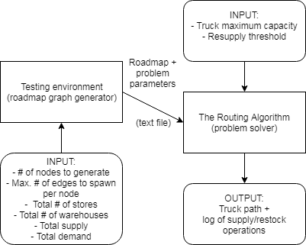
Experimental setup
In order to obtain meaningful, diverse results, we structured our experiment as follows:

Slide 7
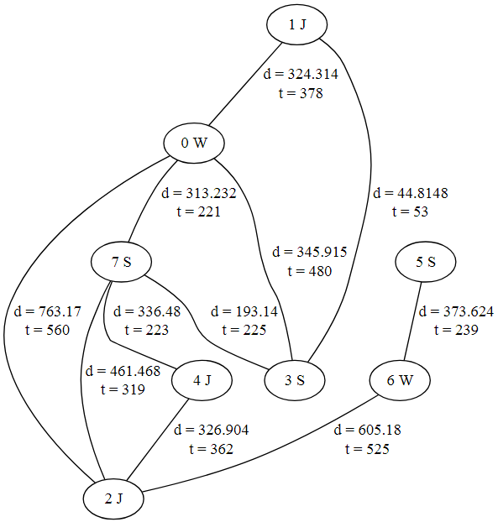
Sample problem
The following graph was generated with parameters of:
12 nodes
Max. 2 edges spawned per node
100 supply
90 demand
It was then solved by the algorithm with truck capacity of 30 and resupply threshold of 0.5

Slide 8
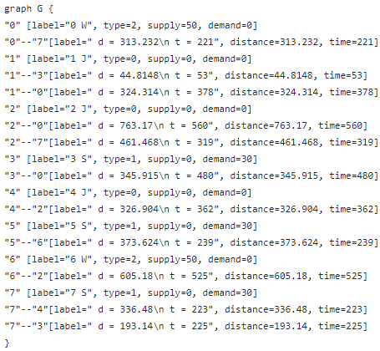
Problem parameters generated

Slide 9
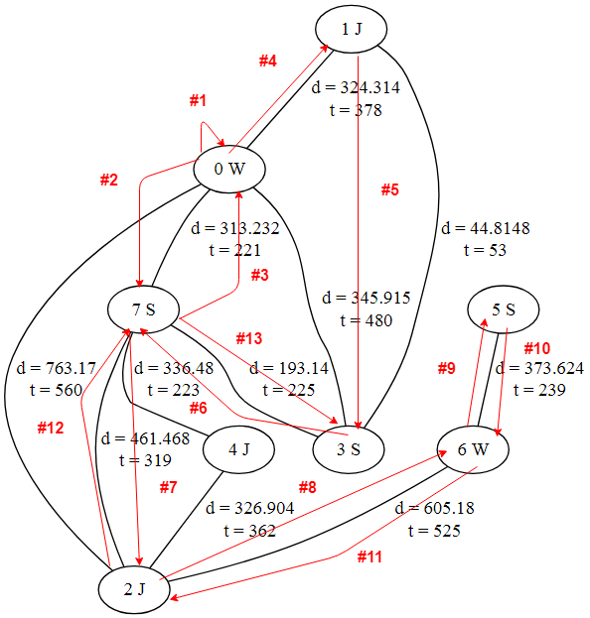
The solution path

Slide 10
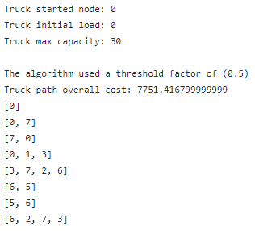
The output of the algorithm
The following is the shortened version of the algorithm log
Our algorithm is capable of producing the details of decision-making at each path segment

Slide 11
Questions?

Slide 12
Thank you!

