Slide 1

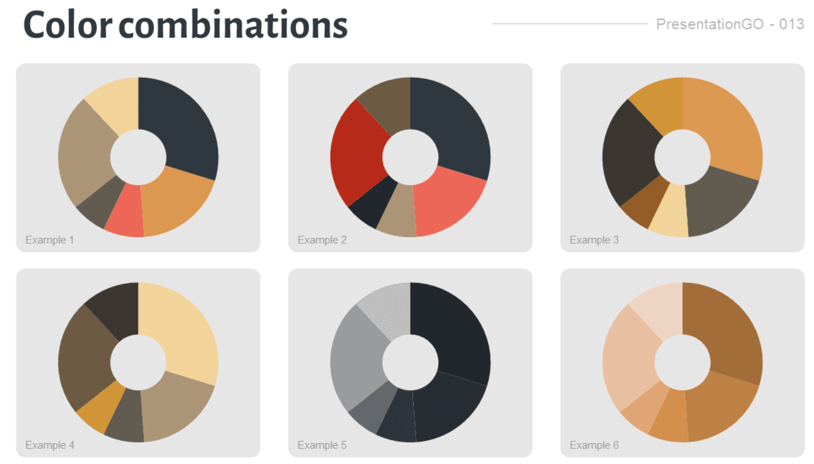
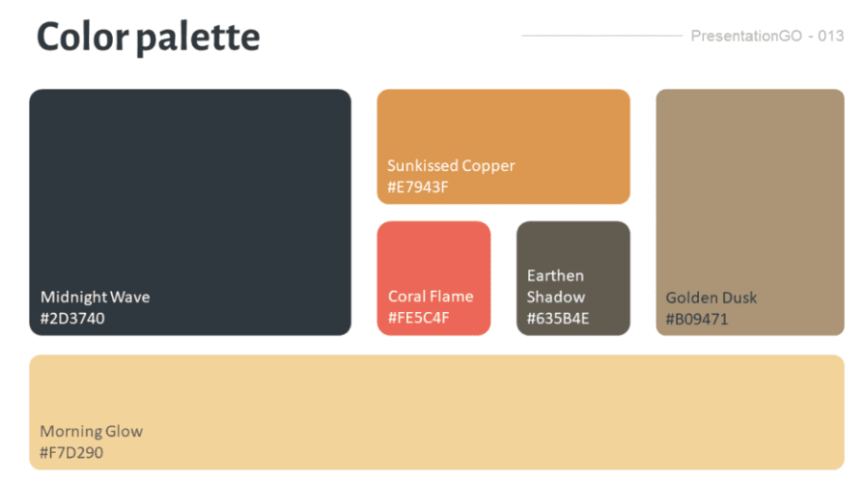

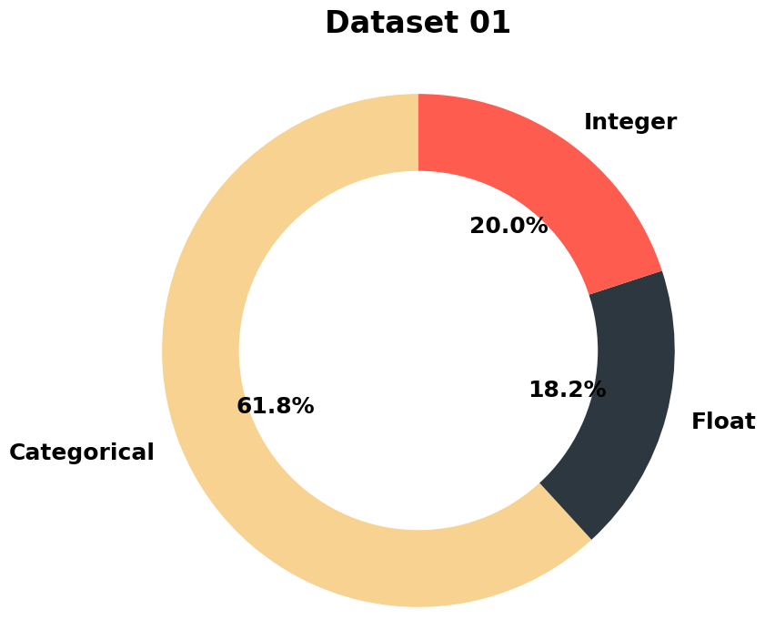
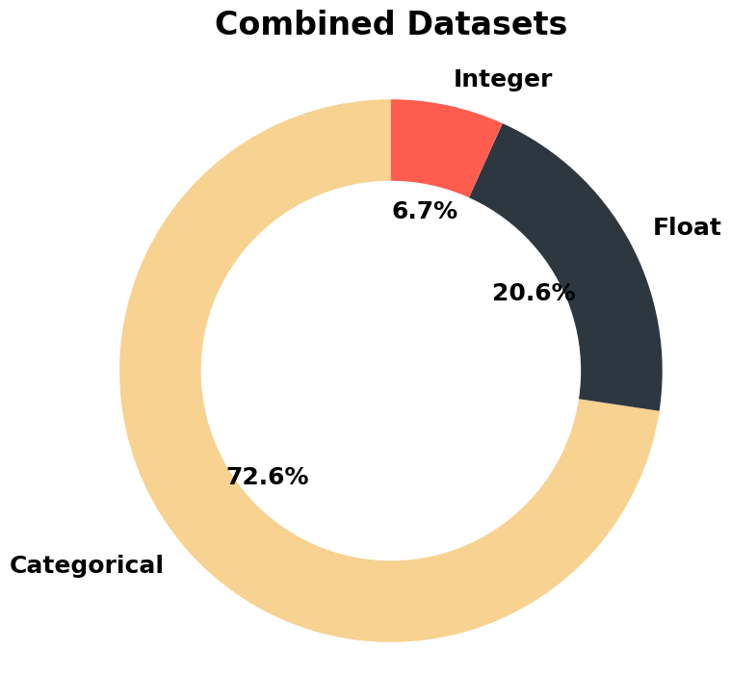
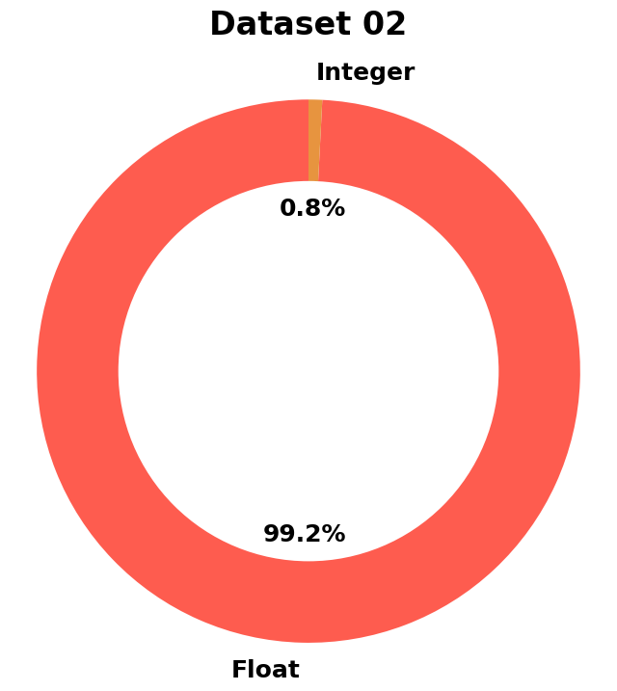
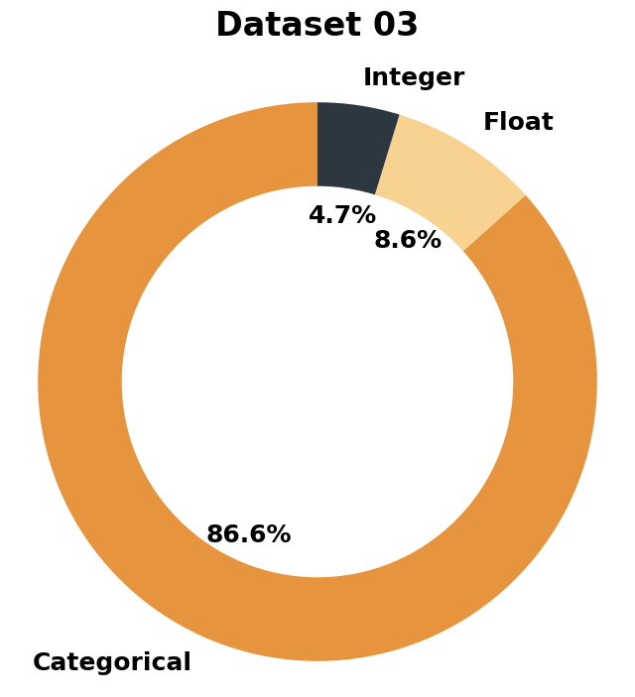
Extreme Weather and Migration: Evidence from Bangladesh
Tiana Le, Sheeba Moghal, Ishaan Babbar, Liz Kovalchuk
Georgetown University Data Science and Analytics
Abstract
Methodology
Results
Conclusion
This project examines retrospective migration data collected in southwestern Bangladesh provided by the Authors Amanda R. Carrico and Katharine Donato. Their study investigates the relationship between extreme weather conditions in the region and patterns of migration. Our team’s investigation of the data delves deeper into the initial findings provided by Carrico and Donato, investigating not just the primary author’s conclusion associating weather with increased migration (particularly after dry spells, albeit also after warm spells and above average rainfall but to a lesser extent).
Similarly, our team’s principal components analysis (PCA) showed that internal migration could be predicted by occupation and month of travel. We examined interrelated variables, getting a better sense of the migrant experience (e.g. access to healthcare or health concerns relation to being a migratory work), investigated using PCA.
Data Identification & Cleaning
Feature Selection
Modeling Techniques
For this study, there were three largely categorical (enormous) datasets. Each were cleaned for their unique aspects of the survey.
Add your information, graphs and images to this section.
Add your information, graphs and images to this section.
Each set was used to investigate climate change’s impact on Bangladesh migratory workers.
Xxx Sheeba
Analysis
Dataset 01
Introduction
In the analysis of the 001 dataset for migration in Bangladesh, we perform feature selection using both numerical and categorical features. We aim to identify the most relevant values that can be subsetted based on our Y target variable, which is to determine if environmental change due to temperature increase/decrease is a factor of migration. To achieve this, we use ANOVA based on the f-test for numerical features, and Chi-square test based on the p-value for categorical features. We determine the categorical feature to be significant if the p-value is less than 0.05.
Add your information, graphs and images to this section.
Dataset 002
Acknowledgements
Theme source: https://www.presentationgo.com/presentation/urban-sunset-custom-color-palette-for-powerpoint/

