Slide 1

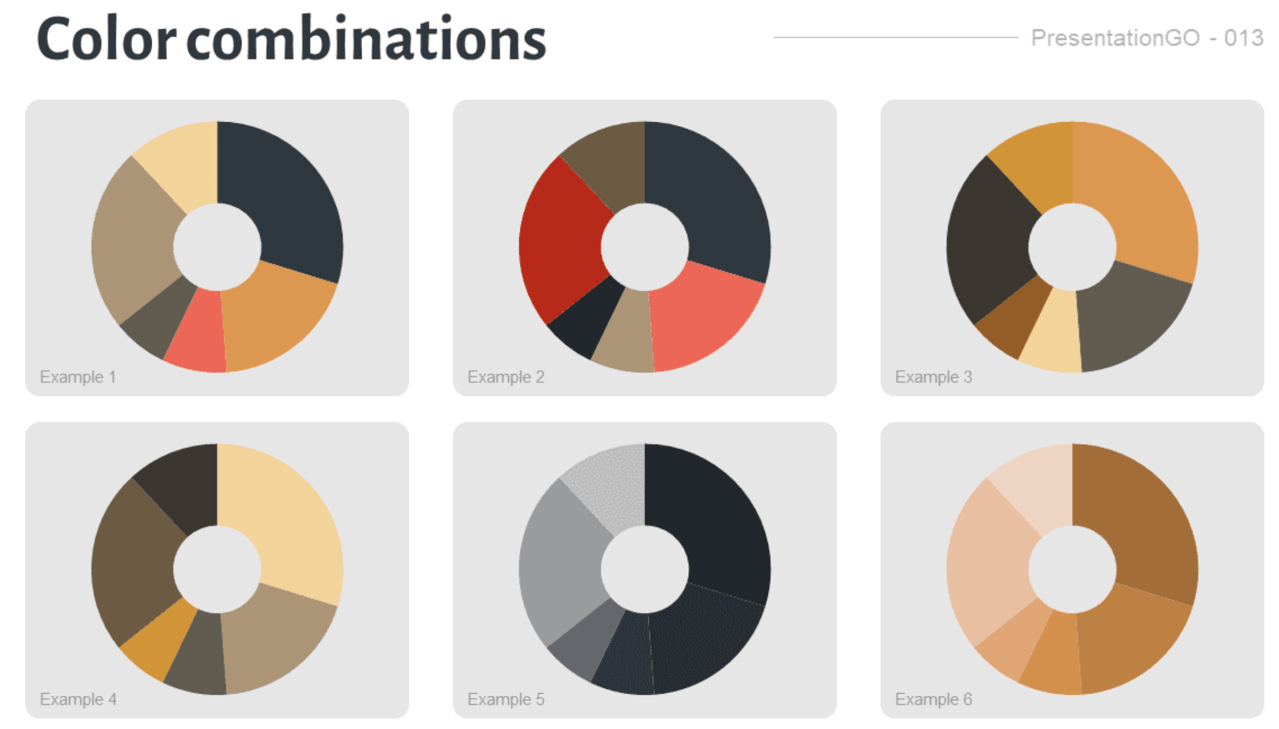
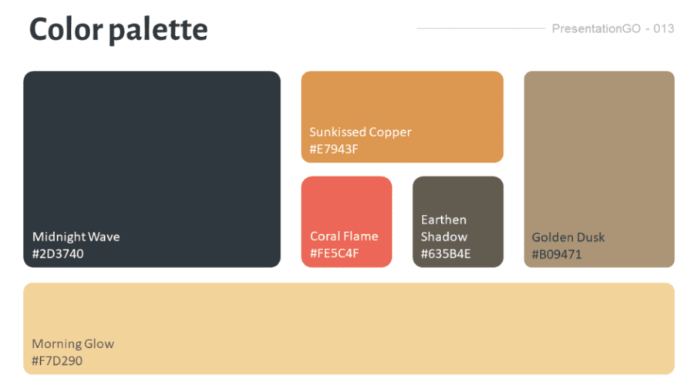

Extreme Weather and Migration: Evidence from Bangladesh
Tiana Le, Sheeba Moghal, Ishaan Babbar, Liz Kovalchuk
Georgetown University Data Science and Analytics
Abstract
Data
Results
Conclusion
This project examines retrospective migration data collected in southwestern Bangladesh provided by the Authors Amanda R. Carrico and Katharine Donato. Their study investigates the relationship between extreme weather conditions in the region and patterns of migration. Our team’s investigation of the data delves deeper into the initial findings provided by Carrico and Donato, investigating not just the primary author’s conclusion associating weather with increased migration (particularly after dry spells, albeit also after warm spells and above average rainfall but to a lesser extent).
Similarly, our team’s principal components analysis (PCA) showed that internal migration could be predicted by occupation and month of travel. We examined interrelated variables, getting a better sense of the migrant experience (e.g. access to healthcare or health concerns relation to being a migratory work), investigated using PCA.
Add your information, graphs and images to this section.
Add your information, graphs and images to this section.
Add your information, graphs and images to this section.
Methodology
Add your information, graphs and images to this section.
Data Identification & Cleaning
Principal Components Analysis
Modeling Techniques
Introduction
Add your information, graphs and images to this section.
Acknowledgements
Theme source: https://www.presentationgo.com/presentation/urban-sunset-custom-color-palette-for-powerpoint/

