Slide 1
Case Study 2 DDS
Matt Sherga

Slide 2
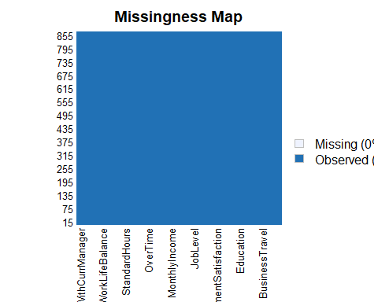
EDA How does the dataset look?
No missing values EmployeeNumber was not removed because I do not know if there is a system to assigning them. It may have some meaning I’m unaware of.

Slide 3
What data is categorical?
Factor Variables
BusinessTravel | JobSatisfaction
Department | MaritalStatus
Education | NumCompaniesWorked
EducationField | OverTime
EnvironmentSatisfaction | PerformanceRating
Gender | RelationshipSatisfaction
JobInvolvement | StockOptionLevel
JobLevel | TrainingTimesLastYear
JobRole | WorkLifeBalance

Slide 4
Can any variables be confidently removed?
One level: EmployeeCount, Over18, StandardHours
 | Levels |  | Levels
Age | 43 | JobSatisfaction | 4
Attrition | 2 | MaritalStatus | 3
BusinessTravel | 3 | MonthlyIncome | 826
DailyRate | 627 | MonthlyRate | 852
Department | 3 | NumCompaniesWorked | 10
DistanceFromHome | 29 | Over18 | 1
Education | 5 | OverTime | 2
EducationField | 6 | PercentSalaryHike | 15
EmployeeCount | 1 | PerformanceRating | 2
EmployeeNumber | 870 | RelationshipSatisfaction | 4
EnvironmentSatisfaction | 4 | StandardHours | 1
Gender | 2 | StockOptionLevel | 4
HourlyRate | 71 | TotalWorkingYears | 39
JobInvolvement | 4 | TrainingTimesLastYear | 7
JobLevel | 5 | WorkLifeBalance | 4
JobRole | 9 | YearsAtCompany | 32

Slide 5
Is the data balanced?
Modeling to predict attrition needs unbiased data. Too many “no” responses. Downsampled to fix.
Attrition | Total
No | 730
Yes | 140

Slide 6
Run the model.
Accuracy: overall percentage of correct guesses. Sensitivity: percentage of correct “No” responses. Specificity: percentage of correct “Yes” responses. Prediction table helps explain.
Accuracy | Sensitivity | Specificity
0.8333333 | 0.8717949 | 0.8
Attrition | Actual No | Actual Yes
Predicted No | 34 | 9
Predicted Yes | 5 | 36
Factor | Level | Probability
BusinessTravel | Travel_Rarely | 0.6842105
StockOptionLevel | 0 | 0.7157895
PerformanceRating | 3 | 0.8526316

Slide 7
Predicted Classifications
ID | Attrition
1171 | No
1172 | Yes
1173 | No
1174 | No
1175 | No
1176 | No

Slide 8
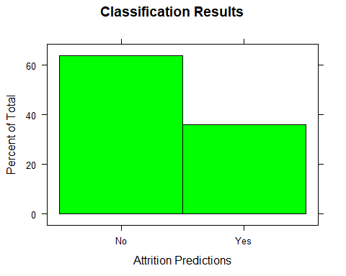
Percentage Distribution of Results

Slide 9
Monthly Income linear model.
Initial model analyses flag insignificant variables on each run, so they can be removed. Final analysis shows strong significance of these variables as predictors.
Predictors | P-Values
Age | 0.0000000
Attrition | 0.0000000
BusinessTravel | 0.0081896
Department | 0.0000000
Education | 0.0000171
EducationField | 0.0000008
EnvironmentSatisfaction | 0.0002293
Gender | 0.0007025
JobInvolvement | 0.0000000
JobLevel | 0.0000000

Slide 10
Use linear model to make prediction on test set.
RMSE tells deviation from our model in dollars. Here we can see the RMSE when the model is run on our test, training, and full datasets.
Test RMSE | Train RMSE | Full RMSE
1344.524 | 838.0656 | 1177.885

Slide 11
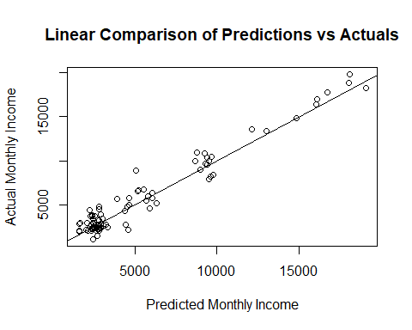
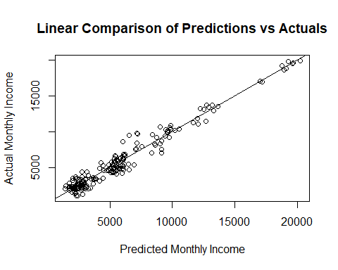
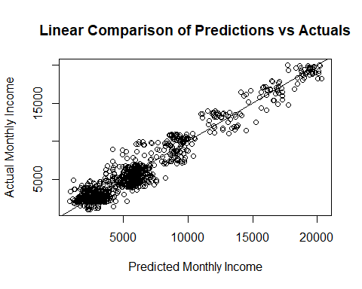
Residual Plots
Plot predicted values vs actual to observe residuals on zero line. Random scattering on both sides of the reference line.

Slide 12
Predicted Monthly Incomes
ID | MonthlyIncome
871 | $6037.08
872 | $3369.88
873 | $11645.96
874 | $2810.90
875 | $2861.54
876 | $4670.47

Slide 13
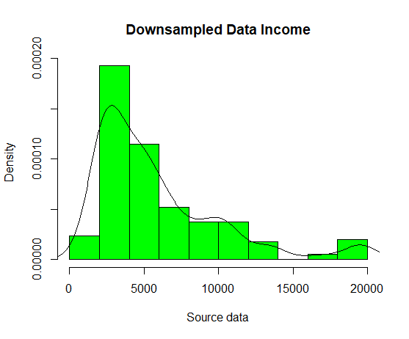
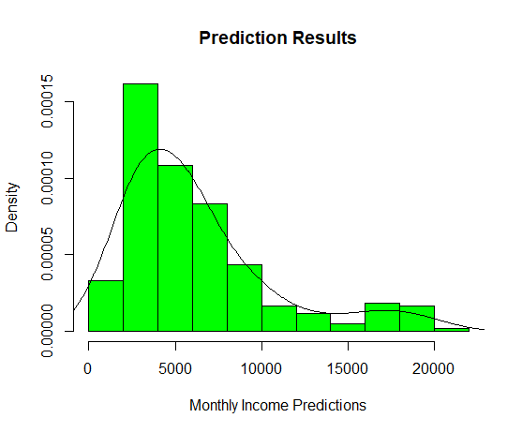
Percentage Distribution of Results
Similar shape to downsampled dataset.

