Slide 1
DDSAnalytics Modeling for Frito-Lay
Matt Sherga

Slide 2
Attrition
Accuracy: overall percentage of correct guesses. Sensitivity: percentage of correct “No” responses. Specificity: percentage of correct “Yes” responses.
Accuracy | Sensitivity | Specificity
0.8333333 | 0.8717949 | 0.8
Attrition | Actual No | Actual Yes
Predicted No | 34 | 9
Predicted Yes | 5 | 36
Factor | Level | Probability
PerformanceRating | 3 | 0.8526316
StockOptionLevel | 0 | 0.7157895
BusinessTravel | Travel_Rarely | 0.6842105

Slide 3
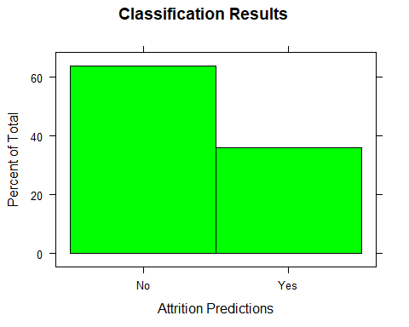
Percentage Distribution of Results
Original dataset was 84%/16%

Slide 4
Monthly Income linear model.
Initial model analyses flag insignificant variables on each run, so they can be removed. Final analysis shows strong significance of these variables as predictors.
Predictors | P-Values
Age | 0.0000000
Attrition | 0.0000000
BusinessTravel | 0.0086473
Department | 0.0000000
Education | 0.0000142
EducationField | 0.0000009
EnvironmentSatisfaction | 0.0000625
Gender | 0.0006821
JobInvolvement | 0.0000000
JobLevel | 0.0000000

Slide 5
Use linear model to make prediction on test set.
RMSE tells deviation from our model in dollars. Here we can see the RMSE when the model is run on our test, training, and full datasets.
Test RMSE | Train RMSE | Full RMSE
$1200.833 | $973.0891 | $1064.569

Slide 6
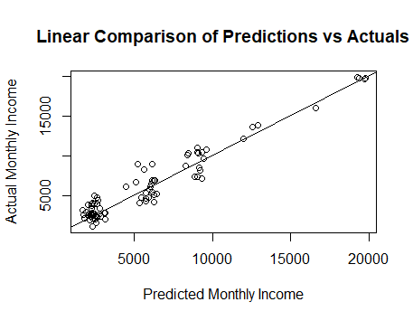
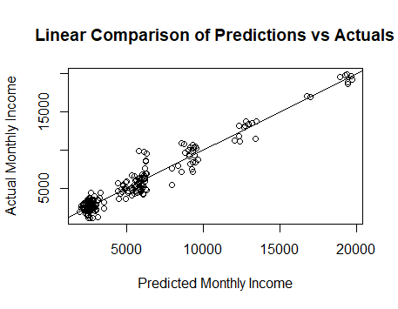
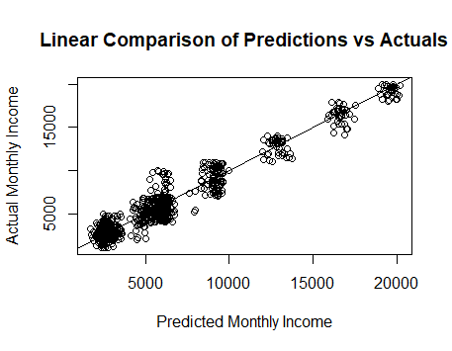
Residual Plots
Plot predicted values vs actual to observe residuals on zero line. Random scattering on both sides of the reference line.

Slide 7
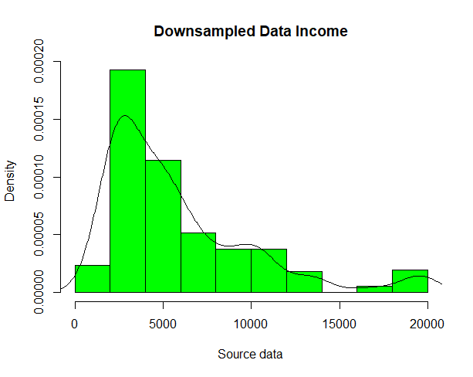
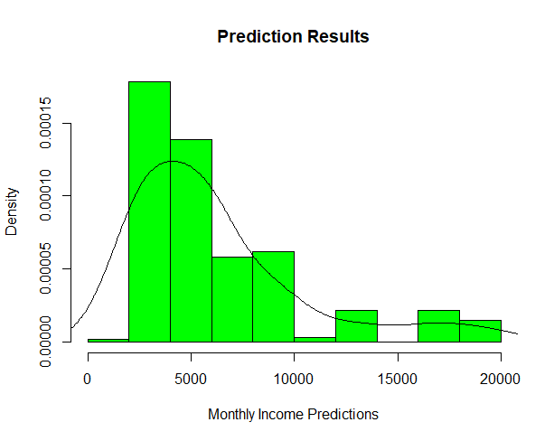
Percentage Distribution of Results
Similar shape to downsampled dataset.

Slide 8
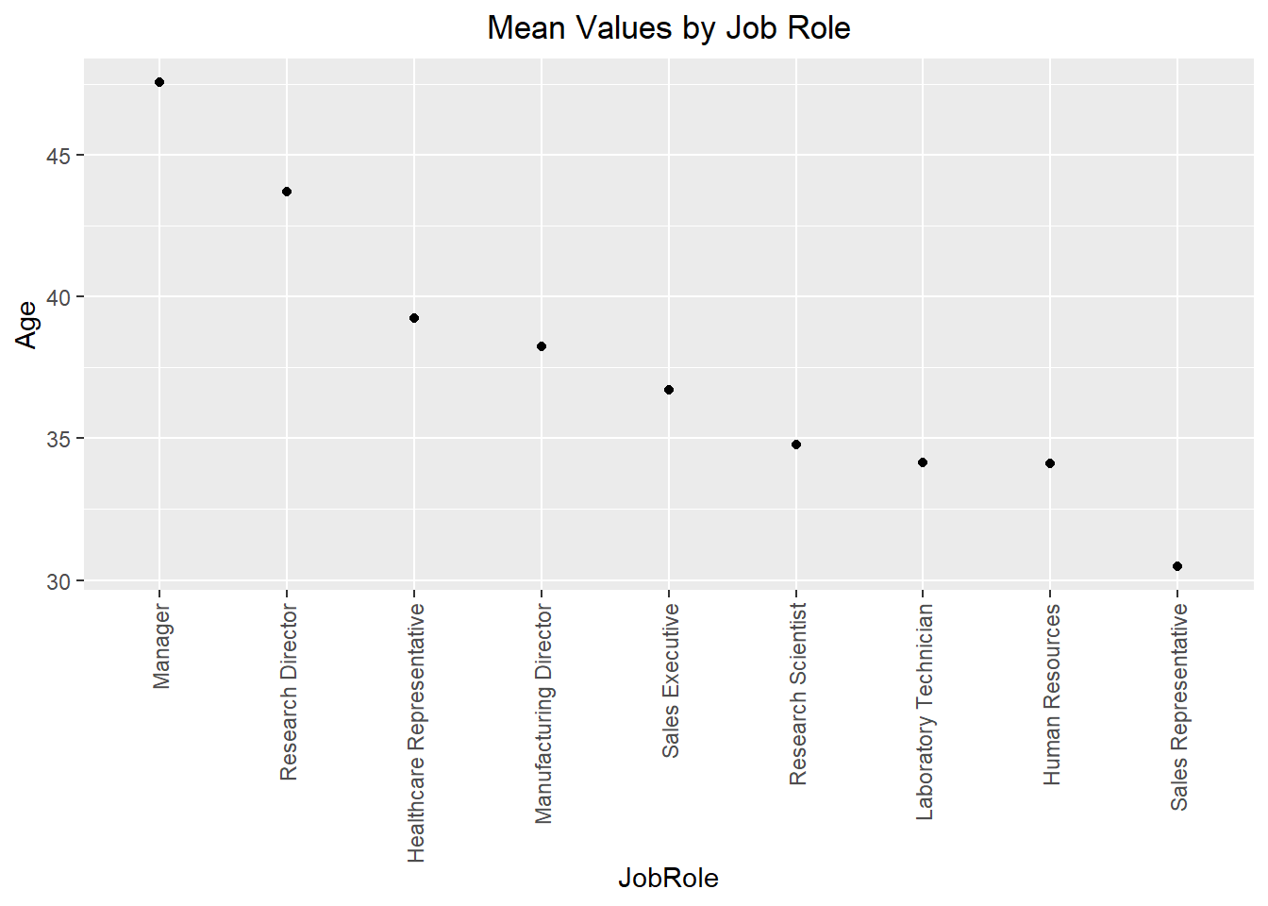
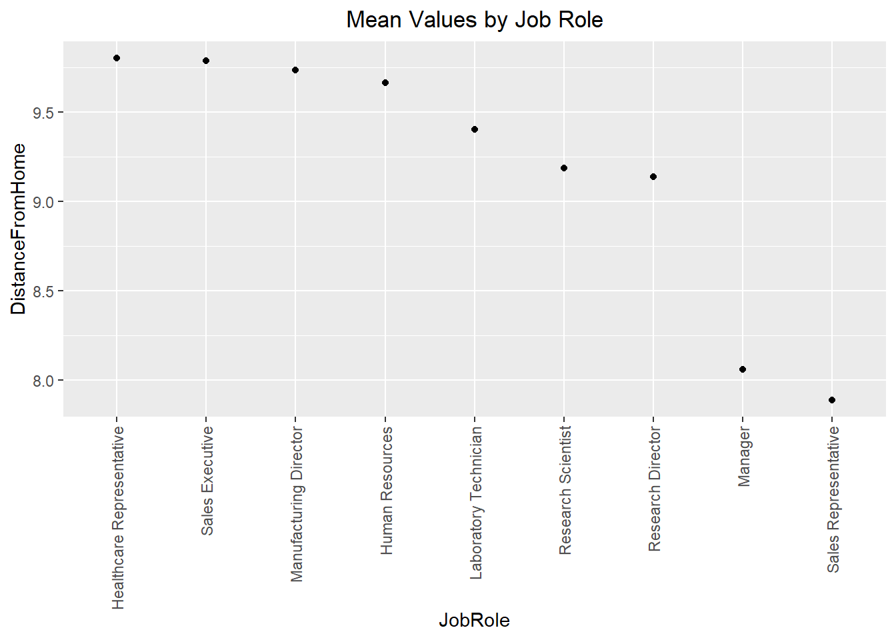
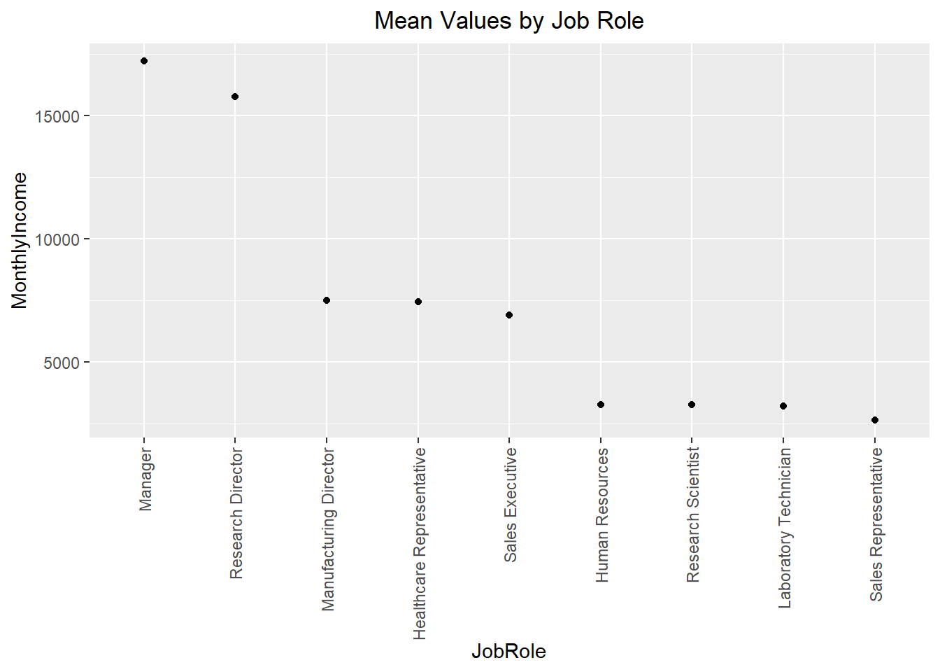
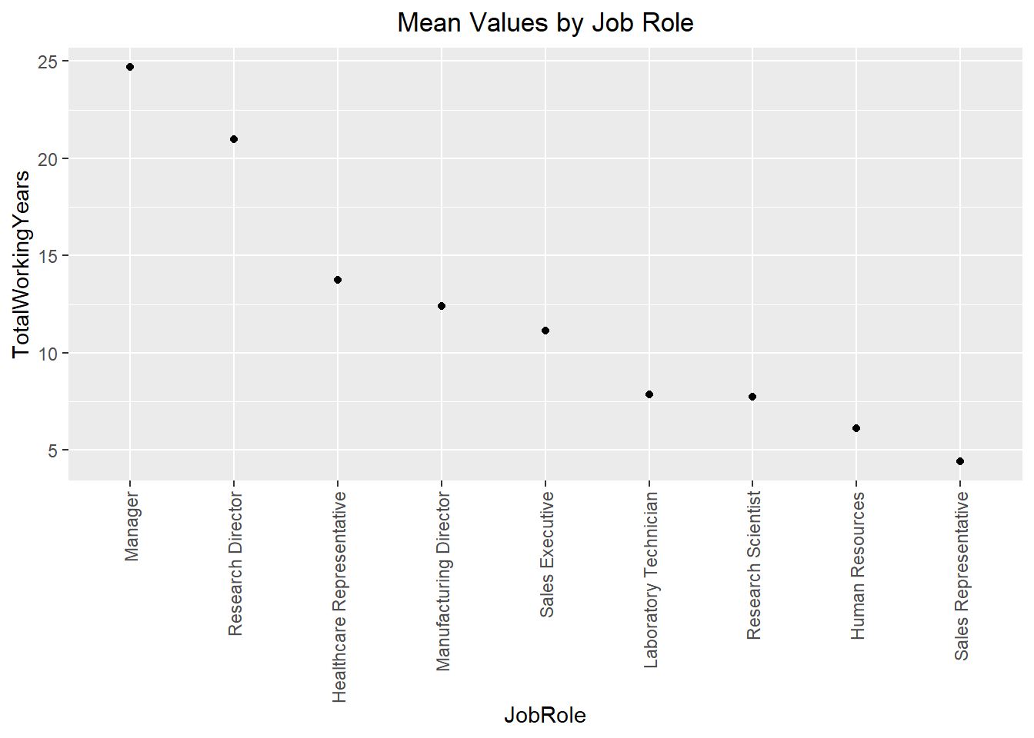
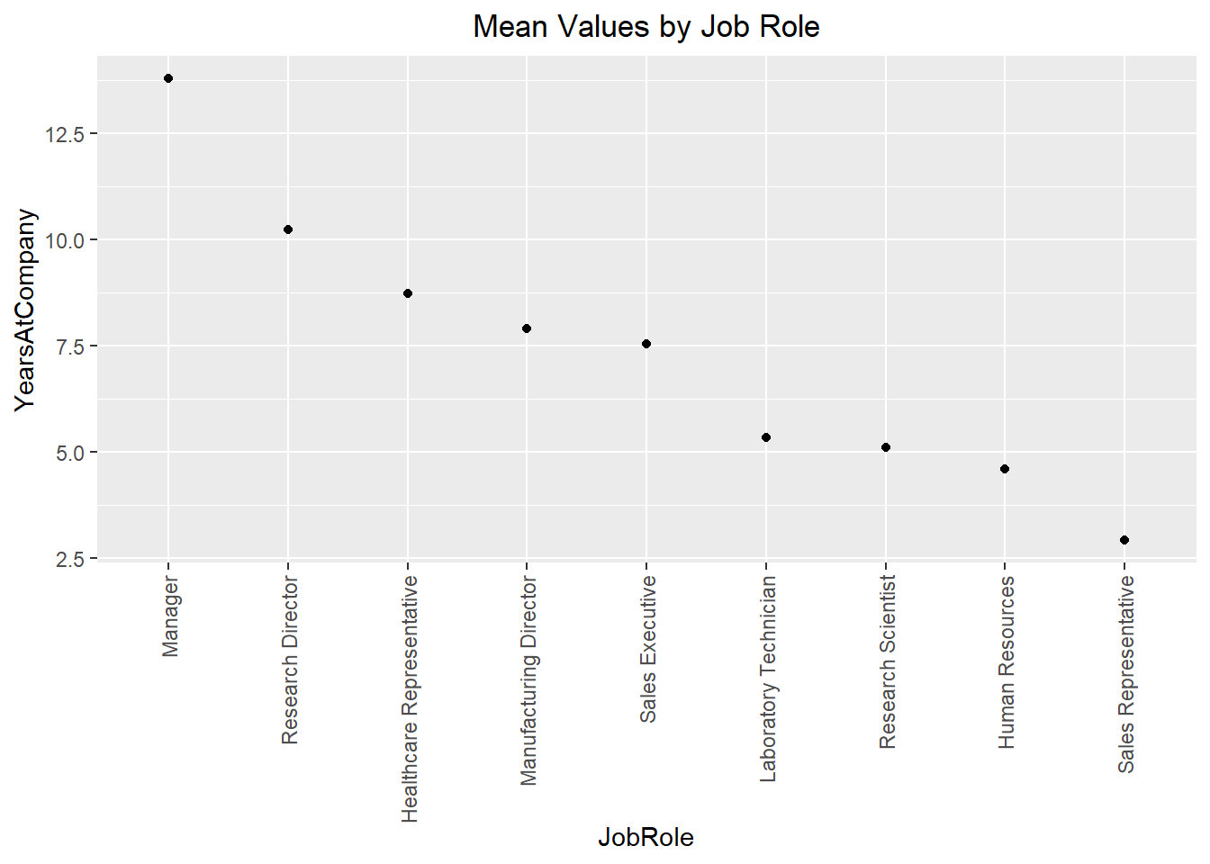
Job Role Graphical Analysis

Slide 9
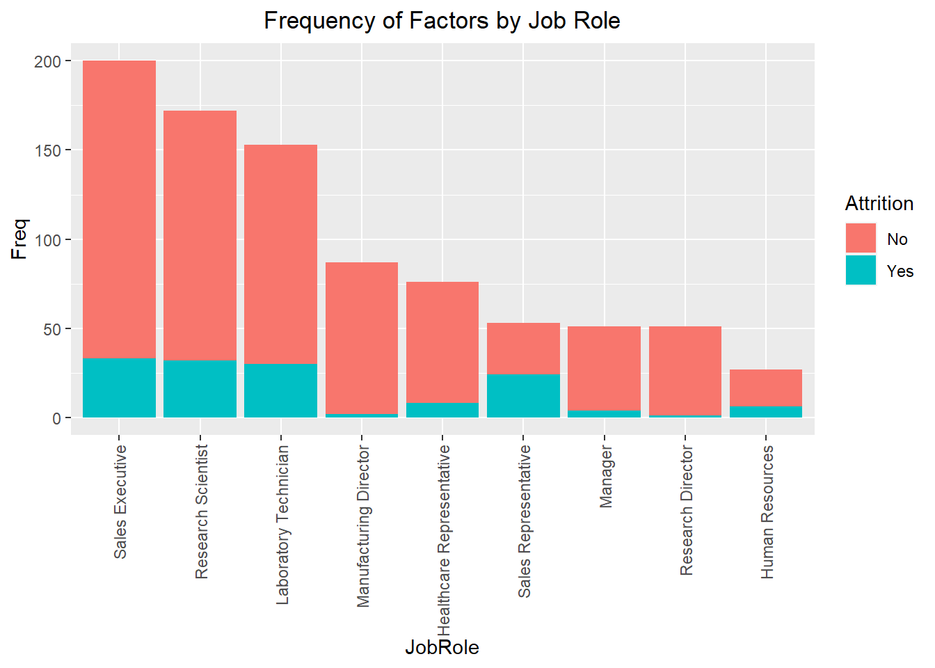
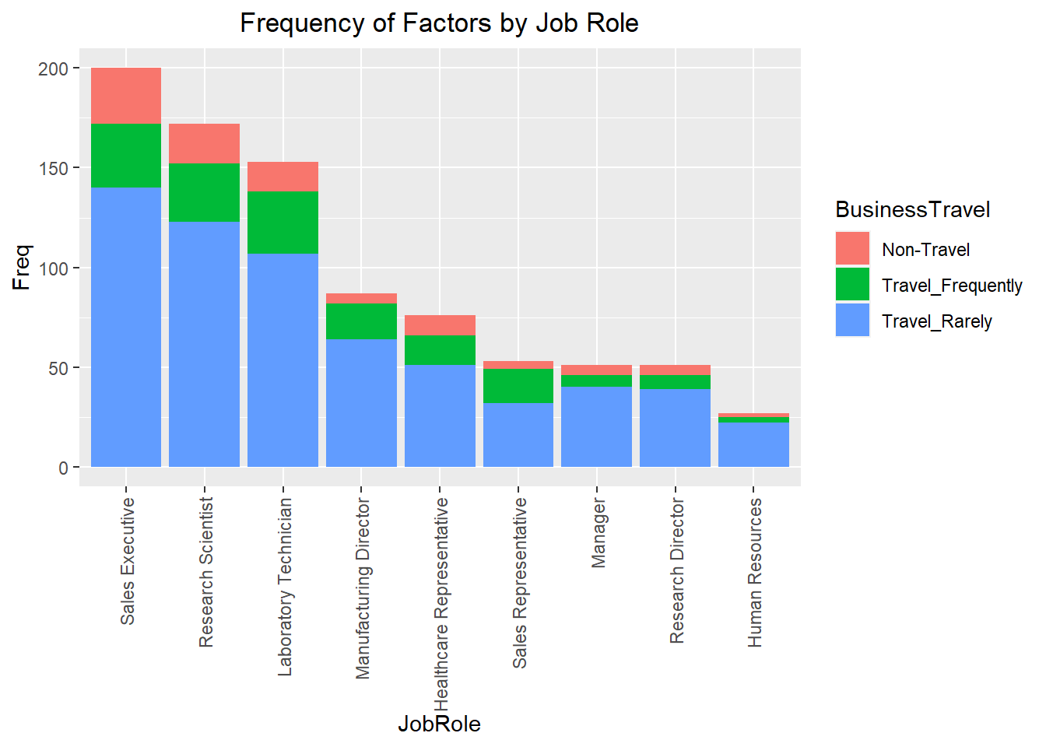
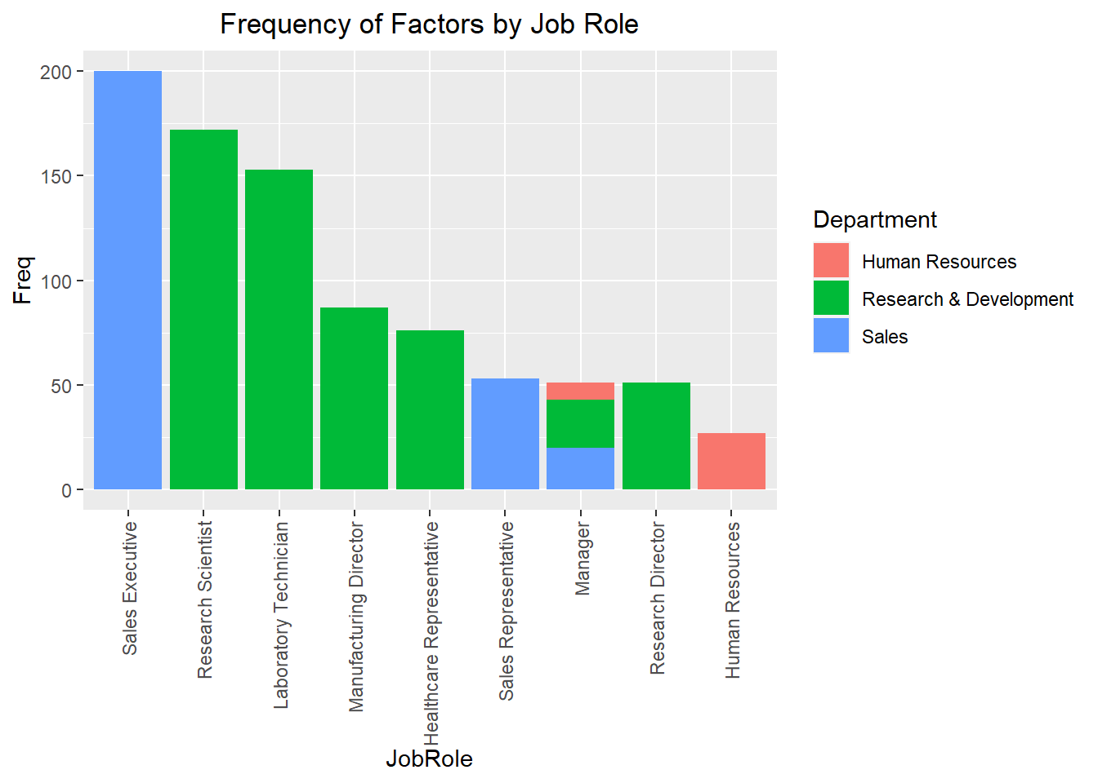

Slide 10
