Slide 1
Case Study 2 DDS
Matt Sherga

Slide 2
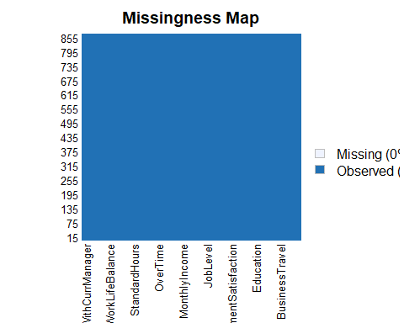
EDA How does the dataset look?
No missing values EmployeeNumber was not removed because I do not know if there is a system to assigning them. It may have some meaning I’m unaware of.

Slide 3
What data is categorical?
Factor Variables
Education
EnvironmentSatisfaction
JobInvolvement
JobLevel
JobSatisfaction
PerformanceRating
RelationshipSatisfaction
StockOptionLevel
WorkLifeBalance

Slide 4
Can any variables be confidently removed?
One level: EmployeeCount, Over18, StandardHours
 | Levels |  | Levels
Age | 43 | JobSatisfaction | 4
Attrition | 2 | MaritalStatus | 3
BusinessTravel | 3 | MonthlyIncome | 826
DailyRate | 627 | MonthlyRate | 852
Department | 3 | NumCompaniesWorked | 10
DistanceFromHome | 29 | Over18 | 1
Education | 5 | OverTime | 2
EducationField | 6 | PercentSalaryHike | 15
EmployeeCount | 1 | PerformanceRating | 2
EmployeeNumber | 870 | RelationshipSatisfaction | 4
EnvironmentSatisfaction | 4 | StandardHours | 1
Gender | 2 | StockOptionLevel | 4
HourlyRate | 71 | TotalWorkingYears | 39
JobInvolvement | 4 | TrainingTimesLastYear | 7
JobLevel | 5 | WorkLifeBalance | 4
JobRole | 9 | YearsAtCompany | 32

Slide 5
Is the data balanced?
Modeling to predict attrition needs unbiased data. Too many “no” responses. Downsampled to fix.
Attrition | Total
No | 730
Yes | 140

Slide 6
Run the model.
No Yes
No 31 3
Yes 7 43
Accuracy: overall percentage of correct guesses. Sensitivity: percentage of correct “No” responses. Specificity: percentage of correct “Yes” responses. Prediction table helps explain.
Accuracy | Sensitivity | Specificity
0.8809524 | 0.8157895 | 0.9347826
Attrition | Actual No | Actual Yes
Predicted No | 31 | 3
Predicted Yes | 7 | 43

Slide 7
Predicted Classifications
ID | Attrition
1171 | No
1172 | Yes
1173 | No
1174 | No
1175 | No
1176 | No

Slide 8
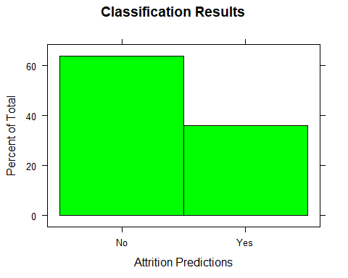
Percentage Distribution of Results

Slide 9
Monthly Income linear model.
Initial model analyses flag insignificant variables on each run, so they can be removed. Final analysis shows strong significance of these variables as predictors.
Predictors | P-Values
Age | 0.0000000
Attrition | 0.0000000
BusinessTravel | 0.0025671
Department | 0.0000000
Education | 0.0000000
EducationField | 0.0002550
EmployeeNumber | 0.0000001
EnvironmentSatisfaction | 0.0000148
JobLevel | 0.0000000
JobRole | 0.0000000

Slide 10
Use linear model to make prediction on test set.
RMSE tells deviation from our model in dollars. Here we can see the RMSE when the model is run on our test, training, and full datasets.
Test RMSE | Train RMSE | Full RMSE
1066.327 | 927.9713 | 1093.938

Slide 11
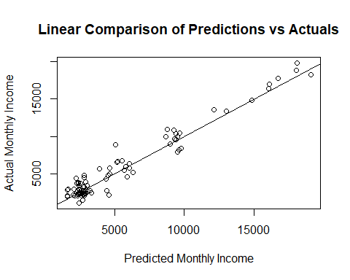
Residual Plot
Plot predicted values vs actual to observe residuals on zero line. Random scattering on both sides of the reference line.

Slide 12
Predicted Monthly Incomes
ID | MonthlyIncome
871 | $5596.86
872 | $3093.20
873 | $13333.05
874 | $1914.13
875 | $2054.78
876 | $4633.11

Slide 13
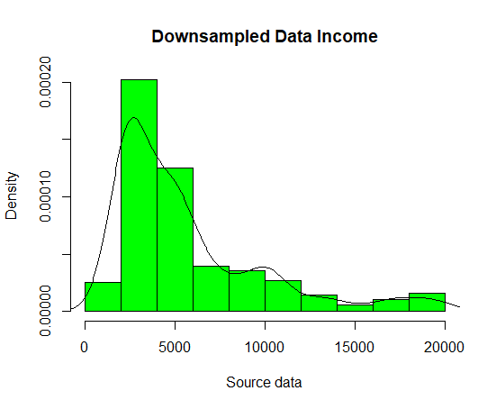
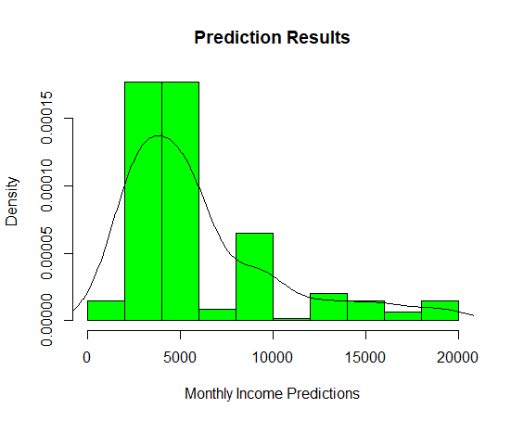
Percentage Distribution of Results
Similar shape to downsampled dataset.

