Slide 1
Building a Social Recommender System
Team - 11
Akhil Raveendran
Deepika Yannamani
Rajesh Thummala
Sheshank Makkapati
Siddarth Varanasi

Slide 2
Outline
Introduction
Overview
The Problem
Solution Proposal
Data Preparation
Categories from interests
Generating clusters of similar users
Associating twitter users to the appropriate cluster of users
Recommend to the users 3 out of the 6 proposed items
Results
Conclusion

Slide 3
Introduction
The goal of the project is to build a Multi-domain social recommender system.
This is done by associating a set of interests extracted from the user activities.
Also done by extracting interests from their friendship list (by selecting those friends in the list that indicate an interest more than a peer friendship relation).

Slide 4
Overview
We generated clusters of similar users (i.e. with similar interests) – using user’s social network relationships.
We evaluated the clusters using analysis algorithms. By mapping user’s data and their interests, we recommend social interests for each user.

Slide 5
Problems addressed
First problem is to suggest different interest categories to new users, without any previous user activity to base the recommendations upon.
Second is to rank the existing user’s new recommendations based upon his recent activity.

Slide 6
Solutions
First problem was solved using collaborative and content based filtering.
The second was solved using knowledge based approach.
In both the problems, Kmeans clustering was used to create category clusters and similar users clusters.

Slide 7
Data Preparation
A very large Multi domain interests Dataset of Twitter users with Mapping to Wikipedia is used. We are using this for training and testing as well. The dataset includes number of multidomain preferences per user on music,sport,books,movies,politics etc.
The preferences are extracted from sources such as the messages of users who use Spotify, Goodreads and other content sharing Platforms or from Topical friends.
This extraction is done in 3 steps:
Extracting the interests from users’ textual activities or communications.
Extracting interests from users’ friendship lists.
Mapping interests on to Wikipedia pages.

Slide 8
Extracting the interests from users’ textual activities
Using the textual features based on users’ communications,profiles seem to be a natural way for modeling their interests.
It is computationally very difficult to process millions of daily tweets in real time and also this extraction process is error prone , given the highly ungrammatical nature of blogs.
The drawback here is relatively small number of users access these services and also the preferences are extracted only in few domains.

Slide 9
Extracting interests from users’ friendship lists.
This information is available in users’ profile and no further processing is needed. Interests inferred from topical friends are less volatile since ”com-mon” users tend to be rather stable in their relationships.
Twitter users have hundreds of followees, many of which, rather than genuine friends, are indicators of a variety of interests in diﬀerent domains, such as entertainment, sport, art and culture, politics, etc.
Topical friends are therefore both relatively stable and readily accessible indicators of a user’s interest.

Slide 10
Mapping interests on to Wikipedia pages.
The ﬁnal step is to associate each interest, either extracted from messages or inferred from friendship relations, with a corresponding Wikipedia page.
This step has both the advantage of improving the precision of detected users’ interests, and providing a mean to categorize them.
We use diﬀerent mapping methodologies for interests extracted from messages and those induced from users’ friendship lists.
Since Wikipedia articles are created almost in real-time in correspondence with virtually any popular entity, either book, or song, actor, event, etc., this mapping is possible.

Slide 11
Loading Dataset and Pre analysis.
The data set is first loaded in the convenient form ,i.e Dictionaries.
Basic analysis of data is done during the loading of Dataset.These analysis will turn useful when choosing the more suitable method to perform subsequent tasks.
Firstly, the type of relations are analysed. The relationships considered in this case are: Follows, likes, related match, type.
Then analysing type of subjects is done. Subject includes the first element of every triple, ignoring the relation type.
The examples of the subjects used here are: 'https://play.spotify.com/user/', 'https://twitter.com/intent/',

Slide 12
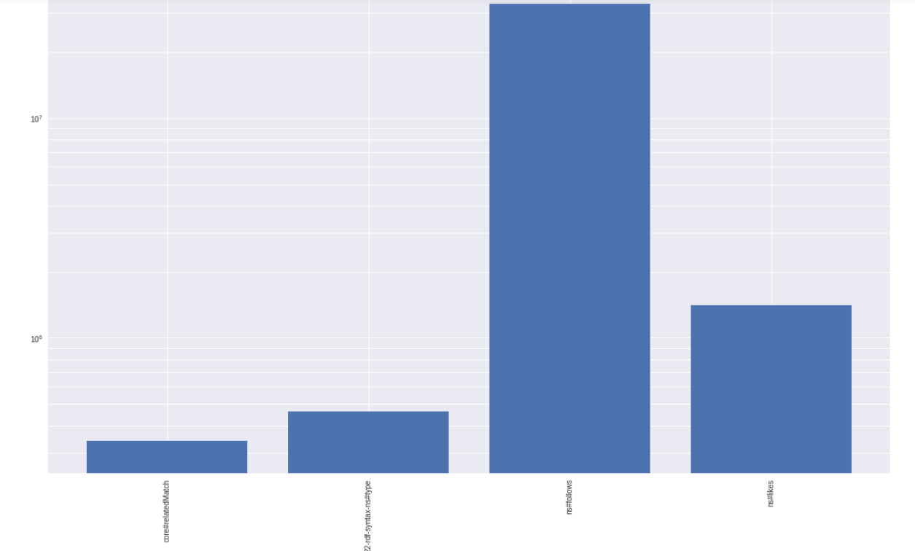
Frequency Plot of the subjects
The plot of subjects , i.e follows, likes, related match, type shows that the data about the followers is higher than other information which is shown in the graph.

Slide 13
Categories from Interests
Extracting categories to synthesize interests using semantic is not a well defined problem, how can we measure the performance of our approach? We should make some assumptions:
Each interest should be semantically related to its category
Categorization should be balanced
Granularity should be appropriate: too many categories are redundant, too few categories weaken the model due to the loss of information.
The balance of the categorization is an easy measure but what about the other two criteria?
We used Wikipedia Navigation Vectors as semantic model, these are obtained applying Wor2vec algorithm to reading sessions.
We select all vectors corresponding to wikipedia articles present in the dataset and perform a clusterization using MiniBatch K-Means

Slide 14
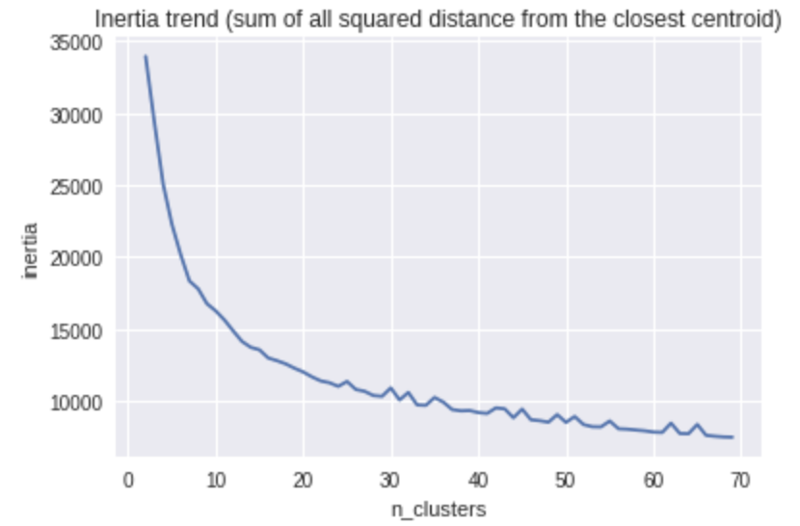
Categories from Interests
Why MiniBatch ???????????
Why K-Means ??????????
The number of clusters is decided looking both at the silhouette coefficient and at the Inertia Trend.
Calculating Inertia Trend

Slide 15
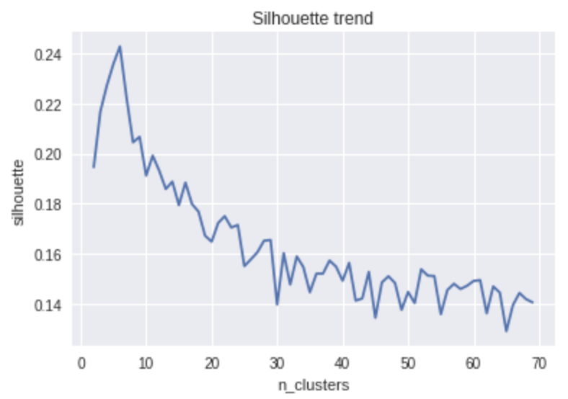
Calculating Silhouette Coefficient
What is Silhouette Coefficient-method of interpretation and validation of consistency within clusters of data
Why to calculate Silhouette Coefficient
Despite few clusters guarantee an higher Silhouette coefficient we choose 41 clusters that provide a sufficient granularity and is near a local maximum of the Silhouette trend.

Slide 16
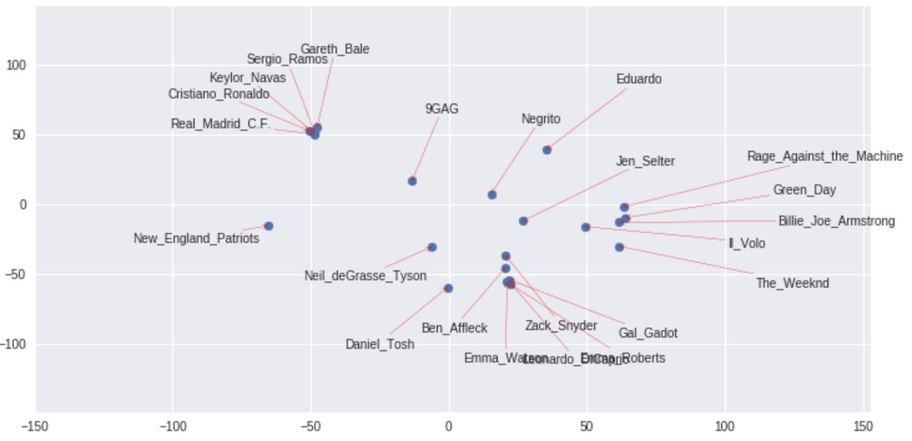
TSNE Plot
Our plot should be in two dimensions, so we use TSNE algorithm after PCA to reduce further the dimensionality. TSNE is the standard for this type of data visualization.
With a single user we can plot the wikipage vectors corresponding to interests, in this way we can see if the distance between them has a semantic meaning. So we can have an idea of the performance of the chosen semantic model.

Slide 17
Generating clusters of similar users
Explored different community detection methods which works best on our large dataset and chose Classic Clustering Algorithm considering its less computational cost
Compared DBScan and K-Means clustering methods
Chose MiniBatch K-Means clustering as it works effectively on big datasets and guarantees cluster balancing

Slide 18
K-Means with Euclidean Distance
Data Preprocessing- Normalization and PCA for dimensionality reduction
Compared different k-valued clusters by computing Silhoutte scores and inertia trend for different values of k (2 to 60)
Determined ideal K-value as 7 based on maximum Sillhoute coefficient
Created 7 similar user clusters

Slide 19
Associate new user to appropriate Cluster
Find the best cluster for each user based on available data of his friends list and list of all their interests
Two recommendation approaches are used: Collaborative and Content based
Collaborative approach - If most of the friends are already tagged with a cluster, we assign to each user, the cluster corresponding to the most frequent cluster among its friends
Content based - When user’s friends are in different clusters, we look at friend’s interests, collect the corresponding categories, predict the cluster of each user using the already trained MiniBatch Kmeans model.

Slide 20
Content based approach
Find interests of user’s friends
Find corresponding wikipages and find categories from wikipages
Normalise the user-category data and reduce dimension using PCA
Find appropriate cluster using trained MiniBatch K-Means clustering model

Slide 21
Ranking proposed interests for given users
Aim - Given user’s interests and proposed new interests, rank top 3 interests based on given list of interests
Challenges - Which approach can be used ??
- Which recommendation system is effective??
Collaborative approach - Find similar users and similar interests,compute score for new interest
Problem with above approach is sparser and larger datasets of users(4L) and their interests(20L)
Knowledge based approach - For each user, use knowledge we have about user and pre-trained model of wiki embeddings to find semanticity. Built an Item based recommendation approach where the similarity between two items is simply given by the cosine similarity between the corresponding vectors. Extra step in this approach is to check semantic meaning as well in addition to similarity score. This approach is effective.

Slide 22
Knowledge based approach
Algorithm steps :
Retrieve all interests for given users into a dictionary and import all query interests for each user
Plot a graph for number of interests per user to tune future parameters
Compute score of each of the proposed wiki pages and choose best three
Score of each page is calculated as :
score(qi) = ∑ Cossim(qi,i(q,j))
Where q1,q2,q3..q6 are wikipages
I(q1) = {i1,i2...i10} are wikipages similar to q1
The parameters 10 (number of interests considered) and 0.1 (similarity threshold) were chosen after some tuning and taking in consideration the number of interests per user.

Slide 23

Knowledge based approach
Challenges :
Some of the pages are missing from wiki page embedding data. Though the fraction of missing pages is small, we wanted to take that problem into consideration
We can simply ignore missing pages. What if missing pages is one among 6 to be ranked?
One idea was to find possible substitute
But most of the pages are actually missing

Slide 24
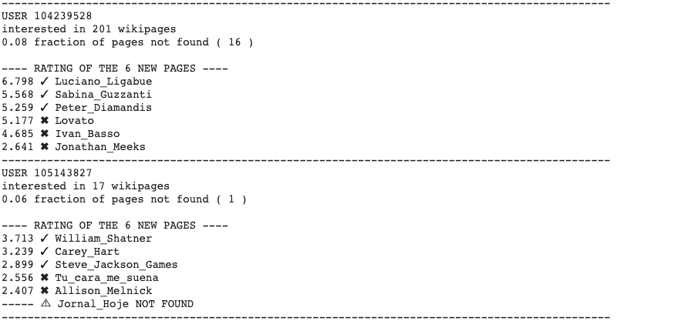
Results
Ranking of proposed items, given user u, and list of his interests will be shown as

Slide 25
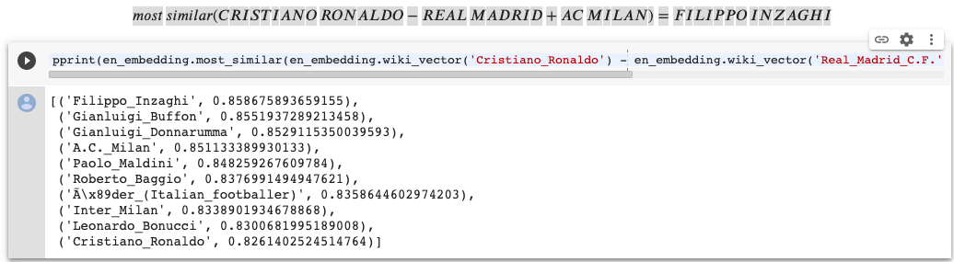
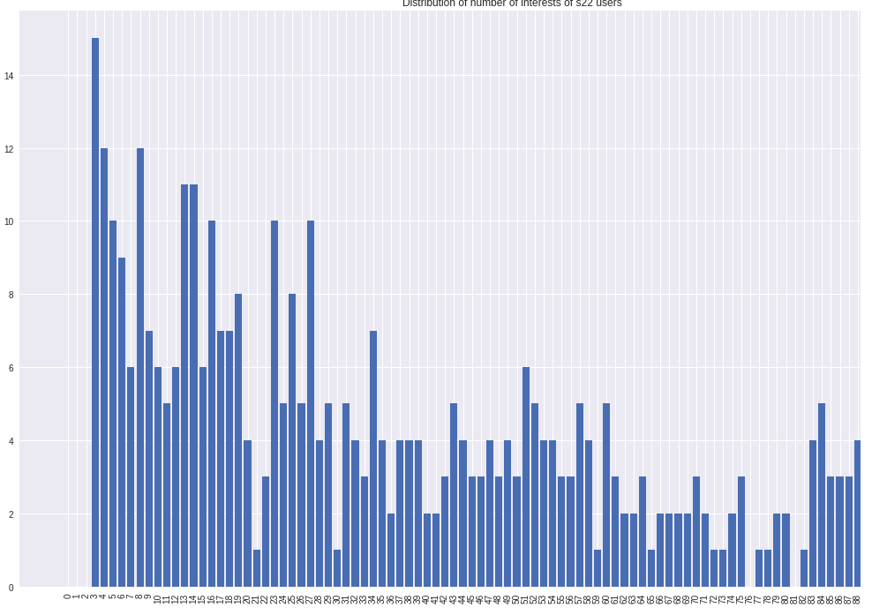
Results
Some of the Intermediate results

Slide 26
Conclusion
In this project, we have implemented Social Network Based Interest Recommendation System based on user’s interests and user’s friends interests
We were able to solve two problems in this project. One of them is recommending interests to new user(cold start problem) and other problem was ranking proposed interests to existing user
Explored different recommendation approaches throughout the project implementation and compared computational costs and performance issues, implemented effective approaches
One of the challenges we encountered was Incompleteness of our data (missing wikipages both in the WIKI_MID dataset and in the Wikipedia embeddings) that affected particularly the last point and our future work goes on addressing this issue

Slide 27
THANK YOU

