Slide 1
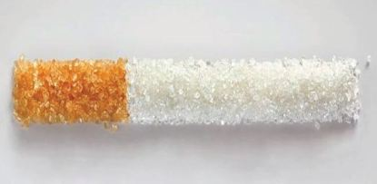
Sugar vs. Smoking
Should sugar be addressed the same way we address smoking?
Presenters: Beth Hakamy
Corrine Ptacek
Manisha Shetti
AKA: “Sugar Smokers”

Slide 2
Background
Tobacco is an identified risk factor for several preventable health problems, with severe complications..
Cigarette smoking causes about one of every five deaths in the United States each year!
https://www.cdc.gov/tobacco/data_statistics/fact_sheets/health_effects/tobacco_related_mortality/index.htm
Many organized efforts to change this behavior through policy and public awareness..

Slide 3
Background
This is not the only behavior that leads to preventable problems..
We’ll focus on a lifestyle choice/behavior, examine how common it is among youth, and if it has any detectable impacts on health..
We choose “Youth Risk Behavior Surveillance System (YRBSS)”..
“Also, we were inspired by an idea we saw on makeover Monday ☺”
https://www.makeovermonday.co.uk/

Slide 4
What is YRBSS?
Was developed in 1990
To monitor health behaviors that contribute markedly to the leading causes of death, disability, and social problems among youth and adults.
These behaviors, often established during childhood and early adolescence, include:
Behaviors that contribute to unintentional injuries and violence.
Sexual behaviors related to unintended pregnancy and sexually transmitted infections, including HIV infection.
Alcohol and other drug use.
Tobacco use.
Unhealthy dietary behaviors.
Inadequate physical activity.
https://www.cdc.gov/healthyyouth/data/yrbs/data.htm

Slide 5
Selected Dataset
YRBSS includes : representative samples of 9th through 12th grade students. These surveys are conducted by CDC every two years, usually during the spring semester in public and private schools.
We Choose 3 years (1997, 2007, 2017), to compare 3 points over 20 decades..
Across several changes of social norms, generations..

Slide 6
Data Analysis

Slide 7
Data Analysis and Cleaning :
We analyzed 20 years of data beginning from 1997 through 2017.
We appended the files and pulled the information into data frames to complete analysis and use the specific information we needed from our dataset
We then mapped questions to show trends from 2007 and 2017. We learned through the data cleanse process that the 1997 survey data was not as robust as 2007 and 2017.
Our team used Matplotlib and Plotly to graph trends and show smoking and consumption of sugary drinks survey data to complete analysis and observations

Slide 8
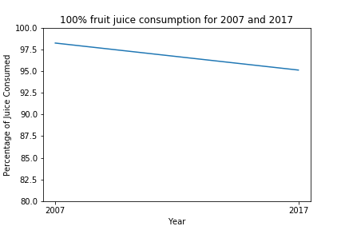
Trend Chart – Matplotlib
Trend chart to illustrate fruit juice consumption of those surveyed in 2007 and 2017.

Slide 9
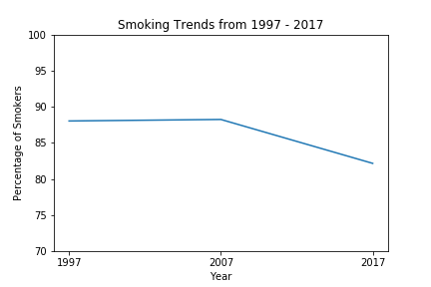
Trend Chart - Matplotlib
Trend analysis of smoking from 1997, 2007 and 2017

Slide 10
Charts – Plotly (DEMO)
Charts you will view:
BMI Range v/s Percentage consumption of juices for 2017
BMI Range v/s Percentage consumption of smoke for 2017
BMI Range v/s Percentage consumption of vape for 2017
BMI Range v/s Percentage consumption of other tobacco for 2017
BMI Range v/s Percentage consumption of juices for 2007
BMI Range v/s Percentage consumption of smoke for 2007
BMI Range v/s Percentage consumption of juices for 2017
5:36
BMI Range v/s Percentage consumption of smoke for 2017
5:36
BMI Range v/s Percentage consumption of vape for 2017
New
5:36
BMI Range v/s Percentage consumption of other tobacco for 2017

Slide 11
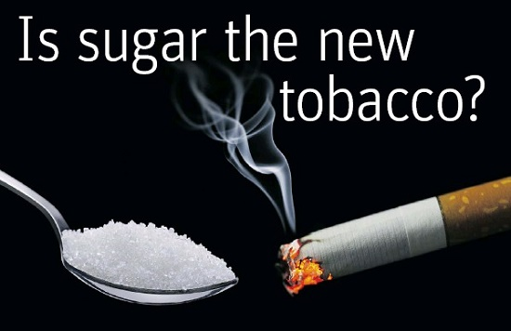

Slide 12
Observations
Underweight teens that responded to the survey had a higher prevalence for smoking
There was no statistical significance in fruit juice consumption compared to BMI to draw any conclusion except that all groups consumed sugary drinks in both years 2007 and 2017
There was no statistical significance in smoking of those surveyed with BMI of normal, overweight and obese both 2007 and 2017
Trend chart illustrated a decline of Tobacco usage
Trend chart depicted slight decline of fruit juice consumption

Slide 13
Limitations:
1997: insufficient data about weight
The survey questions were not consistent year over year.
The data was limited to high school students
The data was self reported
More significant diet data would be necessary to make a case for sugary drinks to have a warning label

Slide 14
Future Analysis:
Gender breakdown
Racial breakdown
Location breakdown
Heatmap where smoking is prevalent
Future data after awareness campaign regarding sugar was completed.

Slide 15
Conclusion
The data did not provide any conclusive evidence to show that sugary drinks was connected to higher BMI.
The data did not provide any conclusive evidence to show that smoking was connected to higher BMI
The supportive articles indicate the rise of type 2 diabetes based on nutritional habits from our childhood to support labels

Slide 16
References:
Dataset
https://www.cdc.gov/healthyyouth/data/yrbs/data.htm
Supporting Articles
https://pubmed.ncbi.nlm.nih.gov/30281992/
https://pubmed.ncbi.nlm.nih.gov/30281997/

