Slide 1
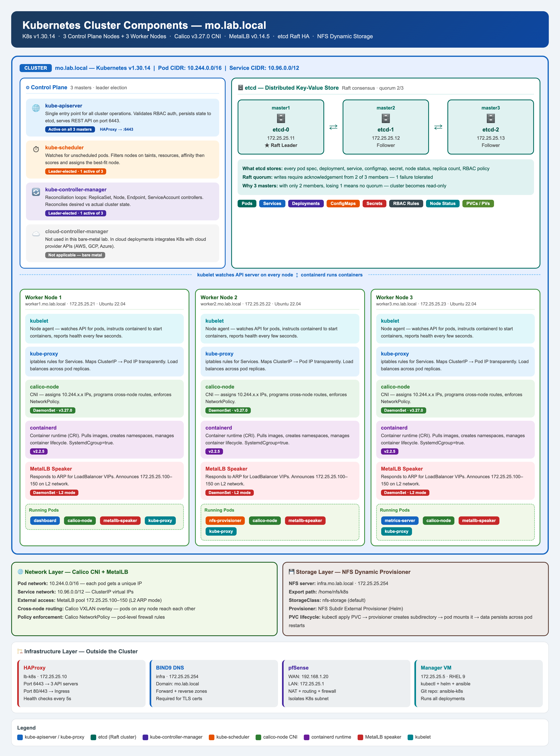
Kubernetes HA Lab
Complete Infrastructure Build — VMware ESXi · pfSense · Kubernetes v1.30.14
mo.lab.local
K8s v1.30.14
Calico v3.27.0
MetalLB v0.14.5
3 Masters + 3 Workers
Status: Operational
Presented by Mohammed Salah
mo.lab.local · 2025

Slide 2
Agenda
What we will cover today
Why this lab?
Traffic Flow & Scheduling
1
5
Business / learning motivation
How packets and pods reach the right place
Lab Architecture
Kafka — Next Step
2
6
Full topology — ESXi, pfSense, DNS, NFS, HAProxy
Corelight / Zeek log ingestion pipeline
Kubernetes Cluster
Live Demo
3
7
3-master HA, etcd Raft, Calico CNI
kubectl, Dashboard, HAProxy stats
Platform Services
Lessons Learned
4
8
MetalLB, Dashboard, Metrics Server, NFS Storage
Key challenges and how they were solved

Slide 3
Why This Lab?
Motivation and goals
Build hands-on K8s experience
Move beyond managed cloud K8s (EKS/GKE) — own the full control plane
Production-grade HA
3 control-plane nodes with stacked etcd — real quorum, real failover
Network security focus
Isolated lab network via pfSense NAT — mirrors enterprise DMZ patterns
Corelight / Zeek integration
Build the receiver pipeline before the sensor arrives — Kafka as the buffer
Full-stack observability
Metrics Server, Dashboard, HAProxy stats — nothing is a black box

Slide 4
Lab Architecture
Full topology — all components and networks
Host
IP
OS
Role
infra
172.25.25.254
RHEL 9
BIND9 DNS + NFS
manager
172.25.25.5
RHEL 9
Ansible + Helm + kubectl
lb-k8s
172.25.25.10
RHEL 9
HAProxy 2.8.14
master1/2/3
172.25.25.11-13
Ubuntu 22.04
K8s Control Plane + etcd
worker1/2/3
172.25.25.21-23
Ubuntu 22.04
K8s Workers
vSwitch0 192.168.1.0/24 — Home LAN
vSwitch1 172.25.25.0/24 — K8s Lab Network
pfSense 2.8.1 — NAT between home LAN and lab network MetalLB L2 pool: 172.25.25.100–150

Slide 5
Kubernetes HA Cluster
v1.30.14 · 3-master stacked etcd · kubeadm
Control Plane × 3
etcd — Raft Consensus
Worker Nodes × 3
• kube-apiserver — handles all K8s API calls
• kube-controller-manager — reconciles desired state
• kube-scheduler — assigns pods to nodes
• etcd — cluster state database (Raft quorum)
• Leader election: 1 active CM + 1 active scheduler
• 3-node cluster: 2/3 quorum to commit writes
• One leader, two followers — auto re-election
• Survives any single master going down
• Stacked: etcd co-located on each master
• TLS encrypted peer and client communication
• kubelet — manages pod lifecycle on the node
• kube-proxy — iptables rules for Service routing
• containerd — container runtime (SystemdCgroup)
• Calico node — enforces network policy
• NFS mounts — dynamic PVC via nfs-storage class

Slide 6
Platform Services
MetalLB · Dashboard · Metrics Server · NFS Storage
MetalLB v0.14.5
Kubernetes Dashboard v2.7
Metrics Server
NFS Dynamic Storage
172.25.25.100–150
https://172.25.25.100
kubectl top nodes/pods
StorageClass: nfs-storage (default)
• L2 advertisement mode
• Assigns real IPs to LoadBalancer services
• Dashboard → .100, Kafka → .101
• No cloud provider needed
• Full cluster visibility
• Bearer token auth (100yr token)
• CPU/memory graphs via Metrics Server
• Pod logs, exec into containers
• --kubelet-insecure-tls patch applied
• Feeds Dashboard resource graphs
• HPA autoscaling source
• No cert required in lab
• NFS Subdir External Provisioner via Helm
• Auto-creates subdirs per PVC
• ReadWriteMany — multiple pods share volume
• 172.25.25.254:/home/nfs/k8s

Slide 7
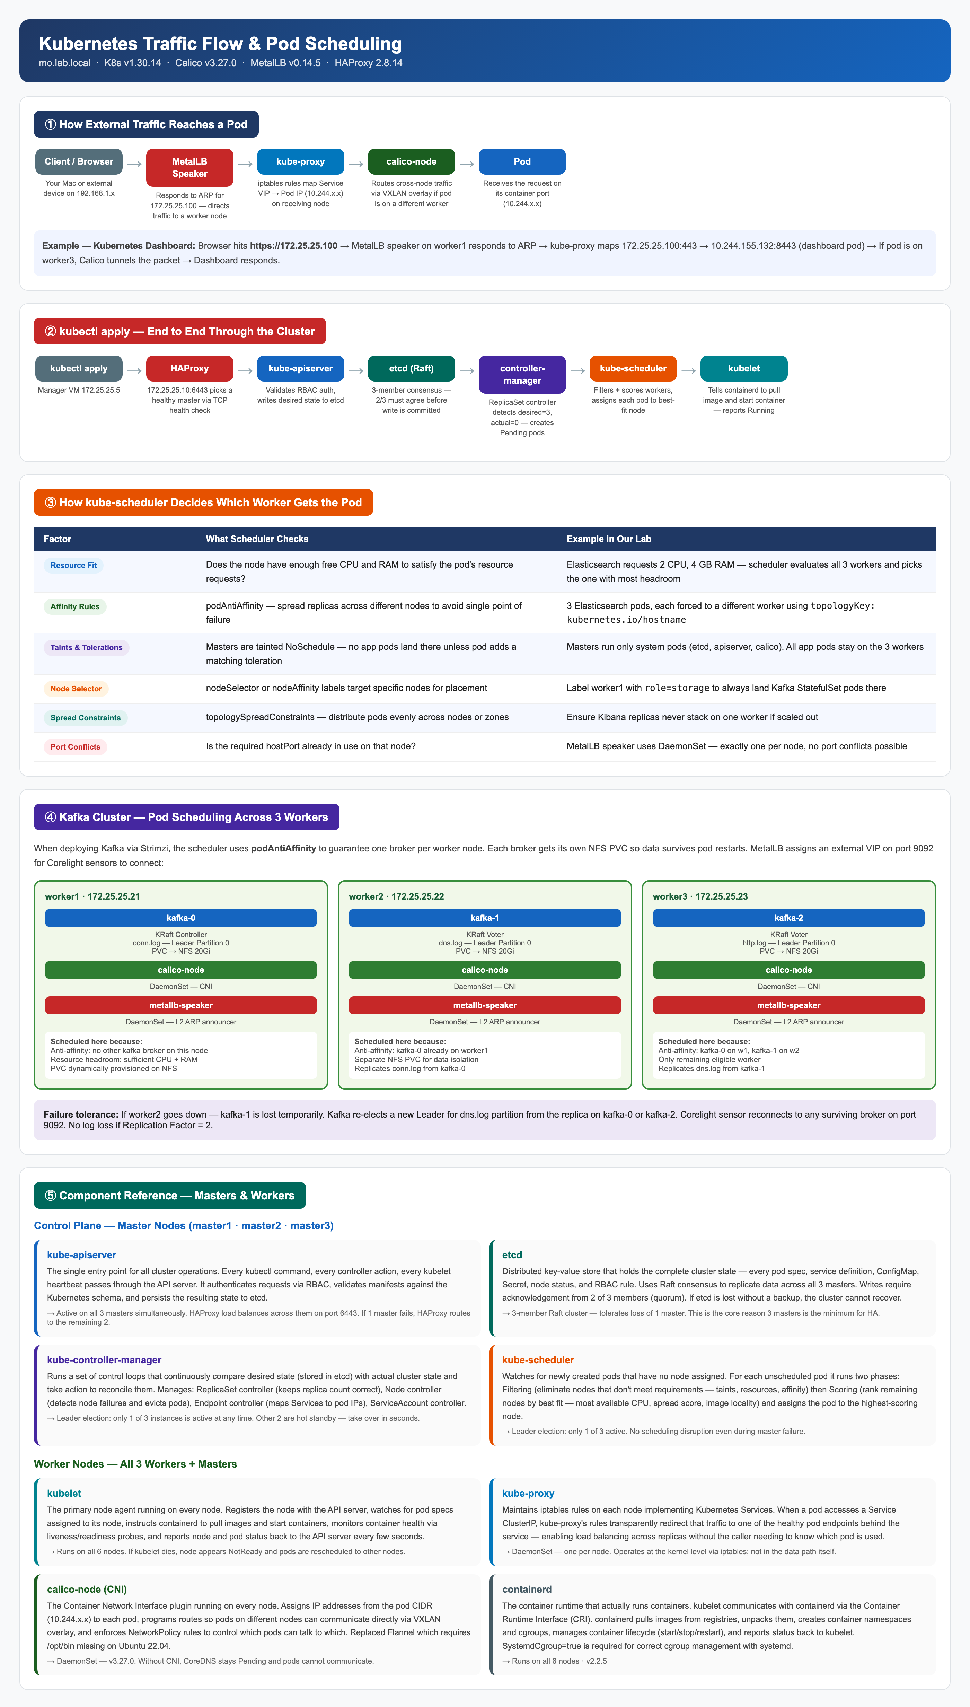
Traffic Flow & Pod Scheduling
How packets and pods reach the right destination
External Traffic
• pfSense NAT → HAProxy (172.25.25.10)
• Port 80/443 → worker ingress
• Port 6443 → control plane API (roundrobin)
• MetalLB L2 responds to ARP for VIPs
kubectl apply flow
• API Server validates + stores in etcd
• Scheduler selects best worker node
• kubelet pulls image, starts container
• Calico programs iptables routes
Scheduler Filters
• NodeResourcesFit — enough CPU/RAM?
• PodTopologySpread — spread across nodes
• Taints/tolerations — exclude masters
• Score → highest-score node wins

Slide 8
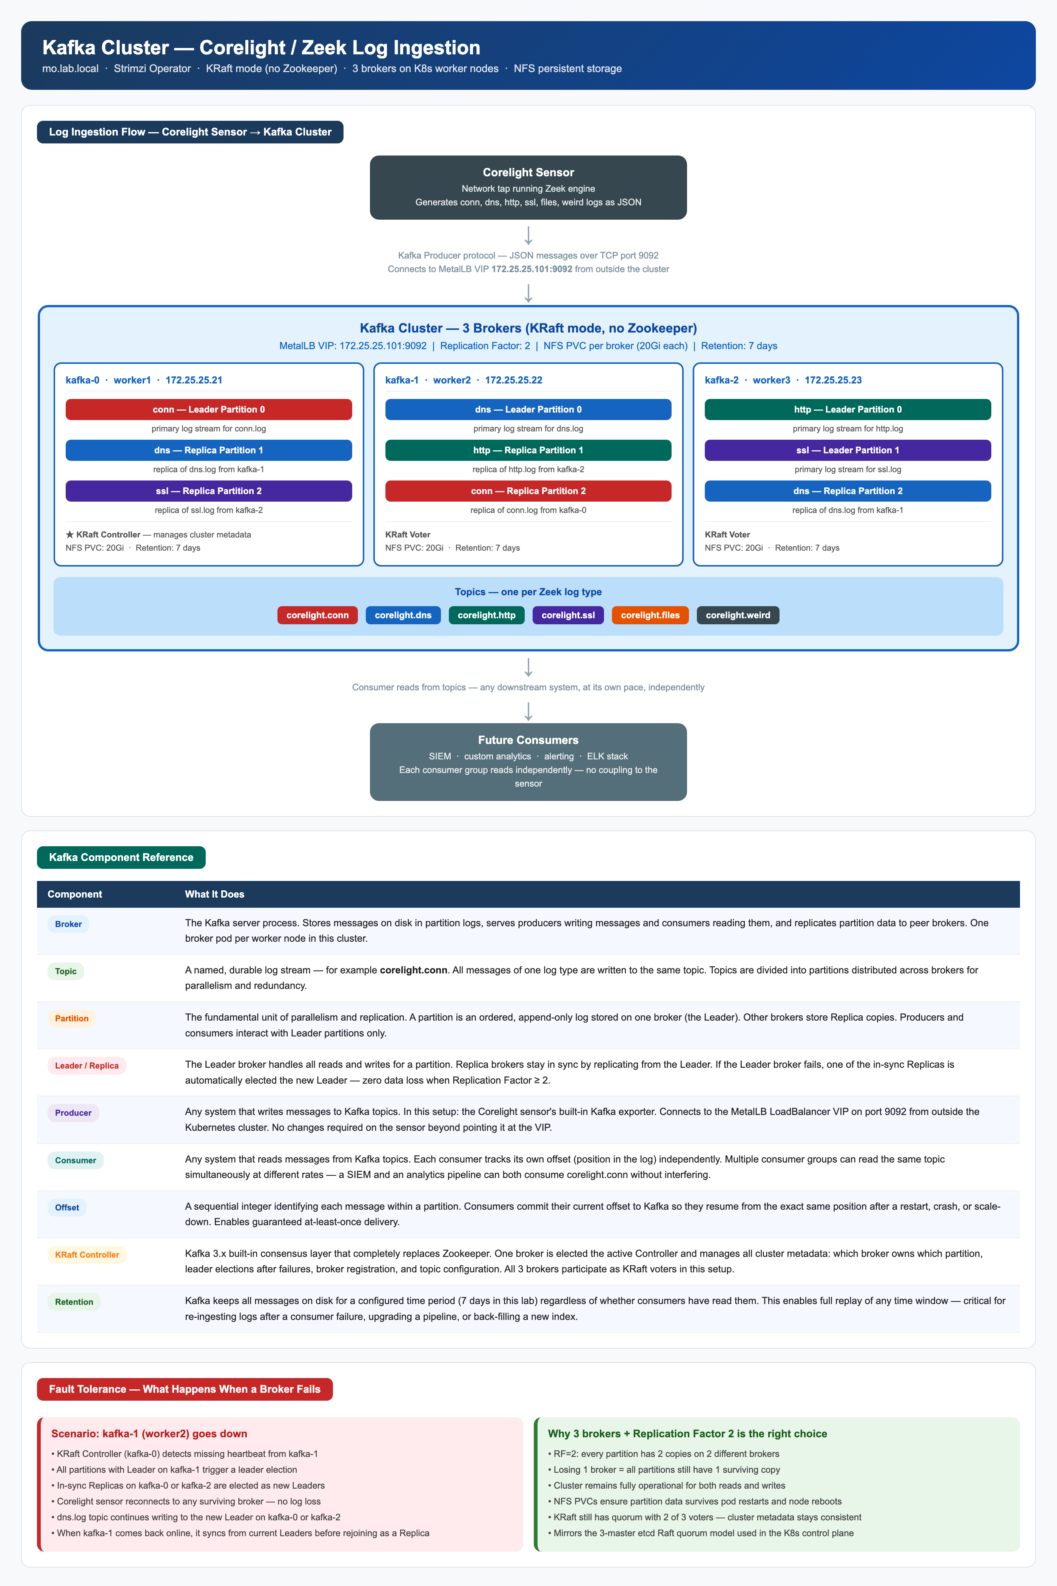
Next: Kafka for Corelight / Zeek Logs
Strimzi · KRaft mode · 3 brokers · NFS storage
Architecture
• 3 Kafka brokers — one per worker node
• KRaft mode — no Zookeeper dependency
• Replication Factor 2 — survives 1 broker failure
• NFS PVCs (20Gi each) — durable storage
• MetalLB VIP 172.25.25.101:9092 — external access
Log Topics
corelight.conn
corelight.dns
corelight.http
corelight.ssl
corelight.files
corelight.weird
Strimzi Operator deploys and manages the entire cluster. Corelight sensor connects to the MetalLB VIP — no cluster changes needed.

Slide 9
Lessons Learned
Key challenges encountered and how they were solved
Flannel on Ubuntu 22.04
etcd Stale Member
⚠ Flannel v0.28.5 requires /opt/bin which does not exist on Ubuntu 22.04 — CrashLoopBackOff immediately.
⚠ A failed kubeadm join left a ghost etcd member entry. Subsequent join attempts failed with "member already exists".
✓ Switched to Calico v3.27.0. Ships as a single manifest, no host binary dependencies, full network policy support.
✓ etcdctl member remove <ID> on master1, then kubeadm reset on the joining master before retry.
HAProxy TCP mode
NFS Mount on Workers
⚠ option forwardfor is HTTP-only — adding it to a TCP frontend causes HAProxy to refuse to start.
⚠ NFS dynamic provisioner pods crashed on startup because nfs-common was not installed on Ubuntu workers.
✓ Remove forwardfor from all TCP-mode frontends. TCP mode passes raw bytes — HTTP headers are not parsed.
✓ Ansible one-liner: ansible workers -m apt -a "name=nfs-common state=present" — then rollout restart.
Certificate Key Expiry
BIND9 DNSSEC Refusing Queries
⚠ The --certificate-key from kubeadm init expires after 2 hours. Trying to join a new master after that fails silently.
⚠ BIND9 default config enables DNSSEC validation. In a lab without signed zones it REFUSED all queries.
✓ Regenerate with: kubeadm init phase upload-certs --upload-certs on master1.
✓ Set dnssec-validation no in named.conf options block.

Slide 10
Live Demo
Cluster walkthrough
kubectl get nodes -o wide
kubectl get pods -A
All 6 nodes Ready — 3 control-plane, 3 workers
All system pods Running — Calico, MetalLB, Dashboard, Metrics
kubectl get svc -A
kubectl top nodes
LoadBalancer services with real IPs from MetalLB pool
Live CPU and memory via Metrics Server
https://172.25.25.100
http://172.25.25.10:9000
Kubernetes Dashboard — live cluster state
HAProxy stats — backend health for API and ingress
etcdctl endpoint health
etcd 3-node Raft cluster — all members healthy

Slide 11
Quick Reference
Endpoints · Versions · Key IPs
Service Endpoints
Component Versions
Kubernetes Dashboard
pfSense
2.8.1
https://172.25.25.100
HAProxy Stats
HAProxy
2.8.14
http://172.25.25.10:9000
Kubernetes API
Kubernetes
v1.30.14
https://172.25.25.10:6443
pfSense Web UI
containerd
v2.2.5
https://192.168.1.20
DNS Server
Calico CNI
v3.27.0
172.25.25.254:53
NFS Export
MetalLB
v0.14.5
172.25.25.254:/home/nfs/k8s
Kafka (planned)
Dashboard
v2.7.0
172.25.25.101:9092

Slide 12
Thank You
Kubernetes HA Lab — mo.lab.local
GitHub: github.com/mshgayar/k8s-pfsense-esxi
Questions?

