Slide 1
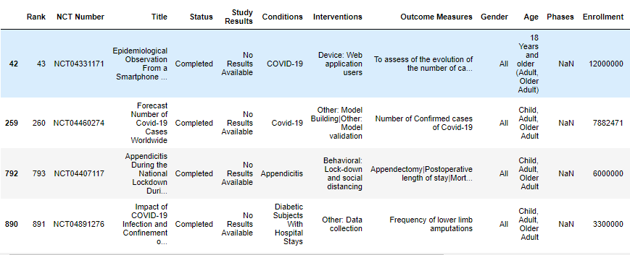
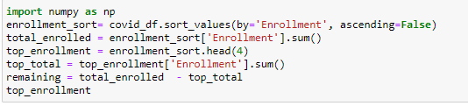
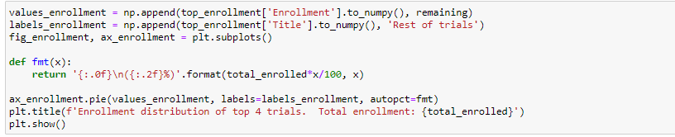
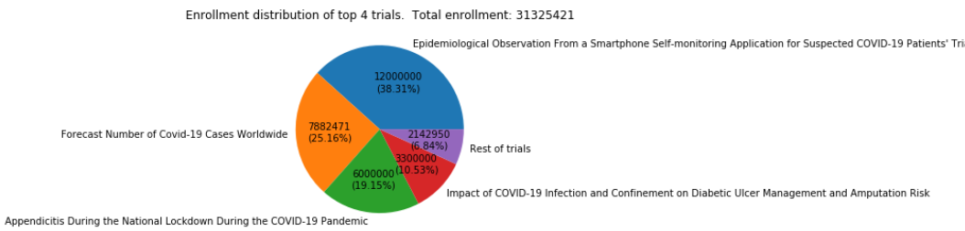
1. Enrollment distribution and top enrollment vs rest
Plot enrollment trials distribution
The top 4 trials by enrollment comprise over 93% of total enrollment

Slide 2
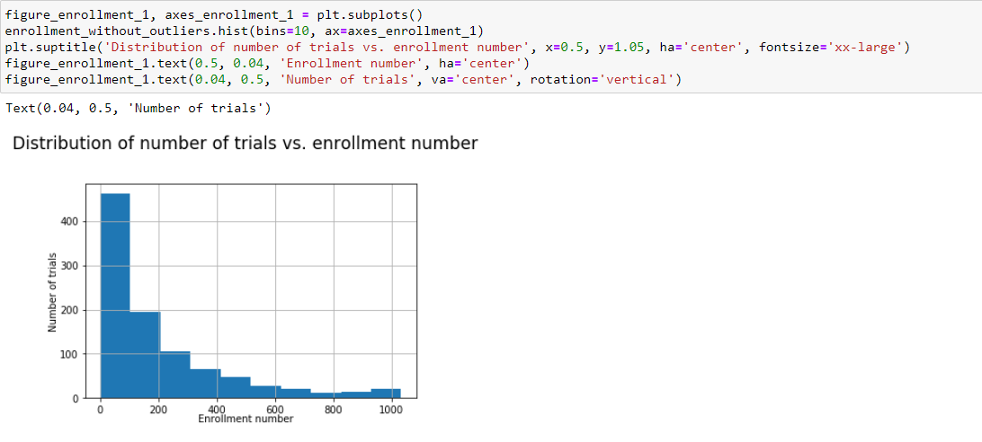
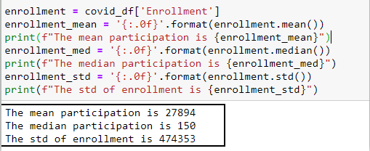
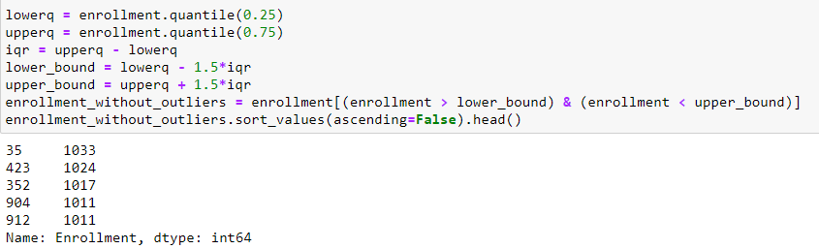
2. Enrollment statistics
Enrollment histogram without outliers
1. Total enrollment (195894) without ouliers is much less than any one outlier
2. Median shows the huge number of low enrollment

Slide 3
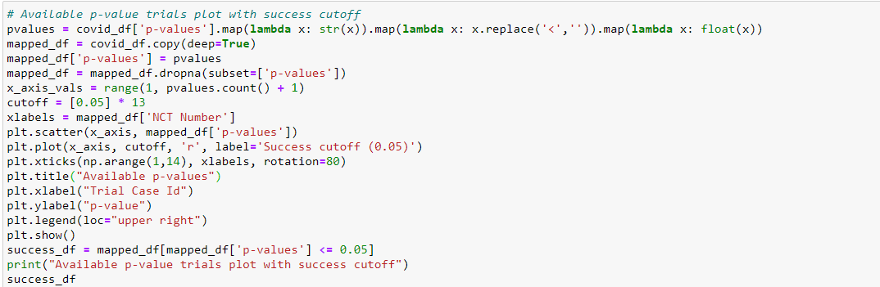
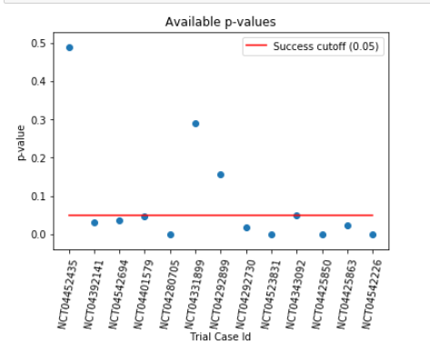
3. The most successful clinical trials based on p-value
Based on p-value cutoff of 0.05 there are 10 successful trials out of 13 available p-values

