Slide 1
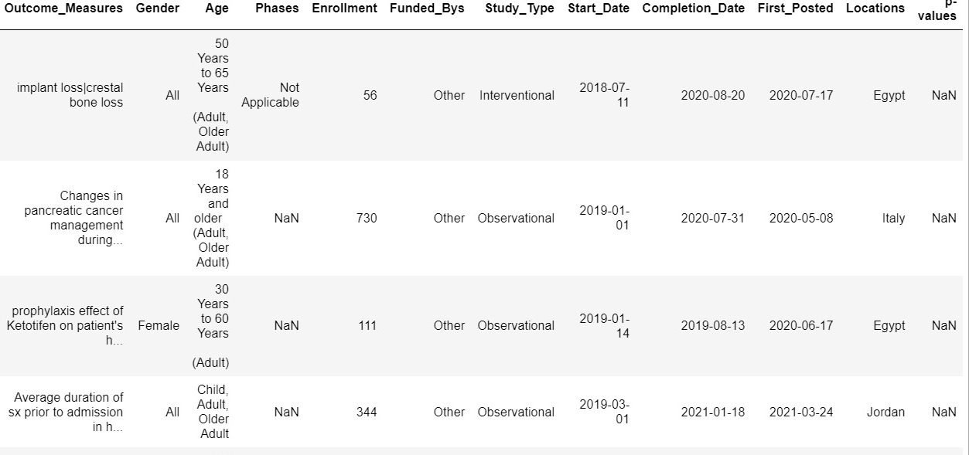
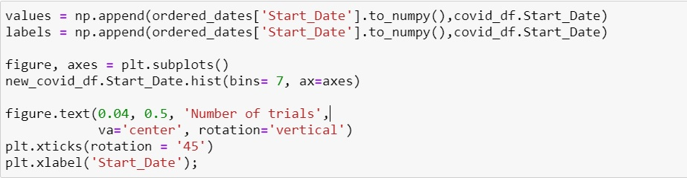
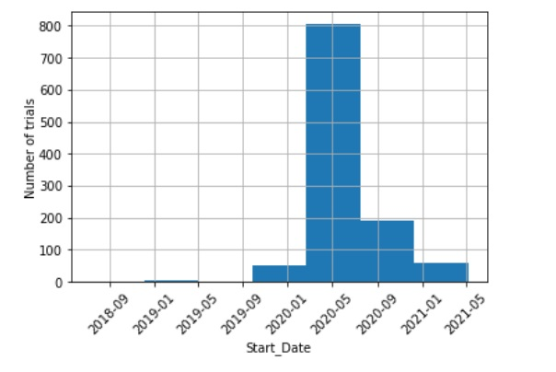
1. Number of Trials Throughout Previous Months
Plot number of trials distributed by date
Most Trials occurred over in January 2020 with over 800. about 4 times as much compared to other months.

Slide 2
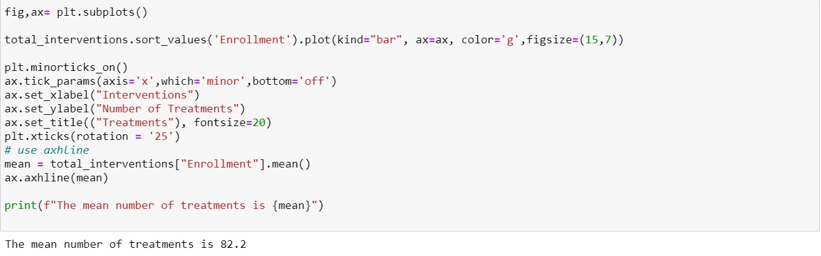
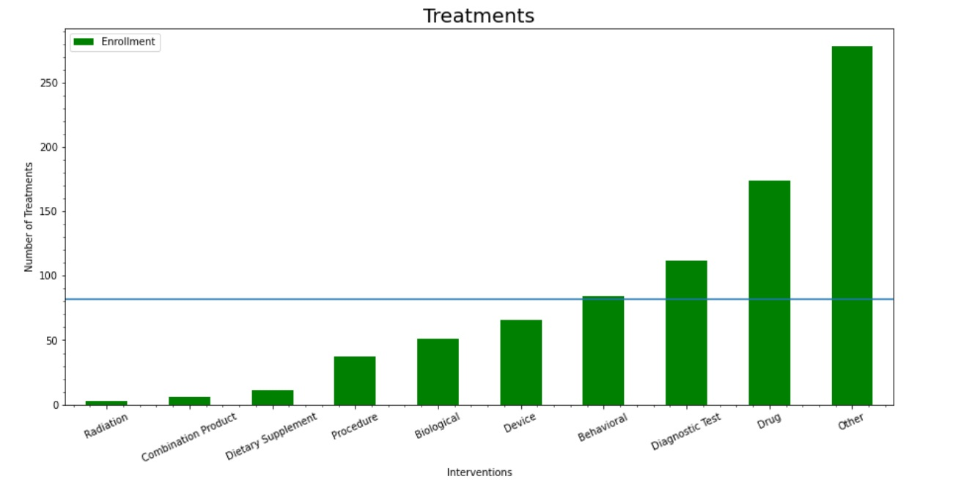
2. Enrollment statistics
1. Behavioral, Diagnostic Test, Drug, and Other are the number of Treatments that are overrepresented in the study
2. Average line shows the number of treatments that fall below, near, and over the average number of treatments

