Slide 1
NKONGE SHEILA MWENDE C025-01-0600/2020 BACHELOR OF SCIENCE IN INFORMATION TECHNOLOGY FINAL PROJECT: PERFOMANCE EVALUATION SYSTEM FOR THE TEACHING STAFF AT DEDAN KIMATHI UNIVERSITY, NYERI

Slide 2
PROBLEM STATEMENT
Current performance evaluation system at Imperial College is time-consuming, reducing productivity.
Manual rating by HR for numerous trainers leads to errors and inconsistencies.
Lack of concrete measures like specific number ranges for performance quantification leads to subjectivity.
Absence of set standards, such as syllabus coverage or student feedback, complicates evaluations.
Need for a more efficient, objective, and standardized performance evaluation system is evident.
Addressing these issues will enhance accuracy, fairness, employee satisfaction, and morale.

Slide 3
OBJECTIVES
Main objective
To develop a performance evaluation system for the teaching staff of Imperial Medical College.
Specific objectives
To register the trainers and supervisors and their roles
To allow the supervisor evaluate the trainers
To allow trainers fill their performance evaluation
To generate reports of teaching staff performance
To visualize the trainers’ performance trends using charts and graphs.

Slide 4
DATA COLLECTION (Interview Questions)
The following were some of the questions used:
Give an overview on how the evaluation is conducted
Your role in the evaluation process
How are peer evaluations integrated into the evaluation process
In what format is the evaluation report generated
How often are the evaluations conducted
The metrics used to evaluate the teachers

Slide 5
DATA ANALYSIS
The evaluation of teacher performance within the IT Department at Dedan Kimathi University is conducted through a comprehensive process, considering criteria such as teaching effectiveness, student feedback, and professional development.
Regular evaluations are conducted to provide timely feedback, with a focus on supporting teachers in their continuous improvement efforts.
Student feedback and course evaluations play a significant role in assessing teaching effectiveness and guiding improvement strategies.
The department emphasizes professional development and provides support through mentorship programs and access to resources.
Challenges include maintaining fairness in evaluations and addressing diverse teaching styles, which are mitigated through ongoing training and targeted support.
The department remains committed to adapting and evolving the evaluation system to align with changing educational priorities and advancements in pedagogy and technology.

Slide 6
SYSTEM ANALYSIS AND DESIGN 1. System Architecture and Flow
System architecture serves as the blueprint for a software system, outlining its composition and functionality, akin to how a structural architect designs a building.
It involves analyzing requirements, selecting appropriate components, and guiding problem-solving throughout the project's execution cycle.
Exposure to diverse tools and technologies equips individuals with the ability to make informed decisions and tackle technical challenges effectively.
Use case diagrams illustrate relationships between actors (users) and use cases (system functions) within the Performance Evaluation System.
Entity Relationship Diagrams (ERDs) depict the relationships between entities in the system, facilitating a clear understanding of data organization.
Class diagrams offer a visual representation of the classes and their relationships within the system, aiding in the design and development process.

Slide 7
Testing And Implementation
User Interface

Slide 8
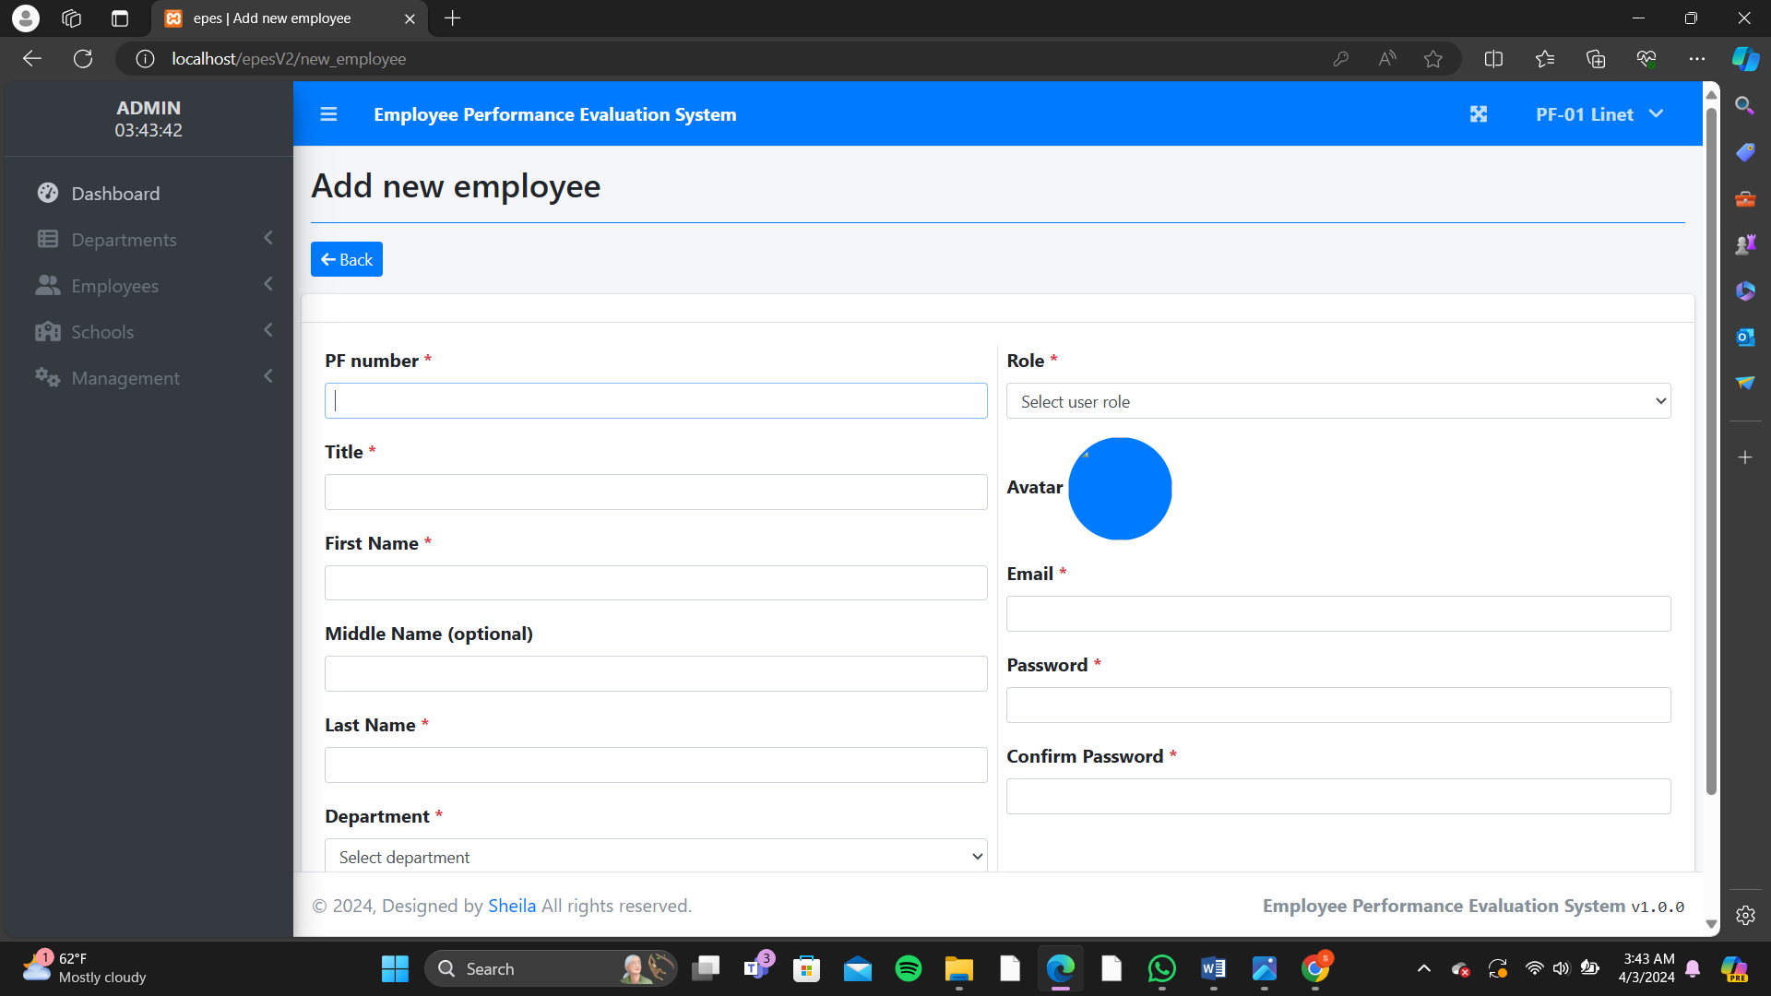
New Employee Page

Slide 9
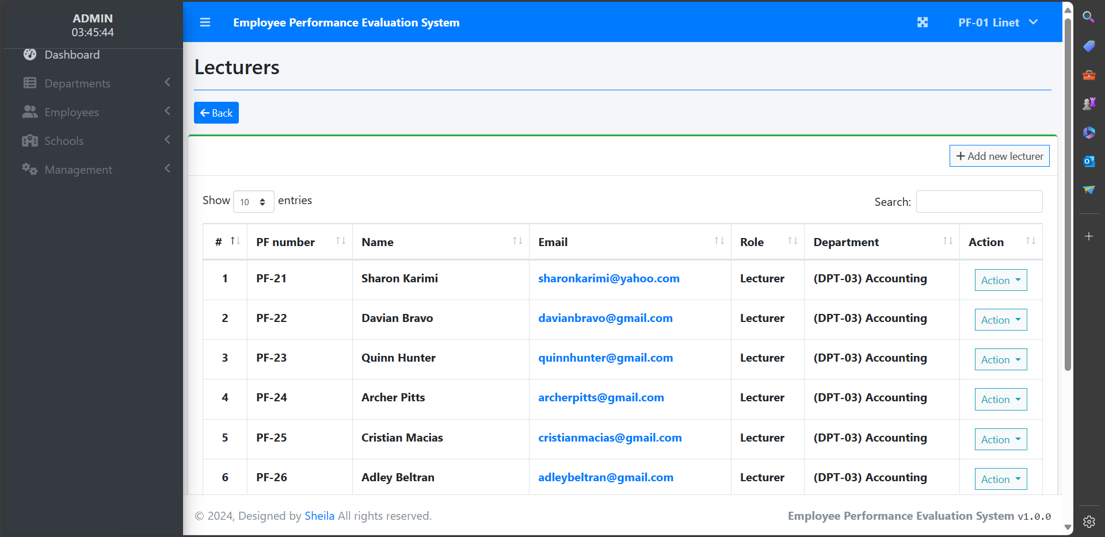
Lecturers Page

Slide 10

CODs Page

Slide 11
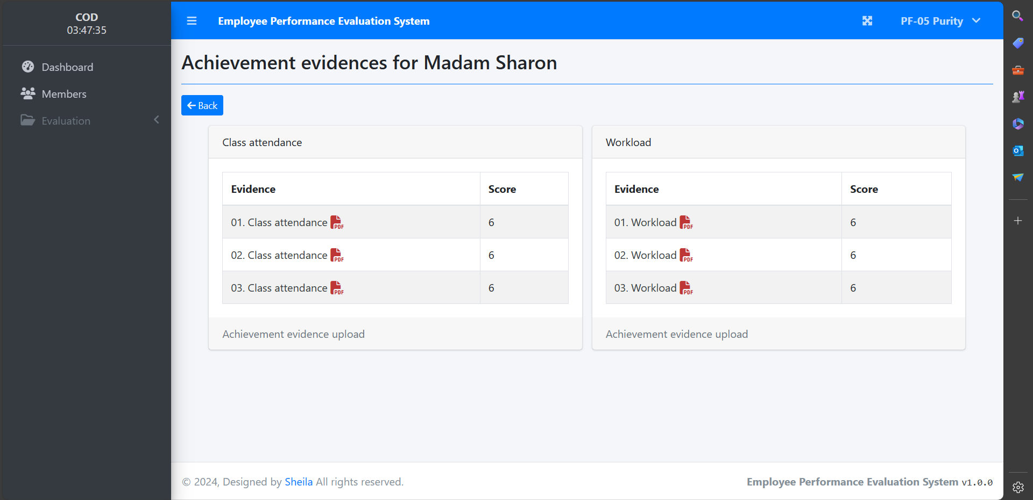
Evaluation Page

Slide 12
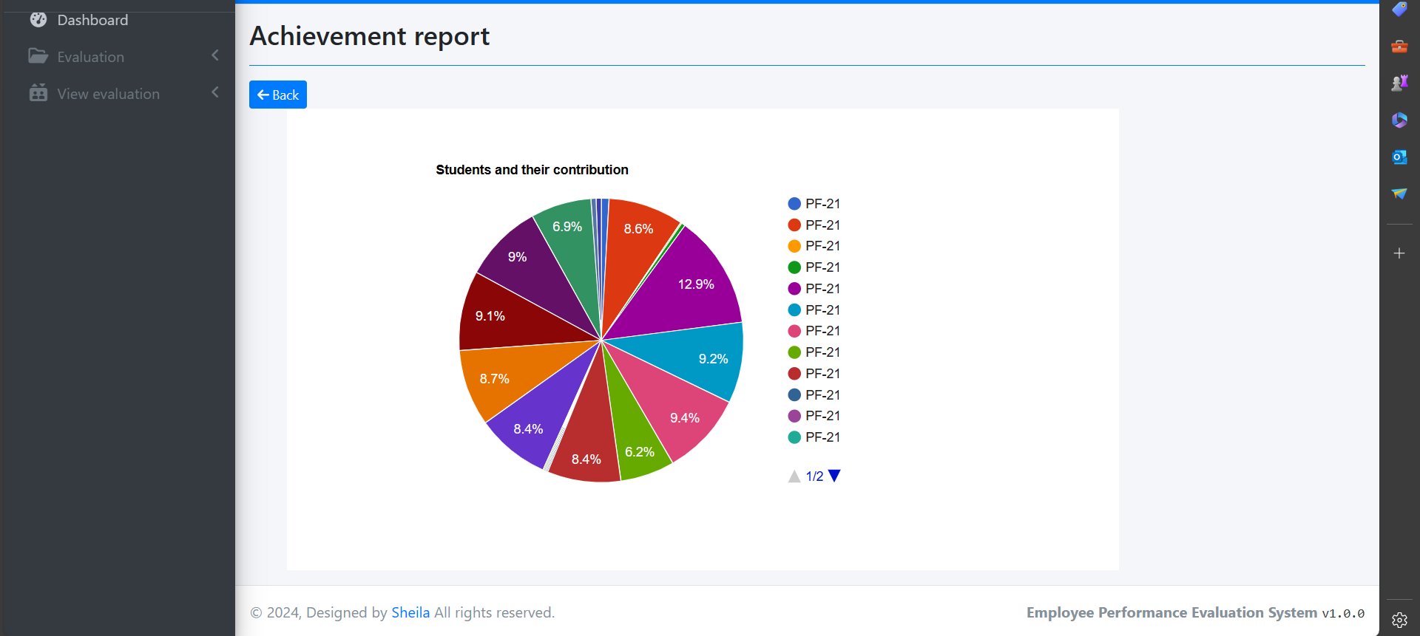
Evaluation Report Page

Slide 13
THANK YOU!

