Slide 1

Total Quality Management: Five Driver
Eng & Tech Driver
(Kylin 2.0 + DDDW + FA Capability)
System Driver
(Standard + Management + Execution)
Intelligence Driver
(Transformation + Empower)
Org & Talent Driver
(Organization + Talent)
Culture Driver
(D.S.B.P. + Mindset & Behavior + Quality Awareness)
1

Slide 2







Eng & Tech Driver: Kylin 2.0 Framework
Input
Eng & Tech Driver
Key Focusing
AI PC
NTI
SMT Process Capability
Tooling Technology & IoT
Intelligent Process
Mechanical interaction
Excellent Product Quality
Extremely User & Customer Experience
NxS
(技术前瞻研究)
Kylin-P: Product Design & Qualification
Kylin-C: Finish-Goods/Parts Design/Process Capability & Standard
QDTP
(质量设计即通过)
Kylin-M: Process Capability& Standard
KPCS
(关键制程能力研究)
Kylin-S: Deepen SVR Quality Eng & Tech
PCSS
(制程标准化)
Kylin-I: Extend IDSG Quality Eng & Tech
2025 LCFC Internal. All rights reserved.

Slide 3




Eng & Tech Driver: Drill Deep Drill Wide
Summary: Practice Drill Deep Drill Wide to key initiative of support engineering & Technical Driver implementation.
Mechanism & Integration
Decision Support
Capability Enhancement
Culture & Concentric Force
Continuous Daily Warroom
Enhance Quality Roll Call
Quick Response (2/4/8/24/48)
Promote Standardization
Deepen PRISM Fupan
Expand Technical Sharing
Practice Eng & Tech Orientation
Enhance E2E Integration
3

Slide 4






Eng & Tech Driver: FA Capability Enhancement
Enhance FA Capability
Key Objective
Shorten EWG/IFIR FA Lead-time
Capability Enhancement
FA Room Expansion
AI Application
Enhance EWG/IFIR FA Accuracy Rate
Enhance Professional Skill
Develop Multi-skill FAE
Technical Sharing
Increase Space
Deploy Equipment & Fixture
Optimize FA Tree
Upgrade AI Analysis Model
4

Slide 5
System Driver: Quality System Maturity Enhancement
Continuously upgrade and iterate Total Quality Management System
to Ensure the realization of Superior Quality Competitiveness and Customer Satisfaction
Quality Standard System
(Product + Benchmark)
Quality Management System
(Capability + Leading)
Quality Execution System
(Spot + Robust)
System Project Management
System Iterate Innovation
Digital Intelligence
System Map
Total Involvement
5
Notes:
标准体系 管理体系 执行体系

Slide 6
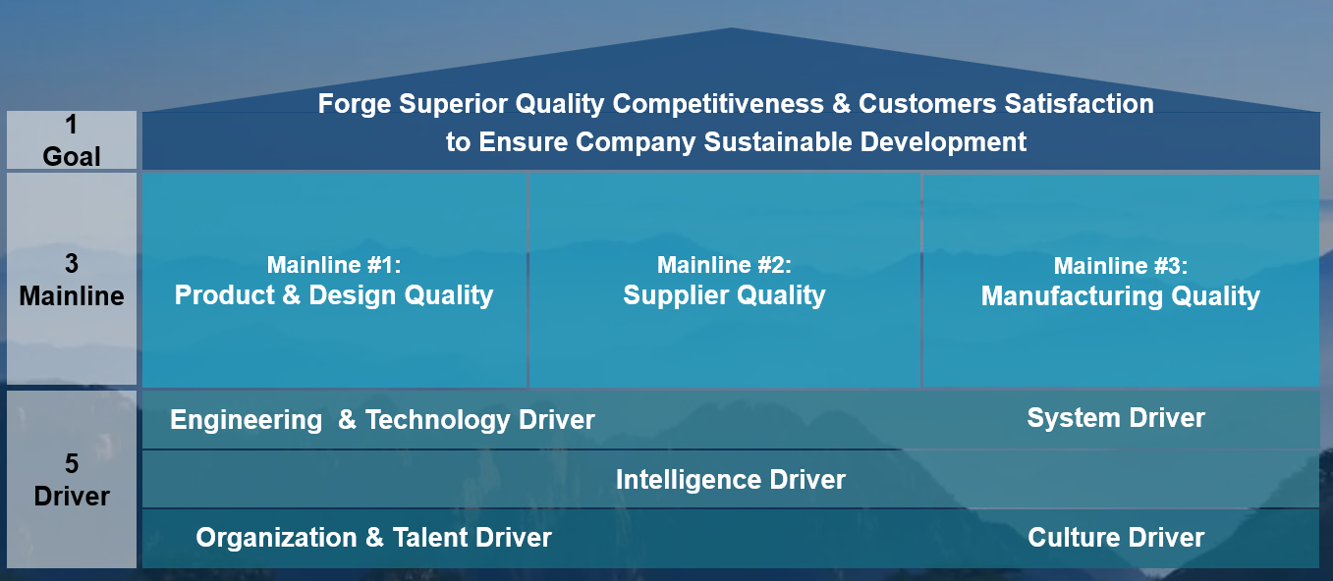
Intelligence Driver: Intelligent Transformation
Intelligence Transformation
Core Value/Objective
Org & Talent Transformation
Phase 1(FY23 1H~2H)
1. Mindset & Knowledge Changing:
Developed 11 course
Organized 22 training
2. Enhance Skill:
PBI visibility training
Involved 50%+ IDL
Phase 2(FY24 1H~2H)
1. Mindset & Knowledge Changing:
Developed 13 AI course
Organized 25 training
2. Enhance Skill:
PBI Advanced Training
Involved 95%+ IDL
Phase 3(FY25~FY26)
1. Data Analysis Expert (5%+IDL)
2. Framework/AI/Automation SME
3. Aid Supplier Quality University
Digital System
Landing
Phase 1(FY23 1H~2H)
1. Synergy with LNV for One QES
2. Integrate PQM/CQM Cloud
3. Unify Portal
4. Build Process Map & Biz. Center
5. Develop Data Center
6. Propel PBI Data Mining
Phase 2(FY24~FY25)
1. Deepen QES 1.0 application
2. Get through LNV&LCFC System
3. Build Knowledge Center
Phase 3(FY25~FY26)
1. Capital Scenarized
2. Scenario Intelligent
3. AI Application (Qua-pilot)
Intelligence Eco-system Empower
Phase 1(FY23 1H~2H)
1.Lift Automation(PA,Supplier, MFG)
2.Data Visibility Analysis
Phase 2 (FY24 2H~FY25)
1.Build Automation Benchmark
2.Data Advanced Analysis & Mining
3.Knowledge Large Model App.
Phase 3(FY25~FY26)
1.Eco-System Intelligent
2.Intelligence Empower (1/3/5 Plan)
3.QaaS (Quality as a Service)
TQM Long-term Framework
6

Slide 7
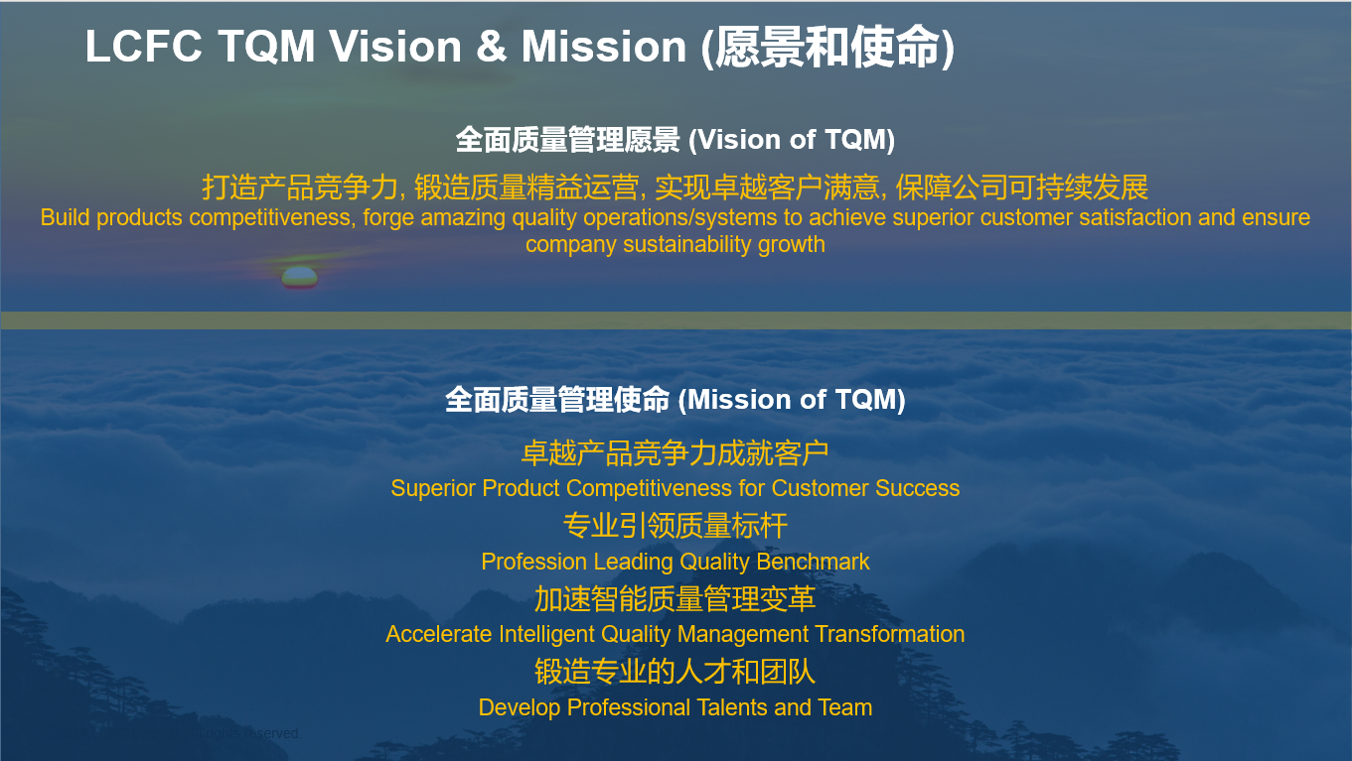
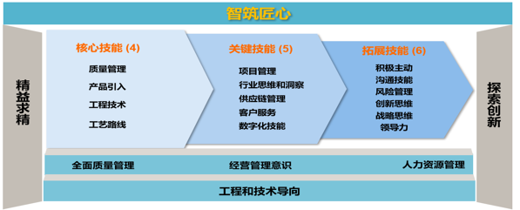
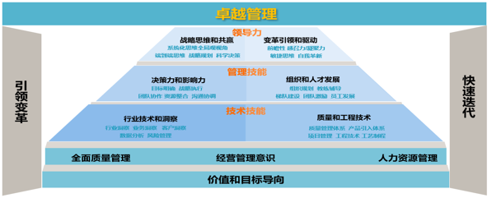
Org & Talent Driver: Eng & Leader Capability Matrix
Engineer Capability Matrix
Vision
Mission
TQM Long-term Framework
Leader Capability Matrix
Strategy
7

