Slide 1



WFB (Win First Battle) process
PQM: Tim Luo
V1.2
2023/12/20

Slide 2
Document Ownership & Control
File No.: |  |  | Version Number: Rev 1.0 |  | Version Number: Rev1.1
Process File Name: WFB (Win First Battle) process |  |  | Owner: |  | Owner | Tim.Luo
 |  |  | Owner’s e-mail Address: |  | Owner’s e-mail Address | luowei9@lenovo.com
 |  |  | Owner’s City, Country: |  | Owner’s City, Country | Shanghai. China
 |  |  | Reviewed By: |  | Reviewed By | Andrew.Liu
Date of Issue: | 2021/06/01 |  | Approved By: |  | Approved By: | Jason. Chen
SIGNATURE | Co-Reviewer:
 | Co-Review Dept.:
 | Date:

Slide 3
Revision Table
Version | Revision Date | Summary of Changes | Revised by | Reviewer
1.0 | 2021/06/01 | Initial Version Release | Tim. Luo | Andrew. Liu
1.1 | 2021/11/15 | Add WFB monthly dashboard | Tim. Luo | Andrew. Liu
1.2 | 2023/12/20 | Add WFB product PSI & JD positive Rate target and WFB required quantity | Tim. Luo | Andrew. Liu
Note:
Version 1.0 or higher are approved for general use
Version X._ contains major changes
Version _.Y contains minor changes

Slide 4
Table of Contents
A .Appendix (WFB requirement matrix )
B. Appendix(WFB readiness check list)
C. Appendix(MFG special control plan)
D. Appendix(WFB UEFAI Finding tracking list)
E. Appendix(WFB MFG Special Control execution )
F. Appendix (WFB monthly dashboard)
Document Ownership and Control
1. Purpose and Scope
2. Terms & Definitions
3. Roles & Responsibilities
4. WFB process build up

Slide 5
Purpose and Scope
Purpose
Aligned with Lenovo BU, GSC and Quality strategy to reinforce system level quality control at the beginning of product launch, in order to achieve the better quality, the better customer experience, the better customer satisfaction and better support business.
Quality team raise request of enhanced product quality control plan earlier, especially for key parts better quality delivery, enhance MFG quality management, more strict cosmetic inspection etc., make product launch with best quality and win the market share.
Scope
Lenovo consumer NB products

Slide 6
WFB Team Member List and Roles & Responsibilities
Area | Function | Responsibility | Remark
Product Quality | PQM | Lead WFB project and Build up WFB team (Both Lenovo & ODM team); Organize WFB team to work out WFB plan and review WFB readiness & execution; Product issue owner; NUDD owner, SS owner, TTQ owner, SGA & EWG owner ; Output WFB report ; Maintain WFB process;
MFG Quality | MQM | MFG issue owner; Plant readiness & management owner;
Supplier Quality | SQM | Parts quality readiness owner; and Parts issue owner;
Development | PA &TPM | Management for the new product design quality assurance risk; Technical issue and design test data owner;
Development | NPI | Product schedule management ,NPI sample owner;
Global Engineer | WWTE&WWME | Plant process review (SOP, Assy, Packing, Fixture review) owner; Plant testing process review , test program readiness review owner;
Service | Service & CQE | Management for new product quality risk in filed and service process; VOC (field performance) feedback;
MKT & Ops | PM & OTM | Product position and Market information sharing; Product overall management;
MFG | ODM/In-house team | New product MFG quality delivery overall owner; WFB data collection;

Slide 7
Abbreviation
WFB: Win first battle.
TTQ: Time to quality.
QMP: Quality management plan
NUDD: New-Unique-Difficulty-Different.
LL: Lesson learn
SS: Ship support
Big data/VOC: Voice of Customer collected from field.
PSI: Product Sentiment Index
EWG: Early Warning Group

Slide 8
WFB process build up
Kick
Off
Readiness Check
GO
PKO
RFQ
BC
SIT
SVT
SOVP
SS
Ideate
Identify WFB product & top focus
Define SPEC clearly
MFG requirement, ensure WFB resource
Build WFB team, work out WFB plan
Review WFB readiness
Cross function team(manager+) on-site UE FAI /CXS
WFB MFG control plan execution
WFB warroom and report release
WFB LL & FuPan
 | PKO & RFQ | SIT | SVT | SOVP | SGA | MP
Key Activity | Align portfolio & priority w/ Geo Identify top focus Define spec in RFQ | Lenovo & ODM WFB KO Taskforce set up Special control for material/MFG process Cosmetic alignment NEW Feature readiness check | WFB readiness check Identified solution trial run & performance tracking Manager+ level & key team Onsite UE FAI/CXS | WFB execution WFB Warroom Key limitation /deviation align with Geo (PM/Service) | WFB execution WFB Warroom EWG & PSI & VOC close loop management | WFB FuPan
Delivery | Keyparts SPEC Issue PCR & New PN for specific parts RFQ package Action plan | WFB taskforce member list WFB readiness check list Cosmetic spec (system &parts ) | WFB readiness check list Strict cosmetic spec | WFB MFG control report | WFB MFG control report | LL & Fupan report Monthly dashboard

Slide 9
BACK UP

Slide 10
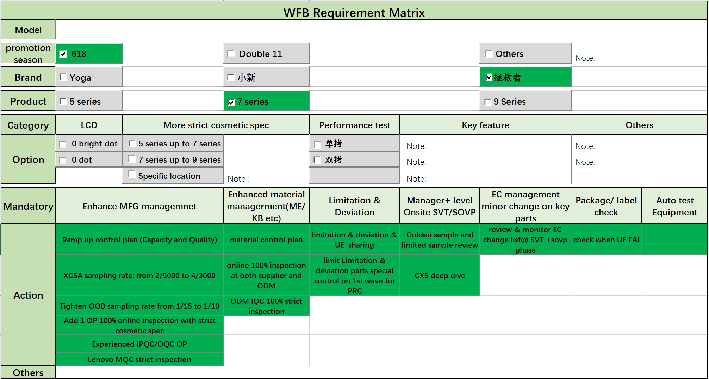
Identify WFB product & top focus
Check the WFB requirement with cross function team(PM&PRC geo team),WFB requirement matrix template as below:

Slide 11
ODM promotion season special control plan for WFB product
Product Scope: WFB products;(PRC Premium products; Promotion products;)
WFB coverage: ① Shipments in First month after SS ; ② Promotion orders
WFB Required Quantity: First wave orders, and no less than 10K.
WFB PSI Target : ( Remark: Lenovo will fine tune the WFB target for continuous improvement, please follow formal released KPI version for latest one.)
6-week PSI for X90 product (base:8.5; stretch:8.8)
JD VOC for X90 product (base: 97%; stretch: 98%）
5. Special Control Point as below:
①
②
③
④
⑤
 | Material Enhancement | Test Coverage Enhancement | OOB/XCSA Enhancement | Method | MQC support
Control Point | 1. ME parts 100% sorting cosmetic before online. 2. K/B 100% check cosmetic and key cap drop & interference issue. 3. LCD 100% check function. | 1. LCD RGB 200% inspection. 2. After ramp up, R/I time increase to 2.5H to dynamic adjust test items base on previous R/I data. 3. 200% online check cosmetic inspection before packing | 1. Tighten OOB sampling rate from 1/15 to 1/10. 2. XCSA sampling rate: 2/5000→4/3000 3. K/B key cap interference special inspection for long keys 4. CXS test in first week, all issues close before shipping. | 1. Special order control process, ensure every order follow this control plan 2. Line Speed Control: normal line speed + 5s for first 1K, reduce line speed base on performance, need keep 20% line speed increasing at least 3. Release quality notice including all CTQ items, L&L and key issue list. 4. Take pictures for all SOVP units each surface; Packing AOI pictures save 3months at least. 5. Set up KPI dashboard daily review | 1. MQC inspect cosmetic for SOVP 50 units in total 400 units, reject rushlike: 0 accept, 1 reject. 2. Tighten sampling rate on promotion products, 40pcs/model/shift(normal 20pcs/model/shift). 3. MQC follow tightened audit checklist to daily audit.

Slide 12
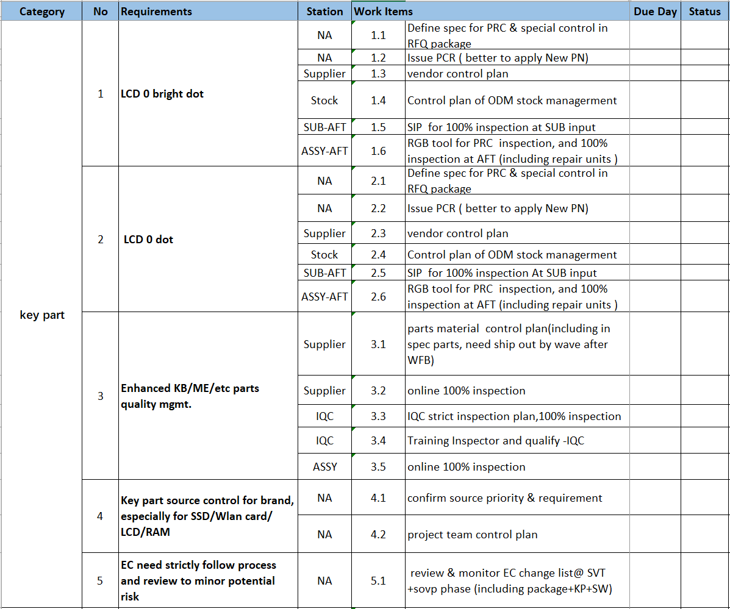
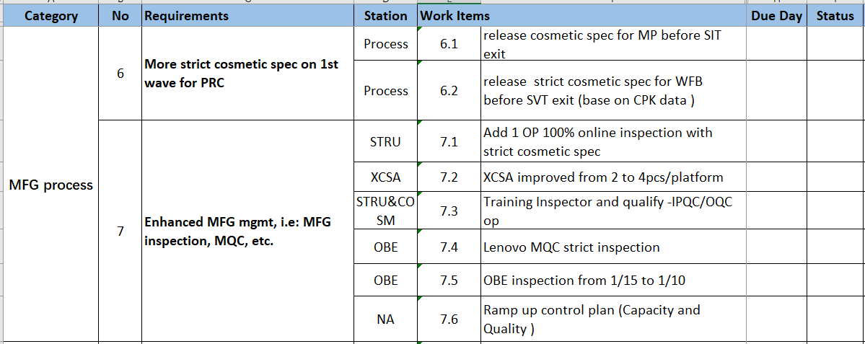
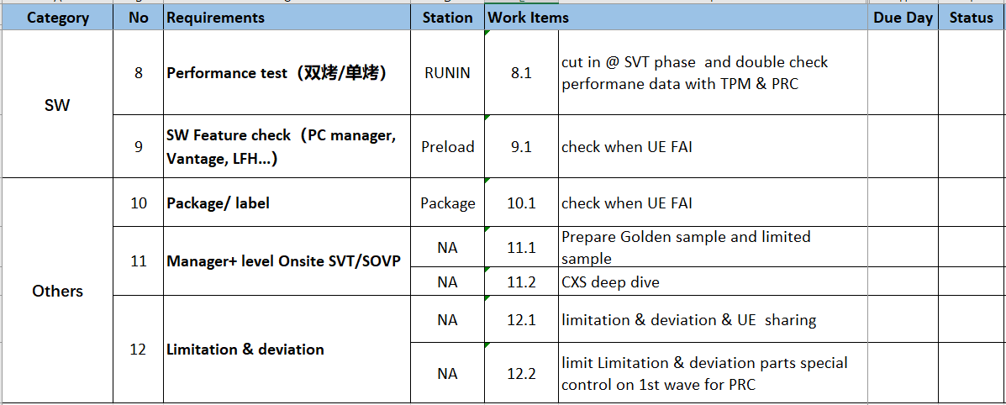
WFB requirement readiness check list
Based on the WFB requirement and track readiness follow the check list, check list template as below:

Slide 13
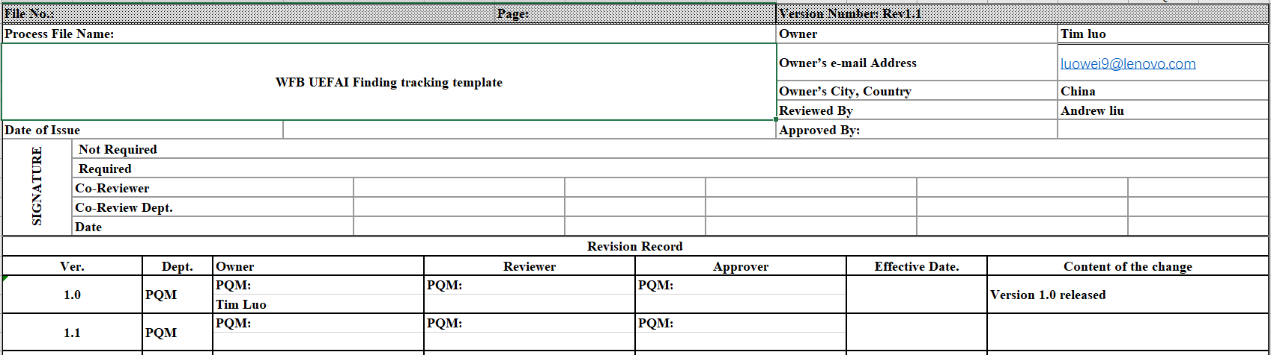
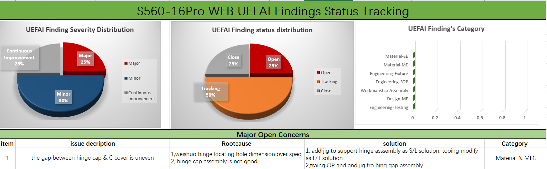
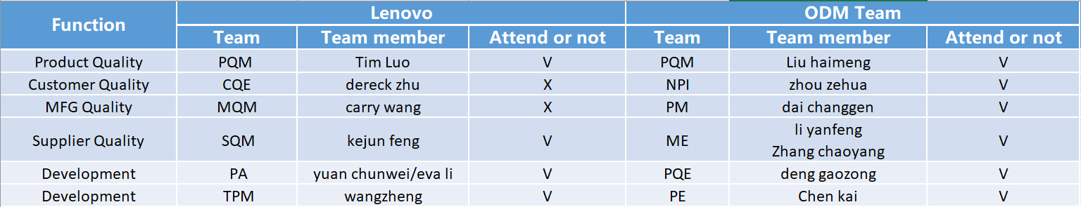
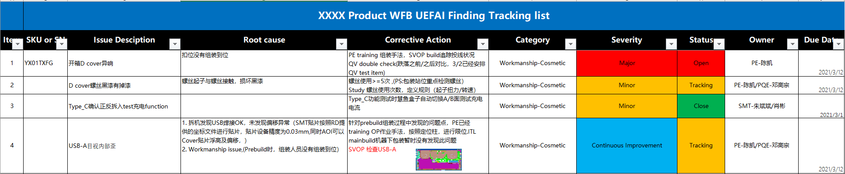
WFB product UEFAI Finding tracking list
Perform UEFAI check after SVT build, and record and track all the findings, template as below for reference.
Cover page:
UEFAI Finding dashboard :
Team member list :
UEFAI finding list :

Slide 14
WFB MFG Special Control execution & Warroom Mechanism
Key Input
Detailed Description
BMS
Output
New line/shift ramp up plan(7 days)
Normal NPI ramp up plan
WFB Warroom Meeting
MFG Input plan
Meeting frequency: according to input plan
Attendee:
Lenovo: PQM,MQM,NPI,SQM,RD, service
ODM: Quality, MFG, engineering, NPI, RD
Purpose:
Put together all information, invite all stakeholders for both MFG and field issues quick clarification and solving
Issue close loop management & tracking
Key parts sorting performance tracking(K/B, ME and panel)
MFG enhanced control plan(cosmetic, OOB, MQC audit &OOB)
Keypart &MFG control plan
WFB Warroom report
KPI trend chart
Key issue tracking
Corrective action follow up
NPI key issue tracking
Tracking plan for NPI key issue
New feature and LL case
Field feedback
EWG
PSI

Slide 15
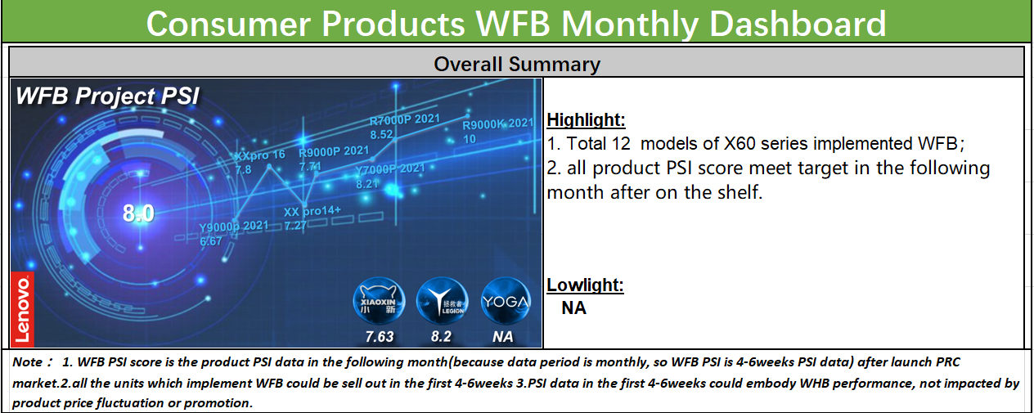
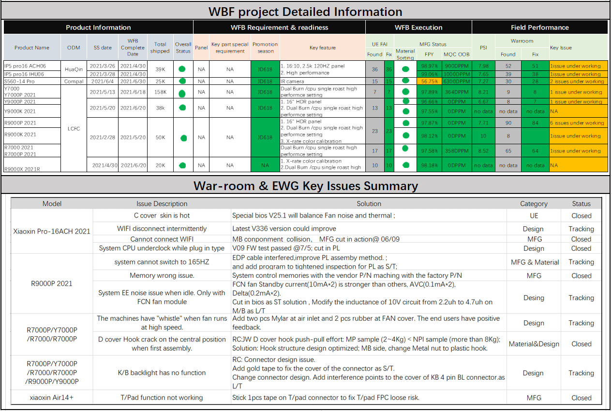
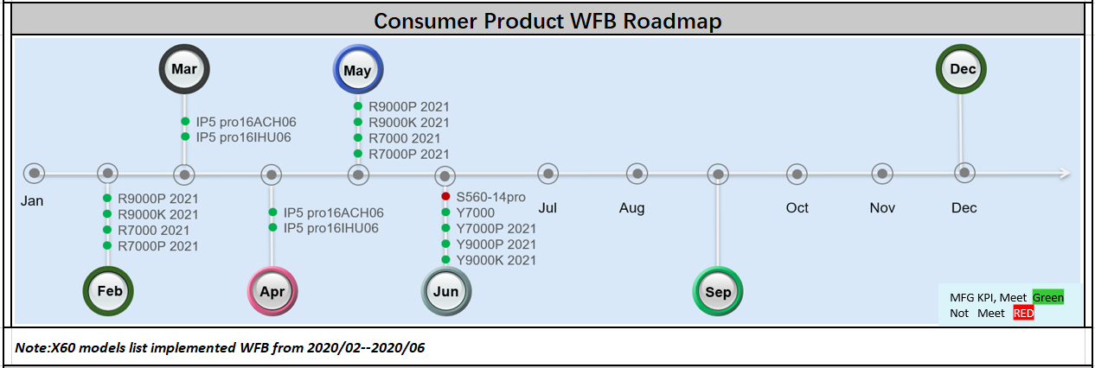
WFB PSI target definition and monthly dashboard
WFB Monthly dashboard will show all the consumer products WFB execution status and its field performance after launch market.
WFB PSI target definition formula will base on WFB PSI score:
WFB PSI score is the product PSI data in the following month(because data period is monthly, so WFB PSI is 6weeks PSI data) after launch PRC market.
all the units which implement WFB could be sell out in the first 4-6weeks
PSI data in the first 6weeks could embody WHB performance, not impacted by product price fluctuation or promotion.
Below is X60 product for reference:

