Slide 1
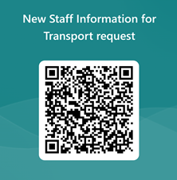
1️⃣ Staff Request Submission (Kobo Form)
Every staff has access to the Kobo Transport Request Form.
They fill in trip details (date, destination, time, purpose)
2️⃣ Data Received by Transport Team
Transport colleagues receive all daily requests automatically in a excel sheet.
Requests are reviewed at the end of the day.
3️⃣ Vehicle Assignment
Based on routes, availability & priority, vehicles are assigned.
Drivers are notified, and next-day plan is finalized.
New Staff Registration (MS Form)
New colleagues fill MS Form to be added to the transport system.
Once approved, they get access to the Kobo request form.
Key Benefits: ✅ Streamlined process
✅ Time-saving
✅ Easy for all staff

