Slide 1


MDSSB-DSAI-01 Digital Transformation and Innovation
Fall 2026
Project Proposals
Stefano Pinto – Data Scientist @ BlinkBase

Slide 2

Blumenthal
Vegesack
Burglesum
Blockland
Gröpelingen
Borgfeld
Seehausen
Walle
Horn-Lehe
Findorff
Oberneuland
Strom
Woltmershausen
Schwachhausen
Mitte
Vahr
Östliche Vorstadt
Neustadt
Osterholz
Huchting
Obervieland
Hemelingen
Stuhr

Slide 3
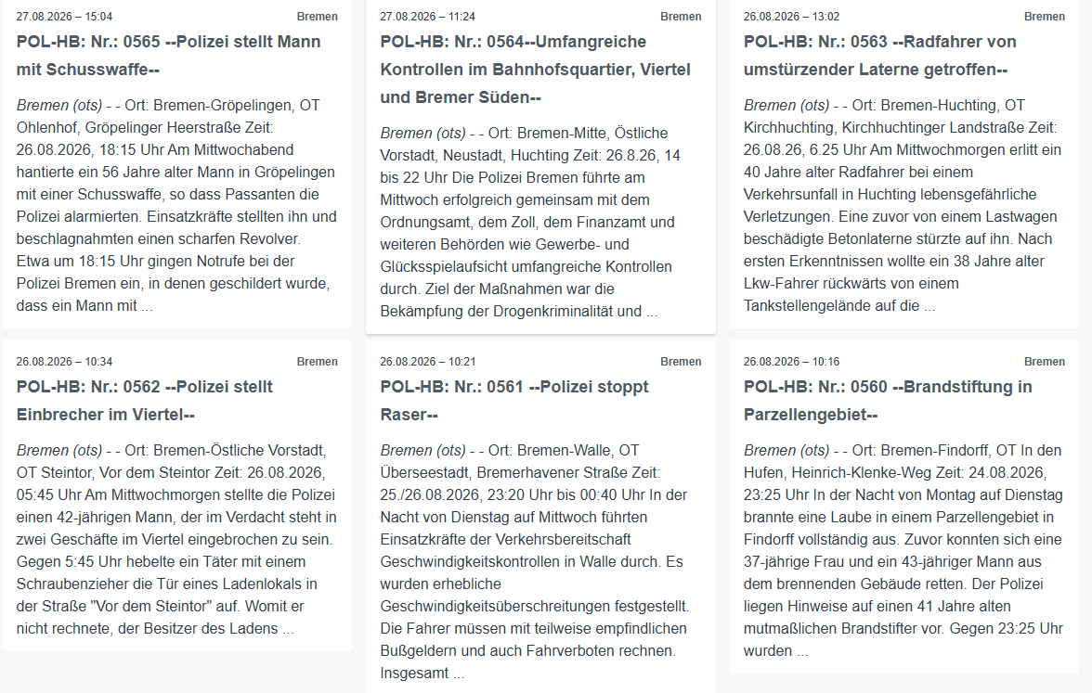
Bremen Press Portal releases daily crime reports, but …
No API
Information scattered
No search function
German only lol.
https://www.presseportal.de/blaulicht/nr/35235
1
2

Slide 4
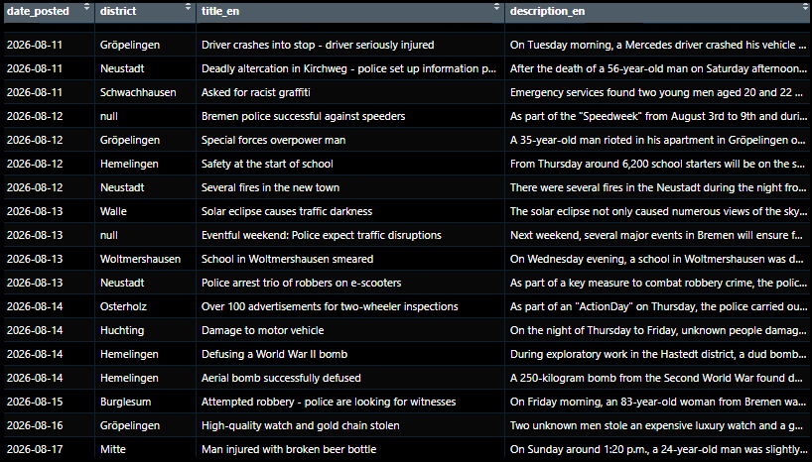
~ 5000 crime reports (2019 – 2026) webscraped and turned into a PostgreSQL Database
Including:
Post date
Translated title
Translated description
City district
Embeddings (768)
1
2

Slide 5
Bremen Police Reports Project 1: Agentic AI Chatbot
You’re data engineers for a Bremen newspaper. Journalists need to investigate local crime trends but don’t know SQL.
Your mission: build an AI agent that translates plain-text questions (e.g., “Are bike thefts rising in Neustadt?”), queries the police database, and writes an accurate investigative summary."
1

Slide 6
Bremen Police Reports Project 1: Agentic AI Chatbot
Build a Chatbot which is able to answer questions about crimes in Bremen
You need to build an Agentic RAG (Retrieval Augmented Generation) Application incorporating the crime data base
Answer the questions on slide 11
Put your code on GitHub and invite me (Stefanopinto@hotmail.de)
Bonus Points for a simple user interface
Suggested Programming Language / Frameworks:
Python 3.12 +
  Pandas or Polars (data wrangling)
  Psycopg2 (DB querying)
  Langchain (Agent)
  Gradio (Interface)
1

Slide 7
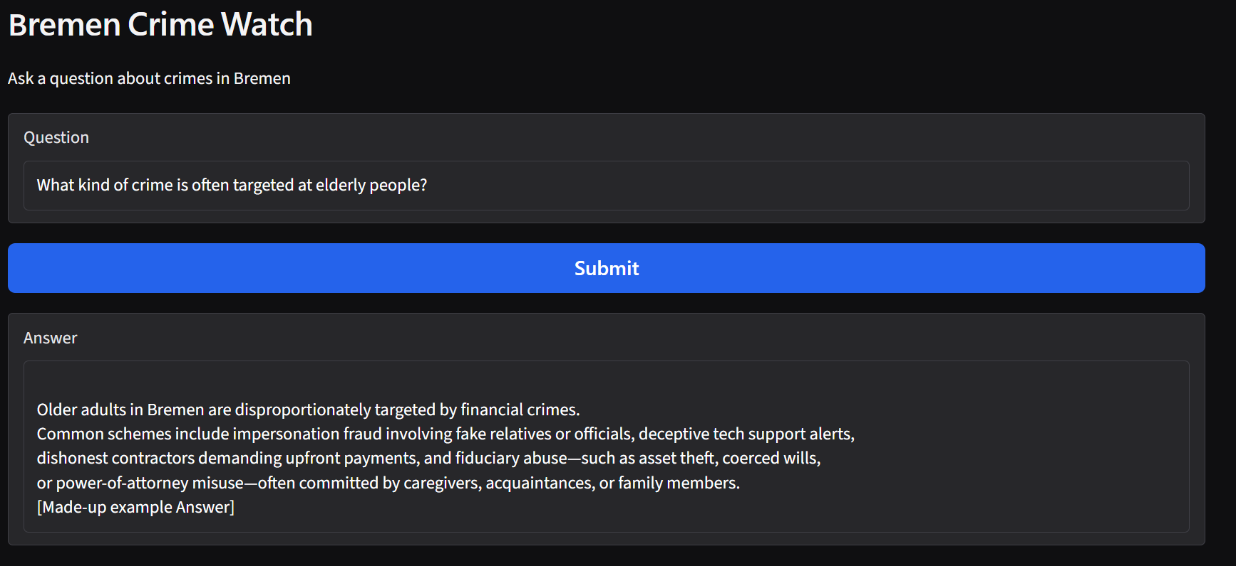
Bremen Police Reports Project 1: Agentic AI Chatbot
EXAMPLE RESULT
(Made up)
1
7

Slide 8
Bremen Police Reports Project 2: Data Analytics
You are crime analysts for the Bremen Police strategic planning division.
Your mission: turn raw incident logs into
actionable intelligence using tools from data science. Uncover seasonal spikes, map district hotspots, and identify threats to vulnerable populations so leadership can effectively deploy patrols."
2

Slide 9
Bremen Police Reports Project 2: Data Analytics
Use methods and tools from data science in order to analyze crimes in Bremen
You need to get familiar with a range of methods from data manipulation, statistics, time series analysis and natural language processing
Answer the questions on slide 11
Put your code on GitHub and invite me (Stefanopinto@hotmail.de)
Bonus Points for a simple dashboard (static or interactive)
Suggested Programming Language / Frameworks:
Python 3.12 +
  Pandas or Polars (data wrangling)
  Psycopg2 (DB querying)
  Bertopic / scikit-learn (topic modeling)
  Streamlit (dashboard)
2

Slide 10
Bremen Police Reports Project 2: Data Analytics
EXAMPLE RESULT
(Made up)
Traffic
Robbery
Drug-related
Burglary
Assault
Gröpelingen
Hemelingen
Mitte
Neustadt
Walle
250
500
750
20
40
60
80
2

Slide 11
Questions to answer for both crime report projects
Categorize reports into distinct crime types (e.g., Theft, Vandalism) and map their district distribution.
How do specific crime frequencies change over time (date_posted) per district? Are there seasonal spikes?
Do specific crime types spike in certain districts during short timeframes (e.g., holidays)? What drives these anomalies?
Which district has the highest volume for each crime type, and how does crime composition vary citywide?
Which crime type most frequently targets the elderly, and in which district?
These two projects involves analyzing a dataset of real-world criminal case descriptions.
By the nature of this research, you will be required to work directly with explicit, uncensored, and sometimes graphical content
1
2

Slide 12
https://gtfs.de/de/realtime/ : Germany-wide real-time datastream about estimated start, departure and delay times of trains, trams, subways, buses, …
Filtered for trams and buses in Bremen from 2026-08-17 to 2026-08-31 in 5-minute intervals as .csv files
3

Slide 13
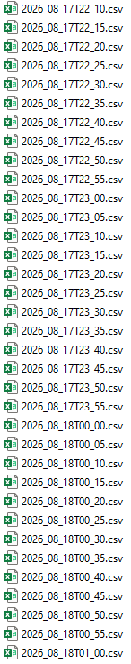
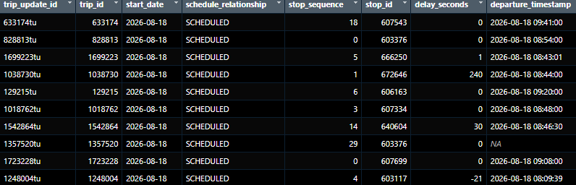
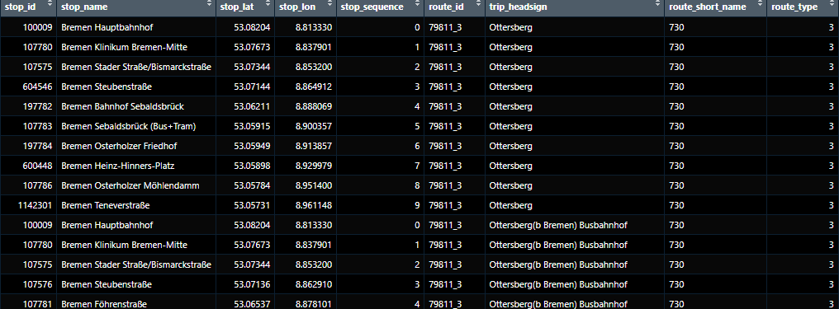
Transit Data (2026_08_18T10_30.csv)
Lookup Table
3

Slide 14
Project 3: Bremen Tram and Bus Transit Data
You are transit analysts for the BSAG (Bremen’s public transport network). Frustrated commuters demand answers for recurring bottlenecks.
Your mission: analyze route and delay data to pinpoint chronic problem stops, uncover root causes of transit slowdowns, and propose solutions to get Bremen moving on schedule.
3

Slide 15
Project 3: Bremen Tram and Bus Transit Data
Assemble the .csv files into one data set
Identify routes and stops for which there are often delays
Research the reasons for delays
Suggest improvements
Put your code on GitHub and invite me (Stefanopinto@hotmail.de)
Bonus Points for a simple dashboard (static or interactive)
3

Slide 16
Project 3: Bremen Tram and Bus Transit Data
EXAMPLE RESULT
(Made up)
53.12
Gröpelingen
Kap-Horn-Straße
Waterfront (Use Akschen)
Goosestraße
Grasberger Straße
Jadestraße
53.10
Emder Straße
Elisabethstraße
Waller Ring
Grenzstraße
Latitude
Haferkamp
Hansator
Daniel-von-Büren-Straße
Lloydstraße
Falkenstraße
Doventorsteinweg
Hauptbahnhof
53.08
Rembertistraße
Humboldtstraße
Am Dobben
Sielwall
Am Hulsberg
Bei den Drei Pfählen
Brunnenstraße
Bennigsenstraße
Malerstraße
St.-Jürgen-Straße
Ludwig-Quidde-Straße
Föhrenstraße
Bahnhof Sebaldsbrück
Trinidadstraße
53.06
Sebaldsbrück (Bus+Tram)
Schloßparkstraße
8.75
8.80
Longitude
8.85
8.90
3
Average delay
[s]
0
300
600
900
1200

Slide 17
Time Series data
What is a time series?
12
150
2
8
1
Something
0
100
4
-1
-2
0
50
-3
Jan '25
2050
Apr '25
Jul '25
2100
Oct '25
2150
Jan '26
2200
02:00
08:00
14:00
20:00
02:00
08:00
14:00
20:00
02:00
08:00
14:00
20:00
02:00
4

Slide 18

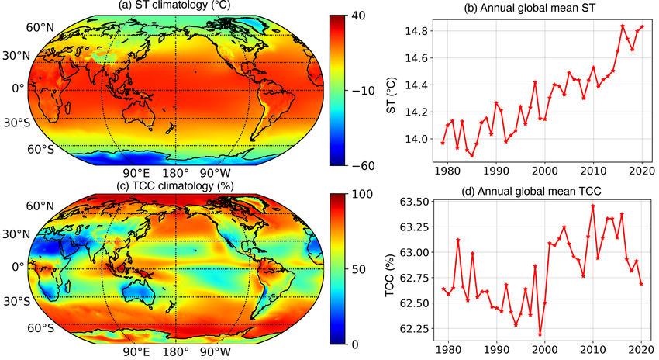

Time Series data
Typical areas?
Difference to „normal“ data?
4

Slide 19
Project 4: Time Series Forecasting with Machine Learning
You are supply chain data scientists for a top condiment brand. Empty shelves during grilling season cost millions.
Your mission: use machine learning to build a time-series forecasting model that accurately predicts barbecue sauce demand, ensuring warehouses are perfectly stocked without wasting excess inventory.
4

Slide 20
Project 4: Time Series Forecasting with Machine Learning
100,00
?
75,00
Something
25,00
4
Past
Future
20

Slide 21
Project 4: Time Series Forecasting with ML
Gold standard: Walk-forward validation
150
Tune
Tune
Tune
Tune
RMSE₃ = 9.41
Model
Something
Model
Model
RMSE₄ = 4.32
100
Model
RMSE₂ = 8.60
RMSE₁ = 10.7
50
2012
2013
2014
2015
2016
2017
2018
2019
2020
2021
Compare
Compare
Compare
Train
Test
4
Average RMSE: 8.25
Sub-train
Validate

Slide 22

RMSE = $\sqrt{\frac{Σ{\left(y_{i}−{\hat{y}}_{i}\right)}^{2}}{n}}$
Project 4: Time Series Forecasting with Machine Learning
Forecasting – Error quantification
40
30
Something
20
10
4
0
Apr 25
May 25
Jun 25
Jul 25

Slide 23
Project 4: Time Series Forecasting with Machine Learning
The data set: Daily Barbecue sauce sales (2021-01-03 to 2026-07-29)
4000
Bottles
2000
?
0
4
2022
2024
2026

Slide 24
Project 4: Time Series Forecasting with Machine Learning
Exogeneous features: Climate data
Temperature
Sun hours
30
20
15
10
10
Average temperature °C
Average daily sun hours
0
5
-10
0
2021
2023
2025
2026
2021
2023
2025
2026
Precipitation
90
Why might these data be good predictors for barbecue sauce sales?
60
Average precipitation (mm)
30
4
0
2021
2023
2025
2026

Slide 25
Project 4: Time Series Forecasting with Machine Learning
Options
Pre-processing
Normalization
Differentiation
Lags
Feature Engineering
Exogenous variables
…
Model types
Support Vector Machine
Random Forest
Gradient Boost (LGBM / xGBoost)
Recurrent Neural Network (RNN)
Long Short-Term Memory (LSTM)
…
Forecasting strategies
Recursive Forecasting
Direct Forecasting
Multivariate Forecasting
Expanding window
Sliding window
….
Model metrics
MAE
MSE
RMSE
MAE
MAPE
…
You do not have to re-invent the wheel. Python package recommendation: skforecast
(built on top of sklearn)
4

Slide 26
Project 4: Time Series Forecasting with Machine Learning
Forecast the 30-day sales amounts of the BBQ sauce data
Implement a complete forecasting workflow, including:
  Pre-processing
  Train-test splitting
  Feature engineering
  Hyperparameter tuning
  Feature selection (including exogenous climate features)
  Model validation
  Forecast
Suggested Programming Language / Frameworks:
Python 3.12 +
  Pandas or Polars (data wrangling)
  Skforecast (ML forecasting)
Put your code on GitHub and invite me (Stefanopinto@hotmail.de)
Bonus Points for a simple dashboard (static or interactive)
4

Slide 27
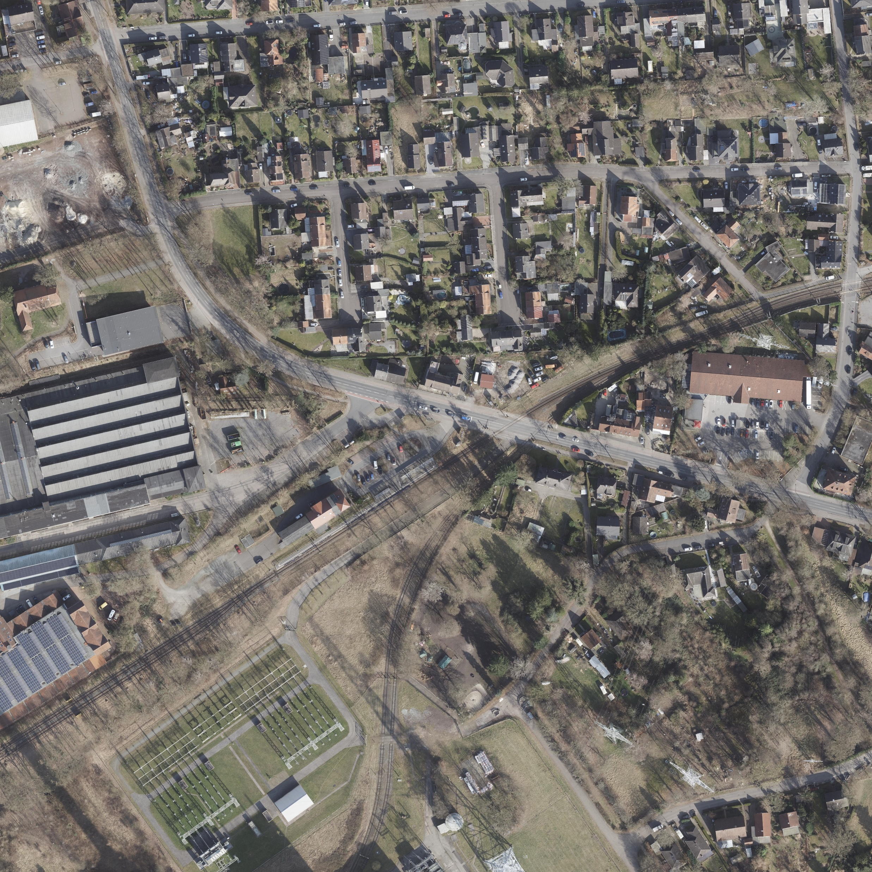
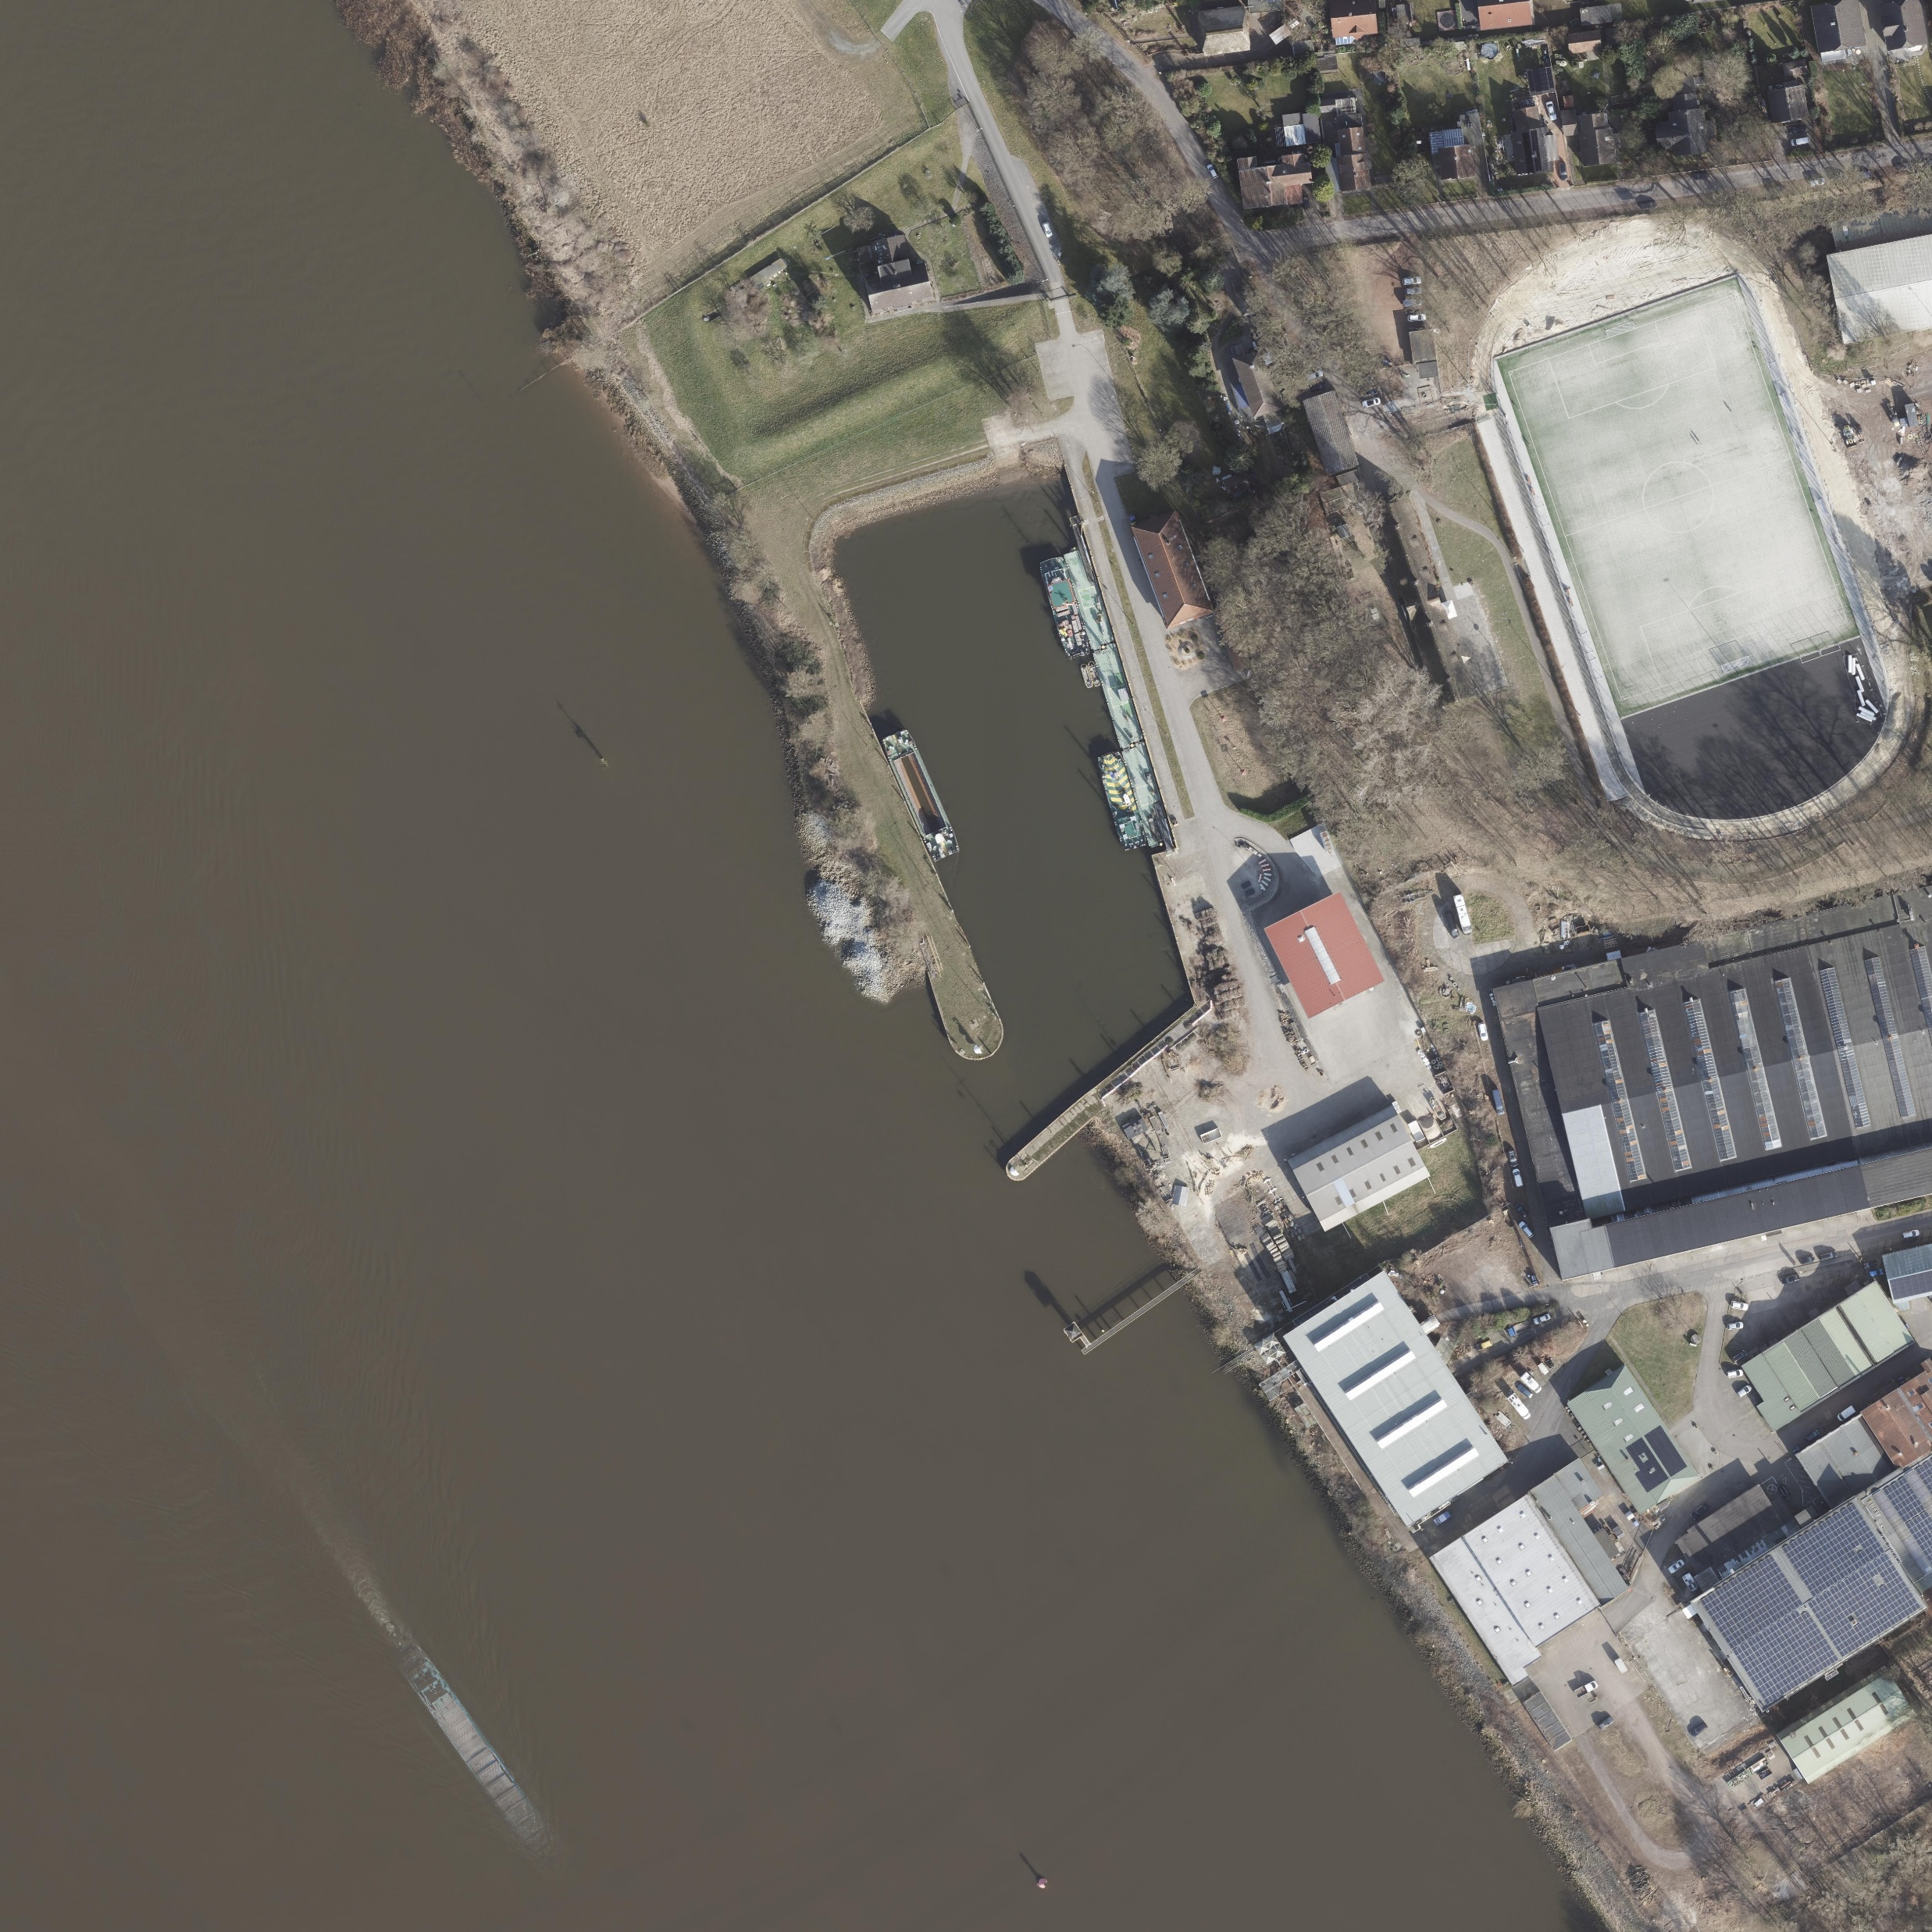
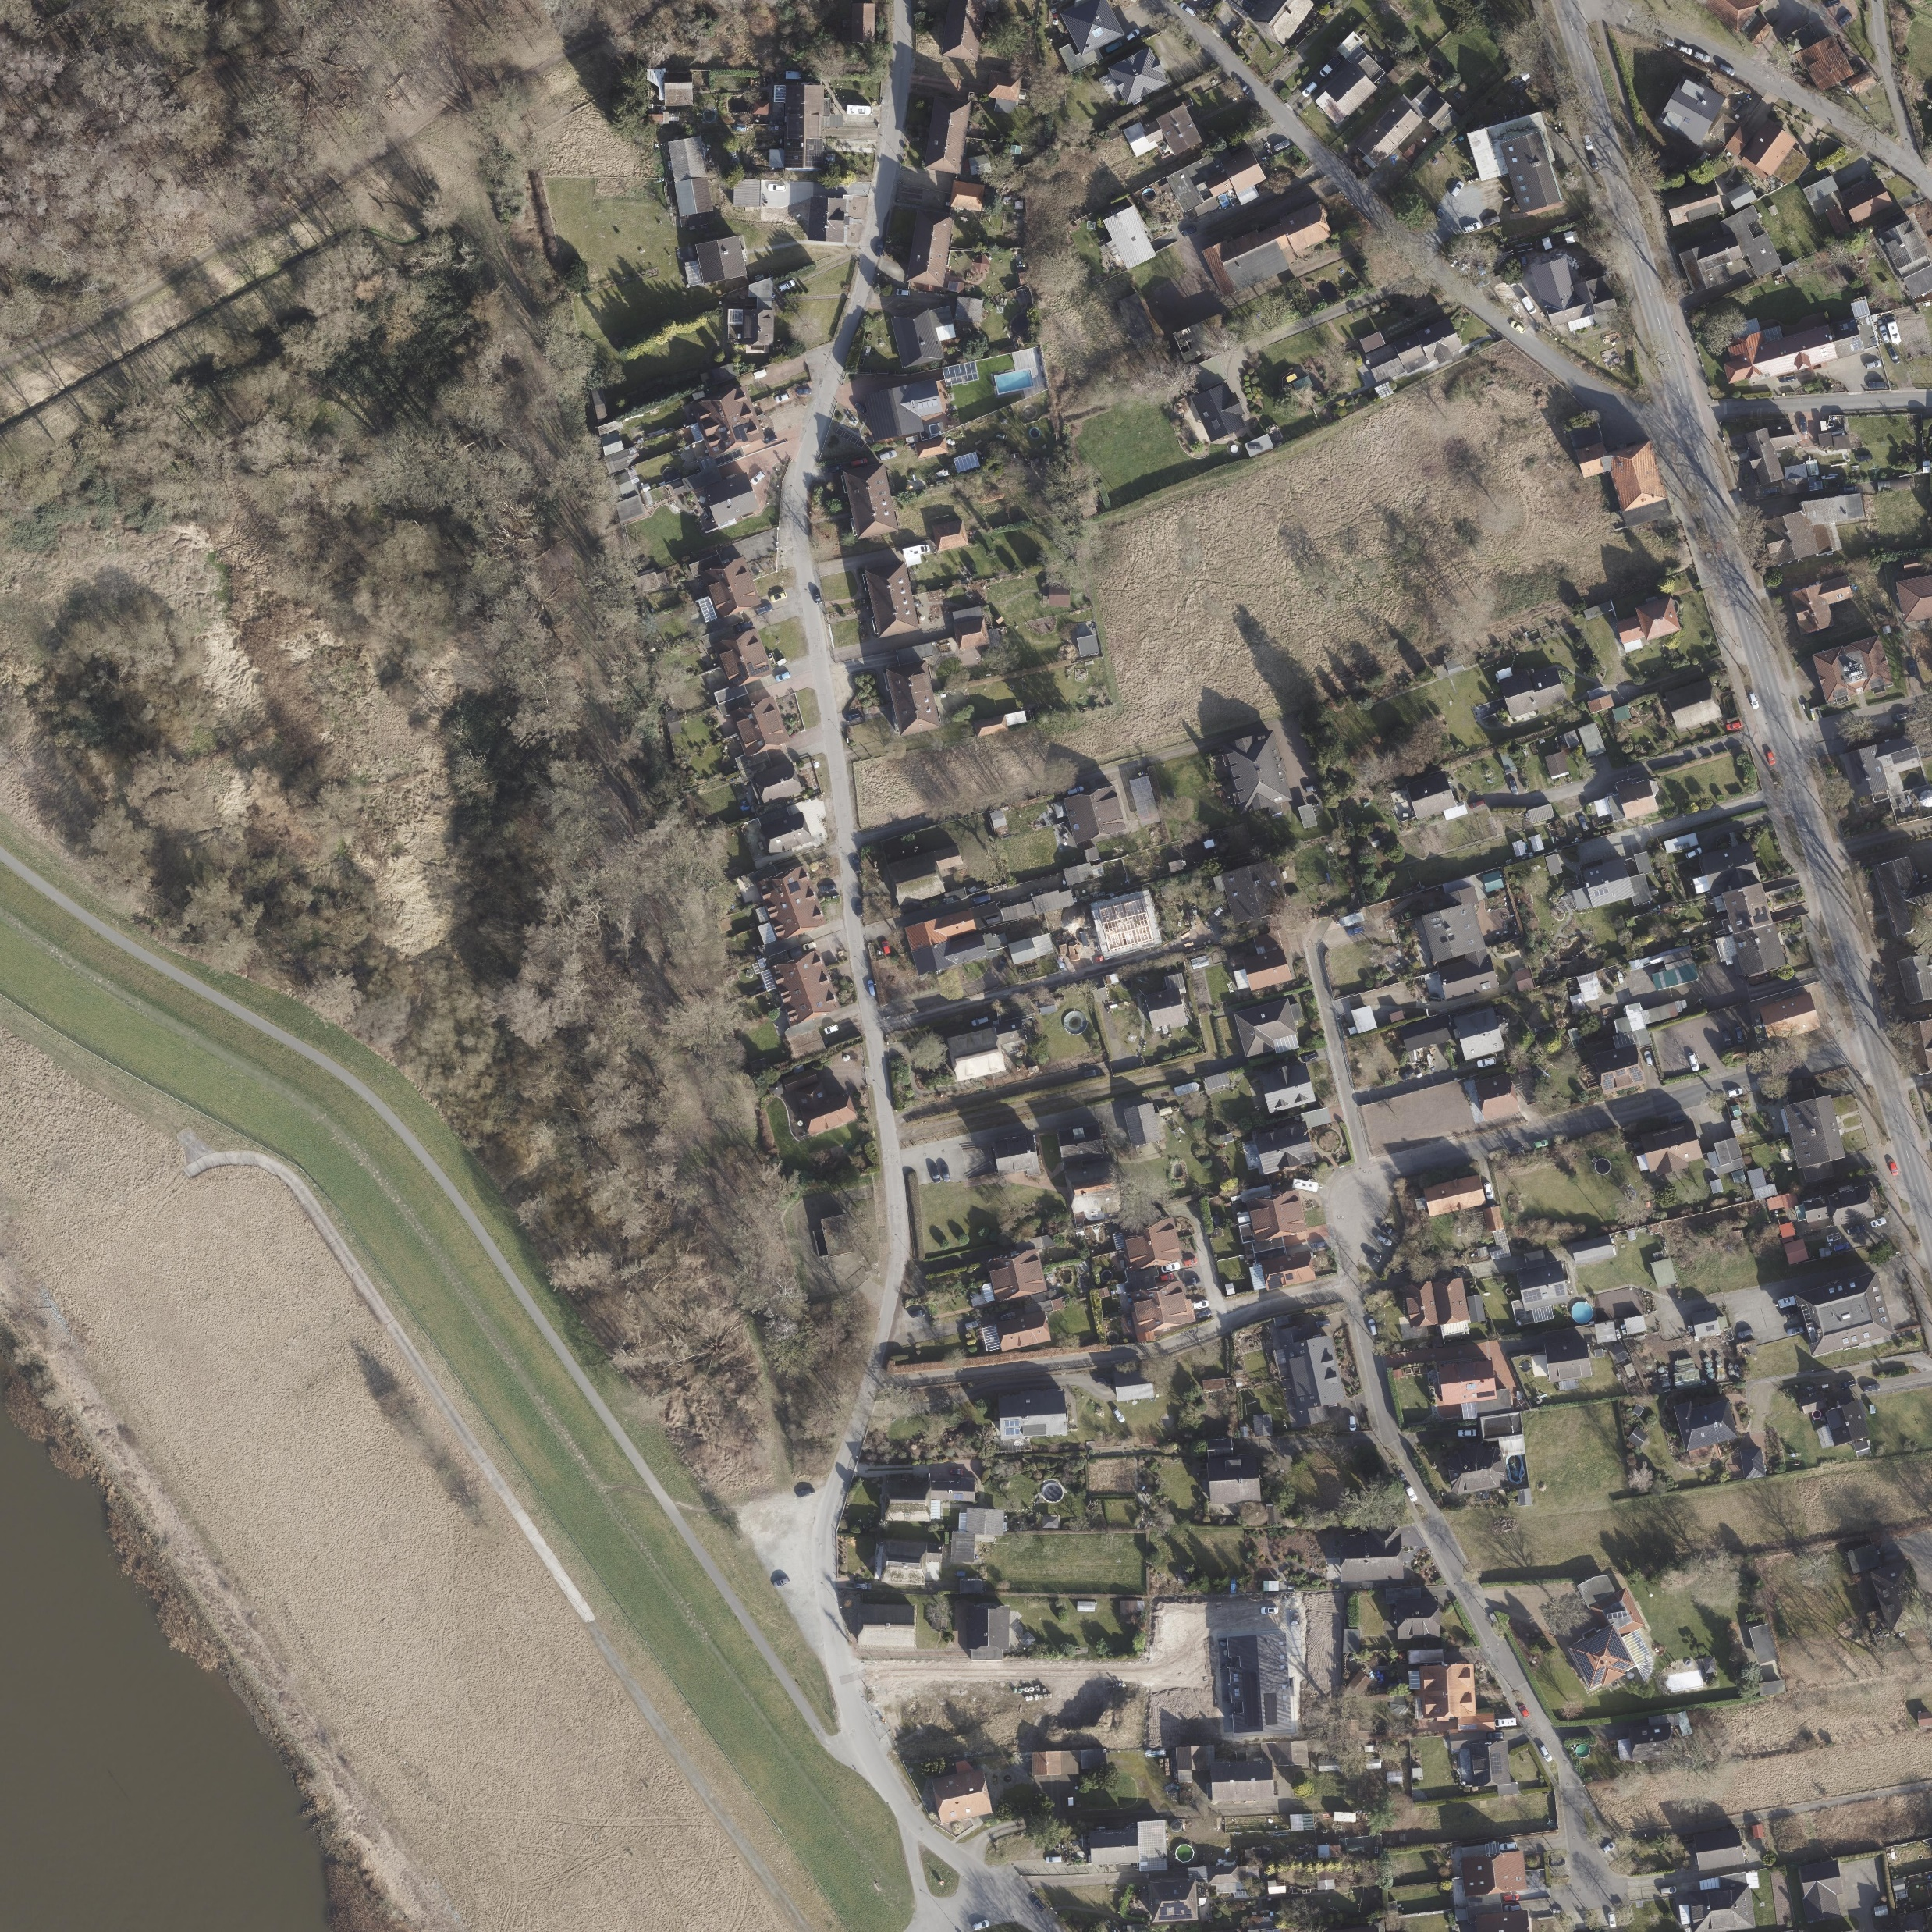
Bremen‘s Agency for Geoinformation releases orthophotos
Orthophotos:
  geometrically corrected for topographic relief, lens distortion, and camera tilt
  uniform scale like a map
  1444 orthophotos total
5

Slide 28
Project 5: Roof Image Detection
You are data scientists working for a renewable energy startup. The city wants to transition to 100% renewable energy, but they don't know how much solar power they can actually generate.
Your mission: build an AI that can scan orthophotos for rooftops and calculate the exact usable roof space area and the resulting solar power potential for every single building in the city
5

Slide 29
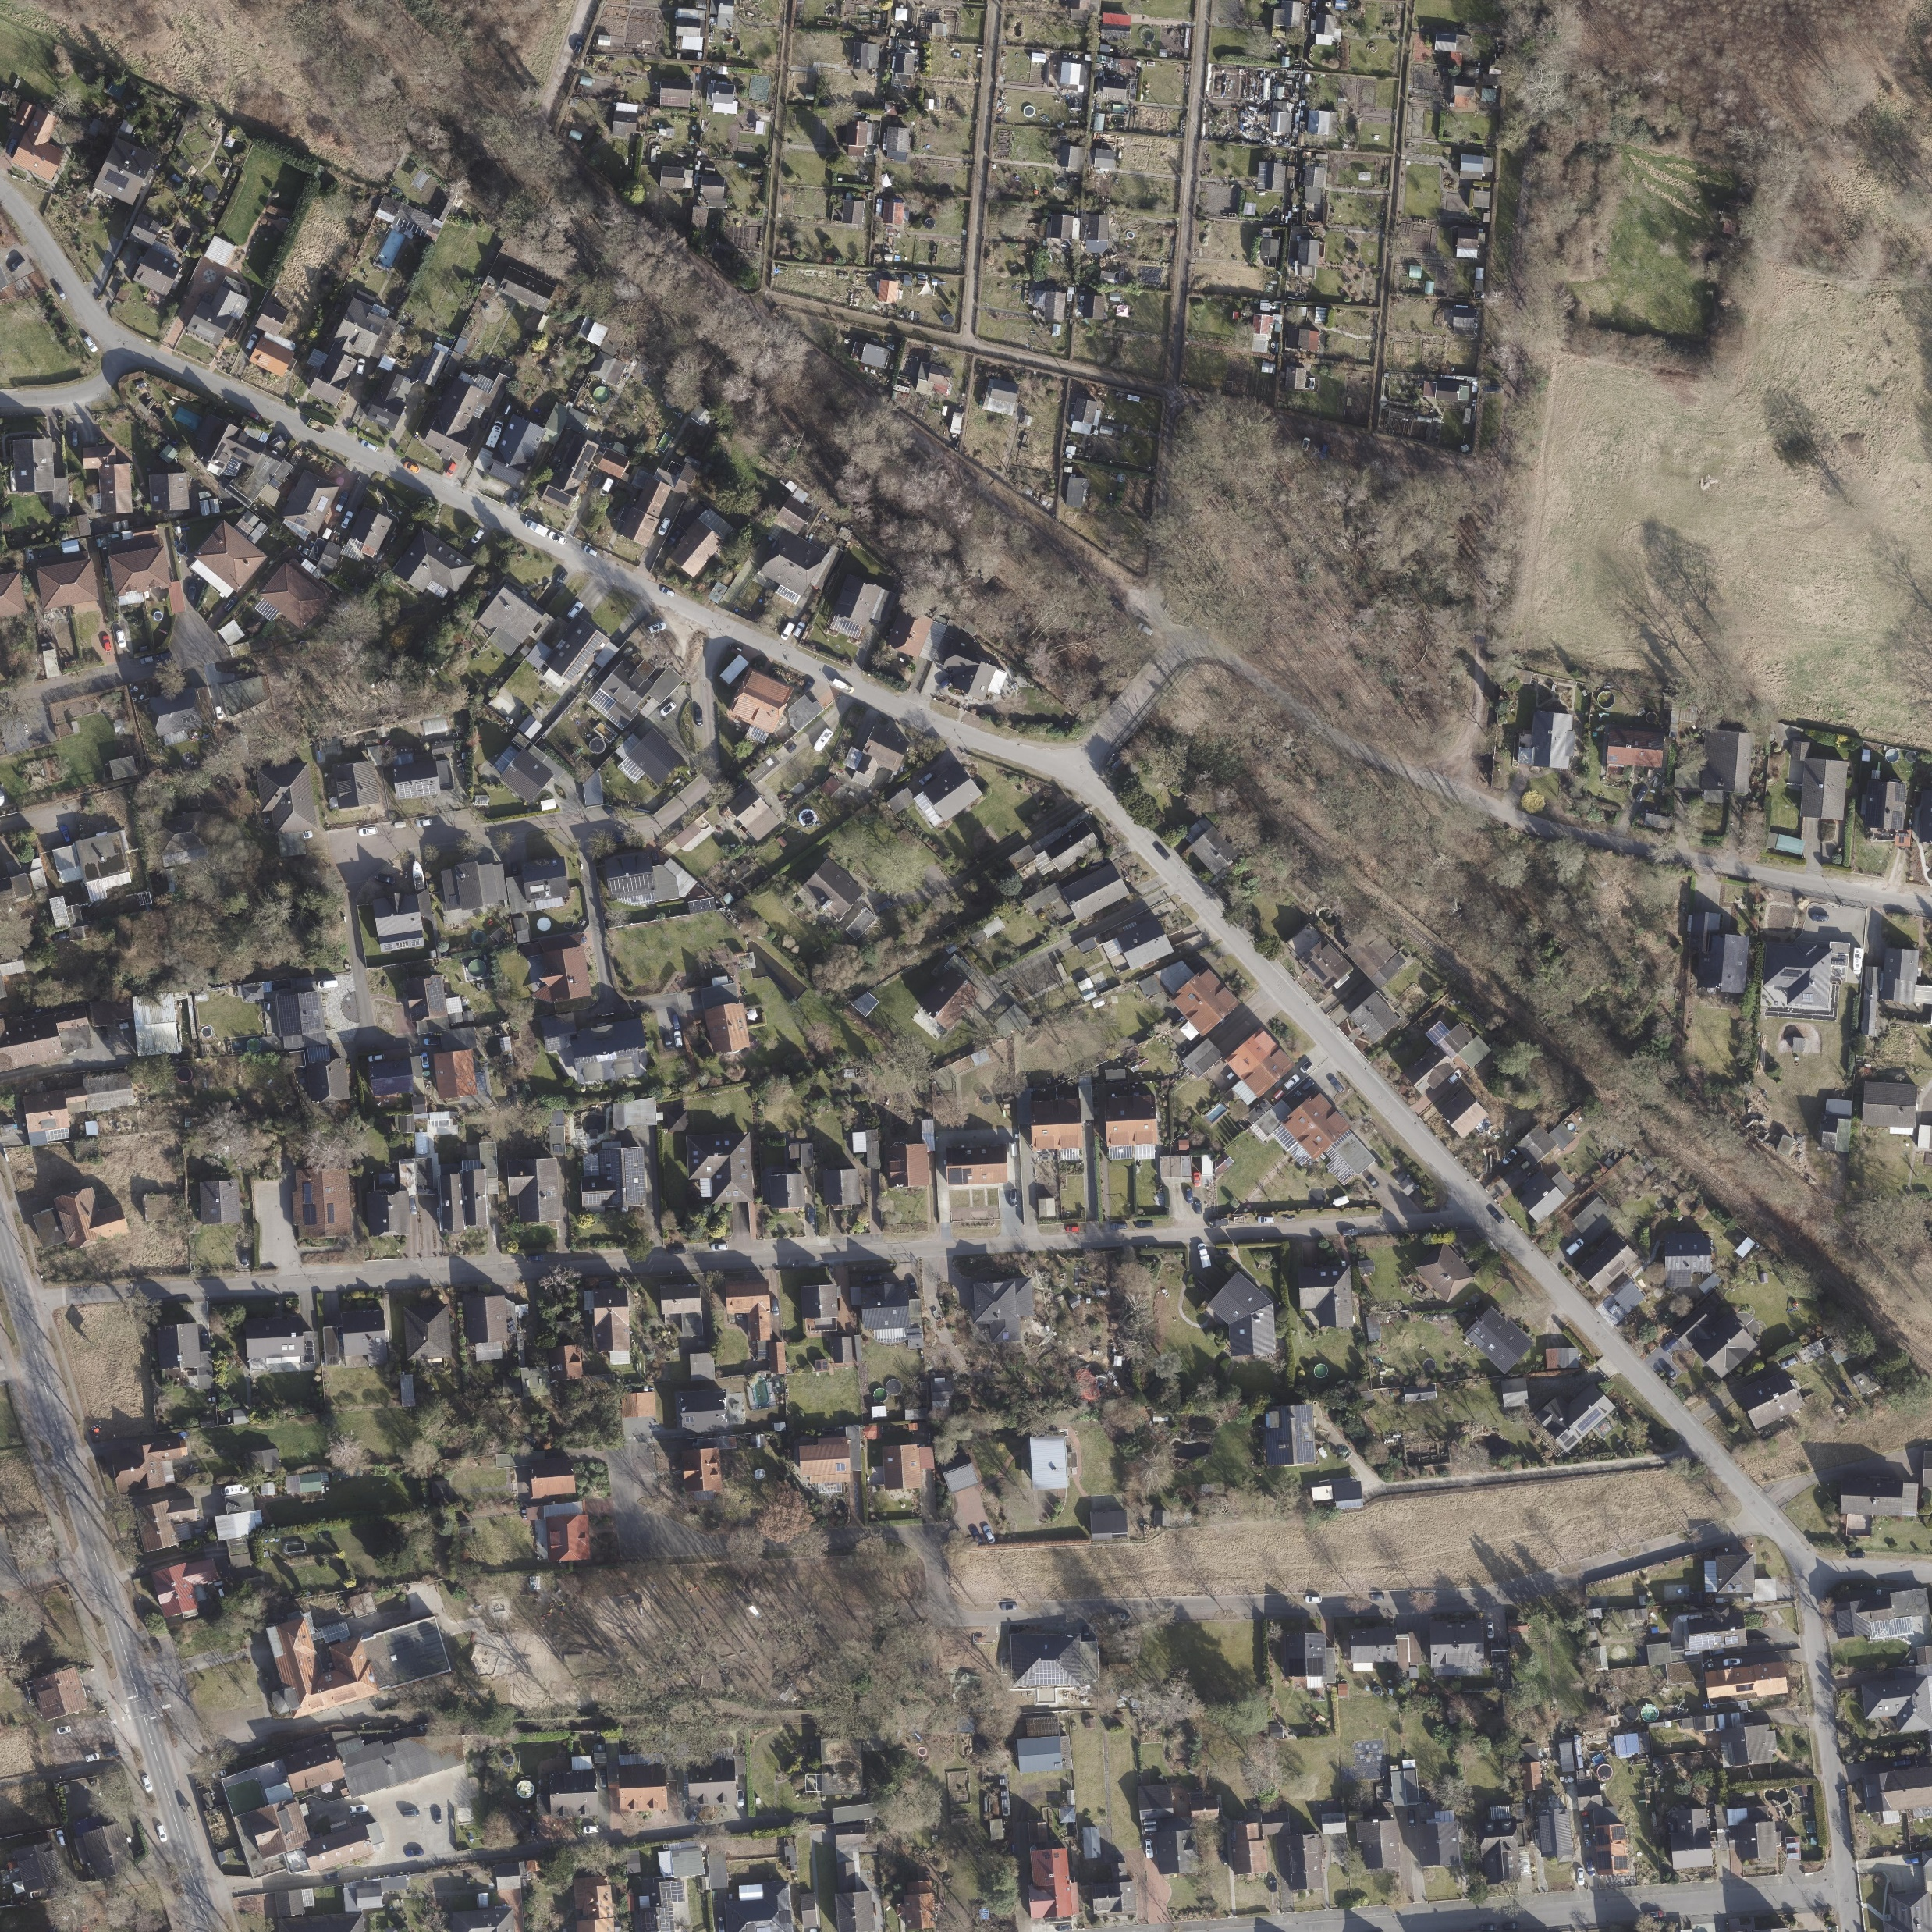
Project 5: Roof Image Detection
<POLYGON ((467762.33 5895659.417, 467753.374 5895658.922, 467752.945 5895666...>
5

Slide 30
Project 5: Roof Image Detection
dop10rgb_32_4675_58955_05_hb_2025
Polygon data present
5
Polygon data missing

Slide 31

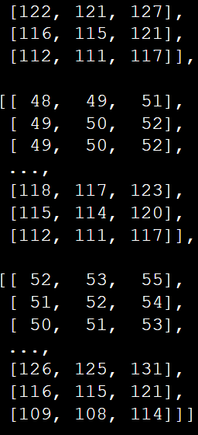
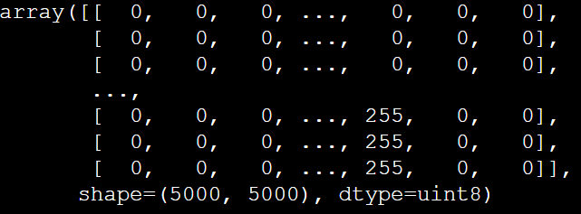
Project 5: Roof Image Detection
Binary
Masking
dop10rgb_32_4675_58955_05_hb_2025
Feature (X)
Target (y)
<POLYGON ((467762.33 5895659.417, 467753.374 5895658.922, 467752.945 5895666...>
5

Slide 32
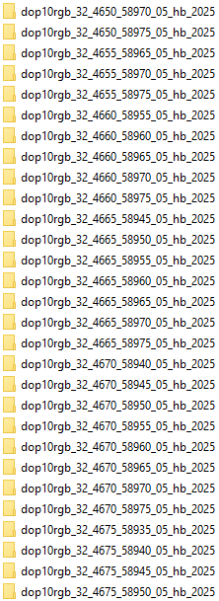
Project 5: Roof Image Detection
500 x 500 m
per tile
Digital orthophoto
Red-green-blue coloring
10 cm per pixel
Bremen
Aqcquisition year
dop10rgb_32_4675_58955_05_hb_2025
UTM Zone 32N
(aka EPSG:25832)
Northing reference
(„y coordinate“)
Easting reference
(„x coordinate“)
5
…

Slide 33
Project 5: Roof Image Detection
Train an image recognition model (a neural network) capable of identifying rooftop polygons on a given orthophoto lacking its polygon data
Aim for Instance Segmentation, not just classification
Find the missing polygons and calculate the total rooftop area + solar energy potential
  Bonus points if you can (somehow) assess the suitedness for solar panels
  Otherwise, assume that every rooftop is suited for solar panel installation
Put your code on GitHub and invite me (Stefanopinto@hotmail.de)
Suggested Programming Language / Frameworks:
Python 3.12 +
  Pandas or Polars (data wrangling)
  ultralytics (YOLO instance segmentation)
5

Slide 34
Overview
Progamming
100 %
Visualization
0 %
Statistics
Crime Data Agentic Chatbot (1)
Crime Data Analytics (2)
Transit Data Delay Analysis (3)
BBQ Sauce Demand Forecasting (4)
Rooftop image recognition (5)
1
2
3
4
5
Manipulation

Slide 35

Good Luck!
Questions?
stefanopinto@blinkbase.io
stefanopinto@hotmail.de

