Slide 1
Business Development Plan
Market Analysis, Strategies, and Expected Outcomes

Slide 2
Topics to be discussed
Executive Summary
Market Analysis
Business Development Strategies
Financial Projections
Expected Outcomes
Conclusion & Next Steps

Slide 3
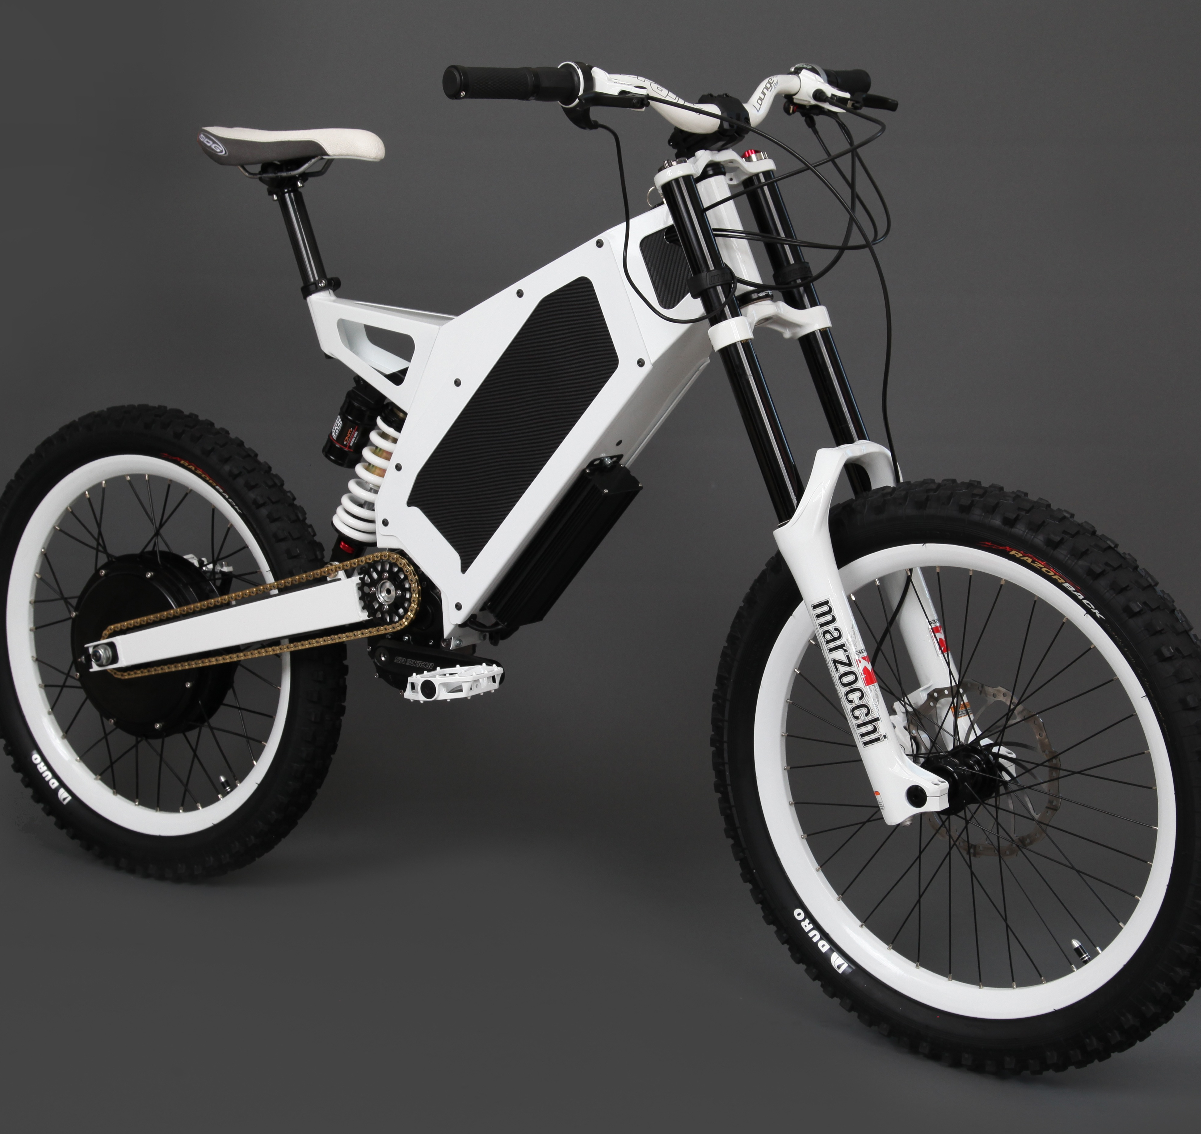
Executive Summary
Vision and Mission:
To revolutionize urban mobility by offering innovative e-bikes that promote sustainable, efficient, and eco-friendly transportation.

Slide 4
Executive Summary
Key Goals:
Short-Term: Launch the product, build brand awareness, and attract early adopters.
Medium-Term: Scale production, establish partnerships, and achieve profitability.
Long-Term: Lead the global e-bike market and transform urban commuting sustainably.

Slide 5
Executive Summary
Strategies and Results:
Use Cutting-Edge Technology.
Superior Design.
Targeted Marketing to build a loyal Customer Base.
Reduce Carbon Emissions.
Achieve Market Dominance.

Slide 6
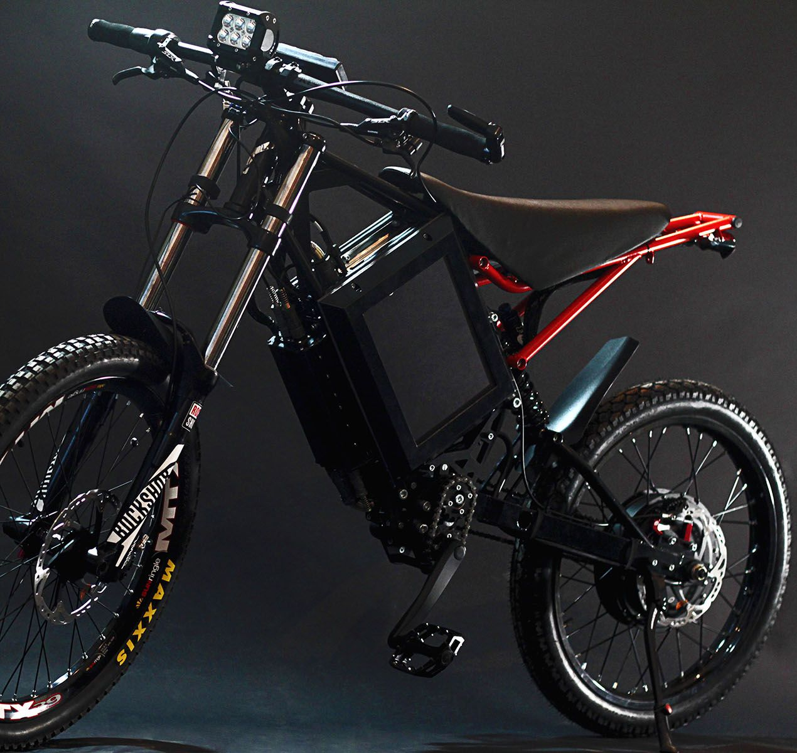
Market Analysis
Industry Overview and Trends:
Growth Rate: Projected CAGR of 10% (2023–2030), with a market size exceeding $65 billion by 2025.
Key Drivers: Urbanization, government incentives, and advancements in battery technology.
Trends: Smart features like GPS, app connectivity, and IoT integration.
Regions: High demand in Europe, Asia-Pacific, and North America.

Slide 7
Market Analysis
Target Market Demographic:
Age Group: 18–45 years old.
Income Level: Middle to high-income individuals.
Lifestyle: Tech-savvy, health-focused, and environmentally aware individuals.

Slide 8
Market Analysis
Competitive Landscape:
Key Players: Giant Bicycles, Trek, Rad Power Bikes, and Bosch eBike Systems dominate.
Emerging Brands: Aventon and VanMoof focus on sleek, tech-enabled designs.
Differentiators: Battery life, motor performance, price, and aesthetic appeal.
Retail Trends: Growth in direct-to-consumer models and online sales channels.

Slide 9
Market Analysis
Market Opportunities:
Expanding cycling infrastructure in cities worldwide.
Growing consumer focus on fitness and sustainability.
Potential in emerging markets and untapped rural regions.
Continuous advancements in lightweight materials and connectivity features.

Slide 10
Market Analysis
Threats:
Dependency on lithium-ion battery supply chains.
Regulatory disparities across regions slowing market penetration.
Consumer hesitations about durability, safety, and maintenance.
Rivalry from electric scooters and other eco-friendly mobility options.

Slide 11
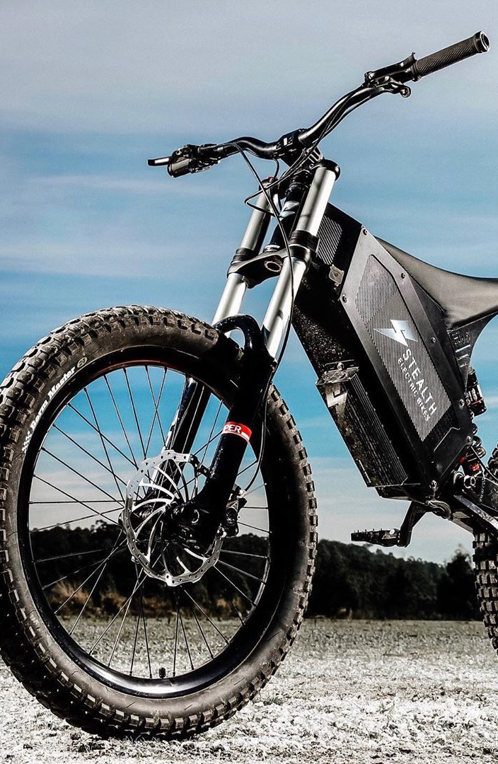
Business Development Strategies
Product/Service Innovation:
Develop lightweight e-bikes with improved battery life and faster charging times.
Integrate smart technology, such as GPS tracking, anti-theft features, and app connectivity.
Offer customizable models for urban commuting, recreation, and cargo transport.
Introduce affordable entry-level models to attract budget-conscious consumers.

Slide 12
Business Development Strategies
Marketing and Sales Plans:
Focus on digital marketing through social media, influencers, and search engine optimization.
Highlight eco-friendliness and cost savings in advertising campaigns.
Offer demo rides, trade-in options, and seasonal discounts to boost sales.
Build an omnichannel presence, combining e-commerce platforms with physical showrooms.

Slide 13
Business Development Strategies
Partnerships and Collaborations:
Collaborate with battery and motor technology providers for improved performance.
Partner with ride-sharing companies to introduce e-bike rental fleets.
Establish relationships with local governments for cycling infrastructure initiatives.
Work with fitness brands and apps to promote e-bikes as part of active lifestyles.

Slide 14
Business Development Strategies
Expansion Plans:
Expand distribution networks in untapped regions, particularly emerging markets.
Open flagship stores in key urban centers to build brand identity.
Diversify offerings to include electric cargo bikes for businesses and delivery services
Explore franchising models or local partnerships to accelerate global presence.

Slide 15
Financial Projections
Revenue Forecast

Slide 16
Financial Projections
Key Financial Metrics
Metric | Year
 | 2024 | 2025 | 2026 | 2027 | 2028
Revenue ($M) | 2 | 5 | 10 | 15 | 20
Net Profit ($M) | -0.5 | 0.5 | 1.0 | 3.0 | 5.0
ROI (%) | - | 10 | 20 | 30 | 35
Break-Even Point | - | Achieved | - | - | -
Customer LTV ($) | 400 | 500 | 600 | 650 | 700

Slide 17
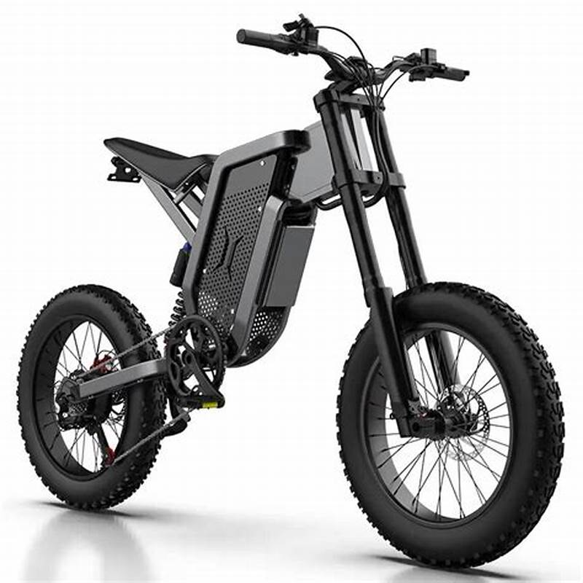
Expected Outcomes
Growth Milestones:
Revenue Growth: The global e-bike market is expected to grow at a compound annual growth rate (CAGR) of 8–10% from 2023 to 2030.
Sales Volume: Expected to see a steady increase, with global sales projected to surpass 50 million units per year by 2030.
Infrastructure Development: Significant investments in infrastructure, such as dedicated bike lanes and charging stations, will enable higher e-bike adoption.

Slide 18
Expected Outcomes
Anticipated Market Share Increase:
Geographic Expansion.
Commuter E-Bikes.
Electric Cargo Bikes.
Tech Integration and Innovation.

Slide 19
Expected Outcomes
Long Term Vision Alignment:
Sustainability and Clean Energy.
Urban Mobility.
Environmental Impact.
Health and Fitness.
Technological Integration.

Slide 20
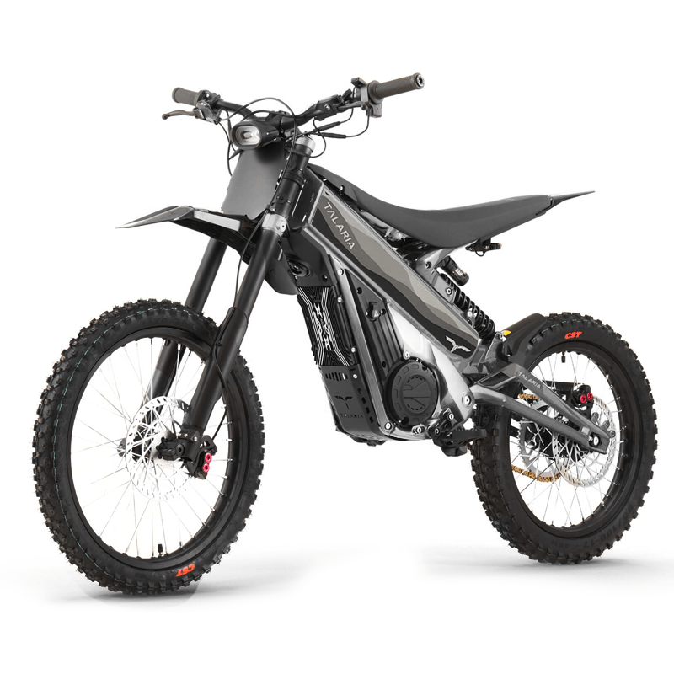
Conclusion & Next Steps
Conclusion:
E-bikes will be integral to achieving environmental sustainability, offering eco-friendly, cost-effective alternatives to traditional vehicles.

Slide 21
Conclusion & Next Steps
Next Steps:
Strategic Planning.
Investment in R&D.
Partnerships and Collaborations.
Marketing and Awareness.

Slide 22

Any Questions?

