Slide 1
Careers in STEM
Biomedical/Physiological Research

Slide 2
About Me
Senior at UIUC – pursuing degrees in kinesiology and molecular biology
Undergraduate research assistant in the Nutrition and Exercise Performance Research Group
Ran cross country and track at Mahomet Seymour and UIUC

Slide 3
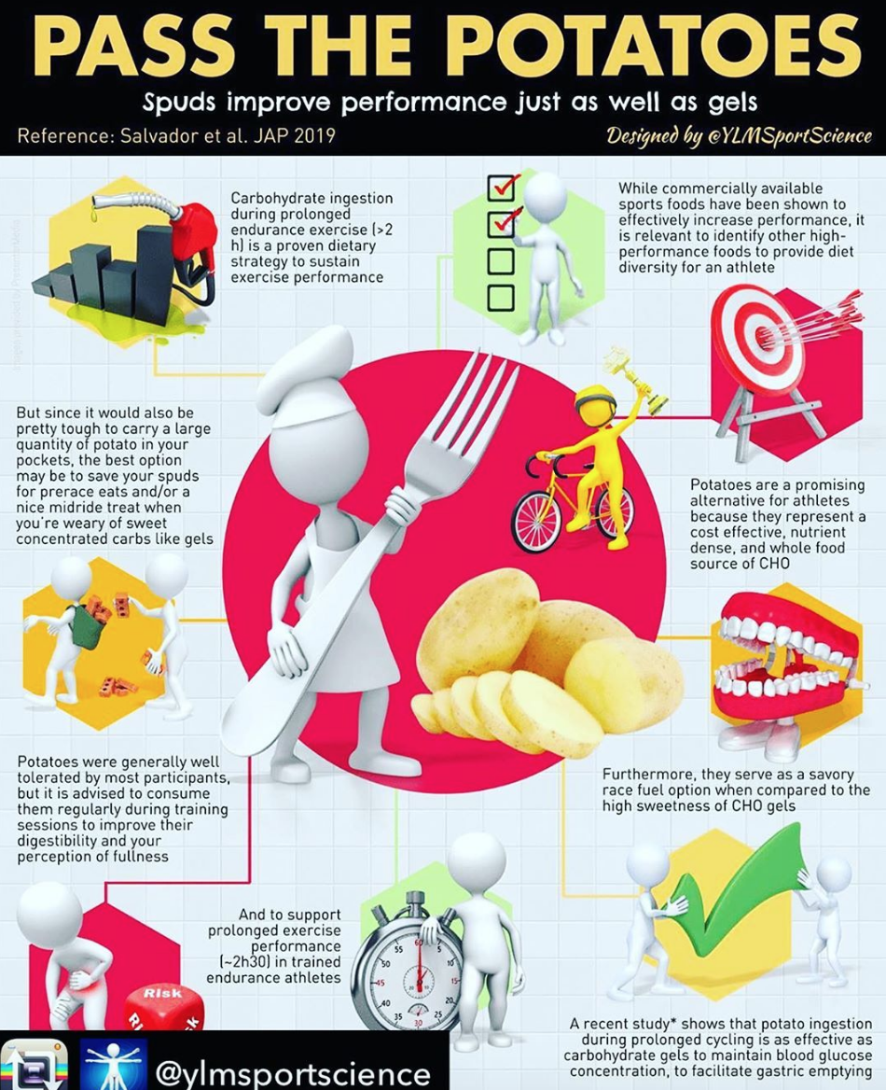
Potatoes Study
12 trained cyclists
2 hour ride at 60% Vo2 max with 3 “hills” followed by time trial
3 conditions – sports carbohydrate gel, potatoes, water
Measured…
How fast carbohydrates were used
How fast time trial was performed
Intestinal damage
Exertion
Core temperature
Along with many others
Turns out, potatoes and gels are equal for performance!

Slide 4
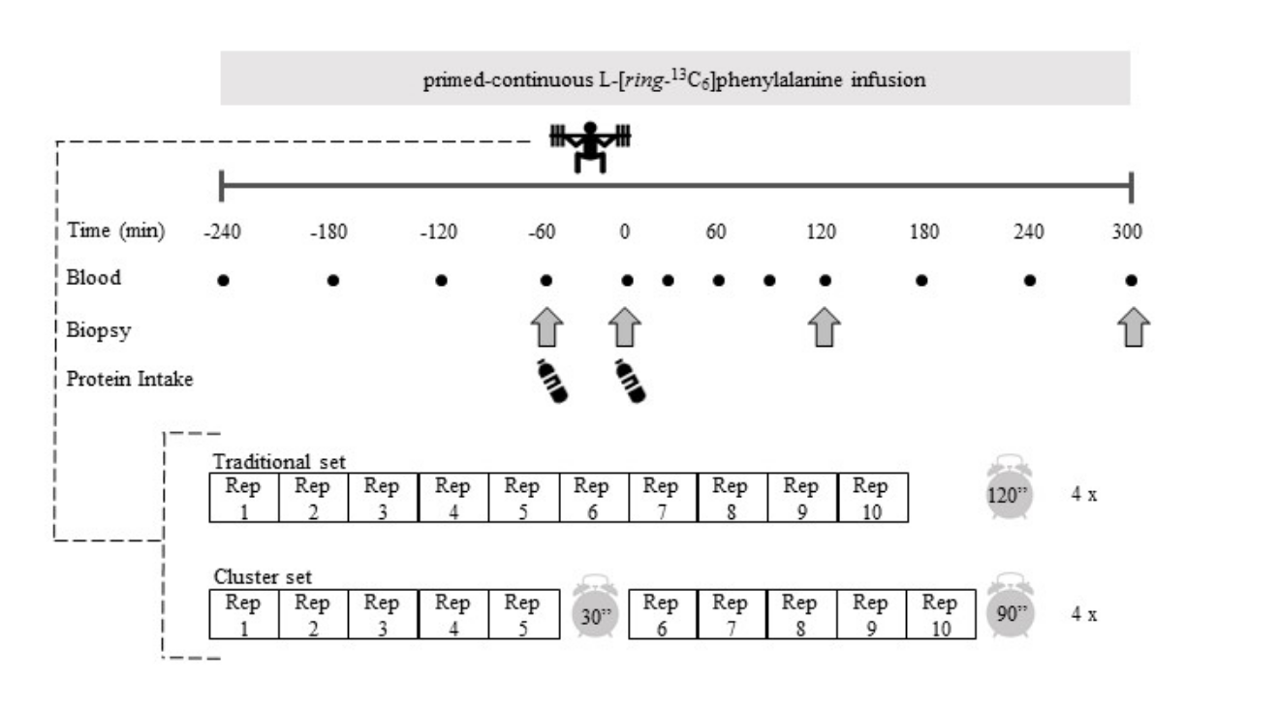
Cluster Study
8 trained weightlifters
Both did 4x10 barbell back squat at 70% 1RM – one cluster, other traditional
Measured…
Muscle protein synthesis
Specific protein activity
How hard they were working
Speed of the weights
Decline of weight as the study progressed
Cluster was better for weight and speed, but both had the same protein activity!

Slide 5
Careers Related to Research
Professor
Separate research institution/industry/government (ie. Mayo clinic, Kraft, NASA)
Good avenue into startup companies/management/administration
Applicable for any health field application (ie. medical school, physical therapy, etc.)
Overall, cultivates a unique way of thinking, builds team working skills, and looks great on any application

