Slide 1
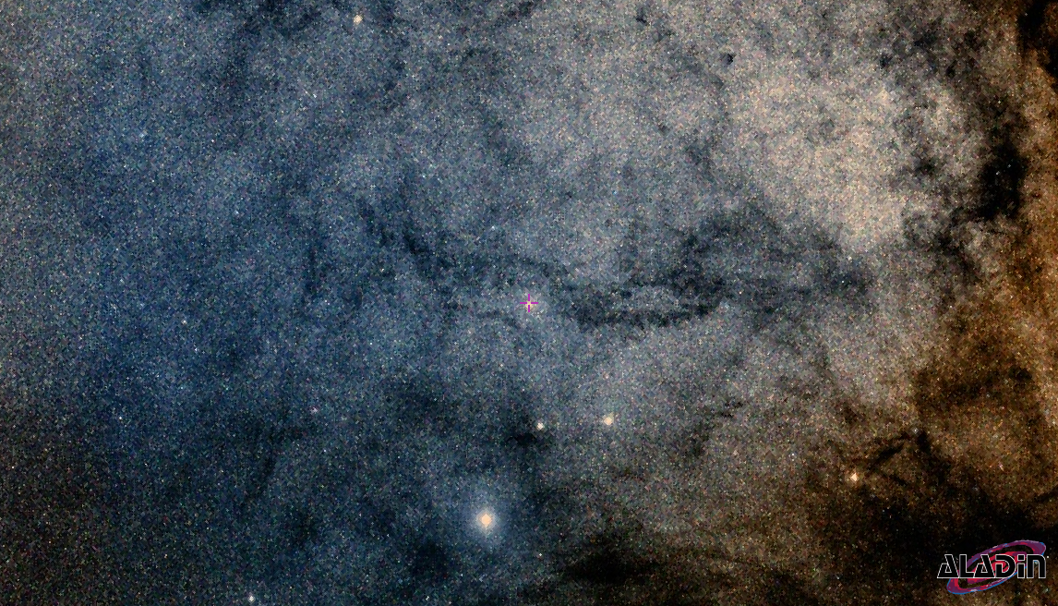
Improved Reddening, Distance and Luminosities for a new sample of Galactic Cepheids
Shubham Mamgain

Slide 2
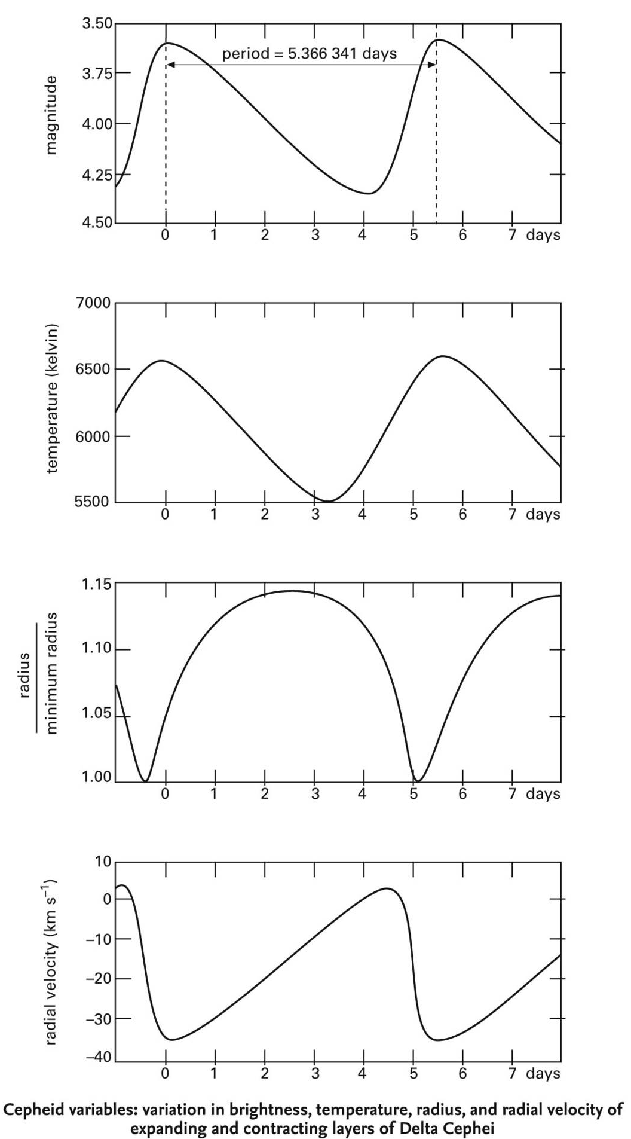
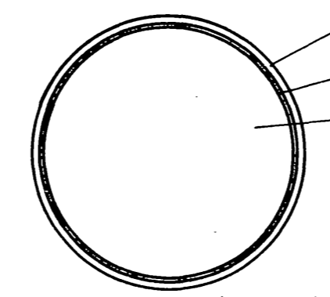
Background . Research . Dataset . Method . Result . Validation . Conclusion . Summary
Object of Interest: Cepheid Variables
Pulsation Cycle of Cepheid
Radius | Rapidly Decreasing | Smallest | Increasing | Largest | Rapidly Decreasing
Temperature | Rapid Increasing | Near peak | Peak | Adiabatic cooling | Rapid Increasing
Ionization | He II → He III κ - mechanism | He III dominated | Recombination |  | He II → He III κ - mechanism
Opacity | Increasing | Increasing | Highest | Decreasing | Increasing
Luminosity | Decreasing |  |  | Highest | Decreasing
H/He⁺
Triple ɑ
He⁺⁺

Slide 3
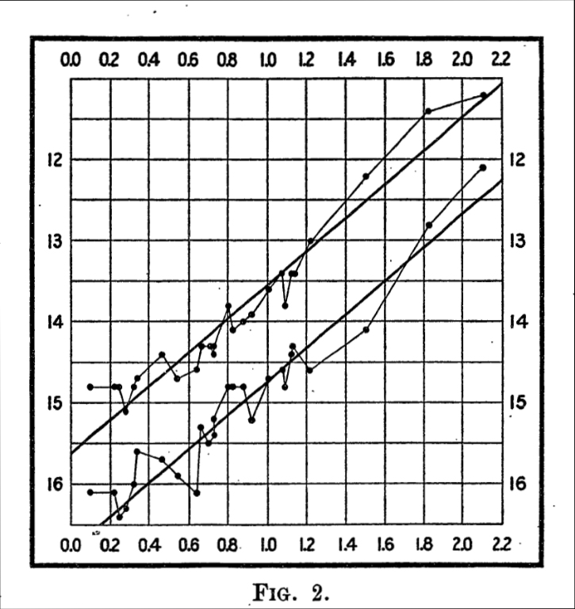
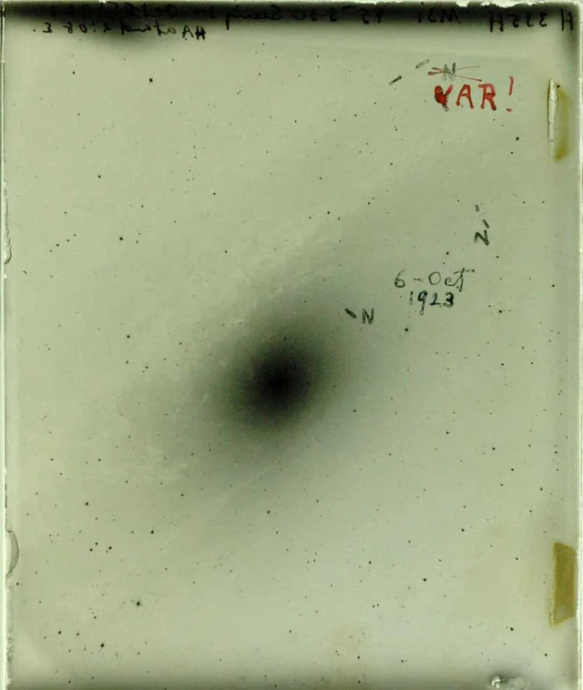
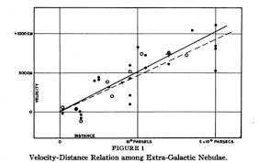
Background . Research . Dataset . Method . Result . Validation . Conclusion . Summary
Object of Interest: Cepheid Variables
Property: Leavitt Law, 1912
Hubble, 1924
Hubble, 1929
31.41 days
Luminosity (mag)
Period (log P)

Slide 4
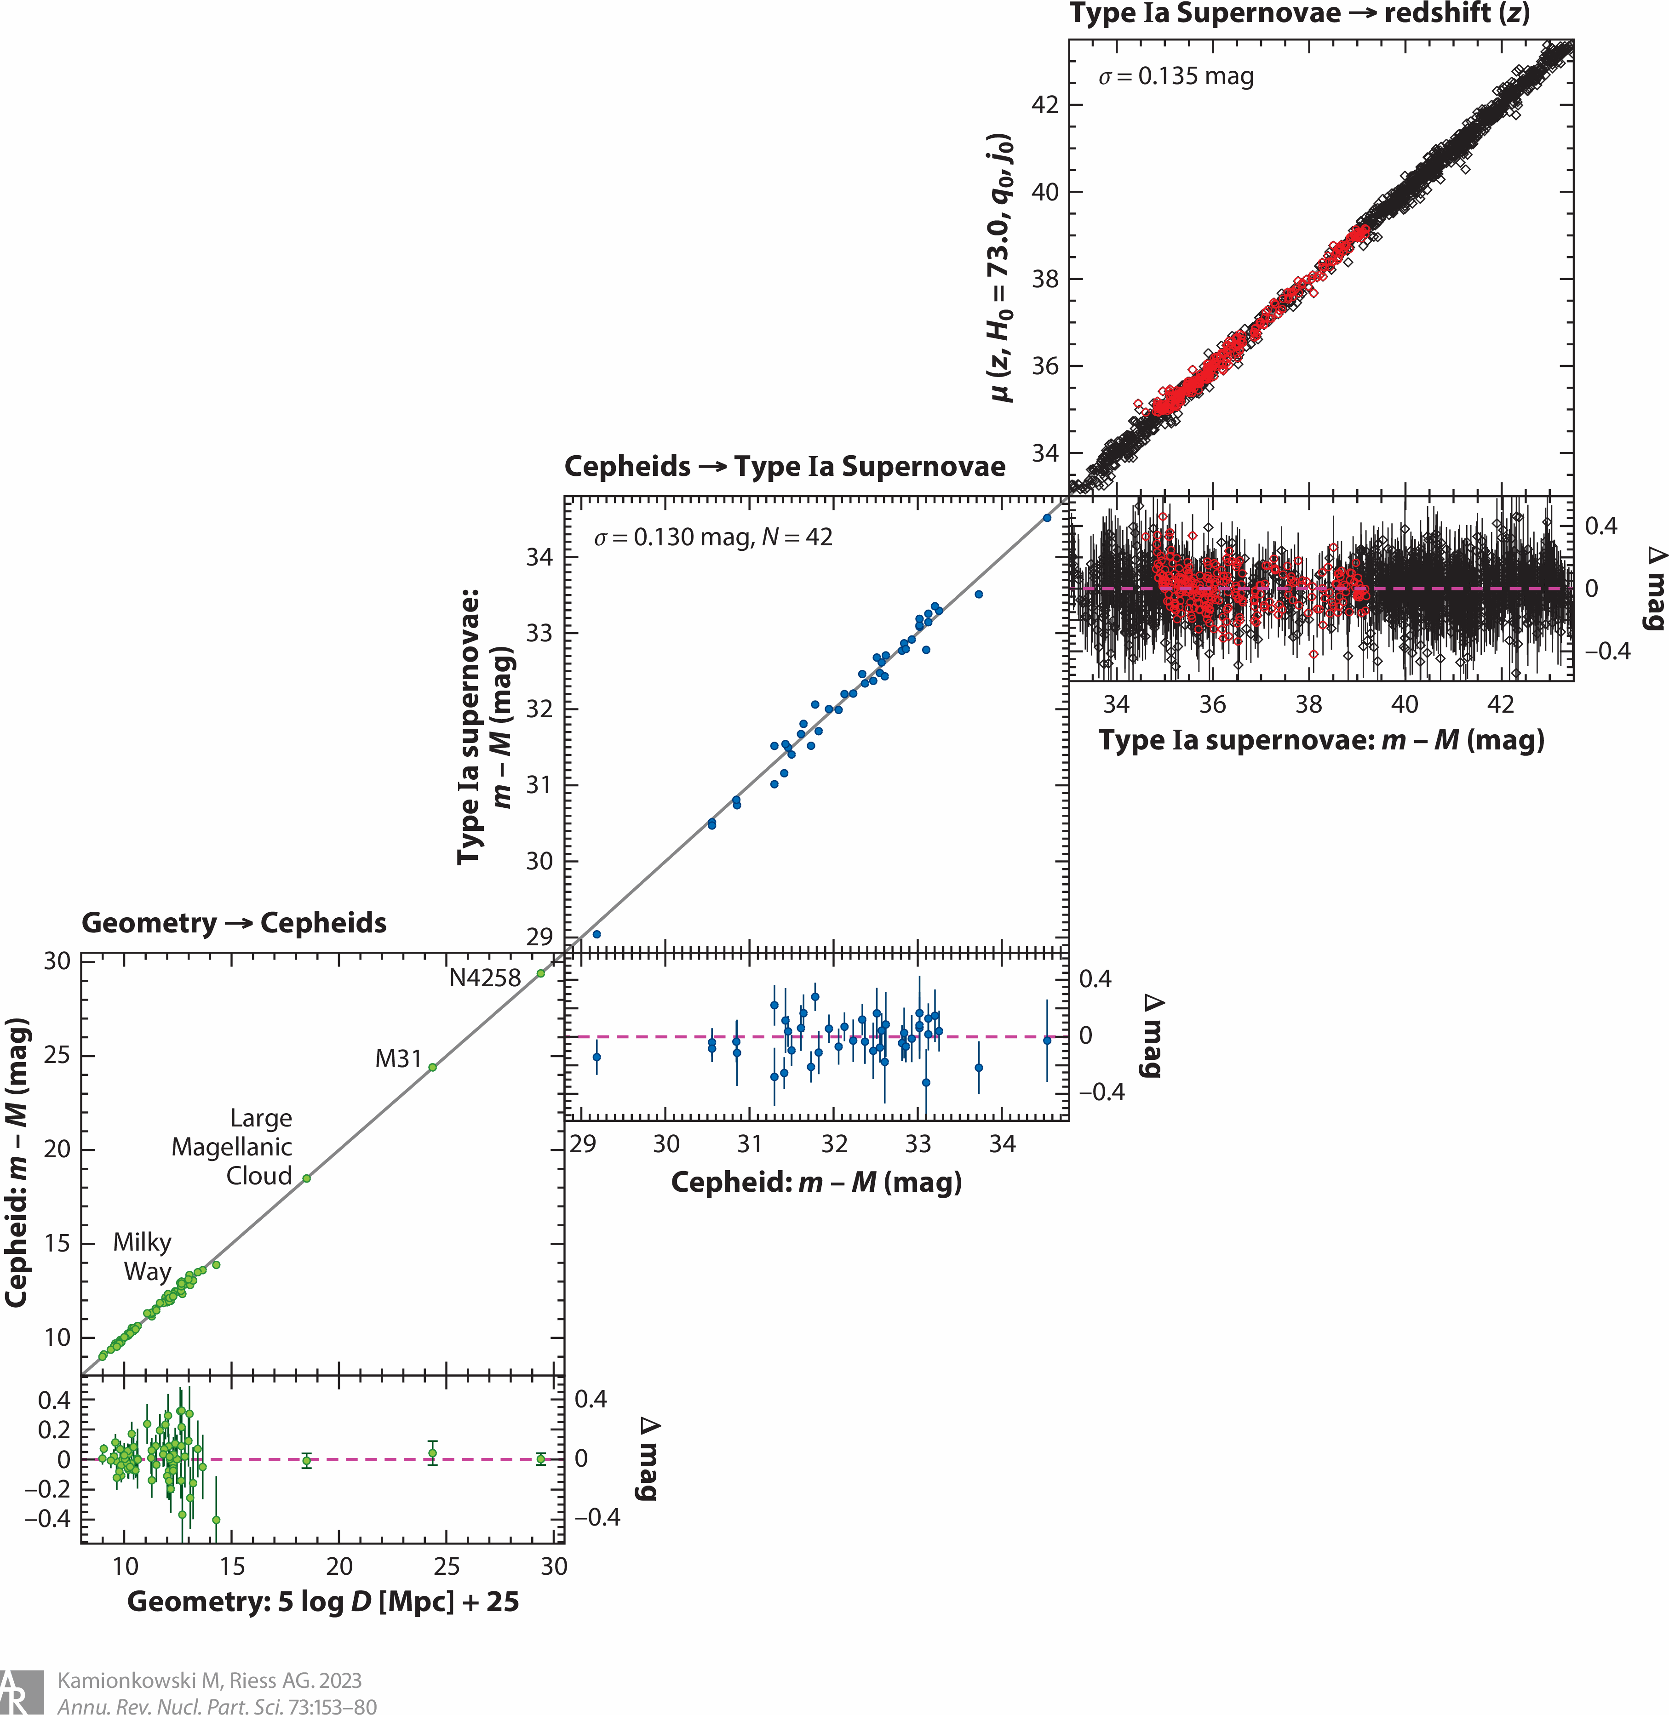
Background . Research . Dataset . Method . Result . Validation . Conclusion . Summary
Object of Interest: Cepheid Variables
Property: Leavitt Law, 1912
Luminosity (mag)
Application:
Cosmic Distance Ladder Calibrator
Period (log P)

Slide 5

Background . Research . Dataset . Method . Result . Validation . Conclusion . Summary
Research Goal: Determine true absolute magnitude of the target Cepheids.
Mλ⁰ = mλ - µ
Apparent
Distance
Absolute
Luminosity
µ
mλ
Mλ⁰
dL : Distance (in parsec)
10 pc
0 pc
µL : Distance Modulus (in magnitude)
0 mag

Slide 6

Background . Research . Dataset . Method . Result . Validation . Conclusion . Summary
Luminosity: Incoming light affected by the interstellar medium present in the line-of-sight.
Mλ⁰ = mλ - µ - Rλ . EBV
Color Excess
E(B-V)
Extinction
Reddening Ratio
Absolute
Rλ
Absolute
Reddened
µ
True
mλ
Mλ⁰
Aλ
Mλ
dL : Distance (in parsec)
10 pc
0 pc
δdλ
µL : Distance Modulus (in magnitude)
0 mag
δµλ

Slide 7
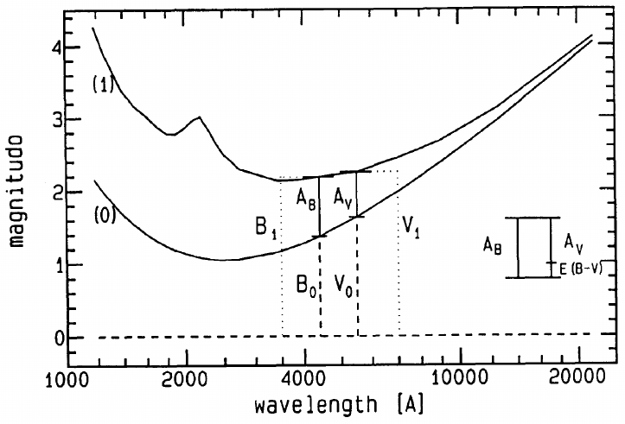
Background . Research . Dataset . Method . Result . Validation . Conclusion . Summary
Reddening: Shorter wavelength get absorbs more effectively than longer ones.
Multi-band Galactic Reddening Ratio
Rλ = RV . (Aλ /AV)
Galactic Reddening Ratio (Sandage, 2004)
Visual band : RV = 3.23
Galactic Extinction Law (Fouque, 2004)
Aλ /AV | B | V | I | J | H | K
 | 1.31 | 1 | 0.608 | 0.292 | 0.181 | 0.11
µ
mλ
Mλ⁰
Aλ
Mλ
Hint: Use multi-band photometry to decouple distance-reddening systematics

Slide 8
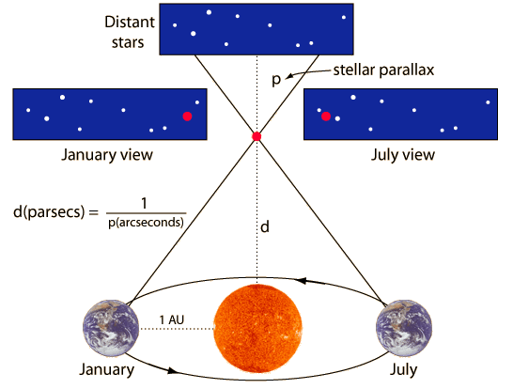
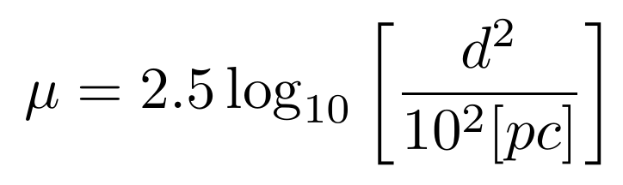
Background . Research . Dataset . Method . Result . Validation . Conclusion . Summary
Distance: Two independent methods employed to determine distance of individual Cepheid
InfraRed Surface Brightness
Parallax
Dilemma: Similar but slightly different results. Which one is correct?

Slide 9
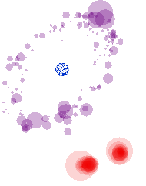
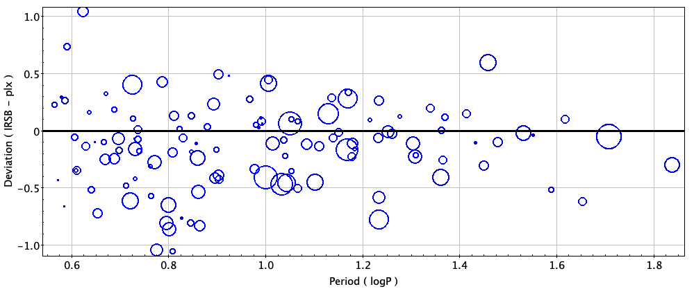
Background . Research . Dataset . Method . Result . Validation . Conclusion . Summary
Galactic Cepheids: BVIJHK Photometry + Color Excess + IRSB/Gaia Distance
B
V
I
J
H
K
E(B – V) x 10
IRSB
Gaia Parallax
MW - 150
LMC - 36
SMC - 32

Slide 10
Background . Research . Dataset . Method . Result . Validation . Conclusion . Summary
Data cleaning: Instability Strip Criteria

Slide 11
Background . Research . Dataset . Method . Result . Validation . Conclusion . Summary
Key Idea: Leavitt Law prior to calibration

Slide 12
Background . Research . Dataset . Method . Result . Validation . Conclusion . Summary
I
Rλ
W
W⁰

Slide 13
Background . Research . Dataset . Method . Result . Validation . Conclusion . Summary
I
Rλ
W
W⁰
II
Mλ
M⁰λ
Rλ
mλ
µ
EBV

Slide 14
Background . Research . Dataset . Method . Result . Validation . Conclusion . Summary
I
Rλ
PWλ
W
W⁰
III
(Δ-Δ)λ
δAλ
Slope = ρλ
logP
ΔM
0
PLλ
II
Mλ
M⁰λ
0
Rλ
ΔW
mλ
µ
EBV

Slide 15
Background . Research . Dataset . Method . Result . Validation . Conclusion . Summary
Possible correction in extinction:
δAλ
Slope = ρλ
δAλ = ΔMλ – ρλ x ΔW
ΔM
0
What if distance modulus require correction?
0
ΔW

Slide 16
Background . Research . Dataset . Method . Result . Validation . Conclusion . Summary
B
V
I
J
H
K
ΔMλ
ΔW

Slide 17
Background . Dataset . Method . Result . Validation . Conclusion . Summary
IV
B
V
I
I
Rλ
From all Cepheids
J
PWλ
δAλ
H
Slope = αλ
ΔMλ
K
ΔΜ
W
W⁰
III
(Δ-Δ)λ
ΔW
ΔW
logP
PLλ
II
Mλ
M⁰λ
Rλ
mλ
µ
EBV

Slide 18
Background . Dataset . Method . Result . Validation . Conclusion . Summary
δμ⁴
Slope = 1
Let there is δμ correction required in modulus, then
δμ³
m = M0 + µ + δμ + Aλ + δAλ
δμ²
Slope = αλ
δμ¹
W = M + RV (B - V) + µ + δμ
Deviation from PL relation
Apparent mag is sensitive to reddening and modulus, however, Wesenheit mag is sensitive to modulus only.
δμ⁴
δμ²
δμ¹
δμ³
Deviation from PW relation
Implies, star will shift in the line of slope 1 for modulus adjustment

Slide 19
Background . Dataset . Method . Result . Validation . Conclusion . Summary
B
δμ⁴
Slope = 1
V
a)
δμ³
b)
I
c)
J
δμ²
H
K
δμ¹
δAλ⁴
δAλ³
δE(B-V) = δAλ / Rλ
δΕ rms
Deviation from PL relation
δAλ
δAλ²
δAλ¹
Suggested modulus correction
Deviation from PW relation
Adjustment in modulus, δμ
δμ
Adjustments in µ lead to corrections in extinction
Resulting δE for δµ in all bands
Least rms in δE yields µ correction

Slide 20
Background . Dataset . Method . Result . Validation . Conclusion . Summary
IV
B
V
I
I
Rλ
From all Cepheids
J
PWλ
δAλ
H
Slope = αλ
ΔMλ
K
ΔΜ
W
W⁰
III
(Δ-Δ)λ
ΔW
ΔW
logP
V
PLλ
II
Mλ
M⁰λ
Rλ
Individual Cepheids
δAλ / Rλ
RMS
mλ
µ
EBV
δμ
δμ
(δμ, δEBV)

Slide 21
Background . Dataset . Method . Result . Validation . Conclusion . Summary
IV
B
V
I
I
Rλ
From all Cepheids
J
PWλ
δAλ
H
Slope = αλ
ΔMλ
K
ΔΜ
W
W⁰
III
(Δ-Δ)λ
ΔW
ΔW
logP
V
PLλ
II
Mλ
M⁰λ
Rλ
Individual Cepheids
δAλ / Rλ
RMS
mλ
µ
EBV
VI
M⁰λ
δμ
δμ
(δμ, δEBV)

Slide 22
Background . Dataset . Method . Result . Validation . Conclusion . Summary
IV
B
V
I
I
Rλ
From all Cepheids
J
PWλ
δAλ
H
Slope = αλ
ΔMλ
K
ΔΜ
W
W⁰
III
(Δ-Δ)λ
ΔW
ΔW
logP
V
PLλ
II
Mλ
M⁰λ
Rλ
Individual Cepheids
δAλ / Rλ
RMS
mλ
µ
EBV
VI
M⁰λ
δμ
δμ
(δμ, δEBV)

Slide 23
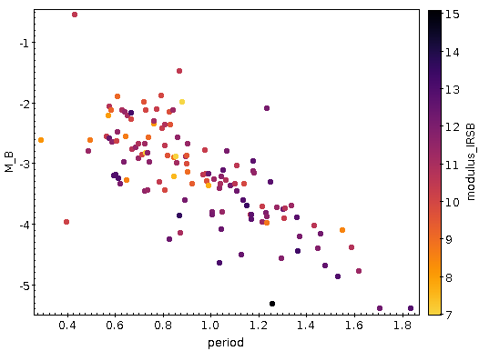
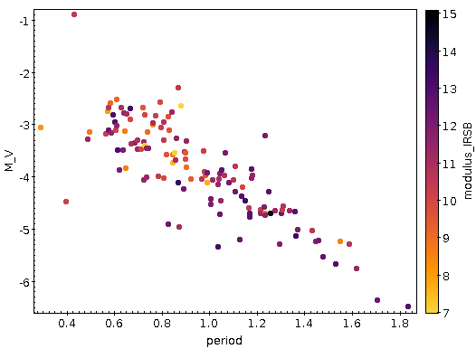
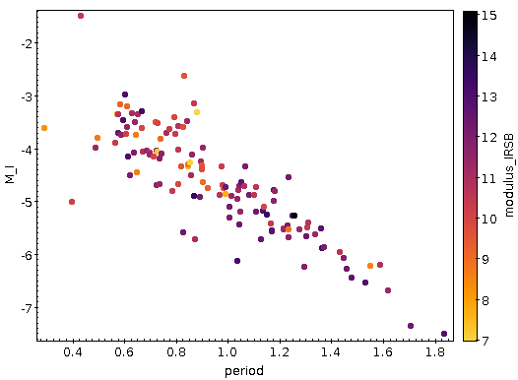



Period Luminosity Relation
Period-Luminosity
Background . Dataset . Method . Result . Validation . Conclusion . Summary

Slide 24
Background . Dataset . Method . Result . Validation . Conclusion . Summary
For each Cepheid
δAλ / Rλ
RMS
δμ
δμ

Slide 25
Background . Dataset . Method . Result . Validation . Conclusion . Summary
M⁰λ
(δμ, δEBV)

Slide 26
Resource
Slide Number | Content | Source
2 | Light Curve | ThomasK Vbg, wikipedia
29 | Blackbody curve | 1993 The Interstellar Extinction Curve

Slide 27
Star Formation
Local minima of spacetime curvature

Slide 28
Star Formation
Local minima of spacetime curvature
Gravitation collapse of (molecular) gas cloud

Slide 29
Star Formation
Local minima of spacetime curvature
Gravitation collapse of (molecular) gas cloud
Protostar core getting denser and warmer

Slide 30
Star Formation
Local minima of spacetime curvature
Gravitation collapse of (molecular) gas cloud
Protostar disk forms, denser and warmer
Temperature: 100-10,000 K

Slide 31
Astronomical Standards
Sun as a standard star :
Luminosity 1 M
Mass 1 M
Radius 1 R
Distance 1 AU
Metallicity 1 [Fe/H]
Sun-type Star

