Slide 1
Hackathon： 3D DataCenter
YangXing MaoHaiJun HuBian
2016 -11- 4

Slide 2
Agenda
Demo Show
Summary
Grownup point (TBD)
Business value
Team

Slide 3
Demo Show
3D DataCenter Demo
GitHub : https://github.com/mshubian/3D_DataCenter

Slide 4
Summary
Background
Extended from Rack View
Technology
Python & JavaScript & HTML5 & WebGL
Implementation
field trip → Sketch map → We prototype → Components → Integration
Completion
40%

Slide 5
Grownup point (TBD)
QR code for Rack
Improvement for data update and collection
Camera with image analysis
Conveniently get real-time data
All kinds of Sensor
Monitoring more kind of data (IOT)

Slide 6
Business Value
Improvement Improvement Improvement
Better one to replace original DataCenter management platform
DataCenter Templates Hub
Modernization Science and technology

Slide 7
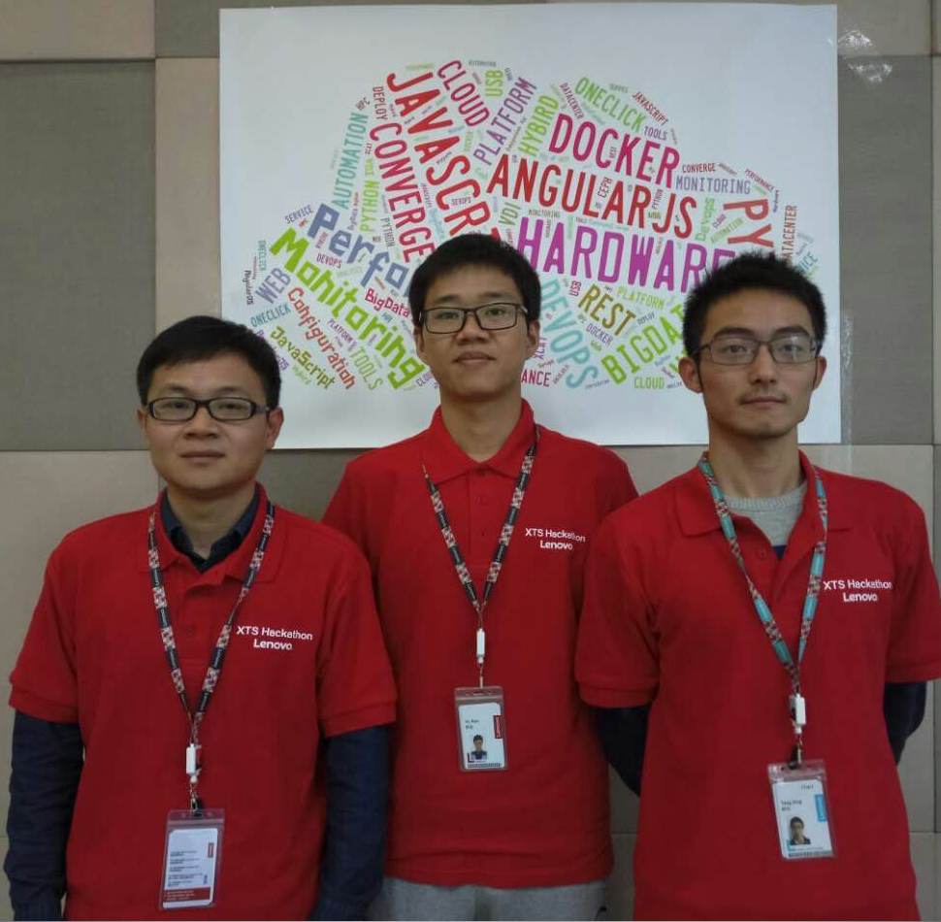
Team
毛海军
杨兴
胡边

Slide 8
Thank You Very Much

