Slide 1
AC6 Curtain Update
Mykhaylo Shumko
5 December 2019

Slide 2
Idea
If a curtain is drifting and it originally had a falling energy spectra, it should have more, slower drifting electrons
On AC6 this will be observed by higher count rates for the trailing AC6 unit
Implementation
Integrate the curtain count rates over 0.5 and 1 seconds, with and without background subtraction
Plot the integrated count ratio of the leading and following units

Slide 3
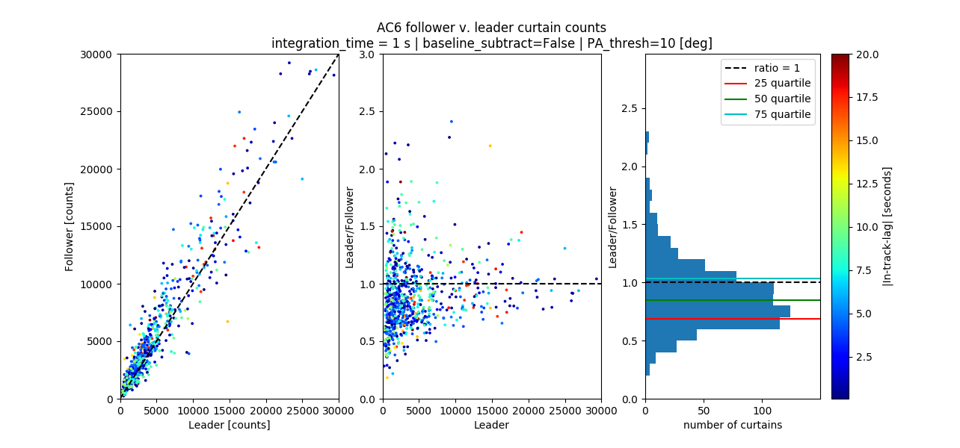
1 s integration time, no background subtraction, pitch angles within 10 degrees

Slide 4
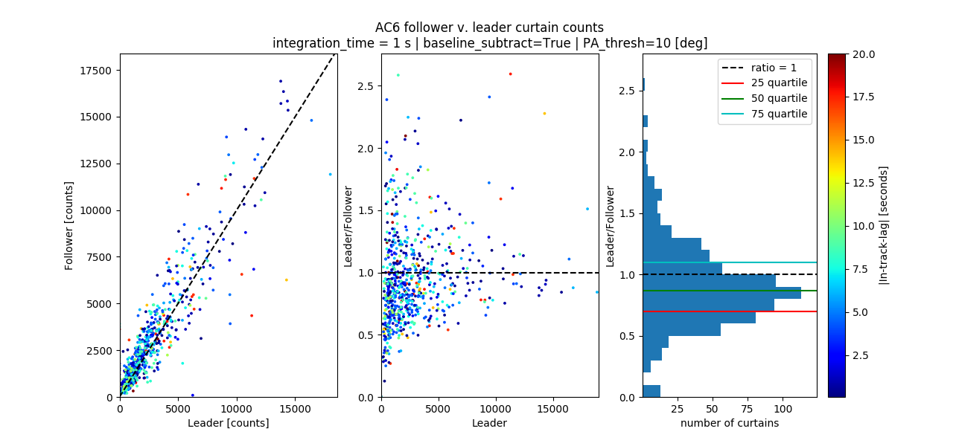
1 s integration time, background subtraction, pitch angles within 10 degrees

Slide 5
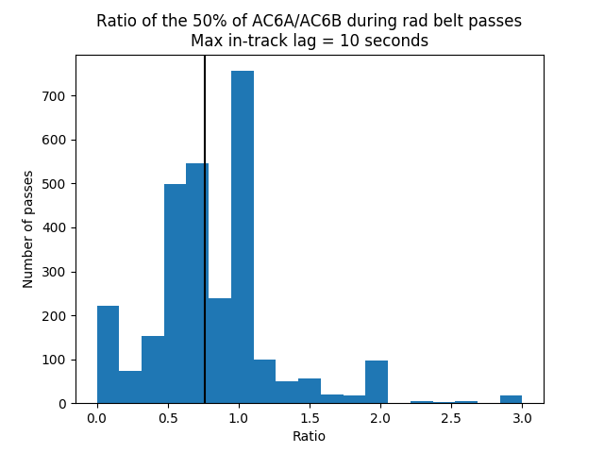
What about dos1 cross-calibration?
On average, does one unit observe higher count rates?
Implementation:
Get count rate statistics from every rad belt pass that AC6 got data together
For each shared pass, estimated the 25, 50, and 75 percentiles from each spacecraft.
Then, as shown here, took a ratio of the AC6A/AC6B median counts for every pass.
Max in-track lag of 10 seconds
AC6B (typically behind) observed more counts.

