Slide 1
Curtains observed in the bounce loss cone
Mykhaylo Shumko
6 December 2019

Slide 2
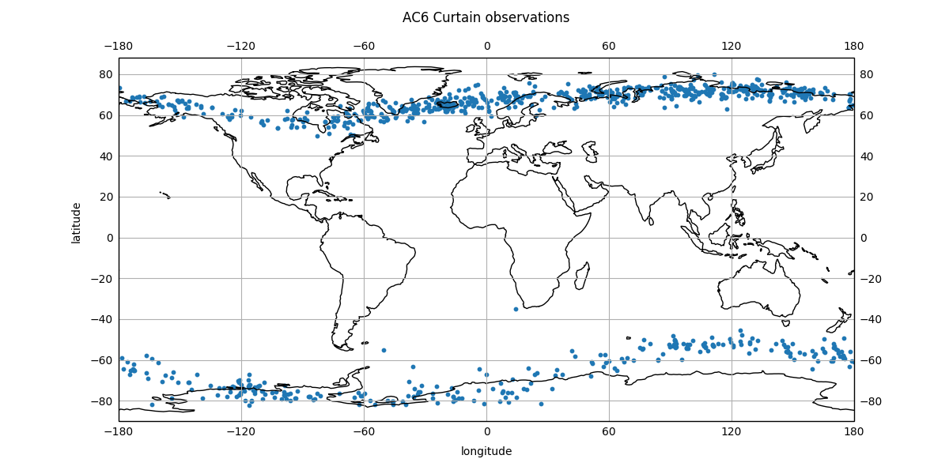
I found a bug
Drew’s comment to look at the longitudinal distribution of curtains lead me to make this plot of curtains observed around the world
My earlier comment about no curtains in the BLC is wrong. My bad
The bug was due to the east/west longitude sign convention in my filtering code

Slide 3
Validation plots
With my fixed code, I found 36 curtains in the BLC
Defined by Loss_Cone_Type = 2
I made a few curtain validation plots
The top panel shows data taken at the same time and bottom panel shows data taken at the same position after shifting by the in-track lag
I annotated AC6’s position for each curtain observation
dos1 count rates are mean-subtracted

Slide 4
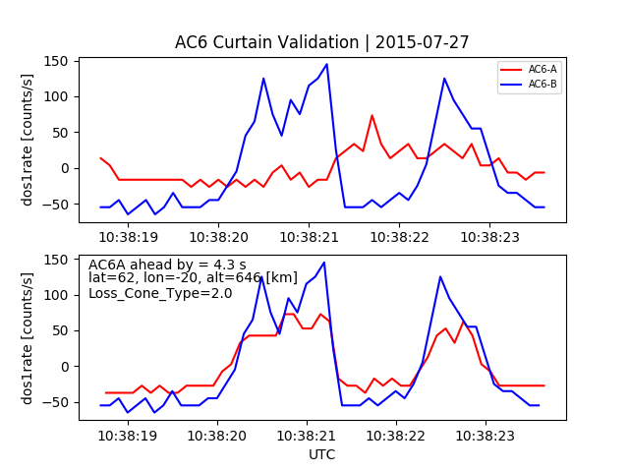
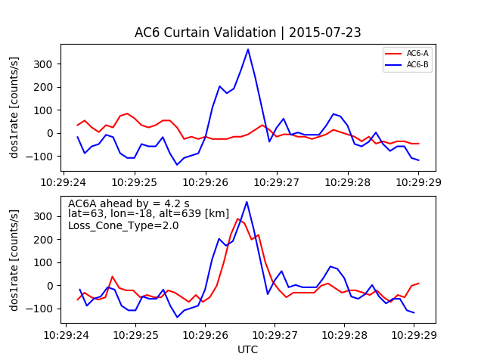
Above Iceland

Slide 5
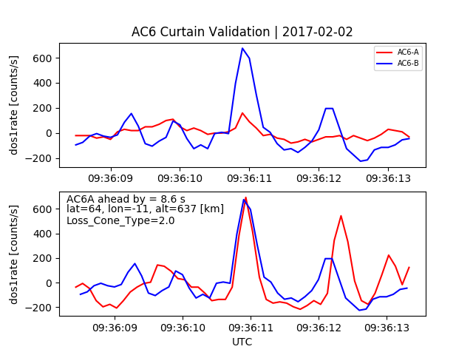
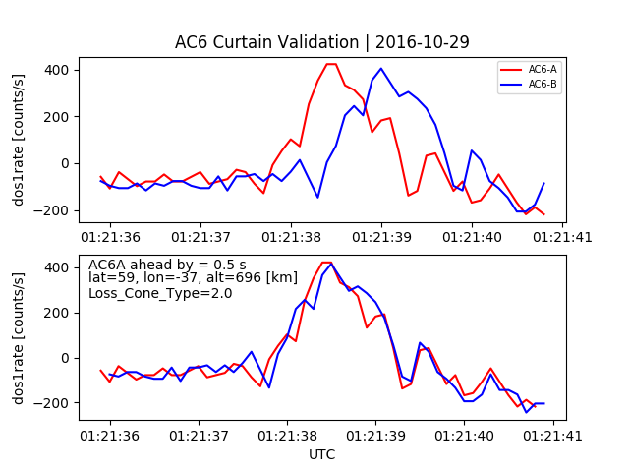
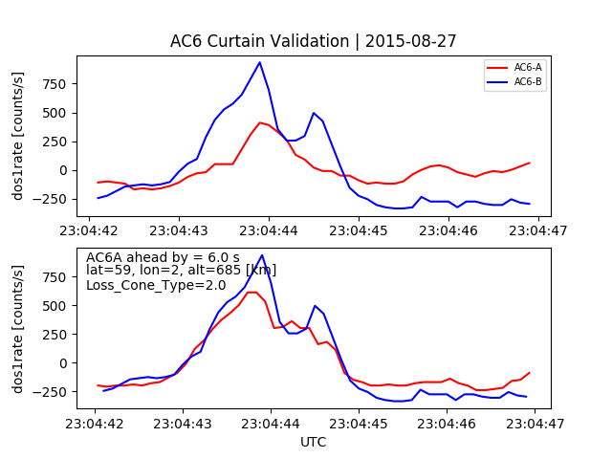
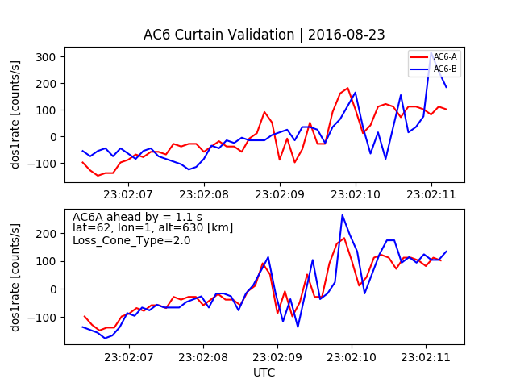
More examples

Slide 6
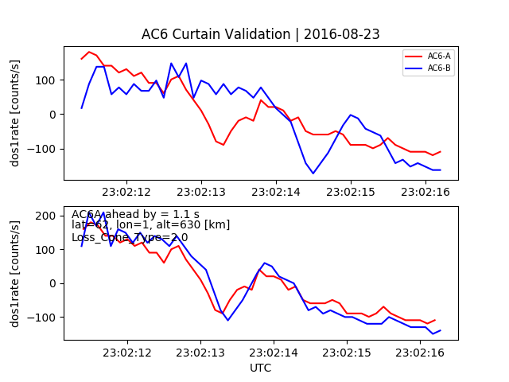
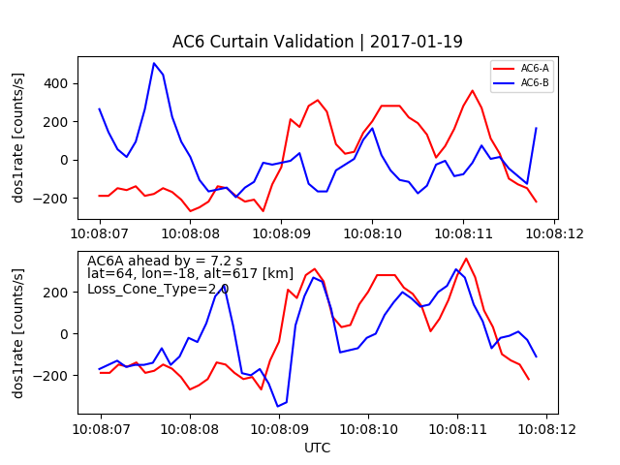
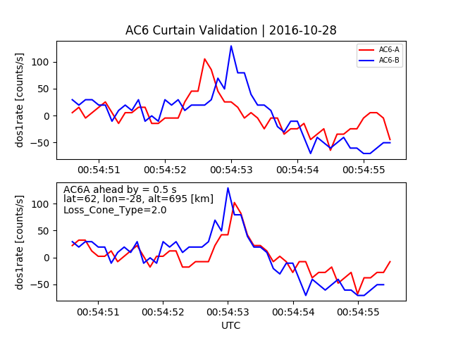
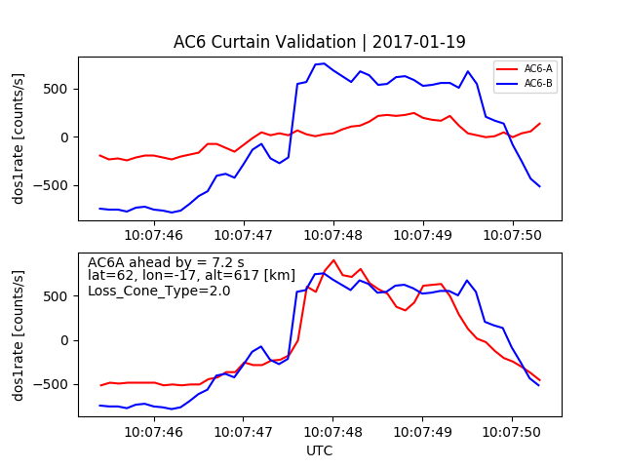
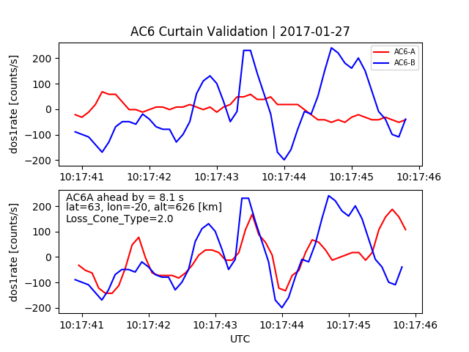
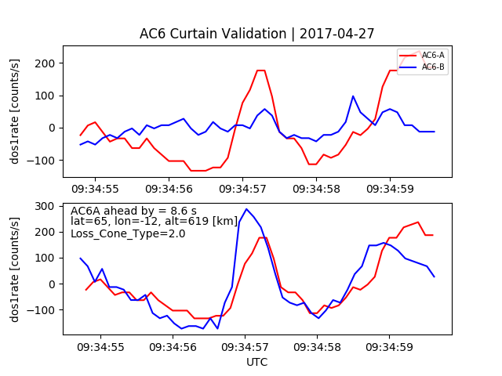
More examples

Slide 7
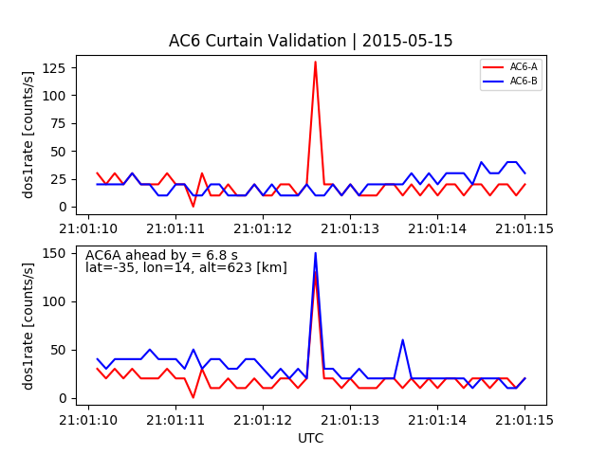
Near the SAA – due to lightning?

