Slide 1
Curtains Statistics Update
29 January 2020
Mykhaylo Shumko

Slide 2
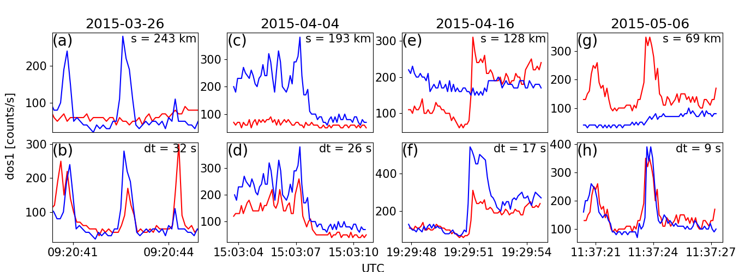
Curtain detections
Used Paul’s burst parameter to identify microburst-like spikes in the AC6 data
Cross-correlated spikes observed at the same time and position
Looked through events that had a high (> 0.8) correlation at the same position
Identified and confirmed 933 curtains

Slide 3
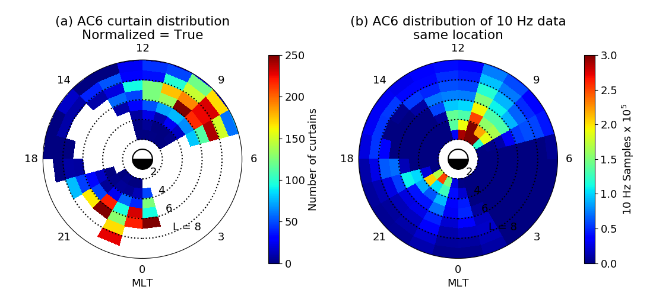
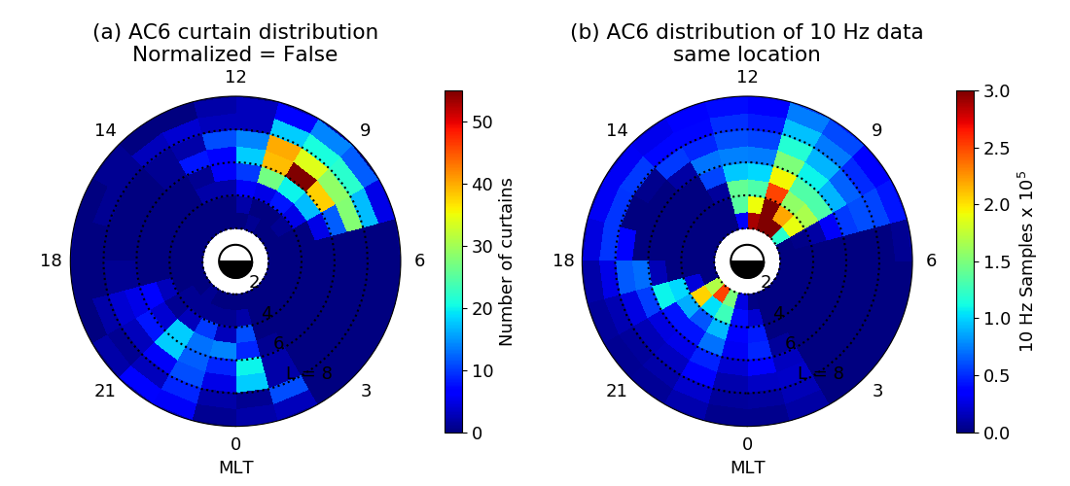
Some stats : L-MLT distribution
In the normalized case the white L-MLT bins had less than 20k good 10 Hz samples so the normalized number of curtains is not shown

Slide 4
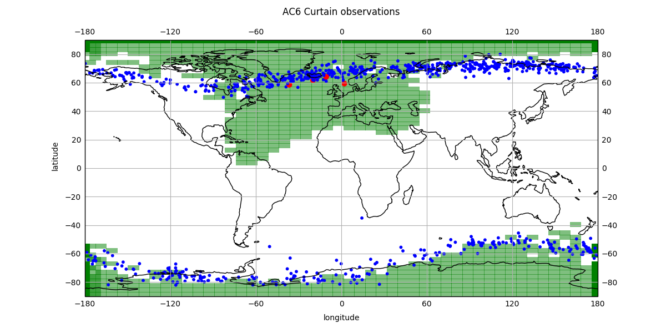
Some stats : lat-lon distribution
Blue dots = curtain detections
Green area shows the BLC/open field lines assuming the OPQ77 field model.
Curtains are observed inside the BLC region

Slide 5
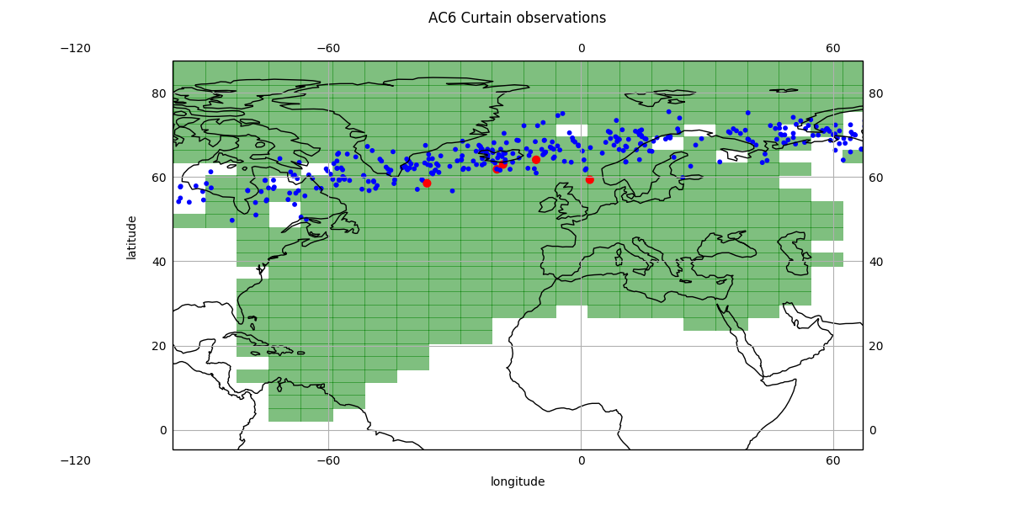

Slide 6
Examples of curtains observed in the BLC

Slide 7
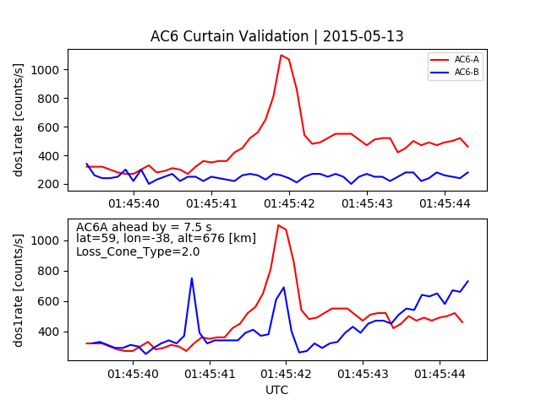
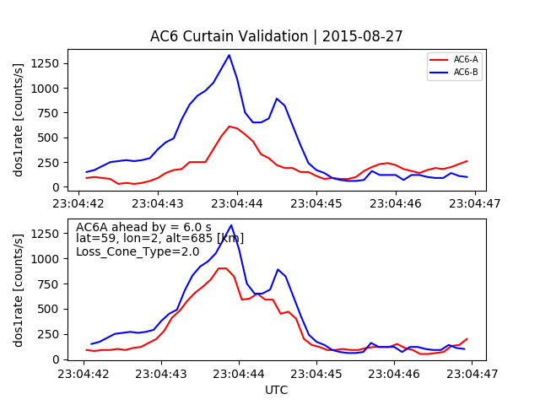
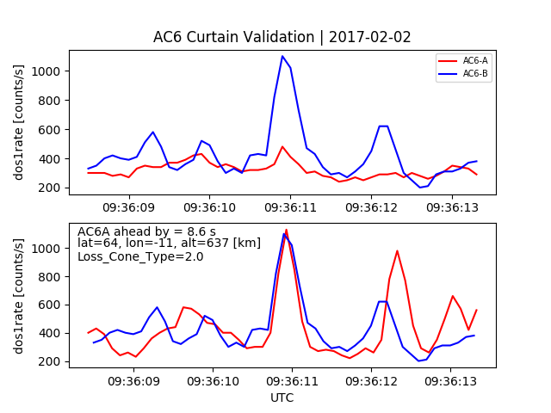
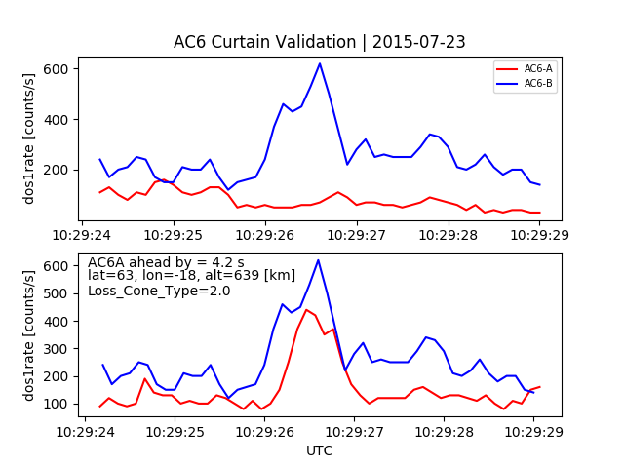
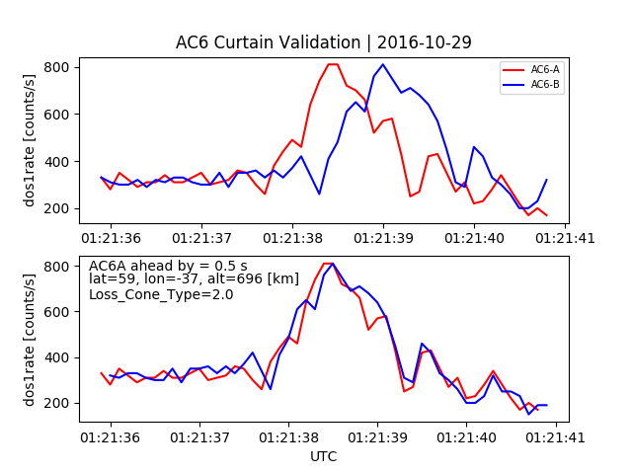
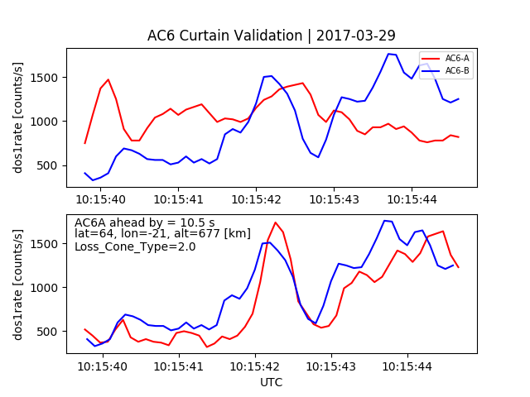
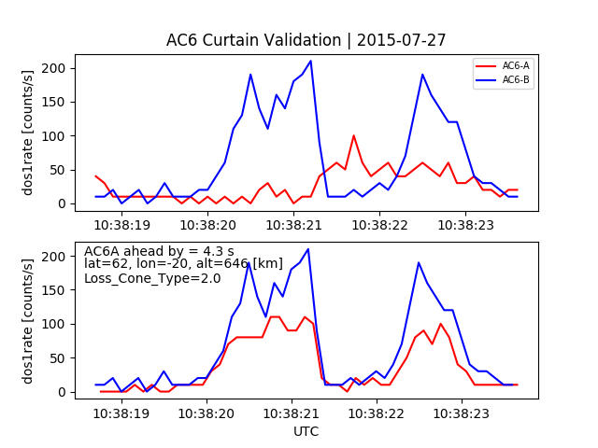
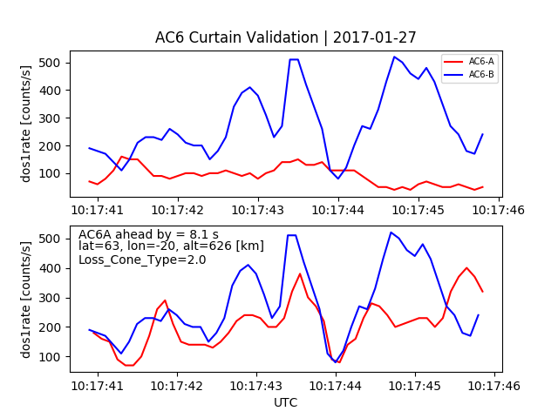
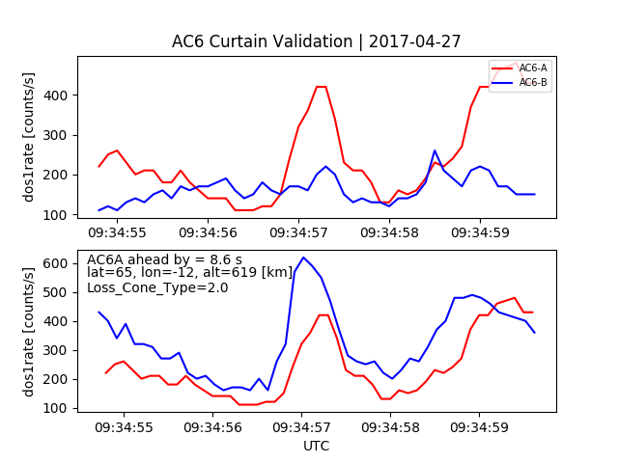

Slide 8
Case study – can choose a nicer example
Observed when AC6 was separated by 9 s
Near Iceland
Lm_OPQ = 5.6
MLT_OPQ = 10
AE = 271 nT

Slide 9
Case study - mirror point altitude
Found that the mirror point of locally mirroring electrons to be 34 km in the SAA
Electrons must have been lost. Other examples have mirror points below Earth’s surface
Since these electrons are lost, what can be driving this precipitation for at least 9 seconds?
We need a DC potential to continuously accelerate electrons
Question – What is the minimum DC potential necessary to lower the mirror point from just trapped (defined as 100 km altitude mirror point in the SAA) to AC6’s altitude?

Slide 10
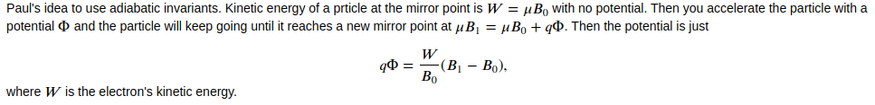
Case study – DC potential
q*Phi = 1 kV for this example. One other example I looked at had a 4.5 kV potential
Seems reasonable to be accelerated by an auroral potential
The mystery continues – are curtains related to microbursts or aurora? We now know at least some can’t be related to microbursts.

Slide 11
Paths forward
Look at the MLT of curtains in the BLC
Look at auroral imagers when AC6 is overhead in Canada
What other curtain stats do you want to see?
More work can be done but maybe this is enough work for a short JRL, followed by a more comprehensive study?

