Slide 1
AC6 Curtain Update
Mykhaylo Shumko
5 March 2020

Slide 2
Whats New
A plot of curtains in the bounce loss cone (BLC)
Curtain width distribution
Auroral Electrojet (AE) curtain distribution
Ready to assemble this into a manuscript

Slide 3
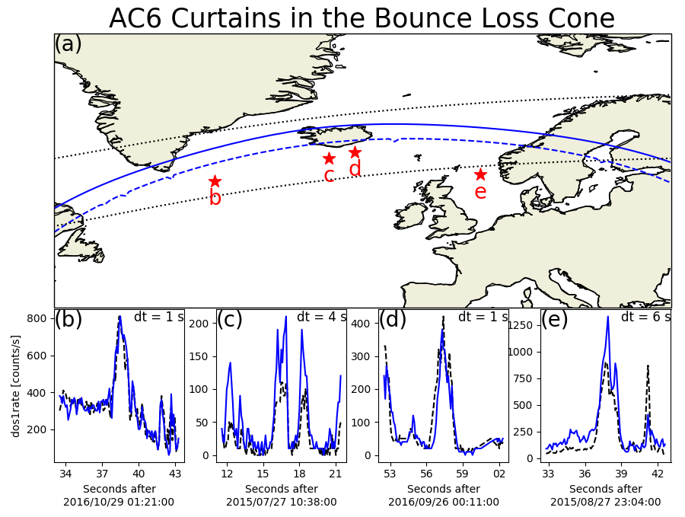
MLT of all but example
C were near midnight.
Example C was at 10
MLT
Very high AE; between 500 and 700 nT
Not near the edge of
The BLC. The edge
ranged from 25 to 50
seconds away

Slide 4
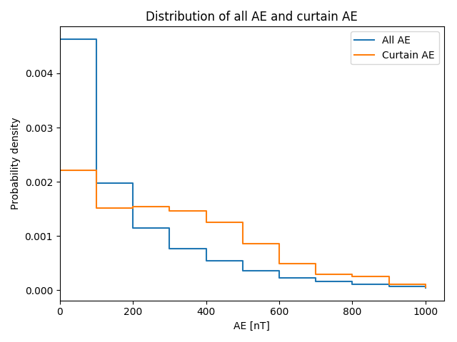
Curtains vs. Auroral Electrojet

Slide 5
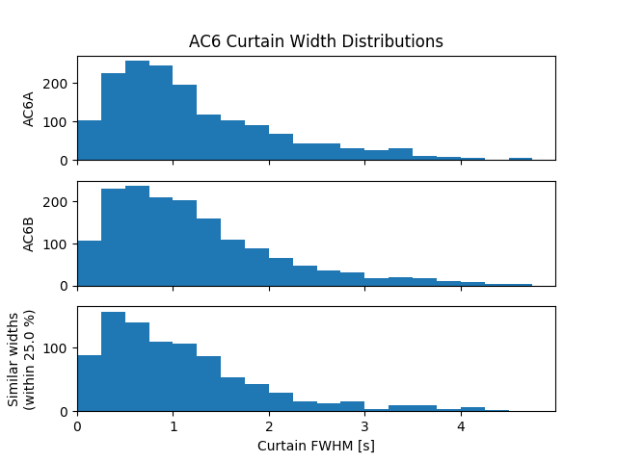
Curtain widths
Width defined as half of the topographic prominence.
Scale the x-axis by 7.5 as a rough conversion to km.
90% of curtains are < 21 km wide.

Slide 6
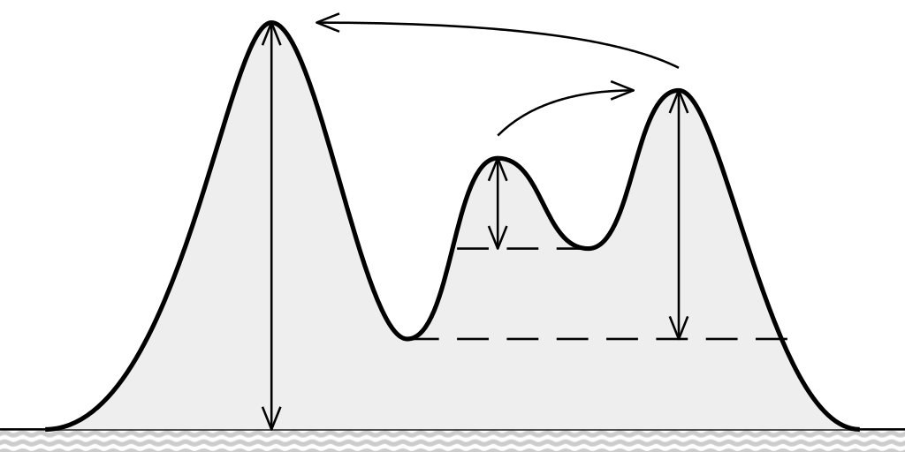
Topographic prominence

