Slide 1
Energetic Particle Precipitation Research Overview and Interests
Mykhaylo Shumko
5 May 2020

Slide 2
Background
What are microbursts?

Slide 3
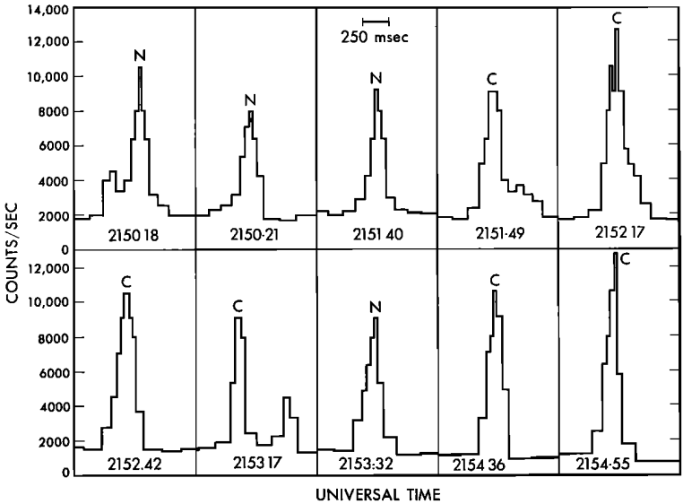
Electron Microbursts
Electron microbursts are a sub-second impulsive increase of electrons from the outer radiation belt into the atmosphere
Discovered in the mid 1960s and studied using high altitude balloons and LEO satellites
Balloons are relatively stationary so microburst precipitation is transient---lost in the atmosphere within a second
> 25 keV X-rays
Brown et al., 1965

Slide 4
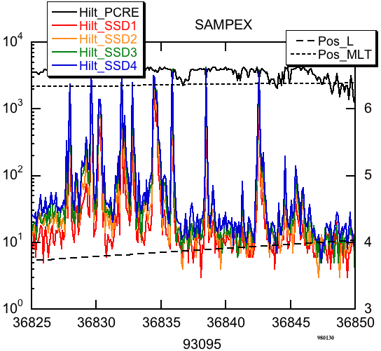
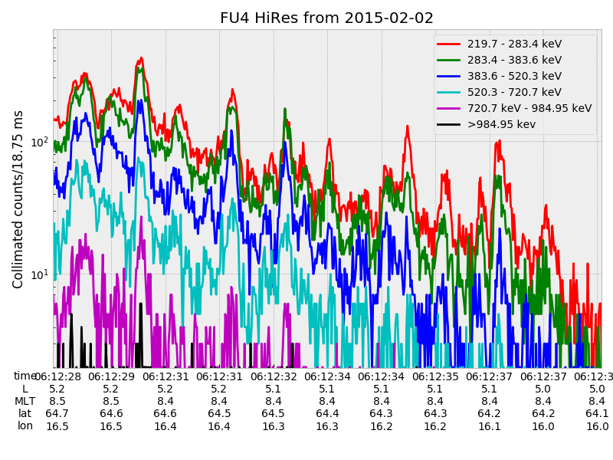
Electron Microbursts. Why should you care?
Understanding microbursts can teach us how waves scatter particles
Microbursts deplete the outer radiation belt electrons
Microbursts also affect atmospheric chemistry
Generally interesting and plasmas are weird.
Blake et al., 1996

Slide 5
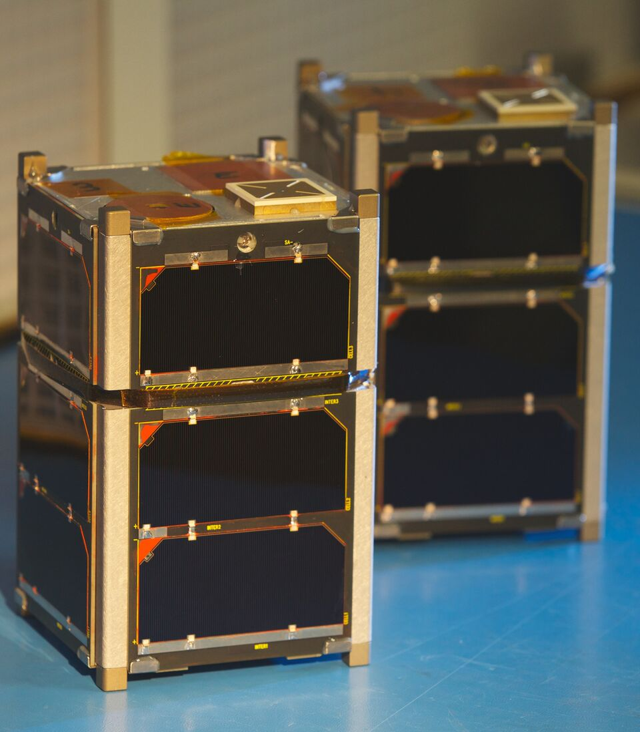
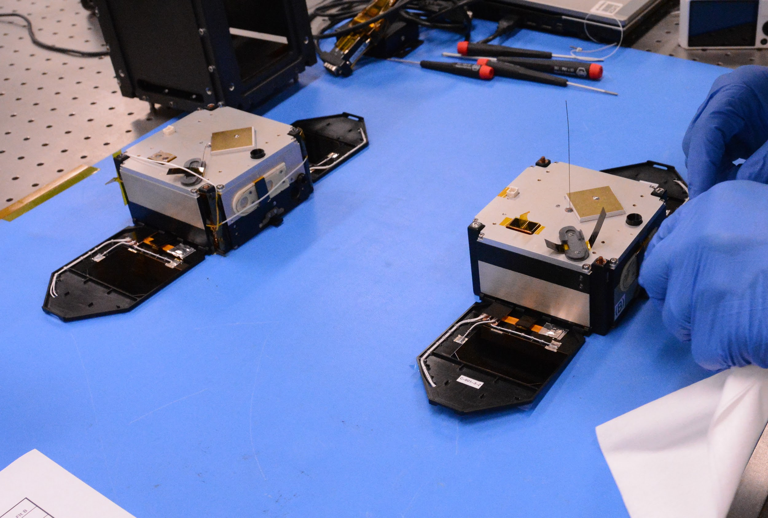
Motivation
From a balloon microbursts are obviously transient
Ambiguous arises from a fast-moving single LEO satellite
We can use multi-spacecraft missions to identify transient precipitation microbursts and newly discovered stationary curtain precipitation
FIREBIRD-II
AeroCube-6

Slide 6
The FIREBIRD-II Mission
Build by Montana State University and University of New Hampshire
Pair of 1.5U CubeSats launched on January 2015 into 600x400 km, 99° inclination orbit
Separation in-track
Solid state detectors with six programmable energy channels observing electrons from 200 keV to > 1 MeV
Flight unit 4 (FU4) is still operational and commanded by Arlo Johnson and me

Slide 7
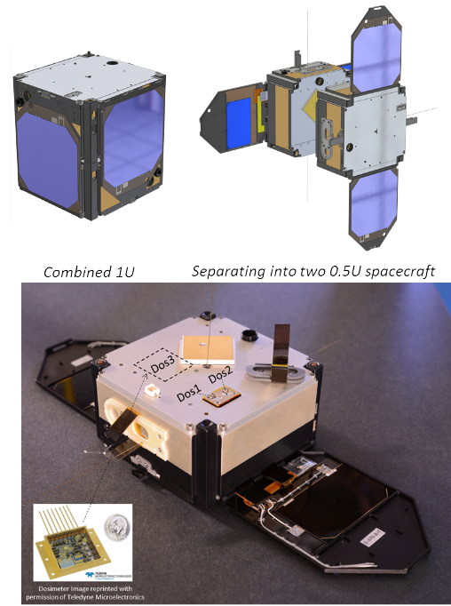
The AeroCube-6 (AC6) Mission
Pair of CubeSats, launched in June 2014 into a 620x700km, 98 degree inclination orbit
Took data together between 2014-2017
Built by The Aerospace Corporation
Their separation is mostly in-track, and was controlled via differential drag
Dosimeters measure > 30 keV electrons
O’Brien et al. [TOR-2016-01155]

Slide 8
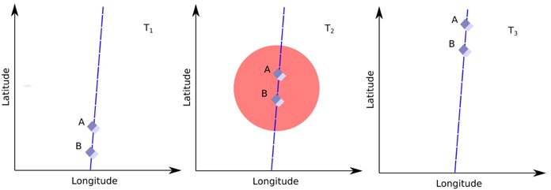
Transient Phenomena

Slide 9
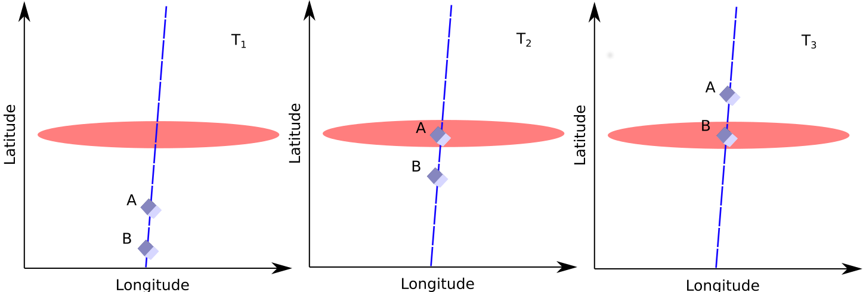
Stationary Phenomena

Slide 10
Graduate Work
How large are microbursts?

Slide 11
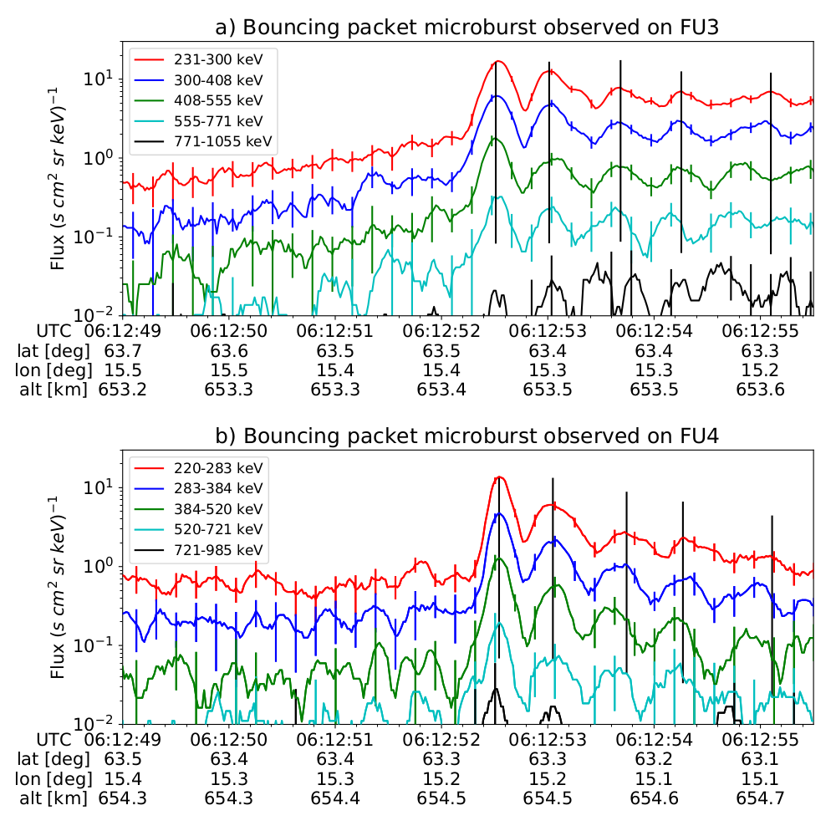
Microburst Size Estimated with FIREBIRD-II
We got lucky and simultaneously observed a microburst bouncing between mirror points
Multiple microburst peaks observed over a few seconds
Used the satellite motion mostly in latitude and eastward electron drift to estimate the size of this microburst
30 km in latitude
50 km in longitude
Maps to 500 km scale at the magnetic equator, similar to whistler mode chorus source scale size

Slide 12
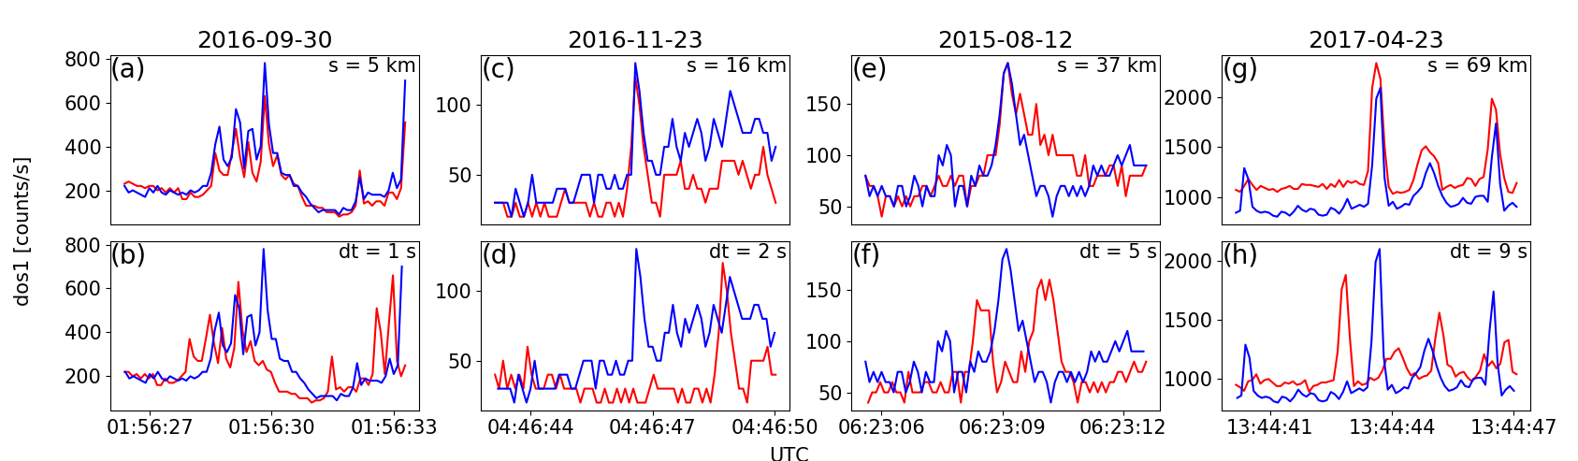
Microburst Size Distribution Estimated With AC6
AC6 observed 662 microbursts simultaneously over a range of separations
I used these microbursts to estimate the microburst size distribution

Slide 13
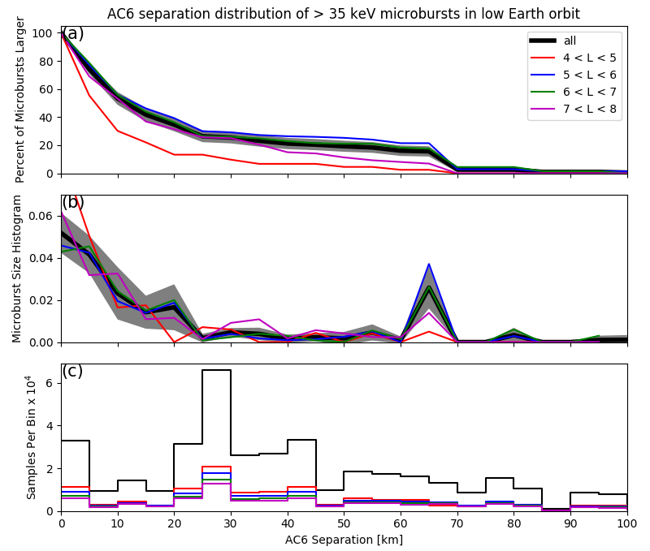
Microburst Size Distribution
Top panel: microburst cumulative distribution function as a function of AC6 separation...
The percent of microbursts larger than the separation
Middle panel: The probability density of microbursts
Bottom panel: How much did AC6 take data together for each separation
Most > 30 keV microbursts were observed at AC6 separations less than 20 km and some were observed up to 70 km
Most microbursts map to < 200 km at the magnetic equator

Slide 14
Lessons Learned
Most microbursts are smaller than 40 km, but there is evidence of a larger population up to ~100 km
Microbursts are scattered over a small region (~ 200-500 km) in the heart of the radiation belt

Slide 15
Postgraduate Work
What are electron curtains?

Slide 16
Electron curtains
A recently discovered form of electron precipitation first reported by Blake and O’Brien, 2016
Look a lot like microbursts, but are observed at the same location for up to a minute
Blake and O’Brien, 2016 proposed that curtains are remnants of microbursts drifting around the Earth
In this ongoing study, I look at the statistical properties of curtains and test the curtain hypothesis

Slide 17
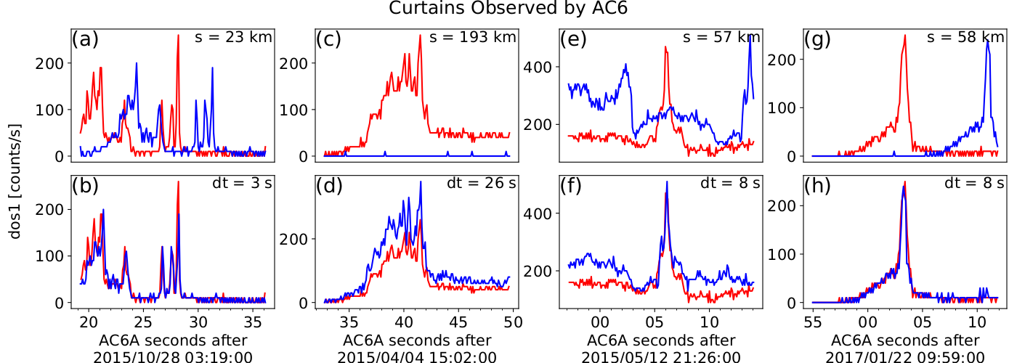
Examples of curtains
> 30 keV electrons from AC6-A in red and AC6-B in blue. Data taken at the same time in the top row and at the same position in the bottom row (AC6-B time shifted by dt seconds)

Slide 18
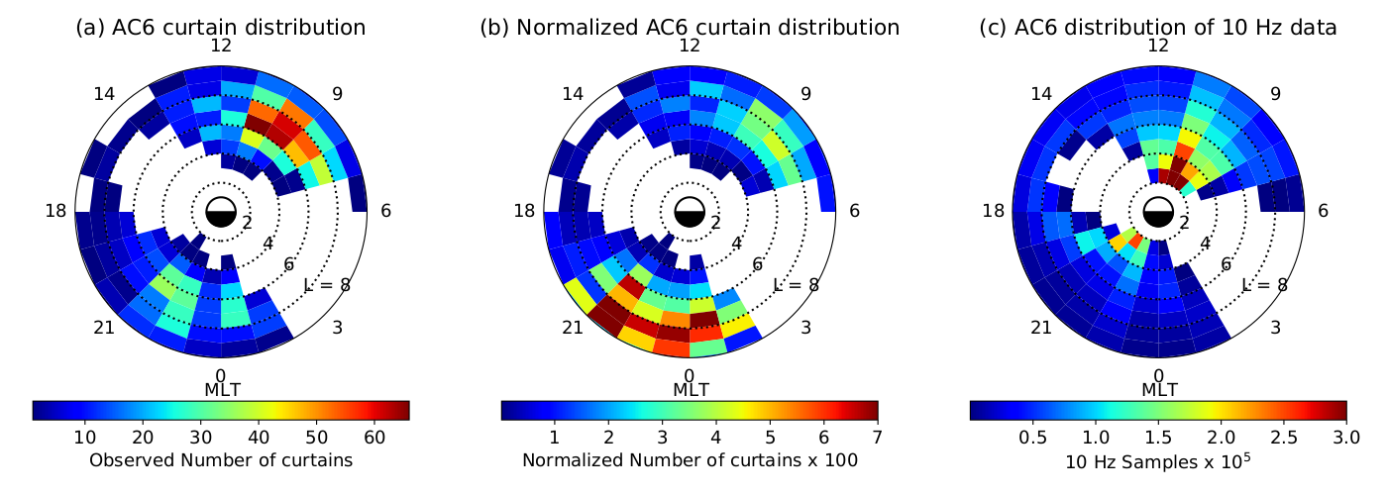
Global Distribution
Found 1634 curtains
Curtain precipitation is an outer belt phenomena
Higher occurrence rate near midnight MLT

Slide 19
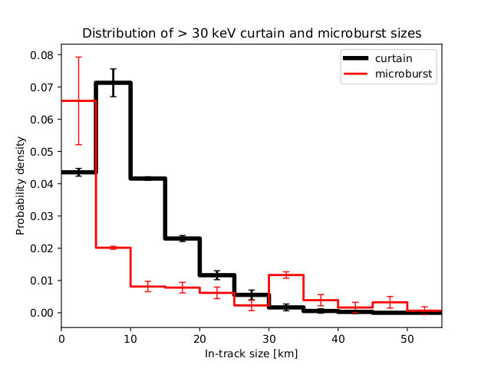
Curtain Width In Latitude
Curtains are very narrow in latitude and 90% are narrower than 21 km
Very similar size distribution to microbursts
Curtains are very likely to be elongated in longitude

Slide 20
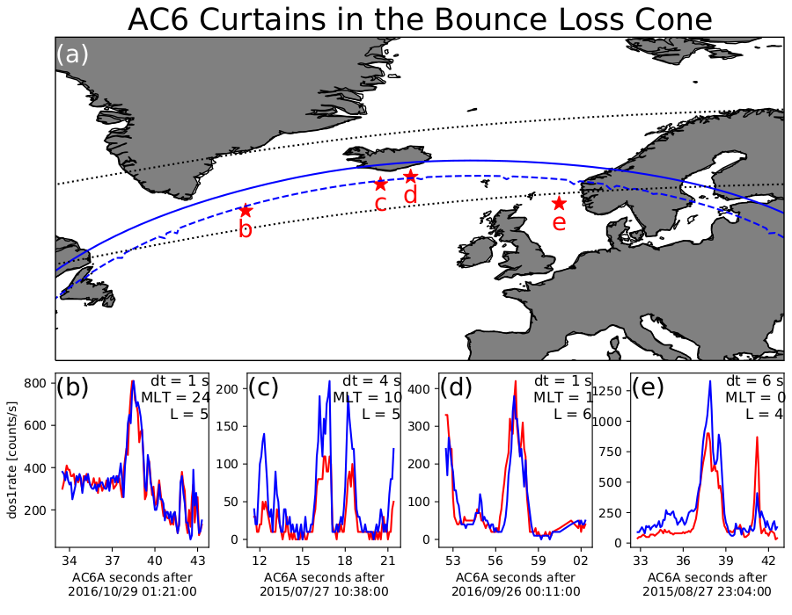
Are curtains drifting or precipitating?
Curtains observed in the bounce loss cone imply that at least some must be precipitating for multiple seconds and not related to microbursts
Map legend:
outer belt boundary
Northern boundary where locally mirroring electrons have a conjugate mirror point at 100 km in the SAA
Northern boundary where locally mirroring electrons have a conjugate mirror point at sea level in the SAA
Location where curtain was observed

Slide 21
Conclusions
Most of the evidence hints that curtains and microbursts are related
BUT curtains observed in the bounce loss cone
Could curtains be related to the aurora? For example, the inverted-V structures observed by FAST [Partamies et al., 2008]?
Future project: look for auroral arcs in ground-based imagers when AC6 was overhead
Looking forward to join you all in person soon!

