Slide 1
Curtains in the bounce loss cone
Mykhaylo Shumko
5 December 2019

Slide 2
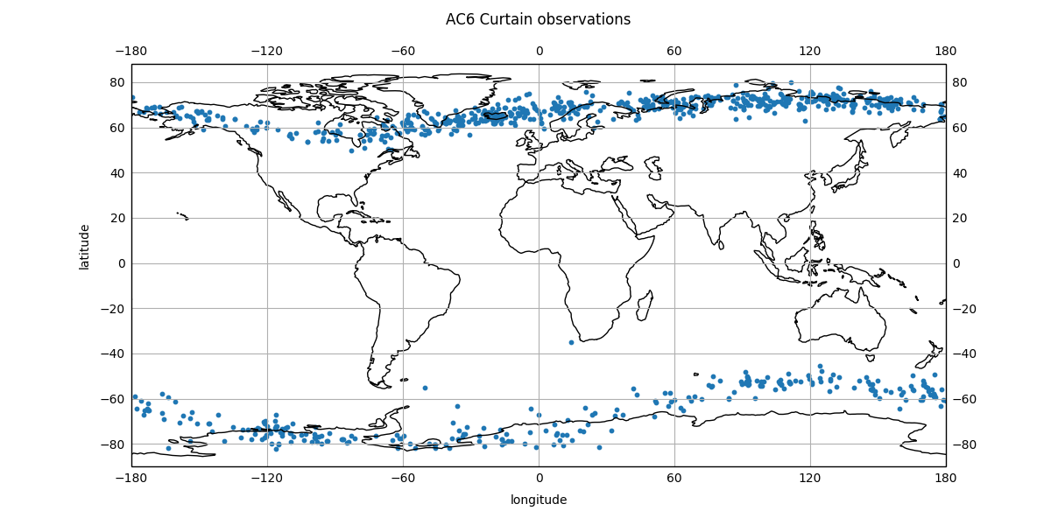
I found a bug
Drew’s comment on the longitude distribution of curtains got me to make the plot on the left
This plot shows where above Earth curtains were observed
My earlier comment about no curtains in the BLC is wrong. My bad
The bug was due to the east/west longitude sign convention

Slide 3
Validation
With my fixed code, I found 159 curtains in the BLC
I defined the BLC perimeter by 56 < lat < 76 and -30 < lon < 10
Now I am working to check if

Slide 4
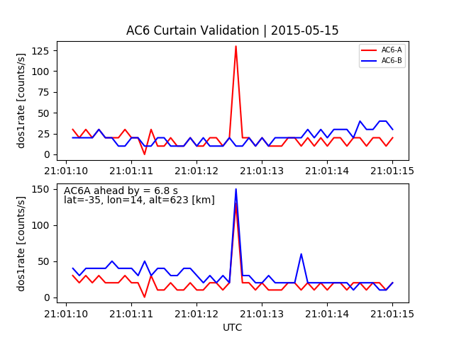
A few validation plots – due to lightning?

