Slide 1
AC6 Curtain Update
Mykhaylo Shumko
27 February 2020

Slide 2
Whats New
Developed a new detection method based on
a 10 second running average. Curtain must be > 2*std above the average
Spatial Pearson correlation > 0.8
Automatically identified and checked 6,000 candidate curtains

Slide 3
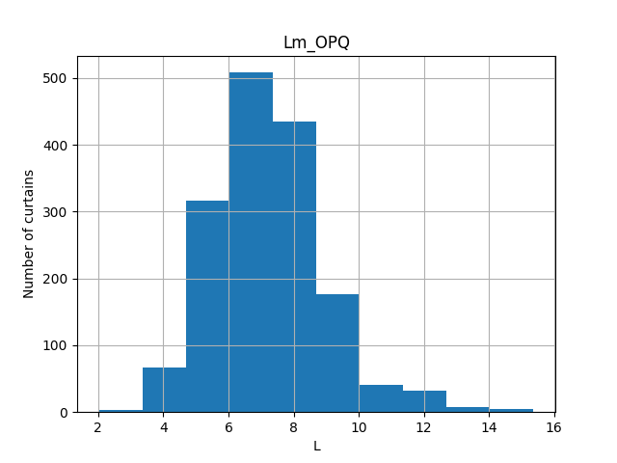
L shell distribution

Slide 4
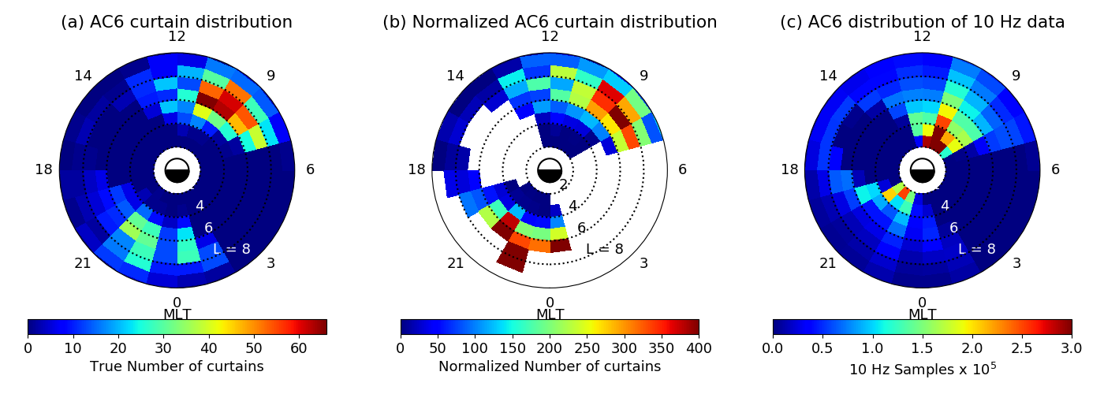
L-MLT distribution

Slide 5
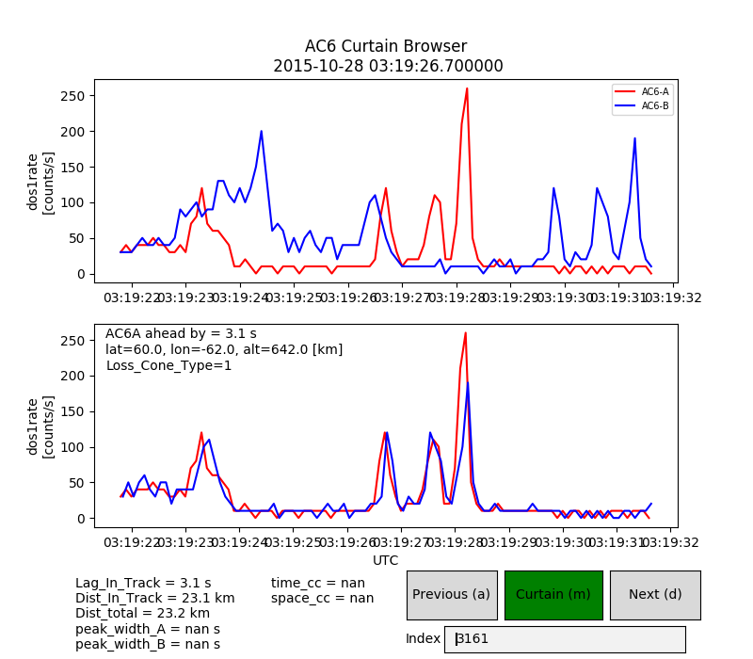
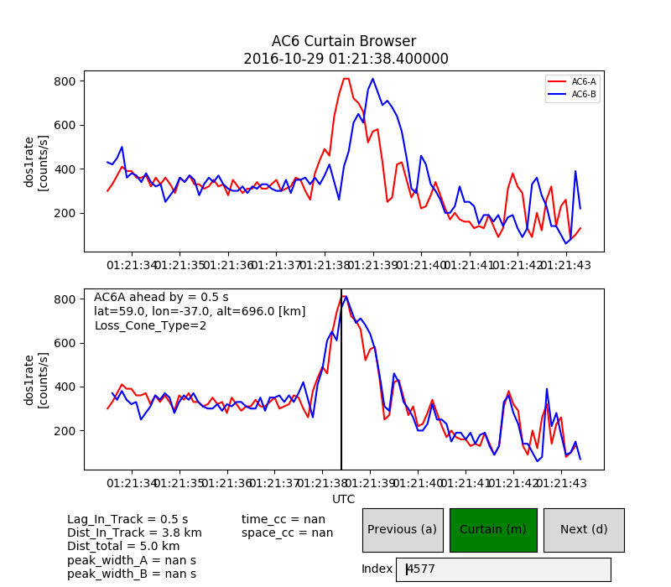
Examples

Slide 6
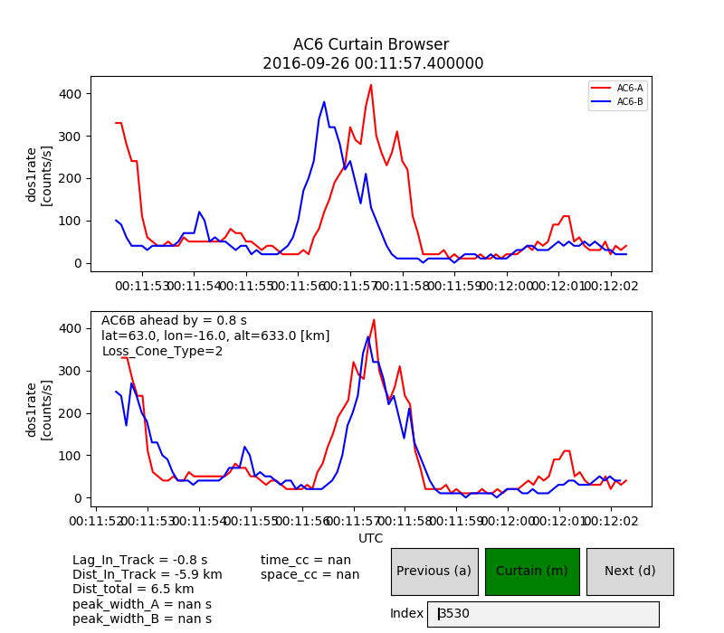
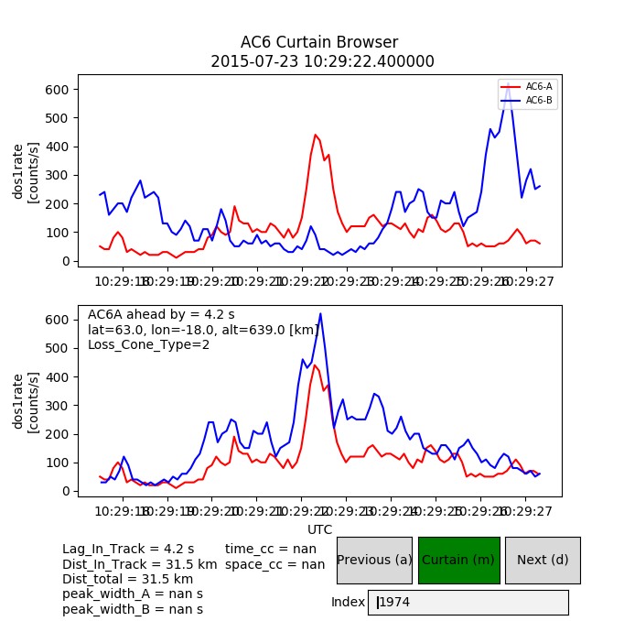
Examples

