Slide 1
Curtains in the bounce loss cone
Mykhaylo Shumko
5 December 2019

Slide 2
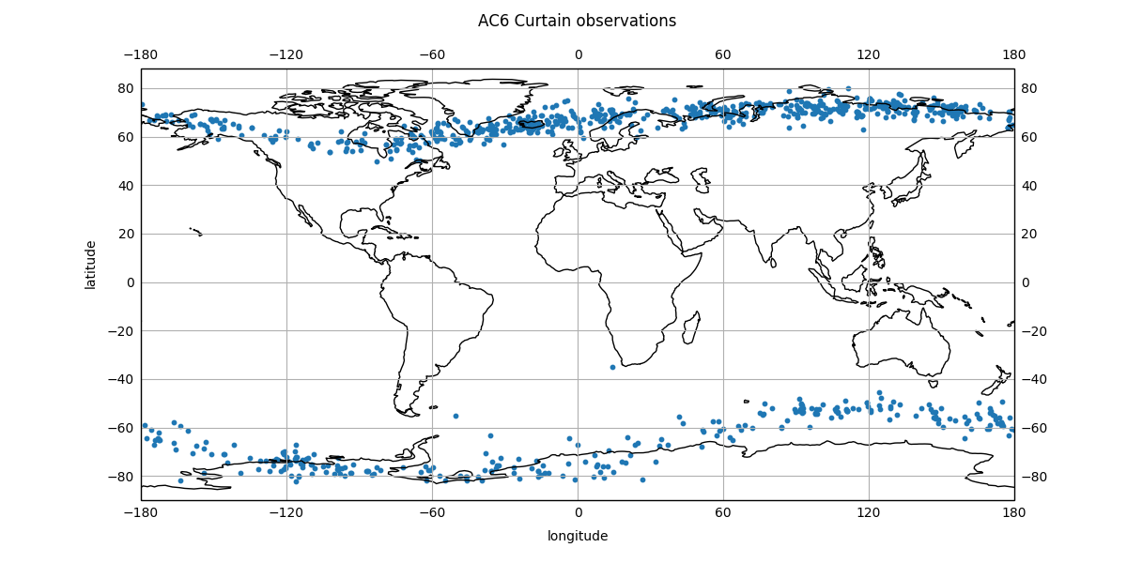
I found a bug
Drew’s comment on the longitude distribution of curtains got me to make the plot on the left
This plot shows where above Earth curtains were observed
My earlier comment about no curtains in the BLC is wrong. My bad
The bug was due to the east/west longitude sign convention

Slide 3
Validation
With my fixed code, I found 110 curtains in the BLC
I defined the BLC perimeter by 56 < lat < 76 and -30 < lon < 10
I am checking for other mistakes
I made a few curtain validation plots
As with Bern’s plots the top panel is data from the same time and bottom panel is shifted by the in-track lag
I annotated AC6’s position for each curtain observation

Slide 4
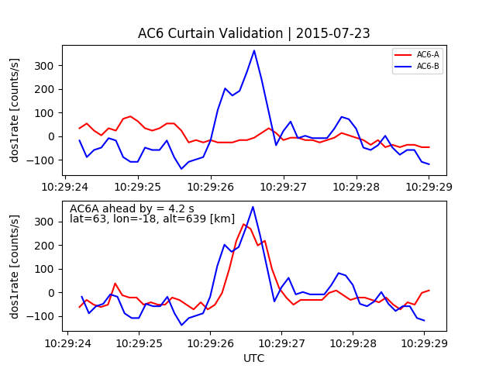
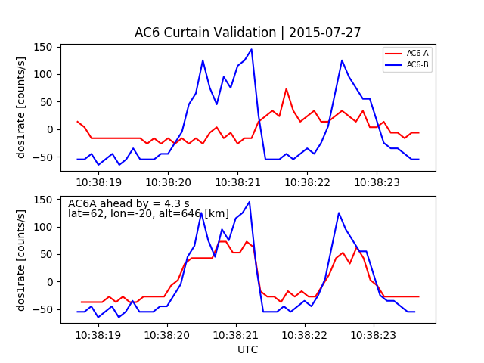
Above Iceland

Slide 5
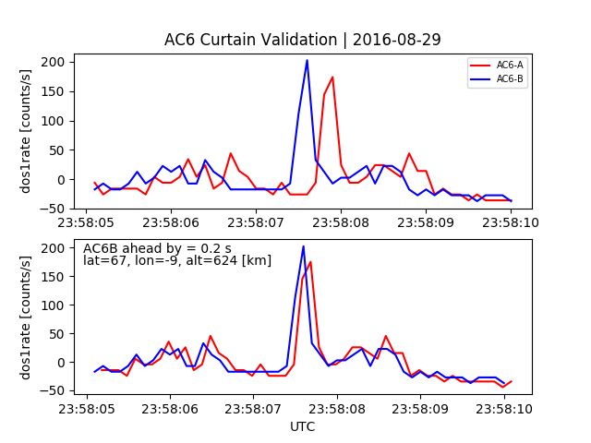
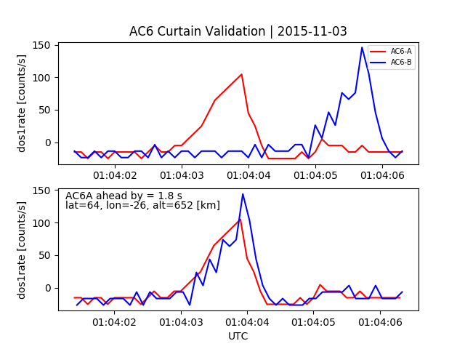
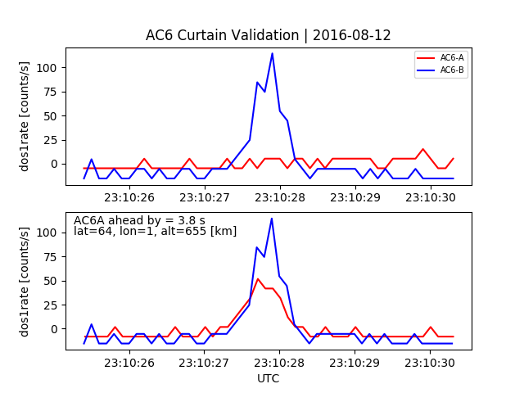
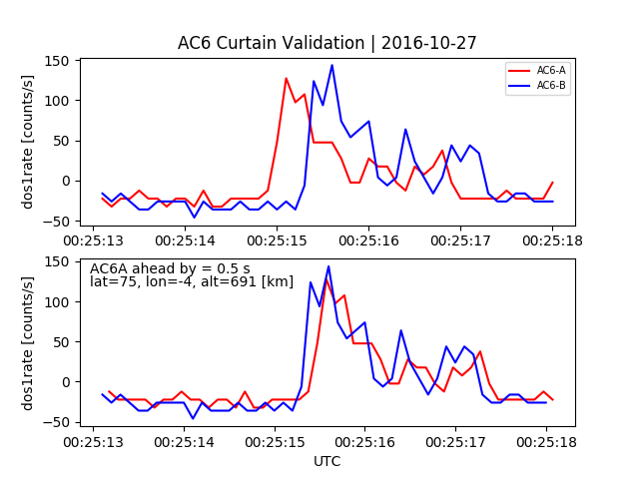
More examples

Slide 6
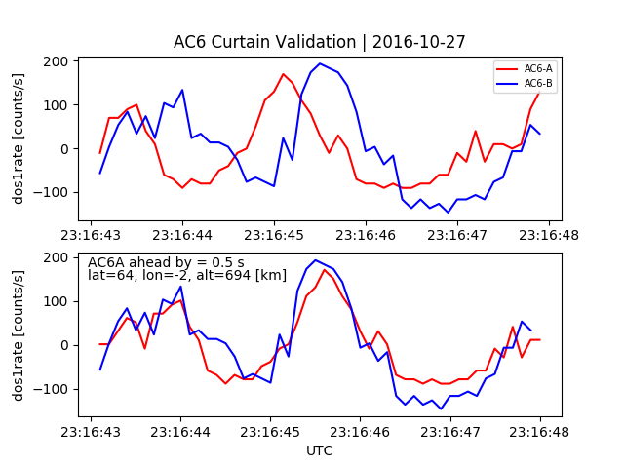
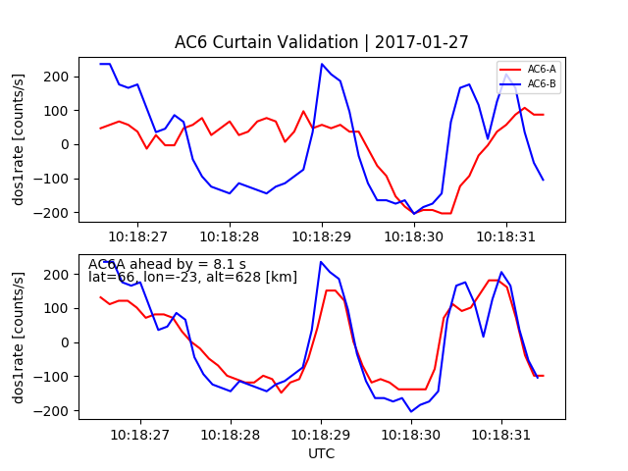
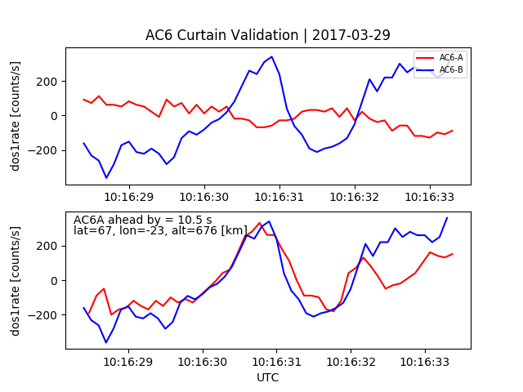
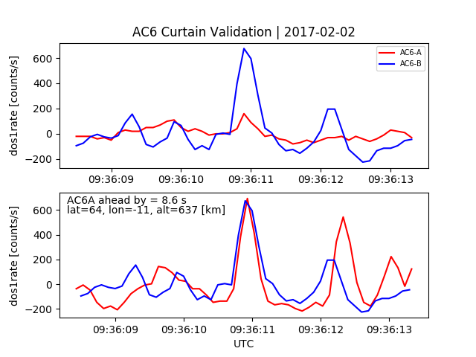

Slide 7
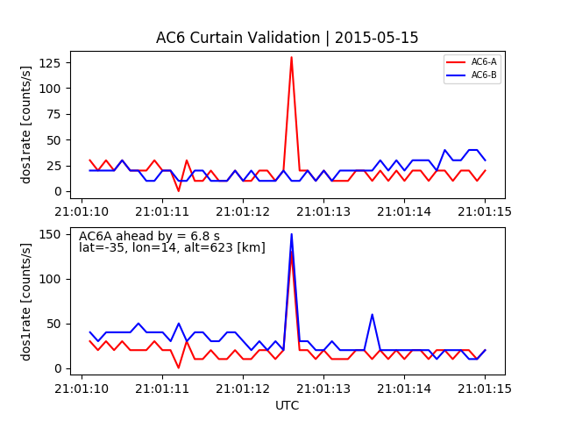
A few validation plots – due to lightning?

