Slide 1
BARREL 3G 3F Microburst Amplitudes
Mykhaylo Shumko
2020-04-15

Slide 2
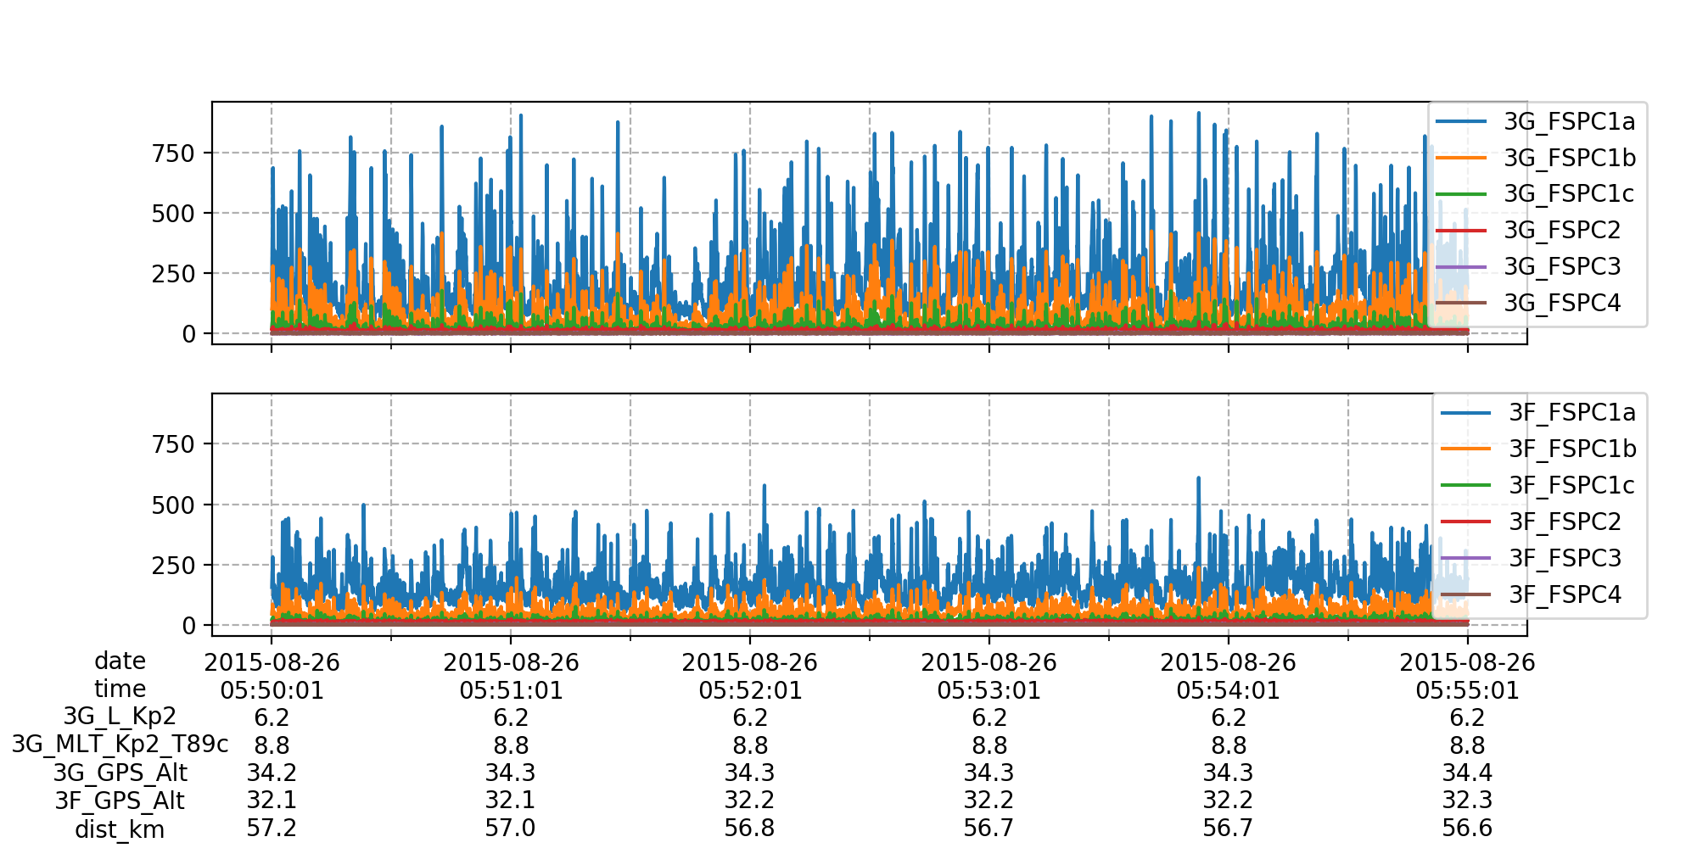
The higher balloon almost always observed higher amplitude microbursts

Slide 3
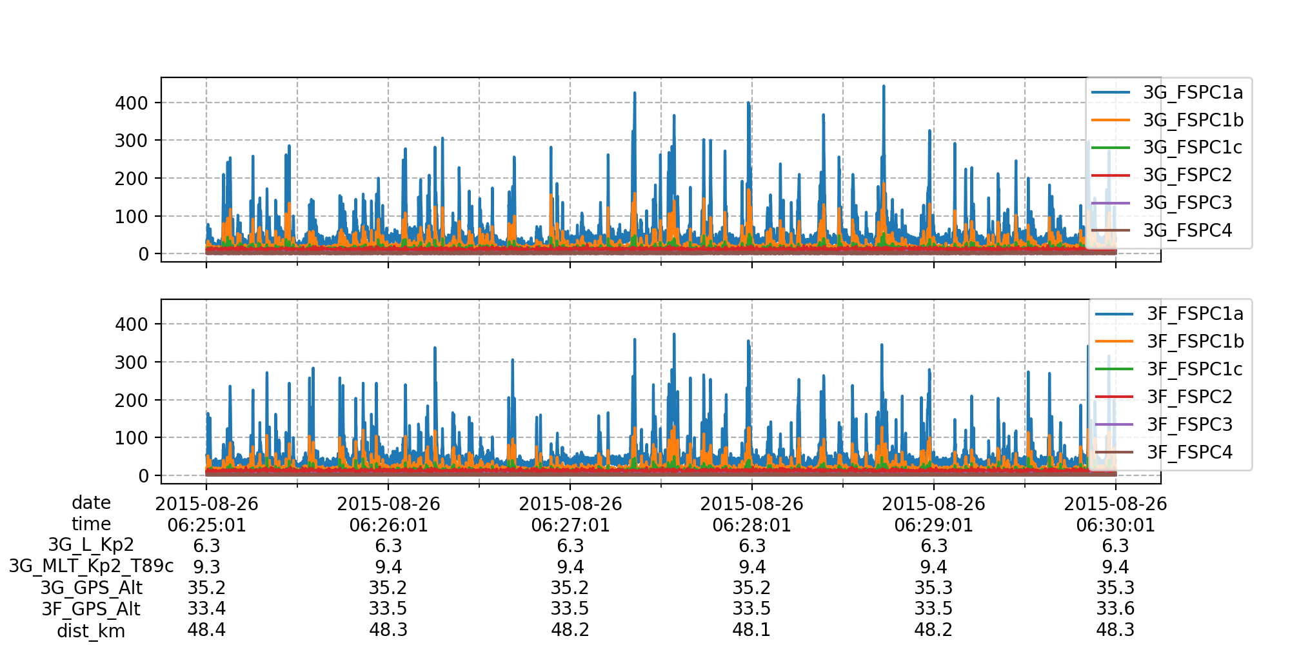
But there are exceptions

Slide 4
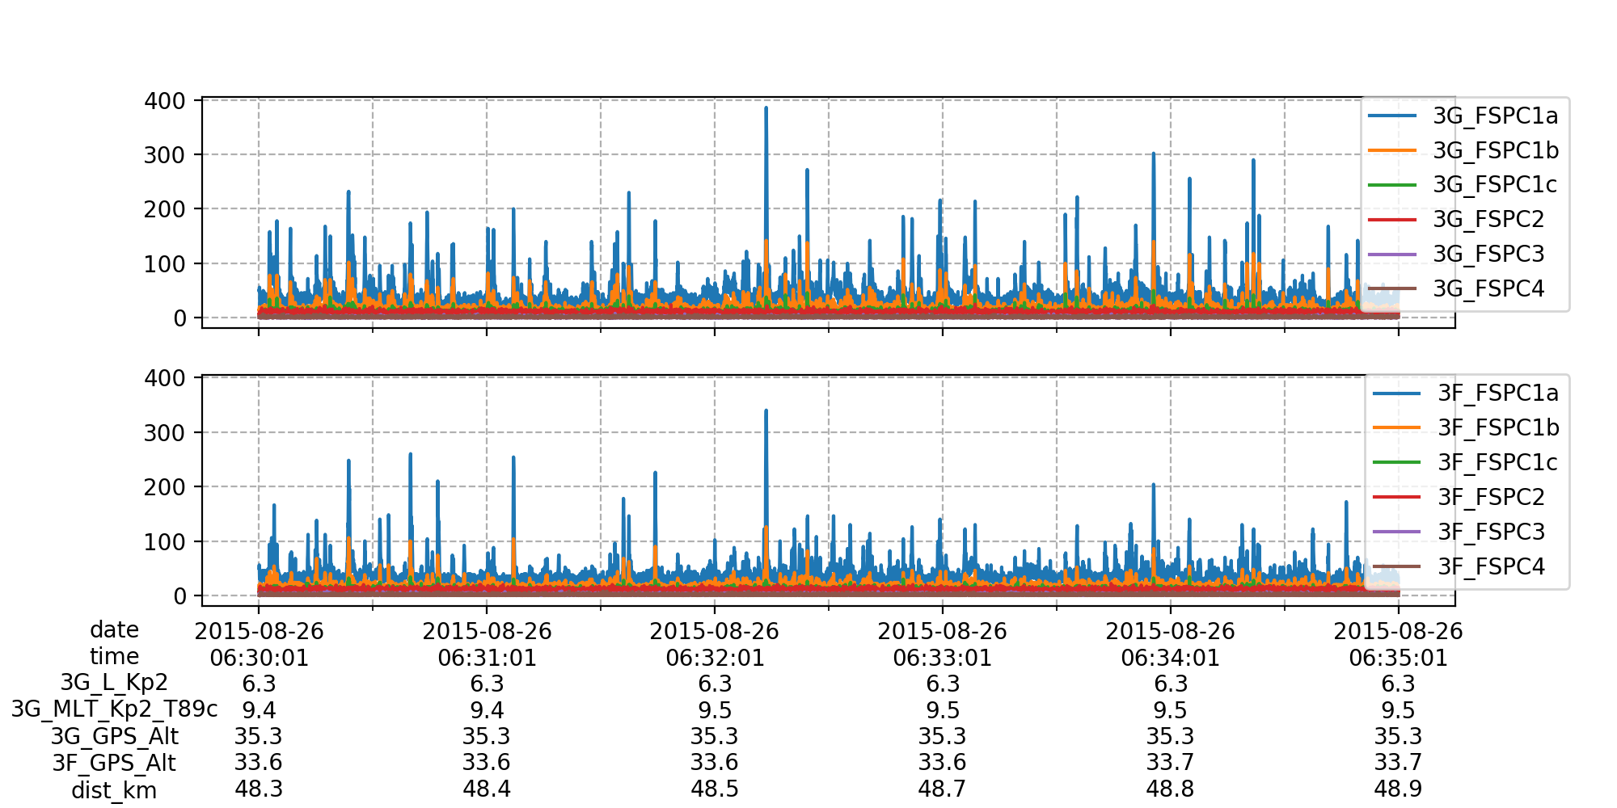
But there are exceptions

