Slide 1
Microburst duration distributions using FIREBIRD-II
Mykhaylo Shumko
2023-01-30

Slide 2
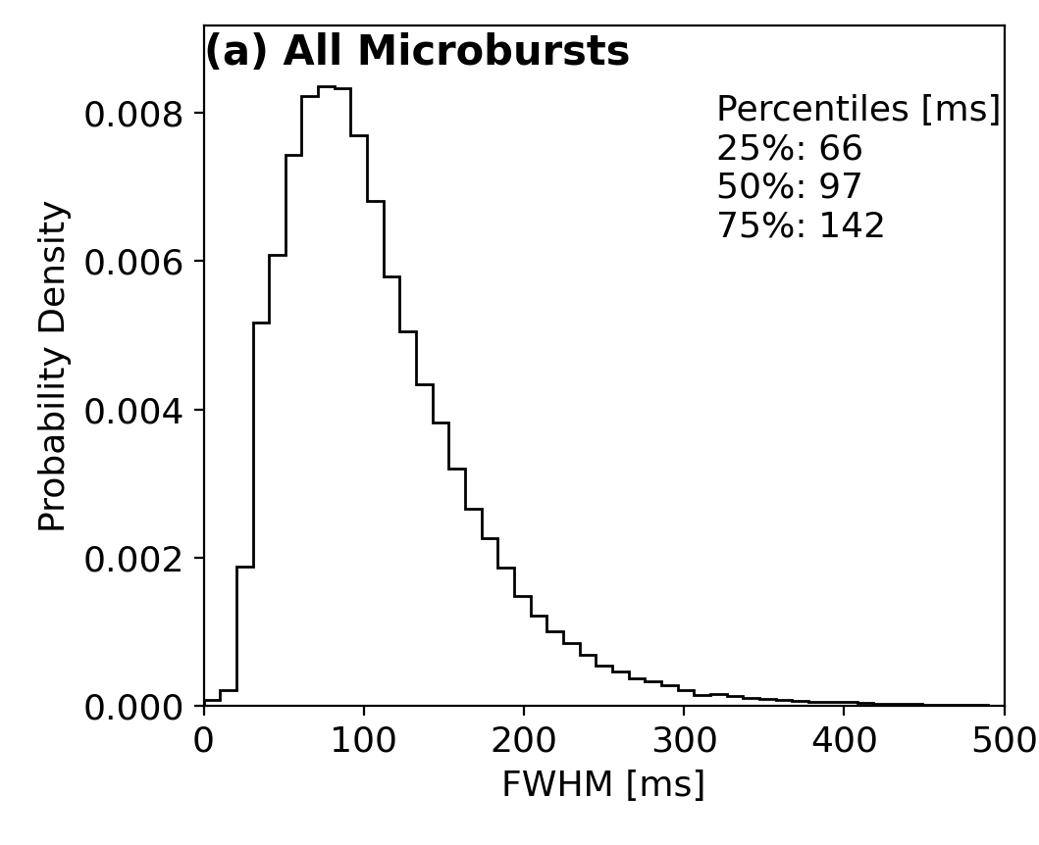
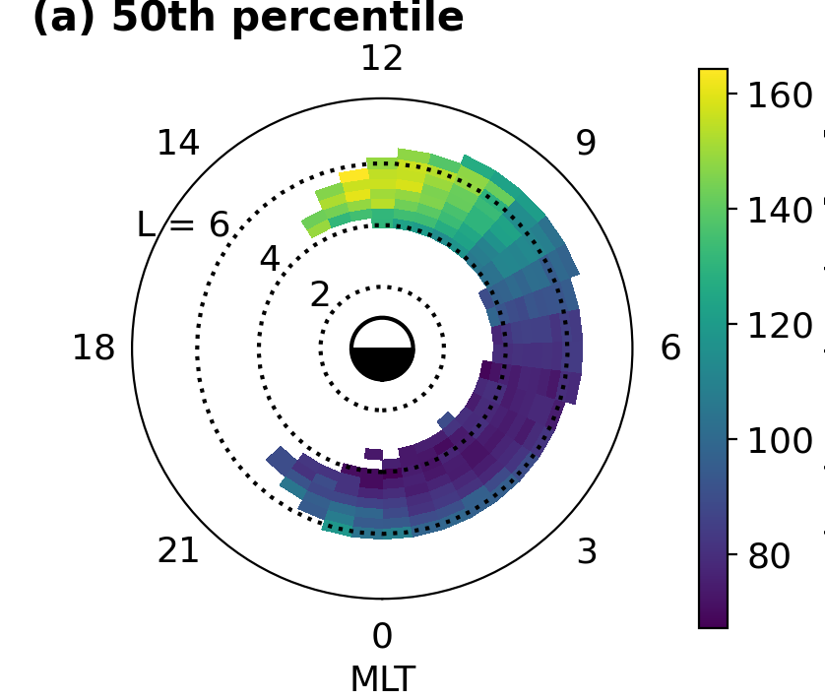
Background: a follow-on study from the Shumko et al., (2021) SAMPEX study
> 1 MeV microbursts have a ~ 100 ms duration.
Doubles in MLT.

Slide 3
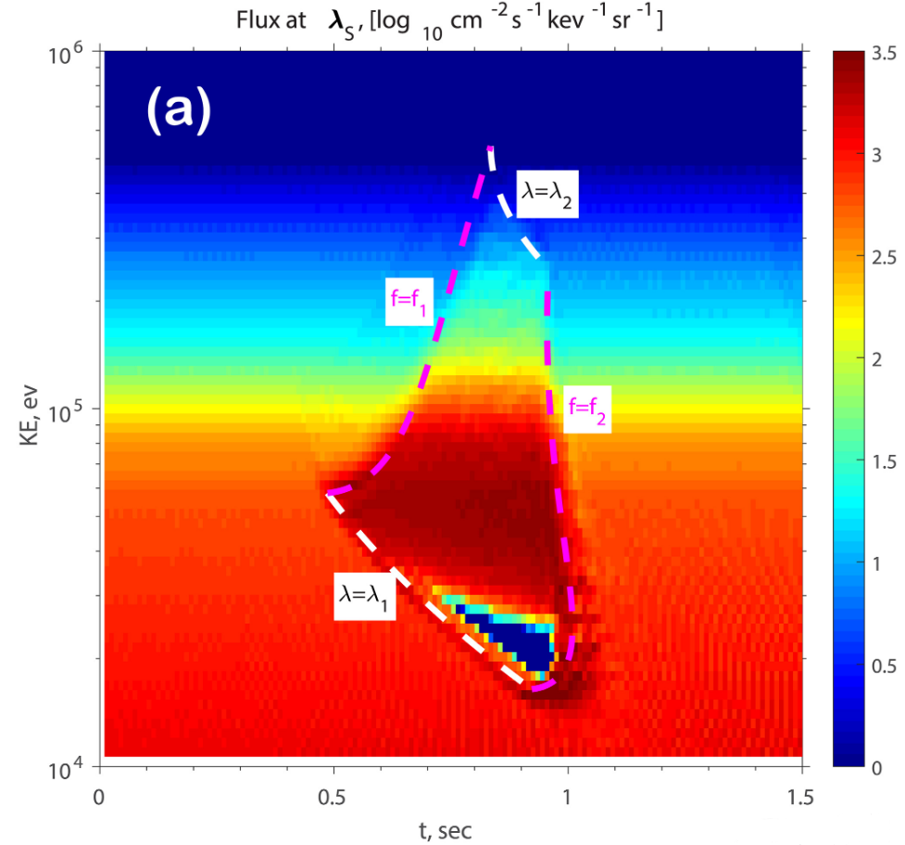
Background: a follow-on study from the Shumko et al., (2021) SAMPEX study
What about as a function of energy?
Chen et al., (2020) shows that the duration of the increased microburst flux has an energy dependence.

Slide 4
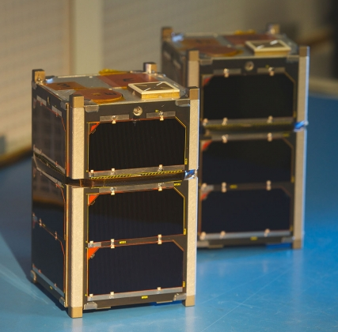
Present study: microbursts observed by FIREBIRD-II.
Pair of 1.5-U CubeSats launched in 2015.
Collimated detector sensitive to 200 keV - > 1 MeV electrons in 6 energy channels
Geometric factor ~ 5 cm^2 sr
Programmable cadence from 12.5 to 50 ms.

Slide 5

Fitting microbursts
Use only microbursts taken at a < 50 ms cadence
Including 18.75 & 12.50 ms cadence
Refer to Johnson et al., (2020) for cadence and campaign details (table 4)
Identified via the burst parameter with > 10 threshold
Resulting 1710 microbursts were fit with a Gaussian + linear trend
Duration quantified by FWHM of the Gaussian
Version 0 of the fit parameters:
Fit 0.3-seconds of data
Initial FWHM guess = 0.1-seconds
Goodness of fit quantified by the R^2 and adjusted R^2 metrics.
650 microbursts with max(r^2) > 0.9 across the 6 energy channels.

Slide 6
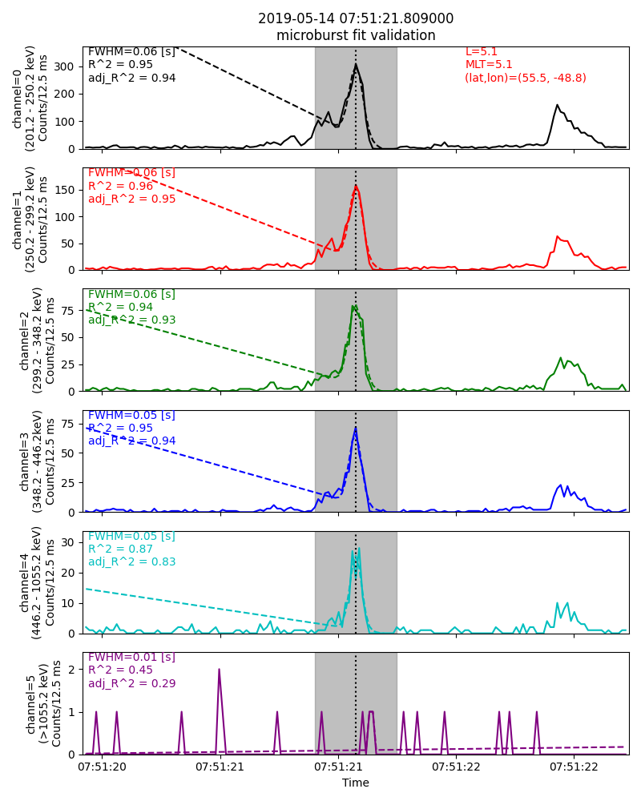
Good Examples
Collimated counts vs time for all energy channels
Solid lines show the data, dashed lines show the fit
Fit duration shown by the grey bar
Peak time in the 200 keV channel show by the dotted black line
Fit parameters for each channel shown on the left of each panel
FIREBIRD location shown in the upper-right corner

Slide 7
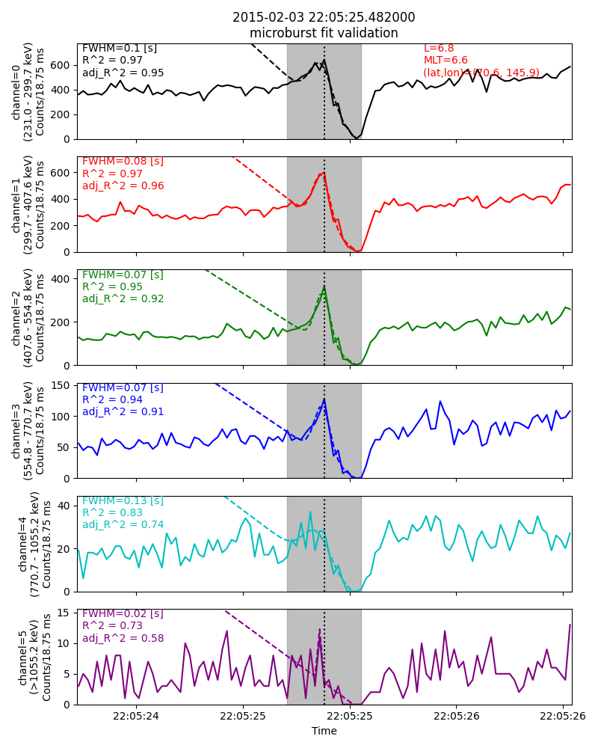
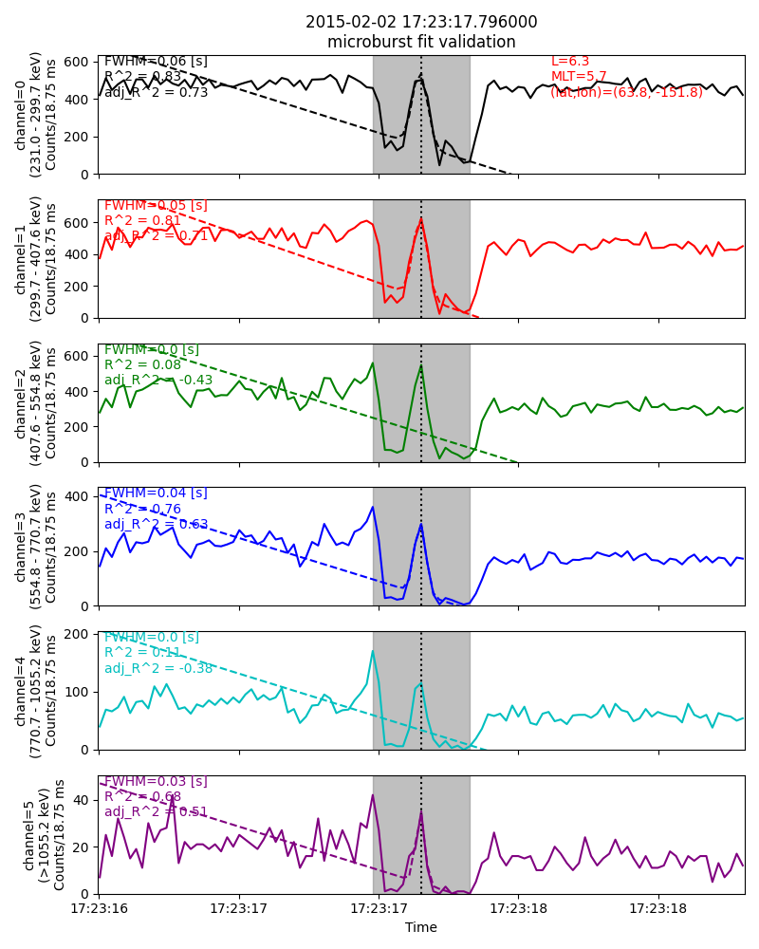
Good Examples

Slide 8
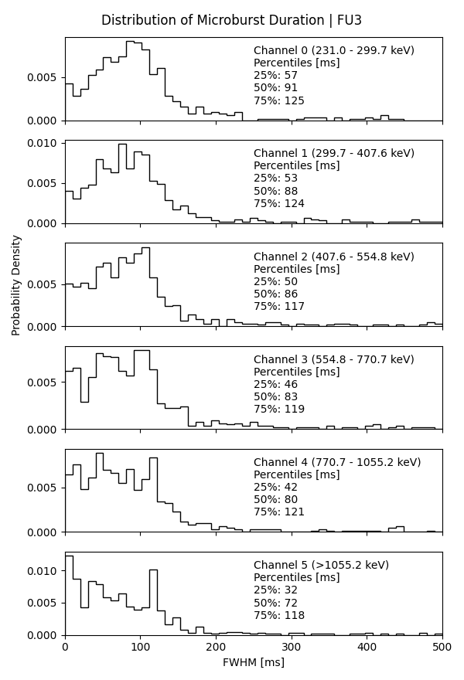
Microburst Durations v0
Fit to a Gaussian with a linear trend with a 300-ms fit width.
Initial microburst width guess is 100 ms.
1768 microbursts fit (fit converged)
6446 microbursts were not fit because
The HiRes cadence was 50 ms, or
The fit did not converge
(I did not track the category)
Used only microbursts with adjusted R^2 > 0.9 for the distribution.

Slide 9
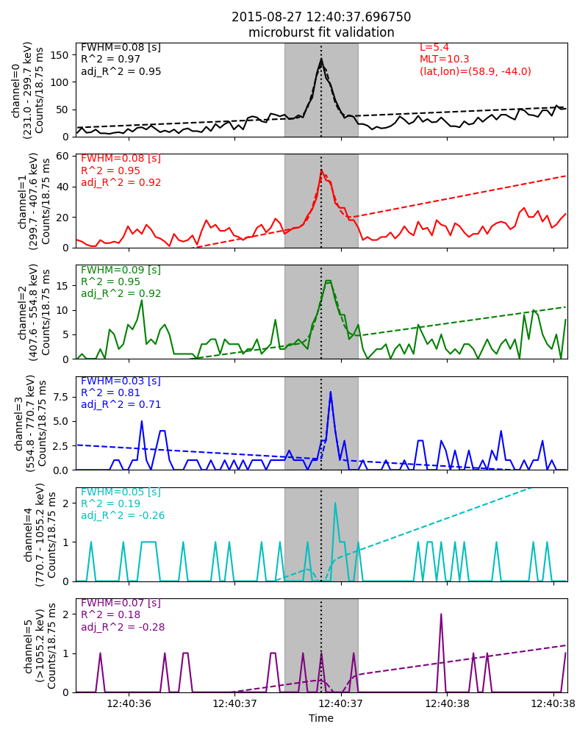
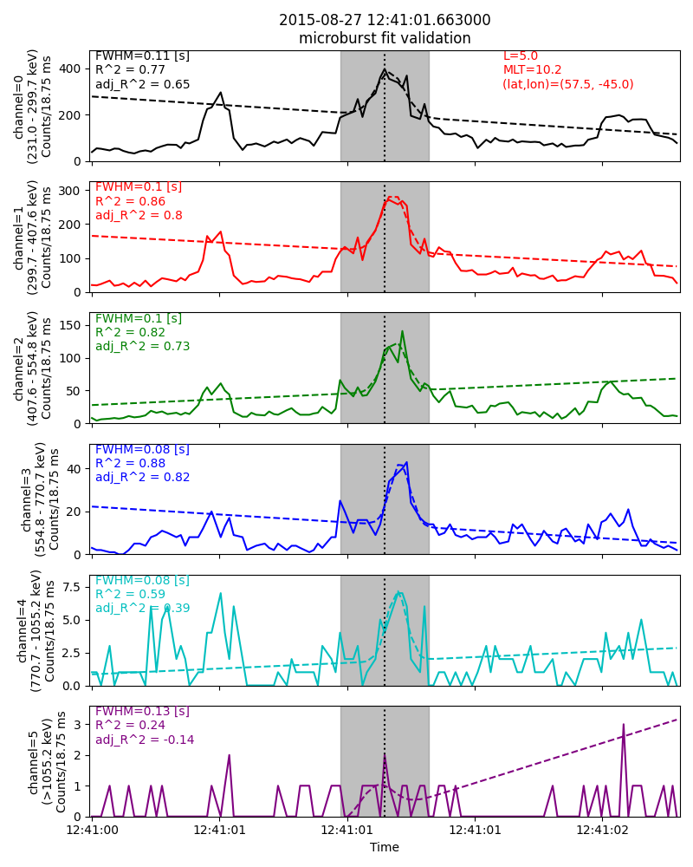
Inverse Dispersion?

Slide 10
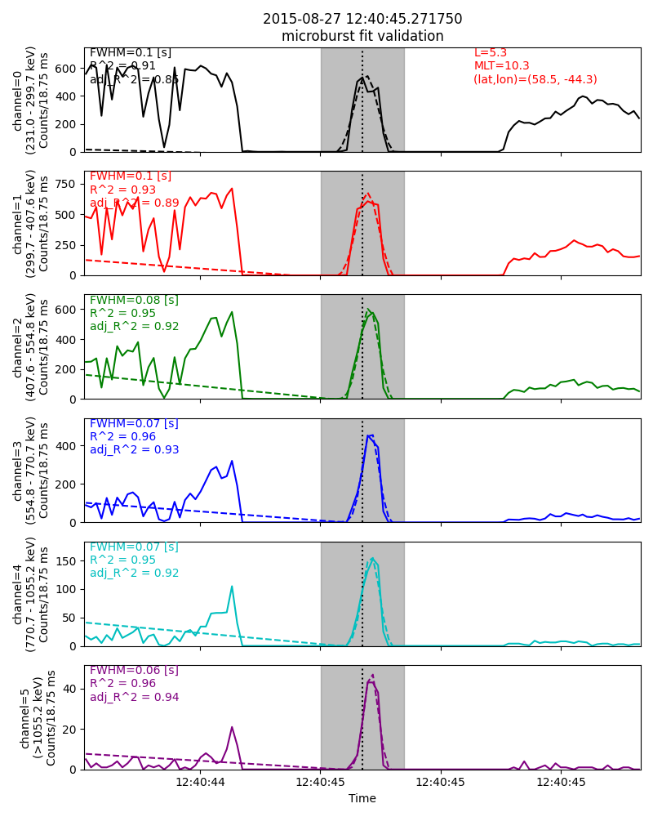
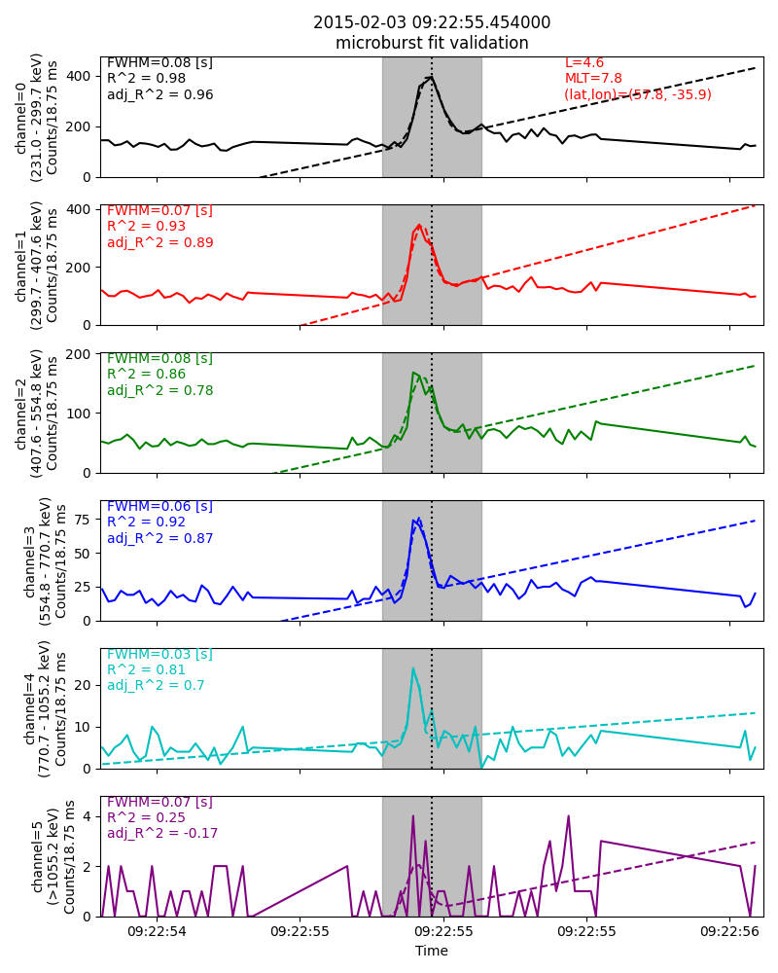
Dispersion?
Saturation?
Regular dispersion

Slide 11
Impressions & Improvements
Impressions
The 200-500 keV durations look nice and surprisingly don’t change much in energy.
The > 1 MeV microburst durations should have been close to 100 ms, but the distribution looks wrong
Improvements
Use my “number of 0’s” based saturation filter to remove bad events.
Closely inspect the fits
Try out different fit initial guesses such as initial fwhm
Maybe could try this using the BARREL data?

