Slide 1
Microburst duration distributions using FIREBIRD-II
Mykhaylo Shumko
2023-01-30

Slide 2
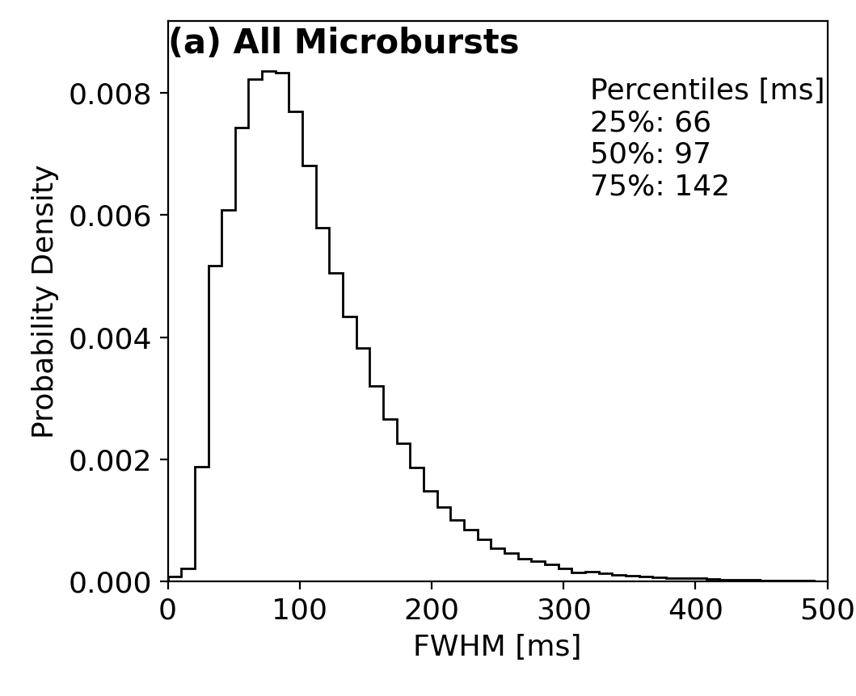
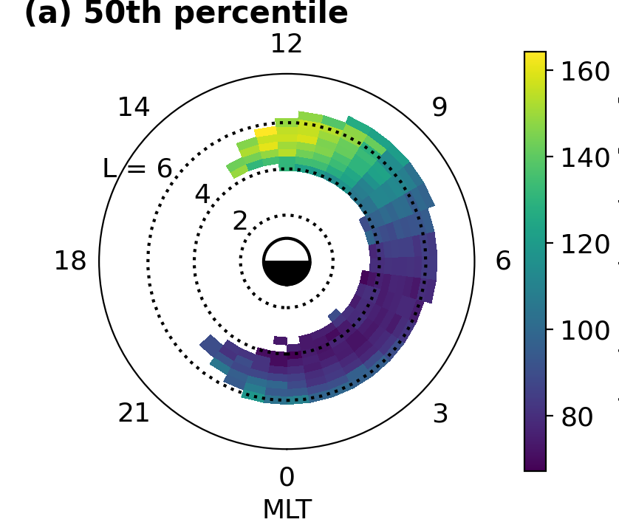
Background: a follow-on study from the Shumko et al., (2021) SAMPEX study
> 1 MeV microbursts have a ~ 100 ms duration.
Doubles in MLT.

Slide 3
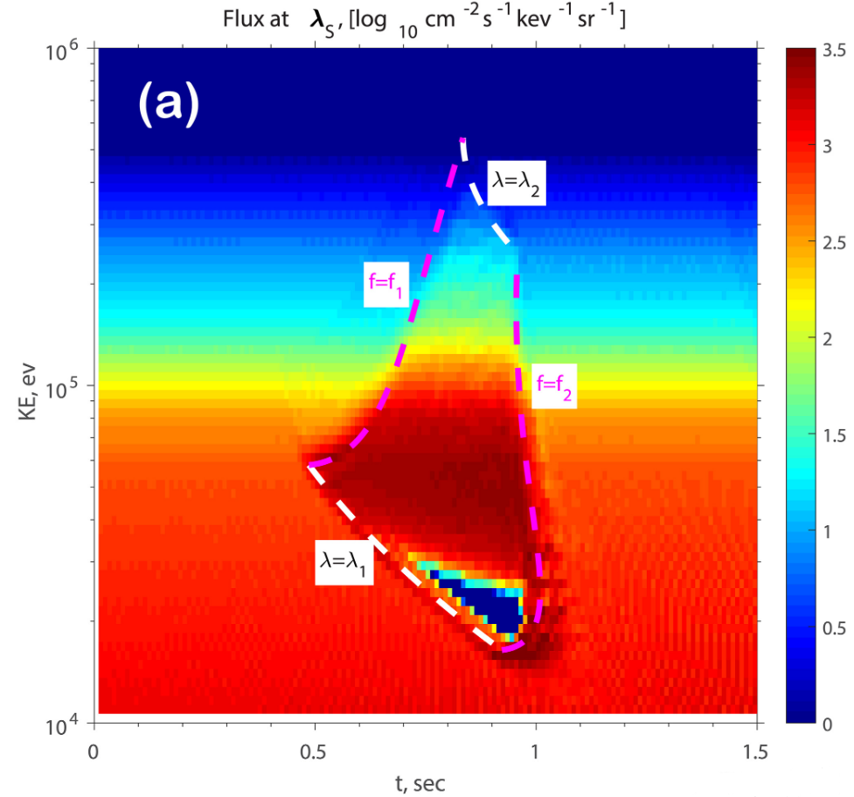
Background: a follow-on study from the Shumko et al., (2021) SAMPEX study
What about as a function of energy?
Chen et al., (2020) shows that the duration of the increased microburst flux has an energy dependence.
Our hypothesis: microburst duration decreases for > 100 keV microbursts
Will we see this in the FIREBIRD-II data?

Slide 4
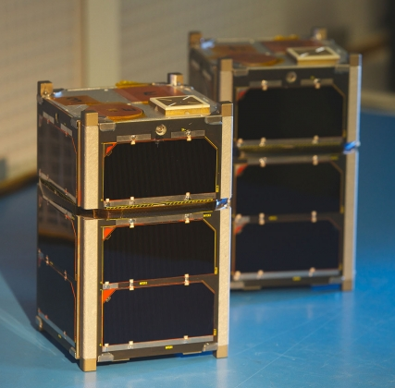
Present study: microbursts observed by FIREBIRD-II.
Pair of 1.5-U CubeSats launched in 2015.
Collimated detector sensitive to 200 keV - > 1 MeV electrons in 6 energy channels
Geometric factor ~ 5 cm^2 sr
Programmable cadence from 12.5 to 50 ms.
See Johnson et al., (2020) paper for more information

Slide 5

Fitting microbursts
Use only microbursts taken at a < 50 ms cadence
Including 18.75 & 12.50 ms cadence
Refer to Johnson et al., (2020) for cadence and campaign details (table 4)
Identified via the burst parameter with > 10 threshold
Resulting 1710 microbursts were fit with a Gaussian + linear trend
Duration quantified by FWHM of the Gaussian
Version 0 of the fit parameters:
Fit 0.3-seconds of data
Initial FWHM guess = 0.1-seconds
Goodness of fit quantified by the R^2 and adjusted R^2 metrics.
650 microbursts with max(r^2) > 0.9 across the 6 energy channels.

Slide 6
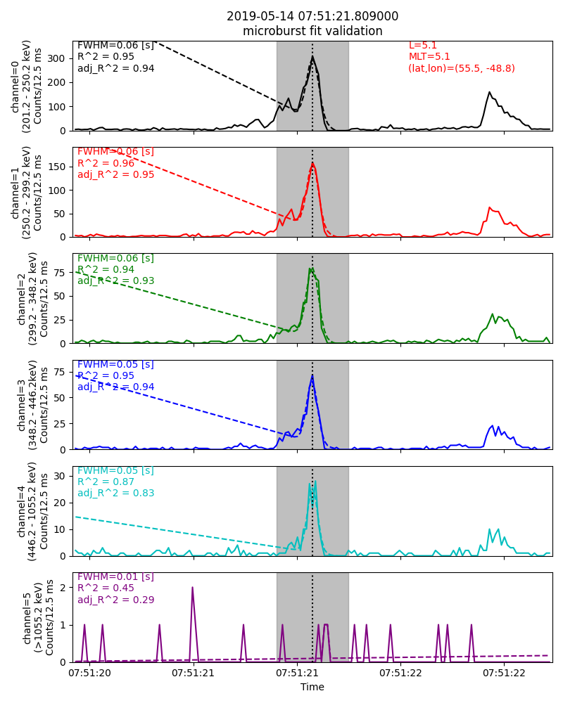
Good Examples
Collimated counts vs time for all energy channels
Solid lines show the data, dashed lines show the fit
Fit duration shown by the grey bar
Peak time in the 200 keV channel show by the dotted black line
Fit parameters for each channel shown on the left of each panel
FIREBIRD location shown in the upper-right corner

Slide 7
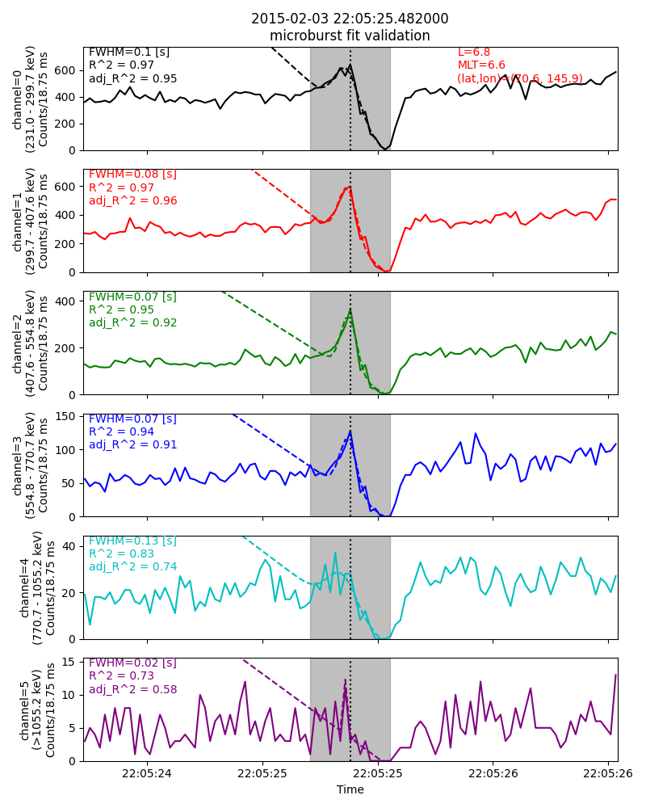
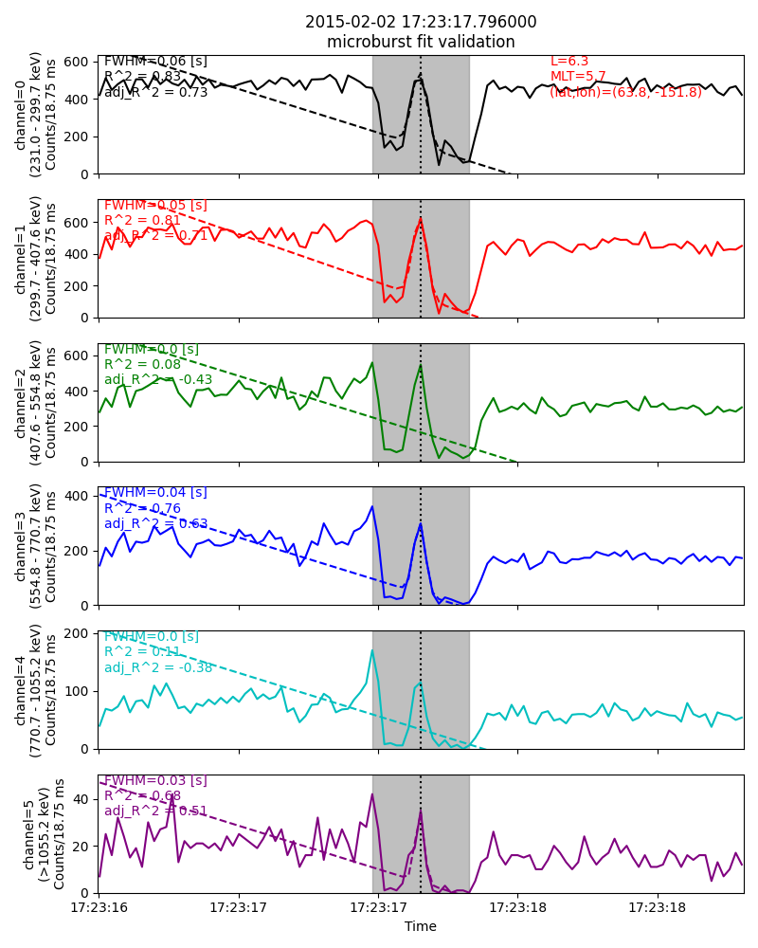
Good Examples

Slide 8
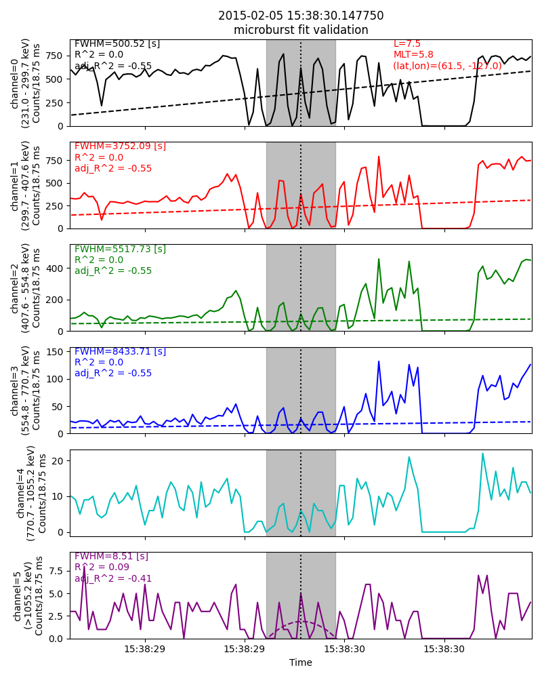
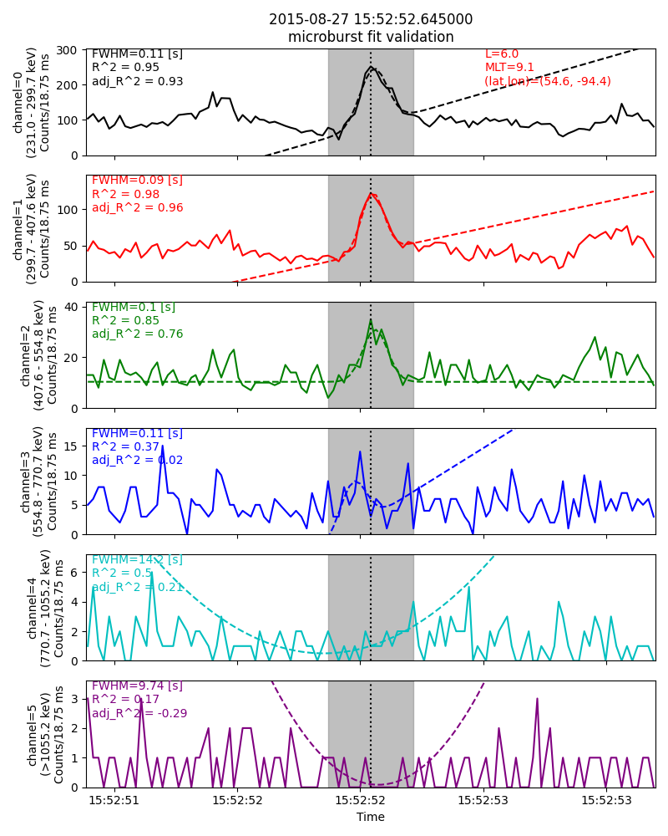
Bad fits

Slide 9
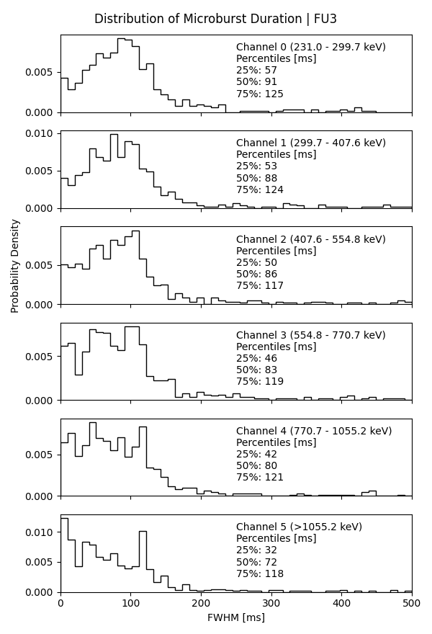
Duration Distributions
Microburst fits were filtered
Each microburst max(R^2) > 0.9 in all energy channels
Distributions in channels 0-2 look believable
Durations slightly decrease in energy and are already narrower than SAMPEX.
Perhaps this can be attributed to the drastically different geometric factors of FIREBIRD-II and SAMPEX?
Channels 3-5 don’t look as nice.
A suspicious peak around 120 ms. Most evident in 4th and 5th energy channel.
Possible fit filtering modifications
Ensure that the 6 channel FWHMs are within X% of the mean FWHM
Check that the amplitudes are all positive
Use a 0s filter to remove dead time saturation

Slide 10
Duration Distributions
Microburst fits were filtered
Each microburst max(R^2) > 0.9 in all energy channels
Distributions in channels 0-2 look believable
Durations slightly decrease in energy and are already narrower than SAMPEX.
Perhaps this can be attributed to the drastically different geometric factors of FIREBIRD-II and SAMPEX?
Channels 3-5 don’t look as nice.
A suspicious peak around 120 ms. Most evident in 4th and 5th energy channel.
Possible fit filtering modifications
Ensure that the 6 channel FWHMs are within X% of the mean FWHM
Check that the amplitudes are all positive
Use a 0s filter to remove dead time saturation
Suspicious peak

Slide 11
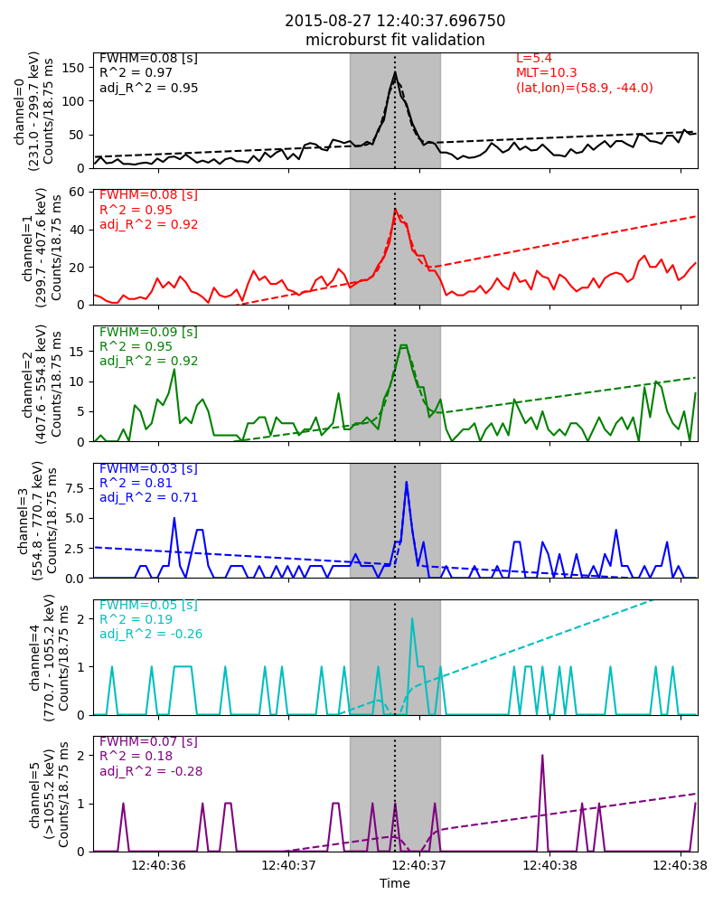
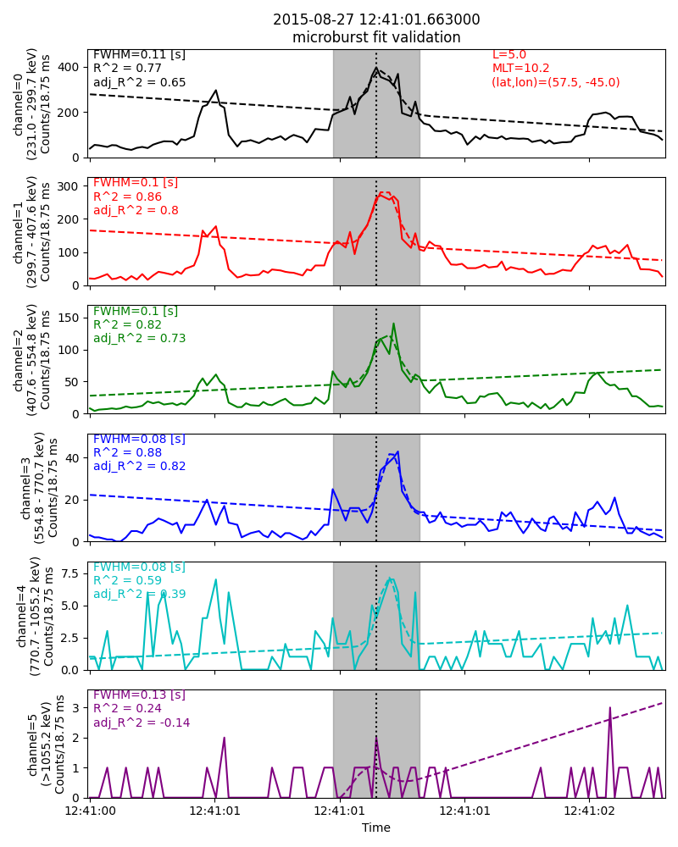
Inverse Dispersion? I don’t see saturation and I’m surprised that I didn’t catch them earlier.

Slide 12
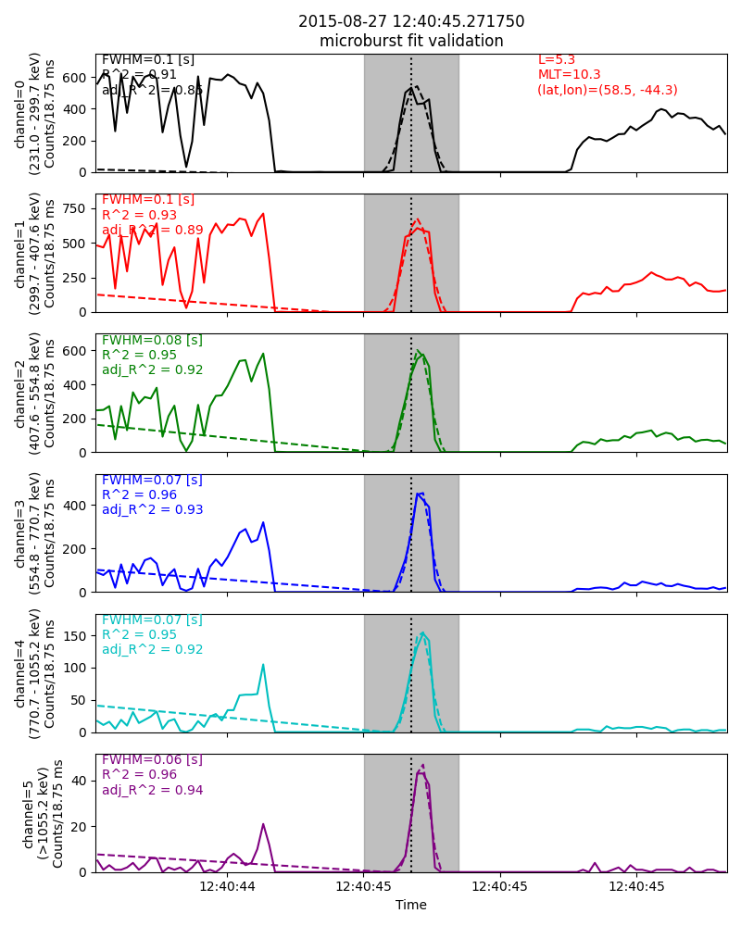
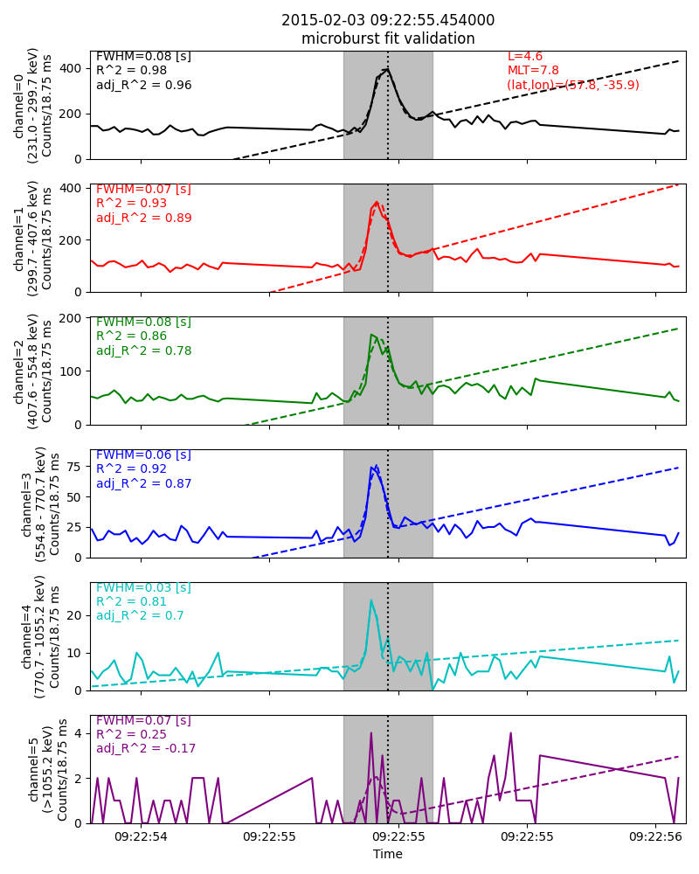
Dispersion?
Saturation? Lower energy channels dip right as the higher energy channel peaks.
Regular dispersion

Slide 13
Impressions & Improvements
Impressions
The 200-500 keV durations look nice and surprisingly don’t change much in energy.
The > 1 MeV microburst durations should have been close to 100 ms, but the distribution looks wrong
Improvements
Use my “number of 0’s” based saturation filter to remove bad events.
Closely inspect the fits
Try out different fit initial guesses such as initial fwhm
Maybe could try this using the BARREL data?
This presentation and code is on github: https://github.com/mshumko/fbrbsp/tree/main/fbrbsp/microburst_duration & https://github.com/mshumko/fbrbsp/tree/main/presentations

