Slide 1
Dispersion Fits
Mykhaylo Shumko
6 March 2023

Slide 2
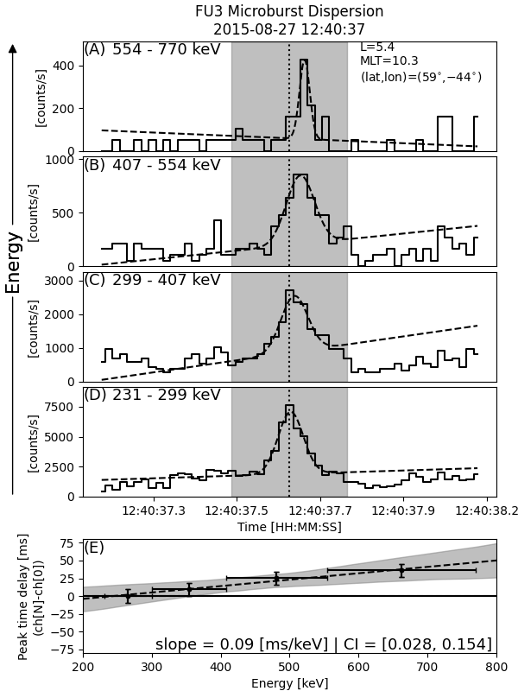
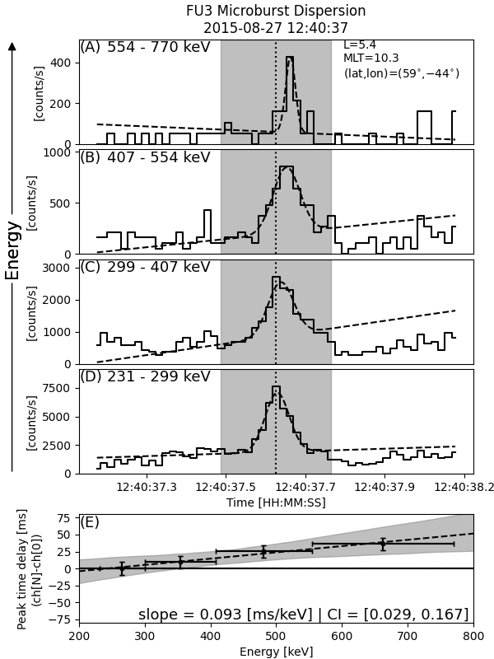

No energy uncertainty
Uniform energy uncertainty
Exponential energy uncertainty

