Slide 1
Microburst duration distributions using FIREBIRD-II
Mykhaylo Shumko
2023-01-24

Slide 2
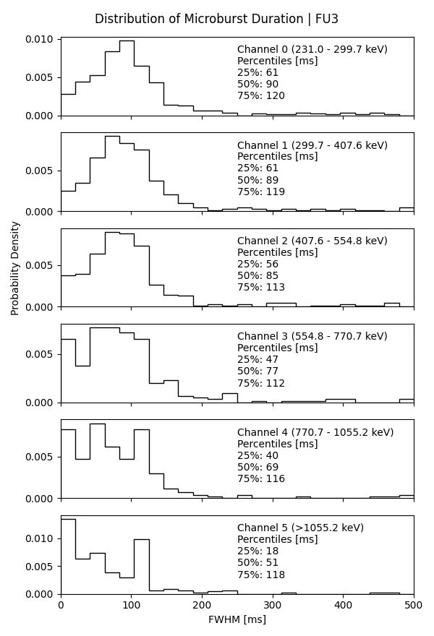
fb_microburst_duration_all_channels_v1
Microbursts identified via the burst parameter on channel 0 (~200 keV) file called FU3_microburst_catalog_v5.csv.
Fit to a Gaussian with a linear trend with a 300-ms fit width.
Initial microburst width guess is 100 ms.
1768 microbursts fit (fit converged)
6446 microbursts were not fit because
The HiRes cadence was 50 ms, or
The fit did not converge
(I did not track the category)
Used only microbursts with adjusted R^2 > 0.9 for the distribution.

Slide 3
Example fits

Slide 4
L-MLT distributions

Slide 5
Impressions & Improvements
Impressions
The 200-500 keV durations look nice and surprisingly don’t change much in energy.
The > 1 MeV microburst durations should have been close to 100 ms, but the distribution looks wrong
Improvements
Use my “number of 0’s” based saturation filter to remove bad events.
Closely inspect the fits
Try out different fit initial guesses such as initial fwhm
Maybe could try this using the BARREL data?

