Slide 1
Microburst Time of Flight Dispersion
Mykhaylo Shumko
2023-02-09

Slide 2
Inverse (positive) dispersed microbursts
Hypothesized by a time-of-flight model in Miyoshi et al., (2010) and Saito et al., (2012)
I stumbled into them. Surprisingly, I did not find them when I looked for them in ~2016.
I identified microbursts using the burst parameter and fit all of the microbursts with a Gaussian + linear trend.
R^2 and adj R^2 are the quality of fits

Slide 3
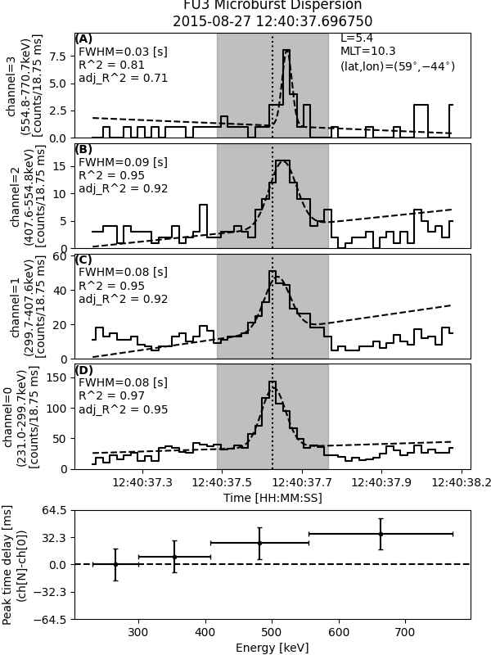
Inverse (positive) dispersed microbursts
Fit info
Location
HiRes data shown in solid and Gaussian fit shown in dashed
Hypothesized by a time-of-flight model in Miyoshi et al., (2010) and Saito et al., (2012)
I stumbled into them. Surprisingly, I did not find them when I looked for them in ~2016.
I identified microbursts using the burst parameter and fit all of the microbursts with a Gaussian + linear trend.
R^2 and adj R^2 are the quality of fits
Gray rectangle is the fit time range and black vertical dotted line is at channel 0’s t0
- points: microburst t0
- X-errors are energy channel widths
- Y-errors is the HiRes cadence

Slide 4
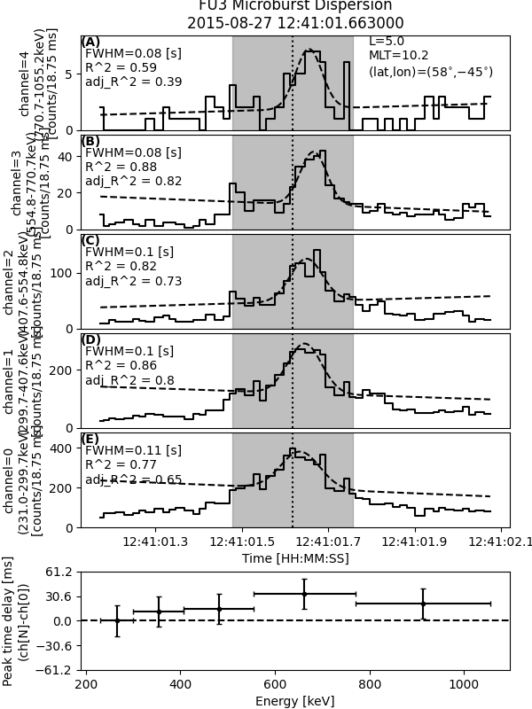
Fit could have been better

Slide 5
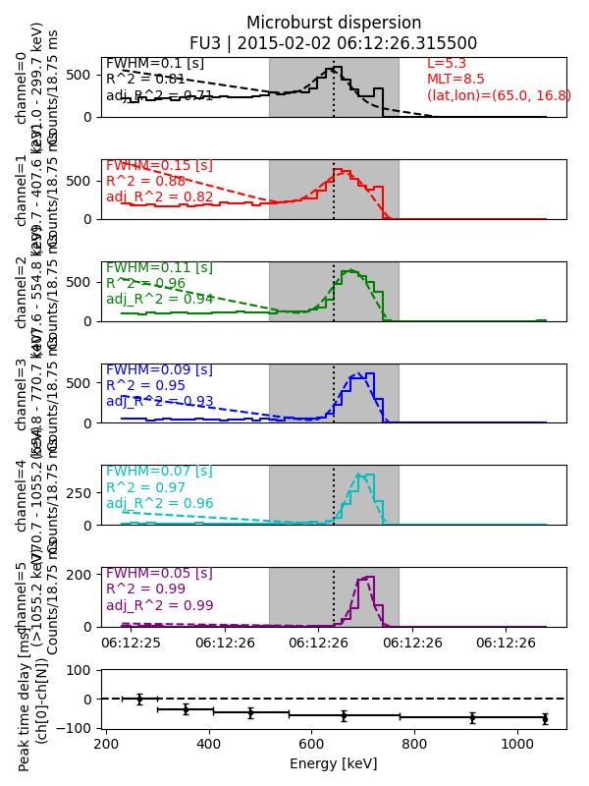
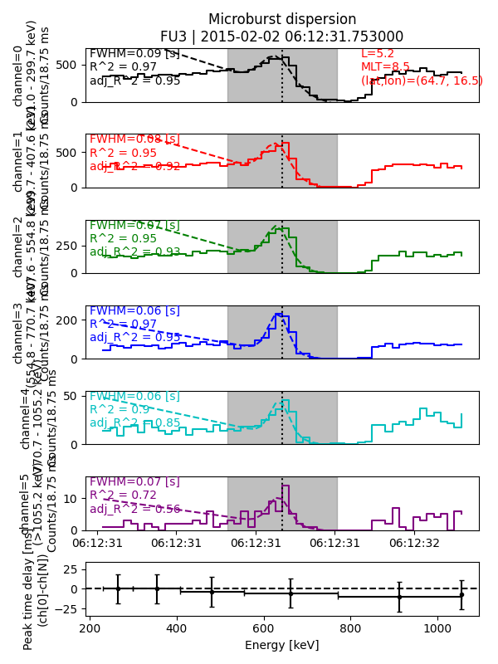

Slide 6
Saturation? Channels 0 and 1 dip right as channel 6 peaks.
No dispersion (as far as FIREBIRD can tell)

