Slide 1
Microburst duration distributions using FIREBIRD-II
Mykhaylo Shumko
2023-01-24

Slide 2
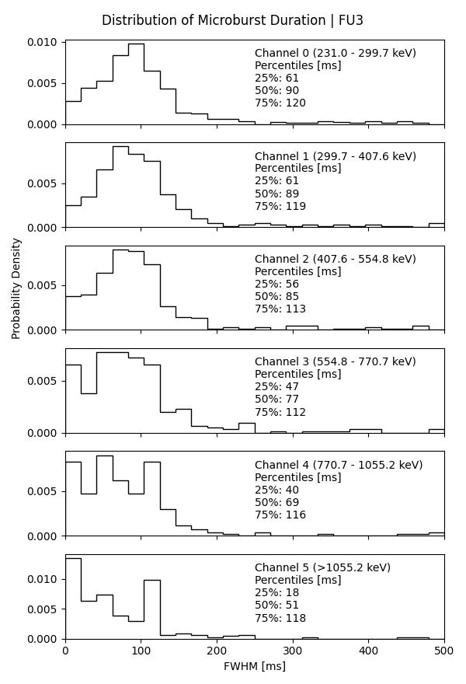
fb_microburst_duration_all_channels_v1
Microbursts identified via the burst parameter on channel 0 (~200 keV) file called FU3_microburst_catalog_v5.csv.
Fit to a Gaussian with a linear trend with a 300-ms fit width.
Initial microburst width guess is 100 ms.

