Slide 1
Chorus-microburst repetition periods: FIREBIRD-II RBSP conjunctions
Mykhaylo Shumko
5 April 2023

Slide 2
Hypothesis
If chorus waves cause microburst precipitation, then there should be a one-to-one relationship between their repetition periods.
Realistically I don’t expect this to be perfect:
Microburst and chorus wave detection codes are not perfect,
Hard (impossible?) to get perfect conjunctions

Slide 3
Methodology
Get the lists of conjunctions: https://doi.org/10.5281/zenodo.7686037
Calculate the number of microbursts, and number of microbursts/s observed during conjunctions.
Microbursts detected via the burst parameter and visually unverified.
Certain times in the data contain many false-positives due to saturation.
Normalized by the HiRes time span within +/- 2 minutes before and after the conjunction (HiRes data is often only for 3-4 minutes).
Calculate the number of chorus waves and normalize.
Used the dechirping algorithm used ﻿to identify lightning signals
Number of chorus waves within +/- 5 minutes before and after the conjunction.

Slide 4
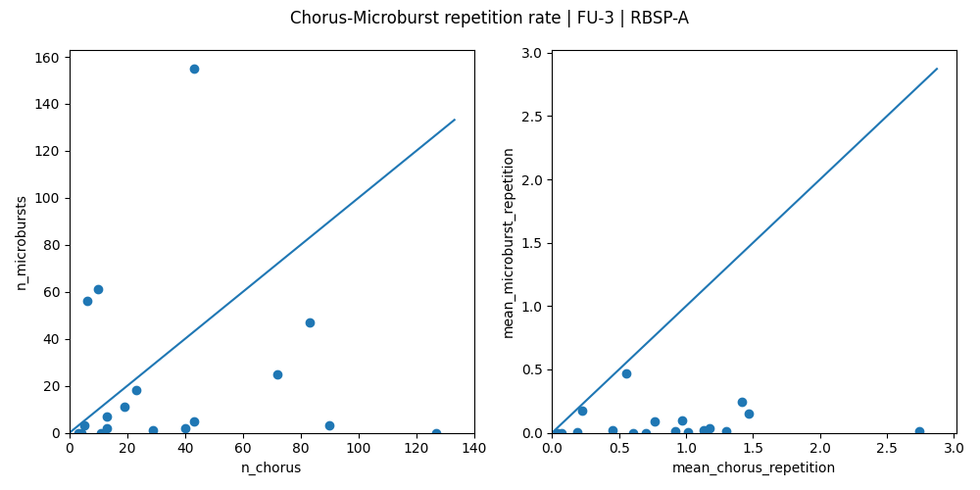
FU3-RBSPA

Slide 5
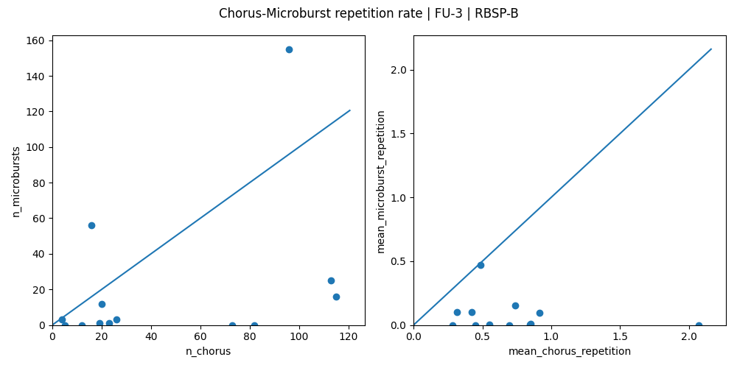
FU3-RBSPB

Slide 6
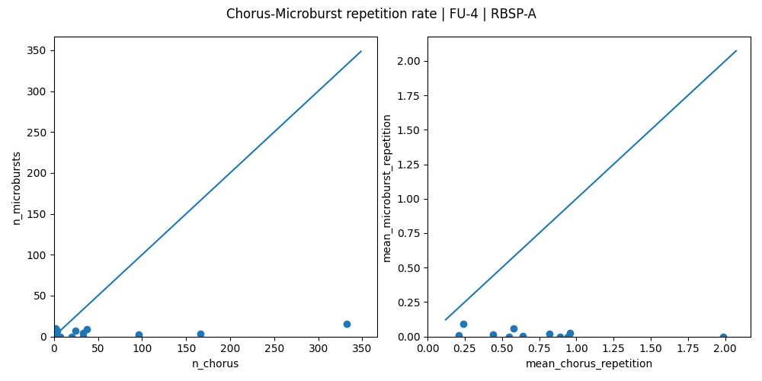
FU4-RBSPA

Slide 7
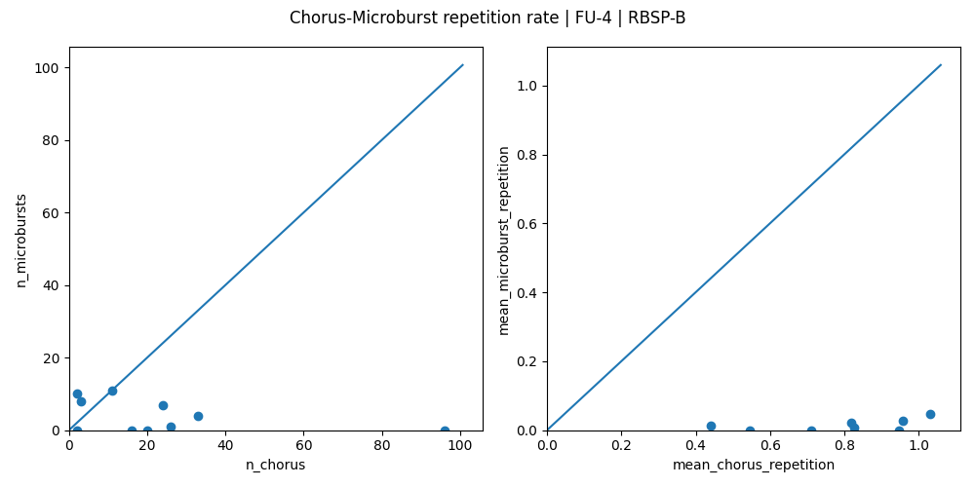
FU4-RBSPB

