Slide 1
Microburst Time of Flight Dispersion
Mykhaylo Shumko
2023-02-09

Slide 2
Inverse (positive) dispersed microbursts
Hypothesized by a time-of-flight model in Miyoshi et al., (2010) and Saito et al., (2012)
Called inverse dispersion in Miyoshi et al., (2010) paper, and positive dispersion in Saito et al., (2012)
I stumbled into them. Surprisingly, I did not find them when I looked for them in ~2016.
I identified microbursts using the burst parameter and fit all of the microbursts with a Gaussian + linear trend.
R^2 and adj R^2 are the quality of fits

Slide 3
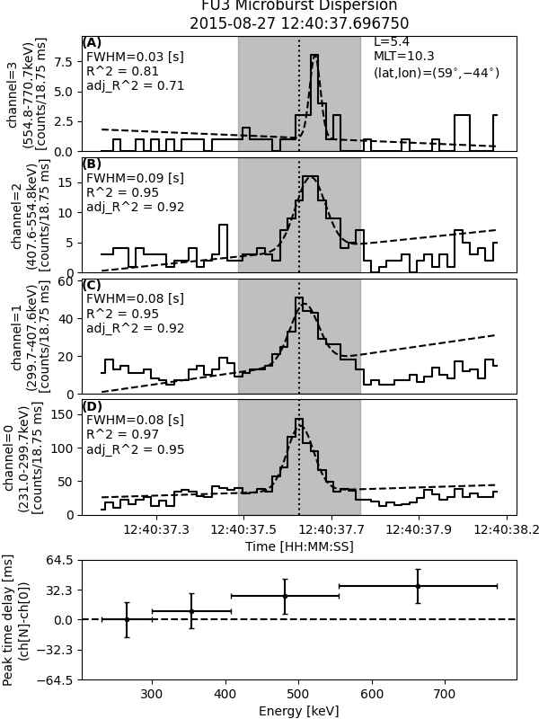
Inverse (positive) dispersed microbursts
Fit info
Location
Hypothesized by a time-of-flight model in Miyoshi et al., (2010) and Saito et al., (2012)
Called inverse dispersion in Miyoshi et al., (2010) paper, and positive dispersion in Saito et al., (2012)
I stumbled into them. Surprisingly, I did not find them when I looked for them in ~2016.
I identified microbursts using the burst parameter and fit all of the microbursts with a Gaussian + linear trend.
R^2 and adj R^2 are the quality of fits
HiRes data shown in solid and Gaussian fit shown in dashed
Gray rectangle is the fit time range and black vertical dotted line is at channel 0’s t0
- Points are microburst t0
- X-errors are energy channel widths
- Y-errors is the HiRes cadence
Positive peak time delay == positive dispersion == inverse dispersion (with respect to CH0)

Slide 4
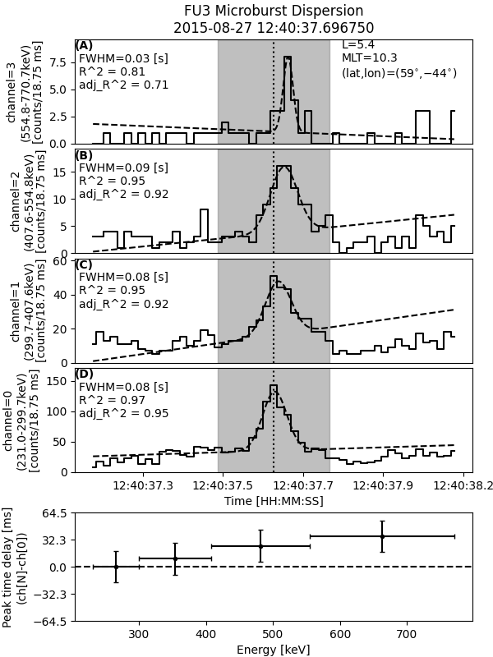
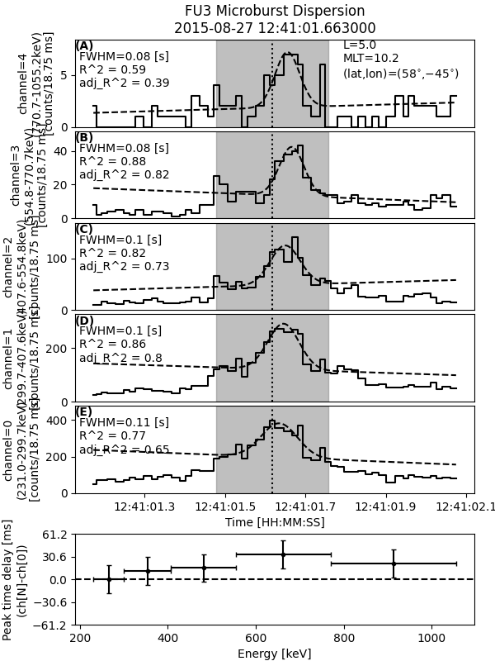
Fit could have been better

Slide 5
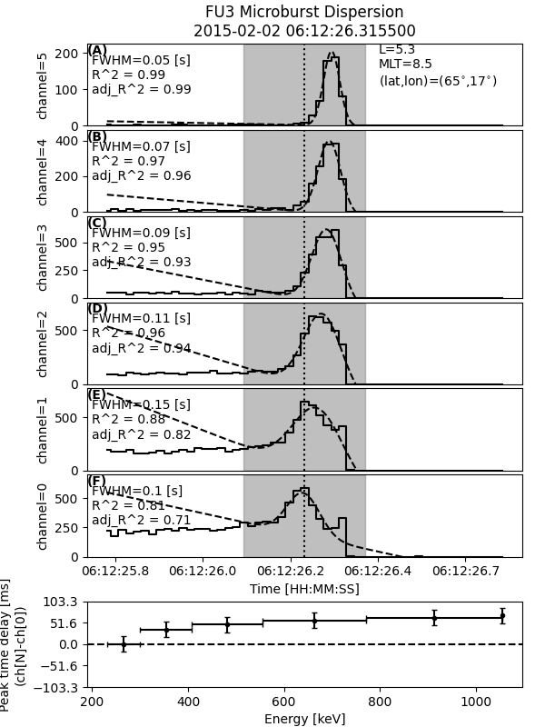
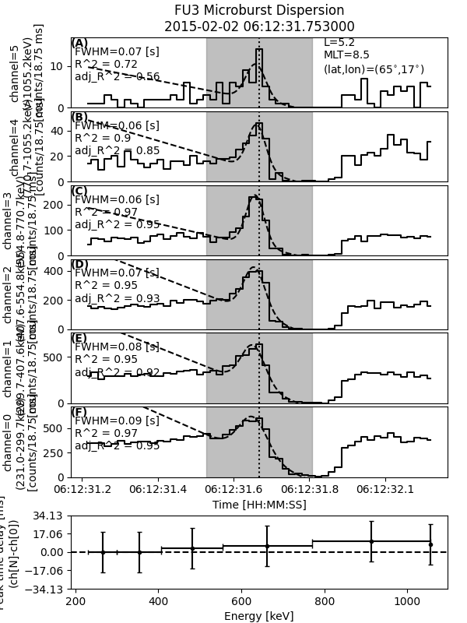

Slide 6
Saturation? Channels 0 and 1 dip right as channel 6 peaks.
No dispersion (as far as FIREBIRD can tell)

