Slide 1
SAMPEX-HILT microbursts vs geomagnetic indices
Mykhaylo Shumko
10 November 2021

Slide 2
Background
Question: what geomagnetic indices best predict > 1 MeV microburst occurrence?
Relevance:
Help launch sounding rockets and other time-critical tasks.
A better input to radiation belt precipitation models
Understand what underlying phenomena drives MeV microbursts

Slide 3
Methodology
Calculate the number of microbursts observed in each radiation belt pass for the 1997-2012 years.
Calculate microburst occurrence rates in each radiation belt pass.
Append the AE, Sym, and Asy indices to the microburst dataset.
Look for trends in microburst occurrence vs indices.
Append the indices' rate of change in multiple time windows.
Look for trends in microburst occurrence vs indices.
If we observe trends at this point, model the occurrence rate with indices as the input.
…

Slide 4
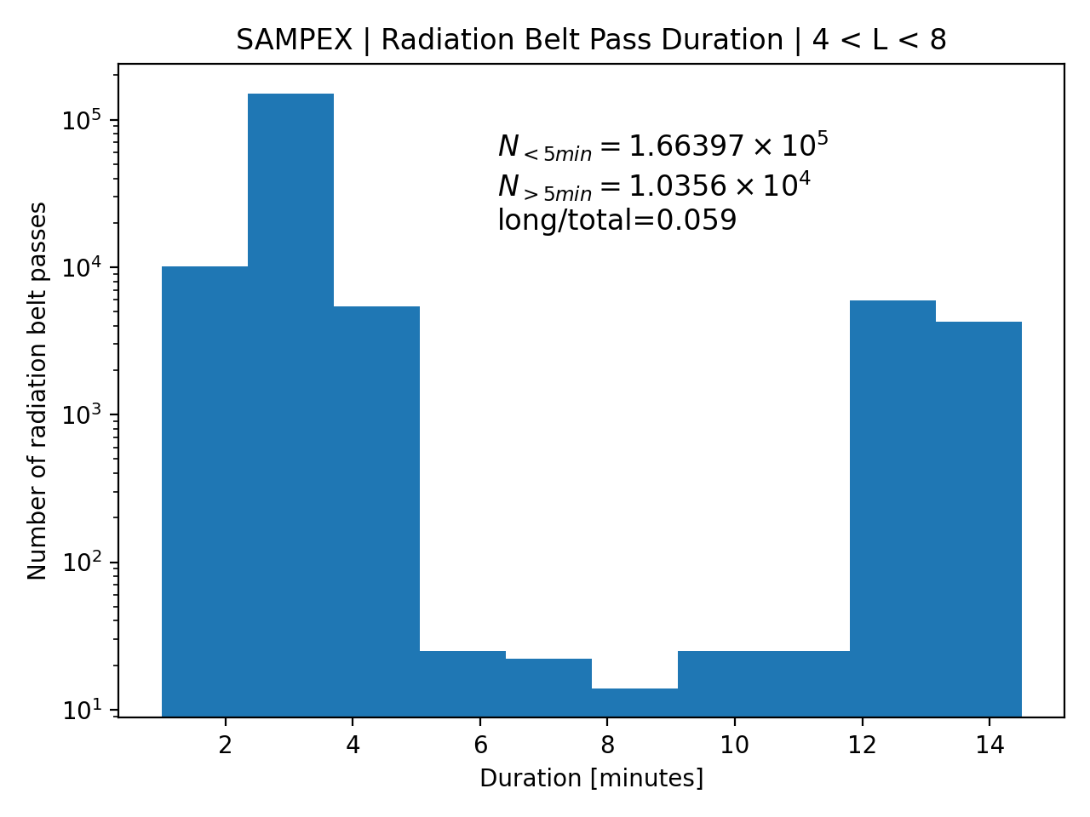
Step 1: 2997-2012 radiation belt passes
Passes defined by 4 < L < 8.
Filtered out passes by the maximum of the attitude flag. Attitude flag >= 100 means SAMPEX was spinning. The spin is bad for microburst detections.
95% of passes are shorter than 5 minutes duration. This is typical. But 5% of passes are much longer---they occasionally happen when SAMPEX doesn’t quite exit L = 8 in the radiation belt on its pole-ward part of the orbit.

Slide 5
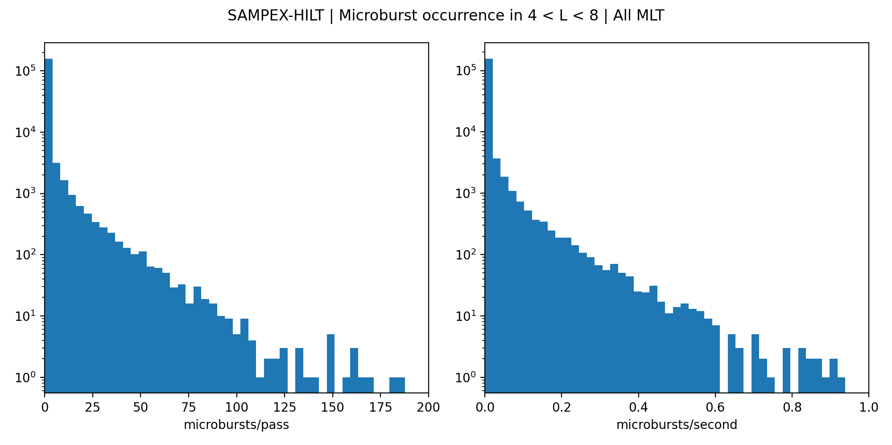
Step 2: Microburst occurrence in each pass
SAMPEX observed no microbursts for most passes.
Exponentially-falling distribution. This means that we’ll have to use stratified sampling, or another sampling method when we model this.
Number of radiation belt passes

Slide 6
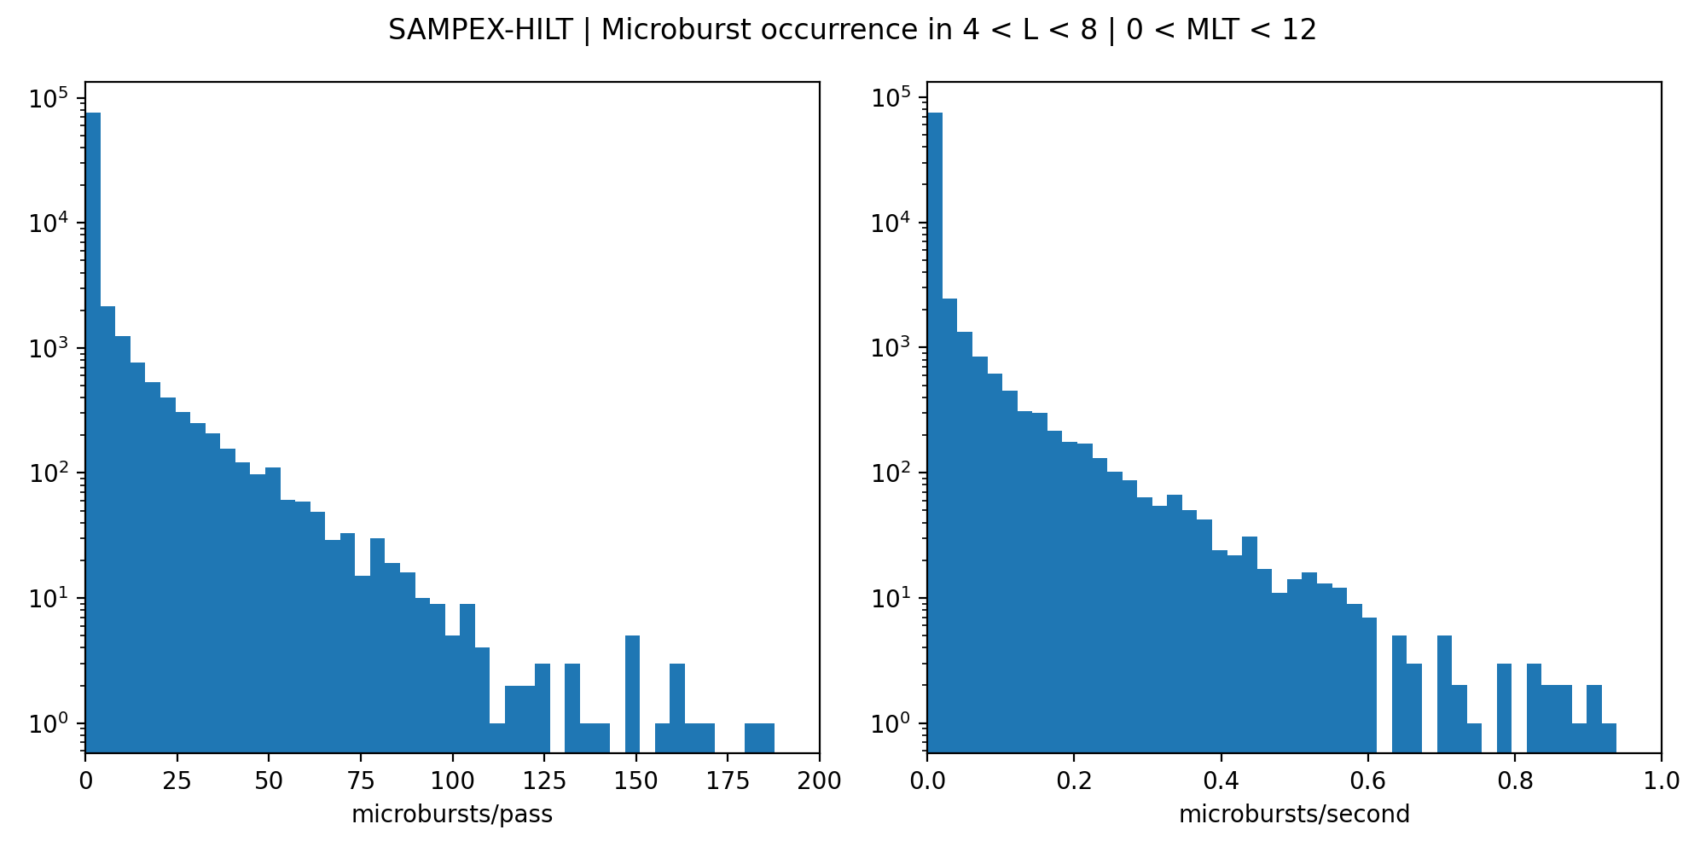
Step 2: Microburst occurrence in each pass
SAMPEX observed no microbursts for most passes.
Exponentially-falling distribution. This means that we’ll have to use stratified sampling, or another sampling method when we model this.
Number of radiation belt passes

Slide 7
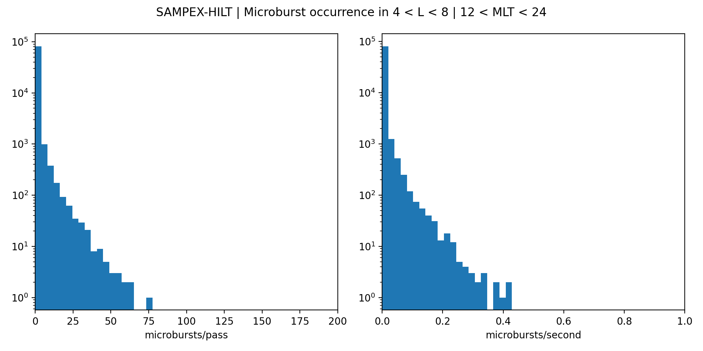
Step 2: Microburst occurrence in each pass
SAMPEX observed no microbursts for most passes.
Exponentially-falling distribution. This means that we’ll have to use stratified sampling, or another sampling method when we model this.
Number of radiation belt passes

Slide 8
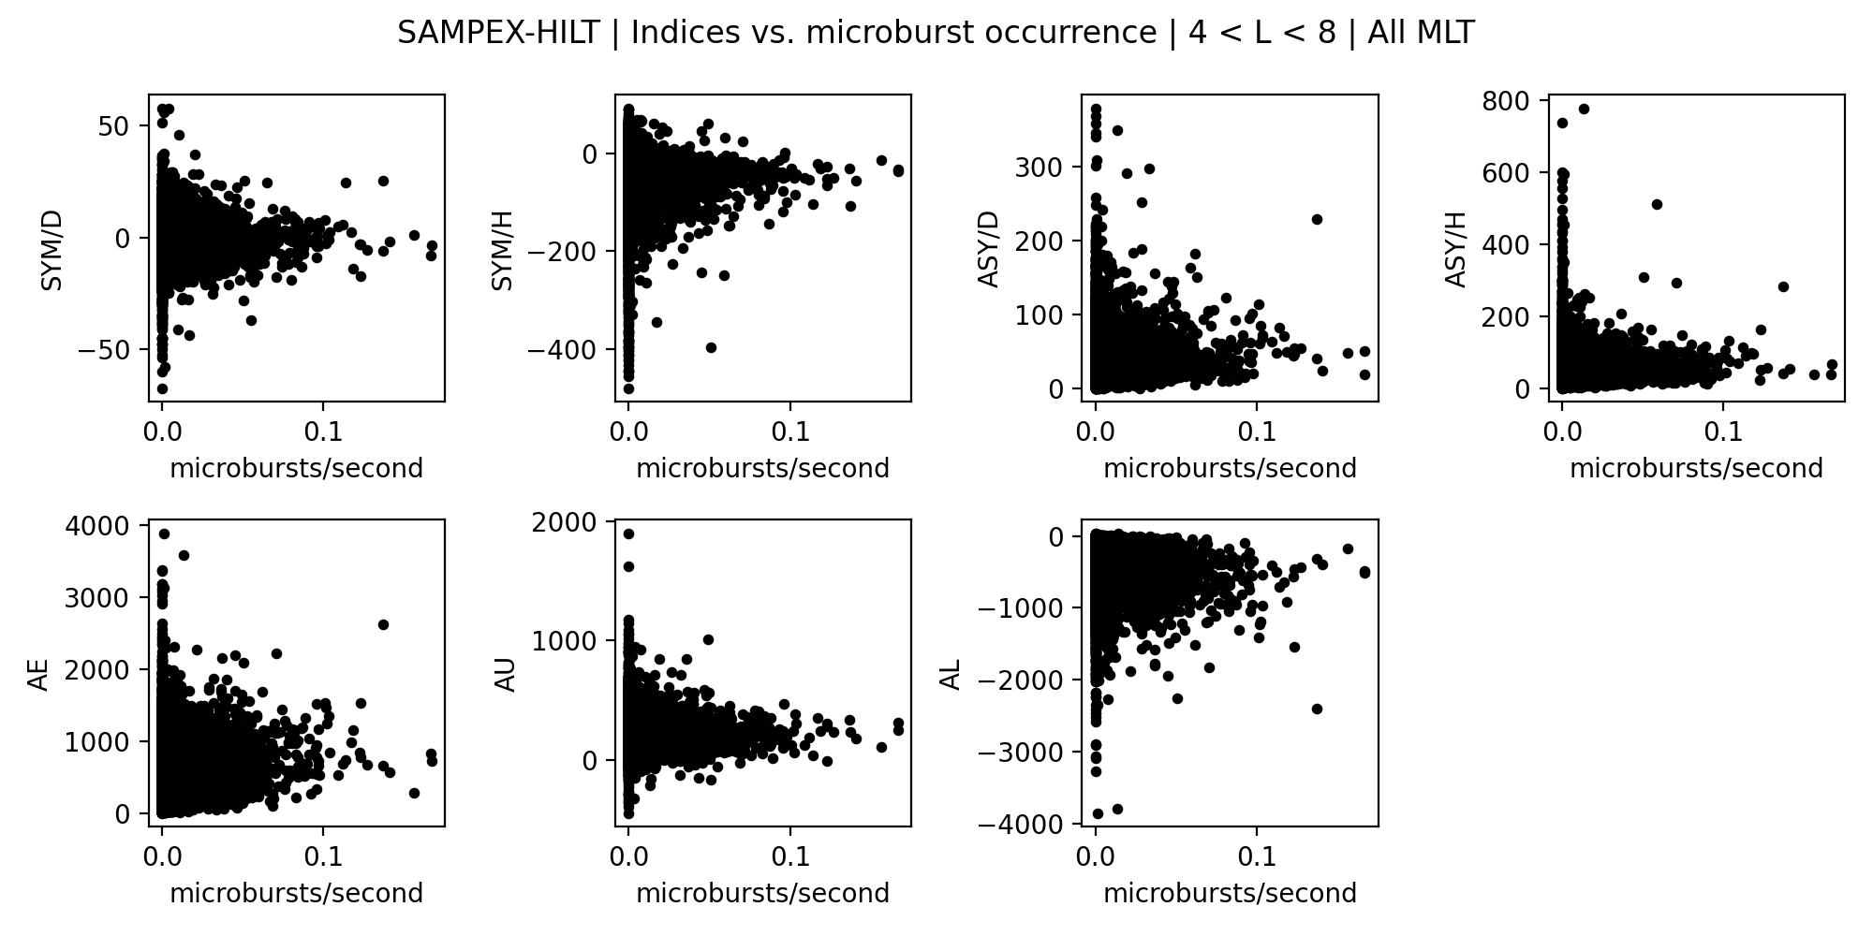
Step 3: Append Indices
To my surprise, I don’t see any significant trends in any of these indices and the microburst rate.
Is there a better way to calculate microburst occurrence rate?
Maybe this is where the rate of change of this indices will be more illuminating.

Slide 9
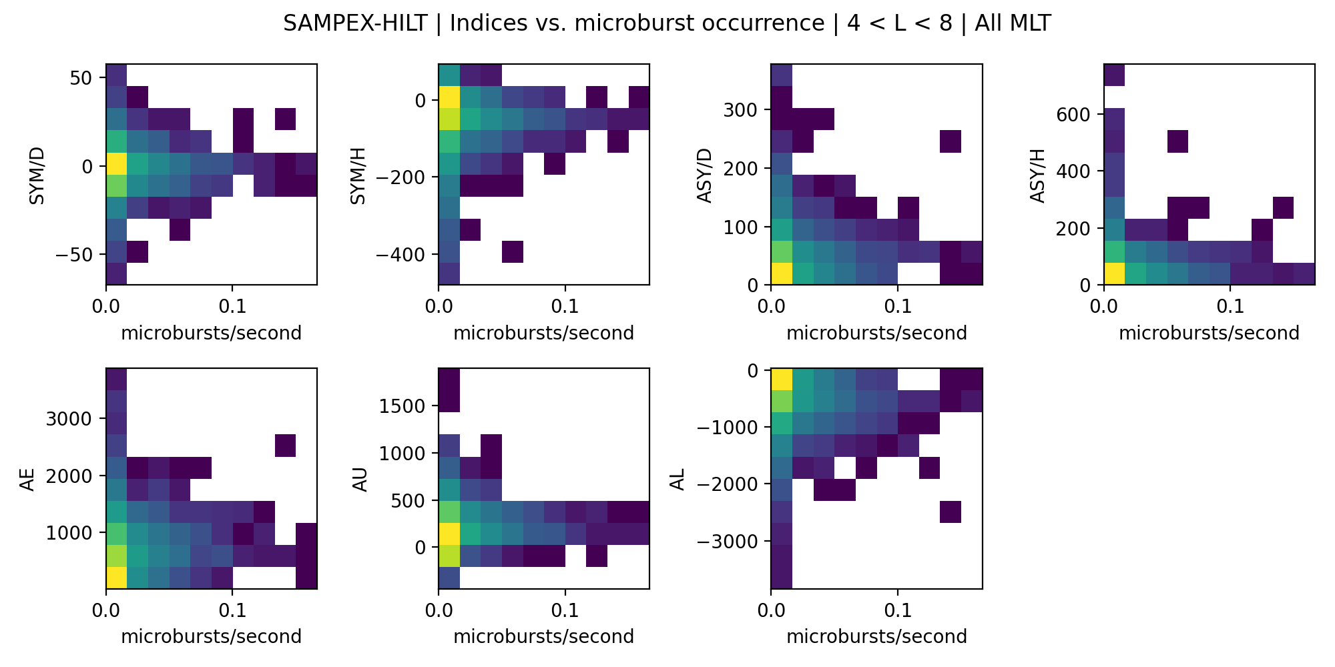
Step 3: Append Indices
To my surprise, I don’t see any significant trends in any of these indices and the microburst rate.
Is there a better way to calculate microburst occurrence rate?
Maybe this is where the rate of change of this indices will be more illuminating.

