Slide 1
SAMPEX-HILT microbursts vs geomagnetic indices
Mykhaylo Shumko
10 November 2021

Slide 2
Background
Question: what geomagnetic indices best predict > 1 MeV microburst occurrence?
Relevance:
Help launch sounding rockets.
A more informed input to radiation belt precipitation models
Understand what underlying phenomena drives MeV microbursts

Slide 3
Methodology
Calculate the number of microbursts observed in each radiation belt pass for the 1997-2012 years.
Calculate microburst occurrence rates in each radiation belt pass.
Append the AE, SYM, and ASY indices to the microburst dataset.
Look for trends in microburst occurrence vs indices.
Append the indices' rate of change in multiple time windows.
Look for trends in microburst occurrence vs indices.
If we observe trends at this point, model the occurrence rate with indices as the input.
…

Slide 4
AE, SYM, and ASY indices
The Auroral Electrojet (AE) index was originally introduced by Davis and Sugiura in 1966 as a measure of global electrojet activity in the auroral zone.
The AU and AL indices are intended to express the strongest current intensity of the eastward and westward auroral electrojets, respectively. The AE index represents the overall activity of the electrojets, and the AO index provides a measure of the equivalent zonal current.
To describe the geomagnetic disturbances at mid-latitudes in terms of longitudinally asymmetric (ASY) and symmetric (SYM) disturbances for both H and D components respectively parallel and perpendicular to the dipole axis.
SYM-H is essentially the same as the Dst index with a different time resolution.

Slide 5
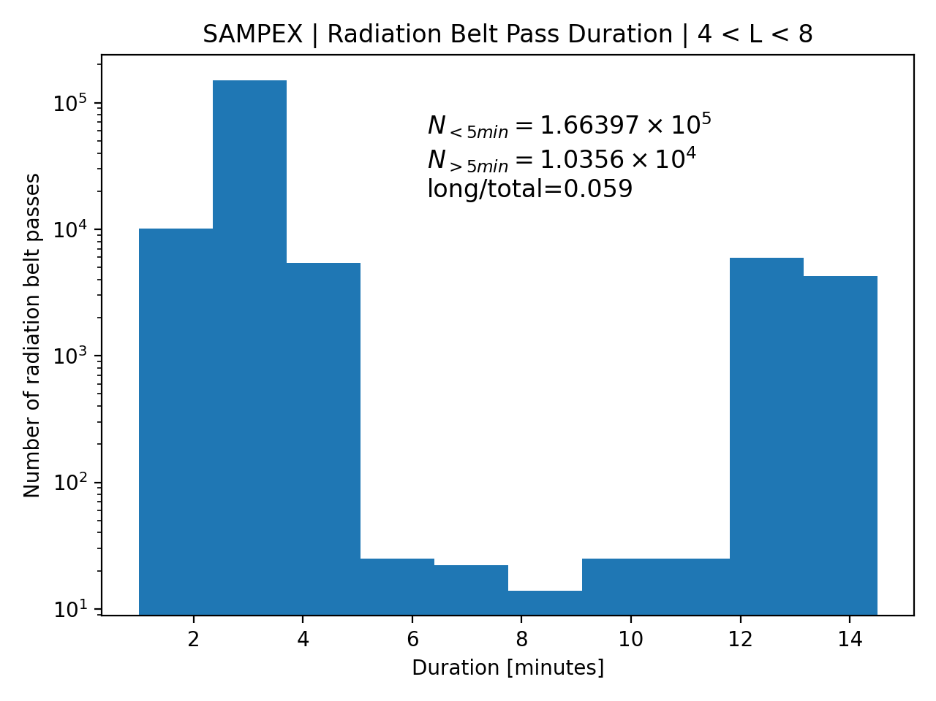
Step 1: 2997-2012 radiation belt passes
Passes defined by 4 < L < 8.
Filtered out passes by the maximum of the attitude flag. Attitude flag >= 100 means SAMPEX was spinning. The spin is bad for microburst detections.
95% of passes are shorter than 5 minutes duration. This is typical. But 5% of passes are much longer---they occasionally happen when SAMPEX doesn’t quite exit L = 8 in the radiation belt on its pole-ward part of the orbit.

Slide 6

Step 2: Microburst occurrence in each pass
$$microburst occurrence = \frac{number of microbursts observed in each pass}{pass duration}$$
$$pass= radiation belt pass$$

Slide 7
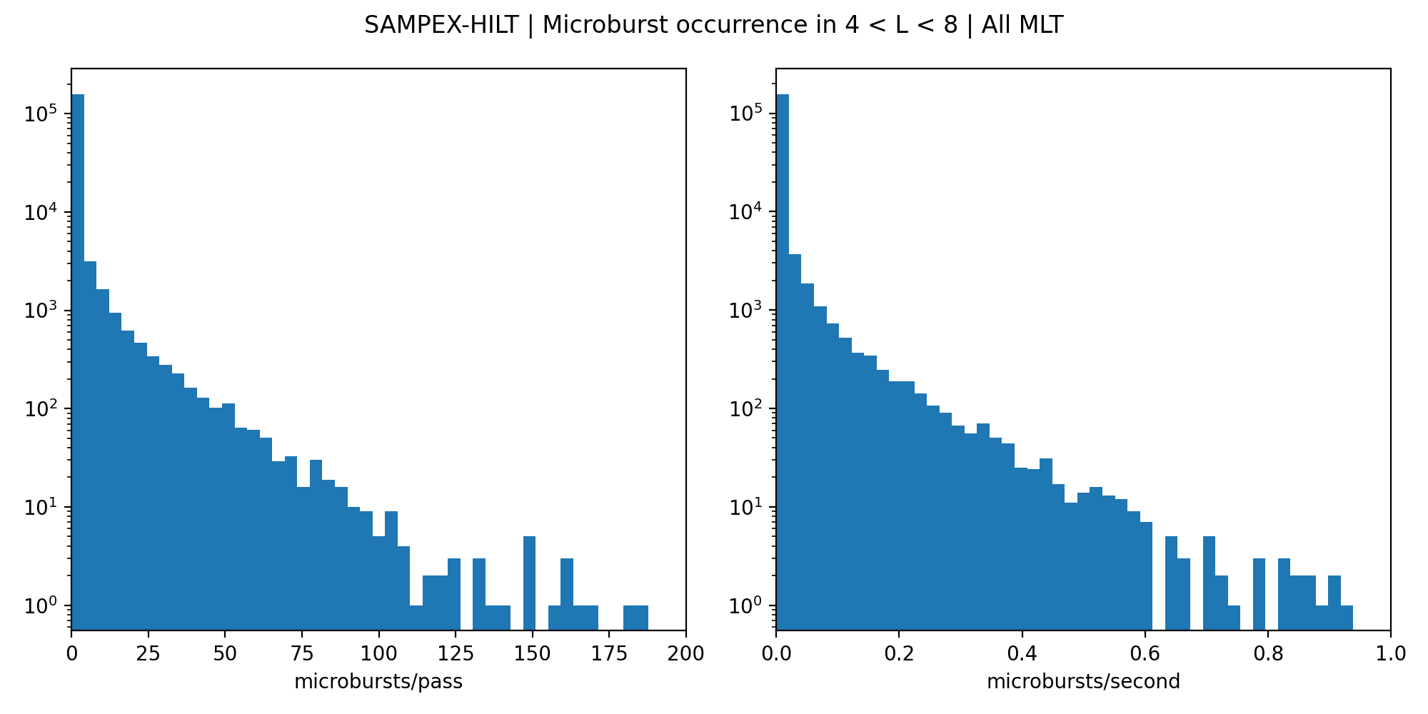
Step 2: Microburst occurrence in each pass
SAMPEX observed no microbursts for most passes.
Exponentially-falling distribution. This means that we’ll have to use stratified sampling, or another sampling method when we model this.
Number of radiation belt passes

Slide 8
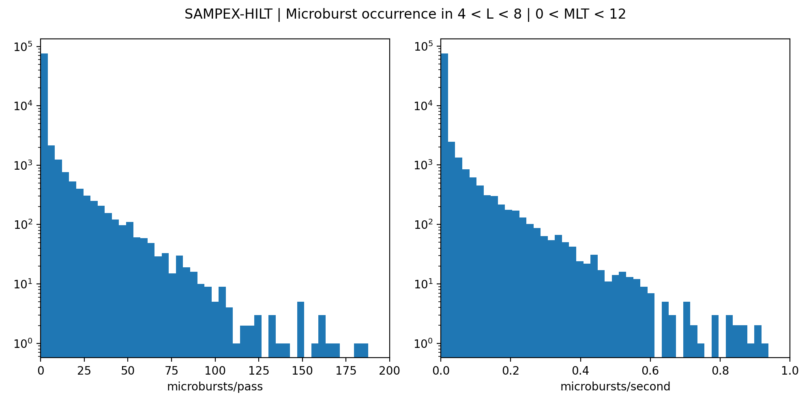
Step 2: Microburst occurrence in each pass
SAMPEX observed no microbursts for most passes.
Exponentially-falling distribution. This means that we’ll have to use stratified sampling, or another sampling method when we model this.
Number of radiation belt passes

Slide 9
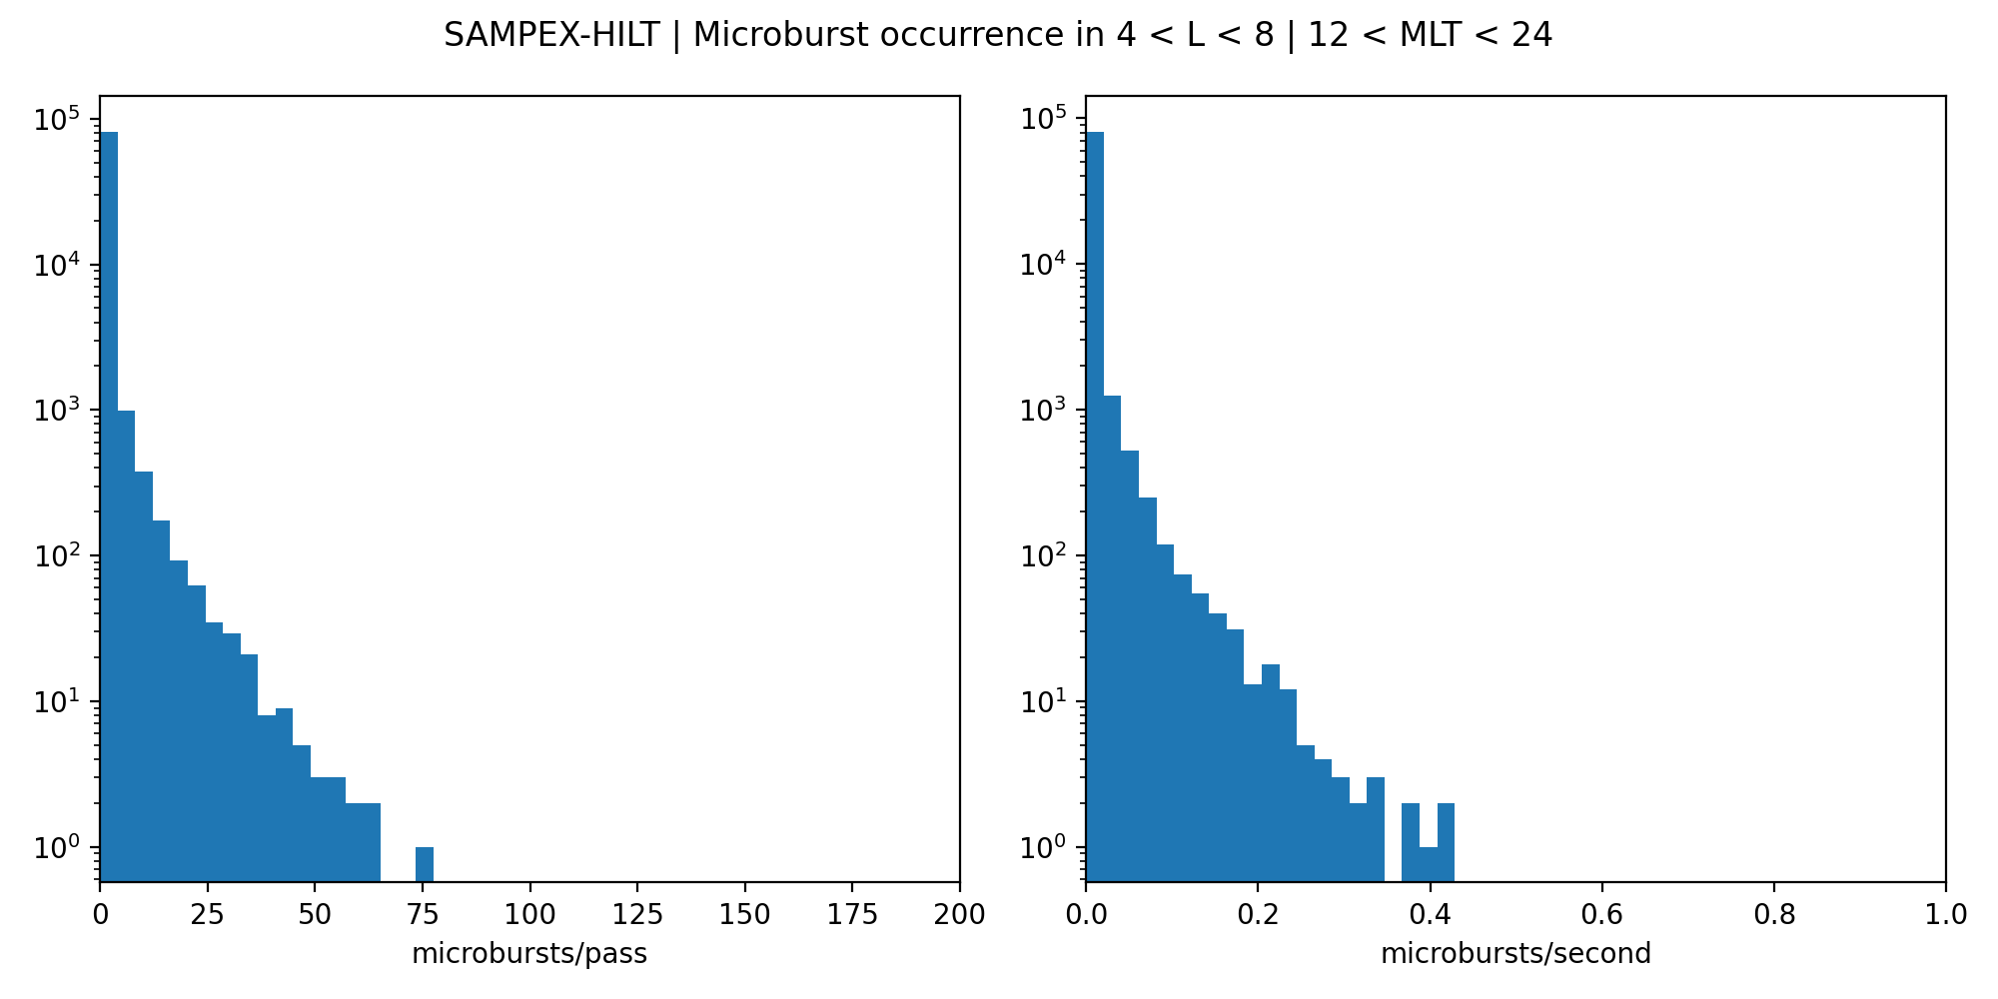
Step 2: Microburst occurrence in each pass
SAMPEX observed no microbursts for most passes.
Exponentially-falling distribution. This means that we’ll have to use stratified sampling, or another sampling method when we model this.
Number of radiation belt passes

Slide 10
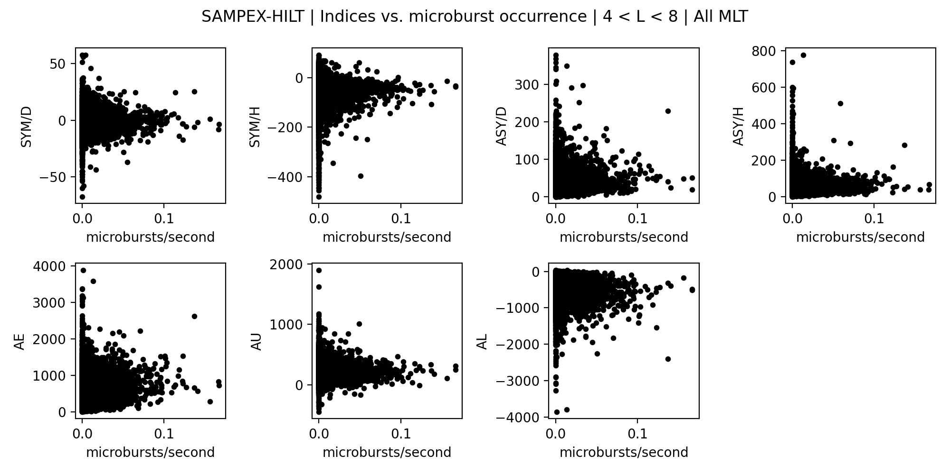
Step 3: Append Indices
To my surprise, I don’t see any significant trends in any of these indices and the microburst rate.
Is there a better way to calculate microburst occurrence rate?
Maybe this is where the rate of change of this indices will be more illuminating.

Slide 11
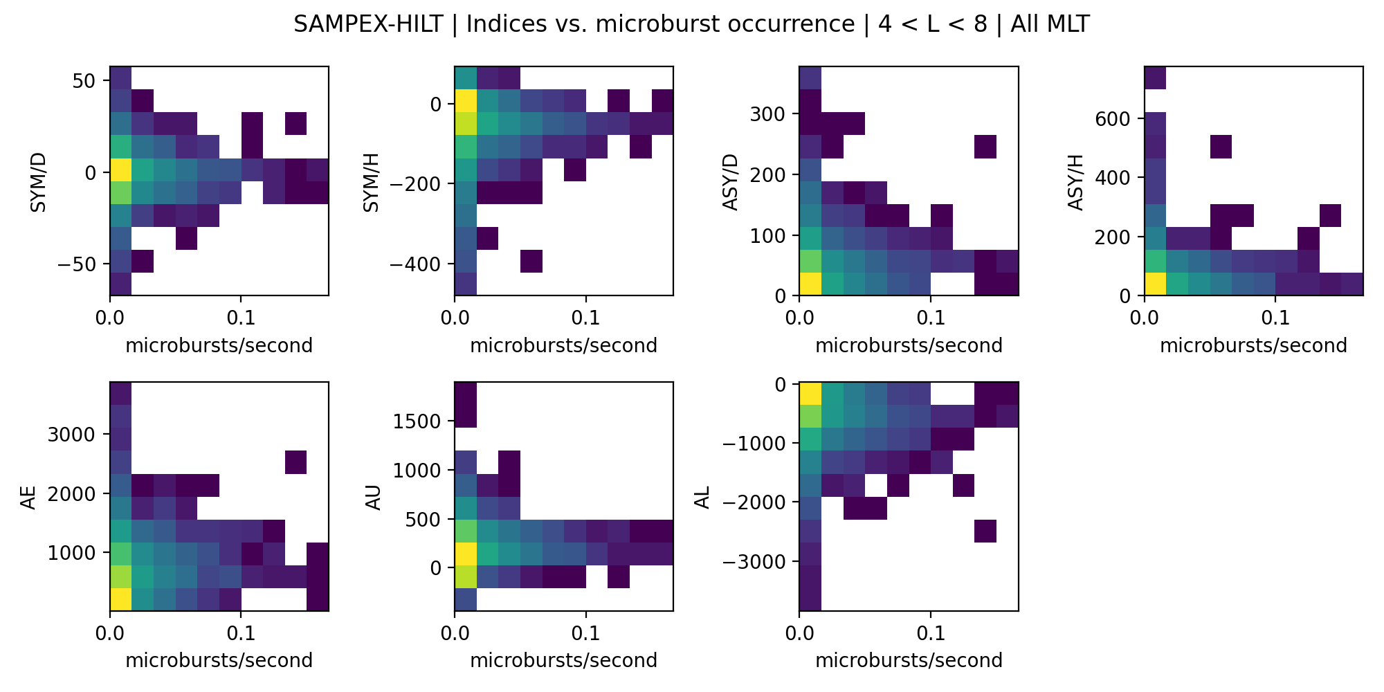
Step 3: Append Indices
Same as the previous slide but in histogram form.
To my surprise, I don’t see any significant trends in any of these indices and the microburst rate.
Is there a better way to calculate microburst occurrence rate?
Maybe this is where the rate of change of this indices will be more illuminating.

