Slide 1
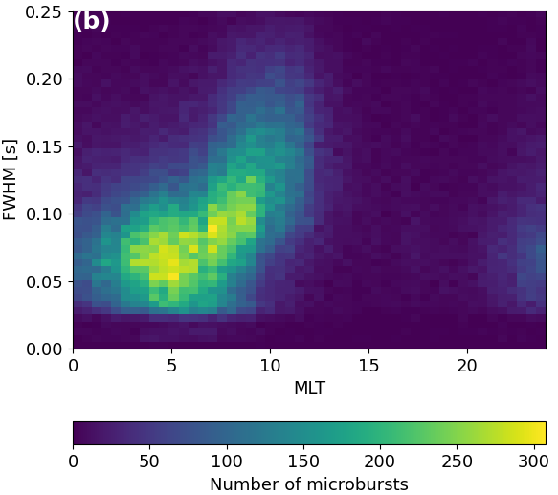
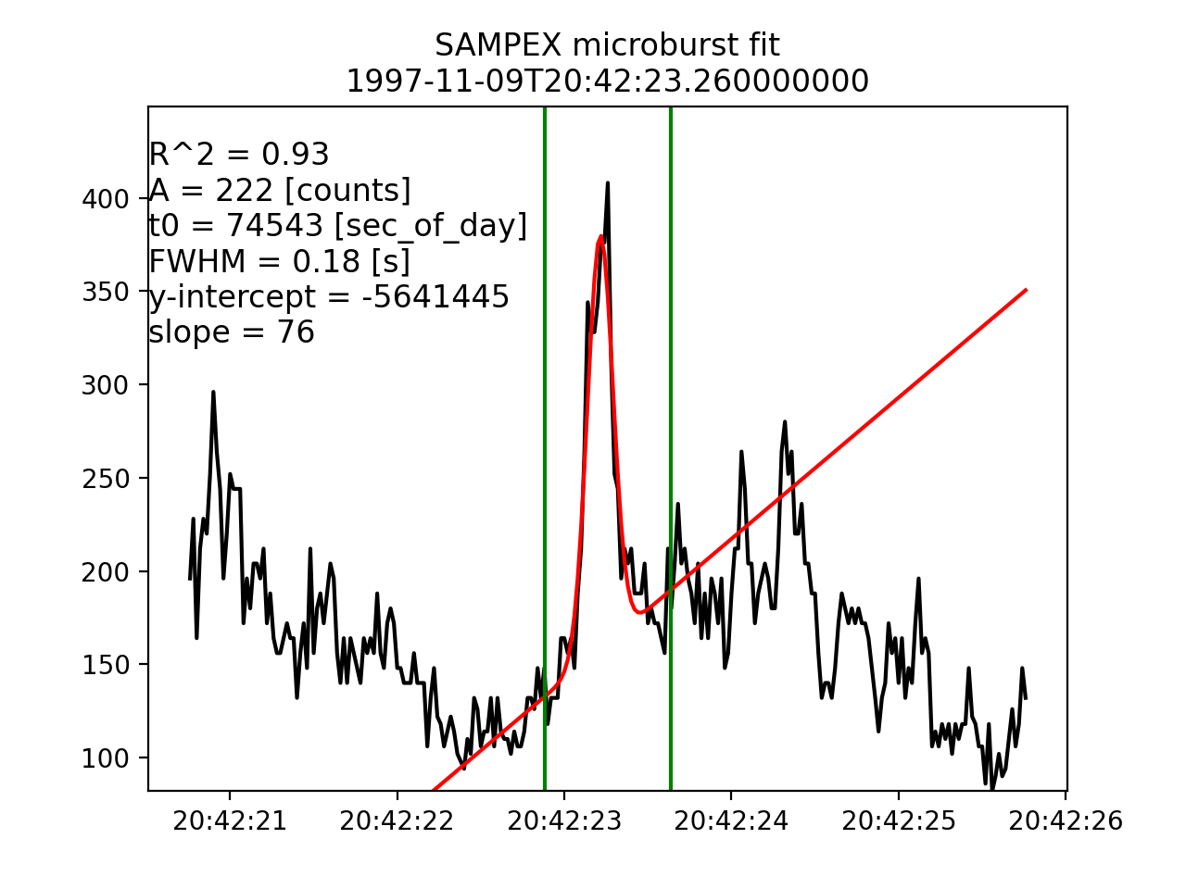
Duration of Individual Relativistic Electron Microbursts: A Probe Into Their Scattering Mechanism
Mike Shumko, Lauren Blum, and Alex Crew

