Slide 1
SAMPEX Microburst Widths Update
Mykhaylo Shumko
20 October 2020

Slide 2
Summary of changes
Created a microburst catalog using the O’Brien et al., 2003’s burst parameter.
Used a 0.5 s baseline (the exact burst parameter… this is the A500 param in O’Brien et al., 2003) microburst_catalog_02.csv
Also generated a microburst list using a 1 s baseline microburst_catalog_00.csv and microburst_catalog_01.csv
Estimated widths at half of the peak prominence (width_s column) as well as the Gaussian FWHM from the fit (fwhm column).
Gaussian function is superposed with a linear trend (5 parameters total)
Implemented the R^2 and adjusted R^2 goodness of fit tests (r2 and adj_r2 columns)

Slide 3
Fit Details
Used a Gaussian for the peak, and a linear trend to account for the drift loss cone background.
The time slice for the fit is:
by default 4x the prominence width
500 ms if the 4x prominence width is less than 100 ms (5 data points). This is a failsafe in case the prominence method fails and width_s is 0.
Initial parameter guesses
Amplitude from prominence
t0 from microburst detection
Width from prominence
Y-intercept = 50
Slope = 0
The saved fwhm units is seconds, t0 is datetime string, amplitude is counts. Y-intercept and slope have units of counts and counts/sec_of_day, respectively.
If fit did not converge, the detection fit parameters are NaN (in a csv it is nothing, i.e. “,,”)

Slide 4
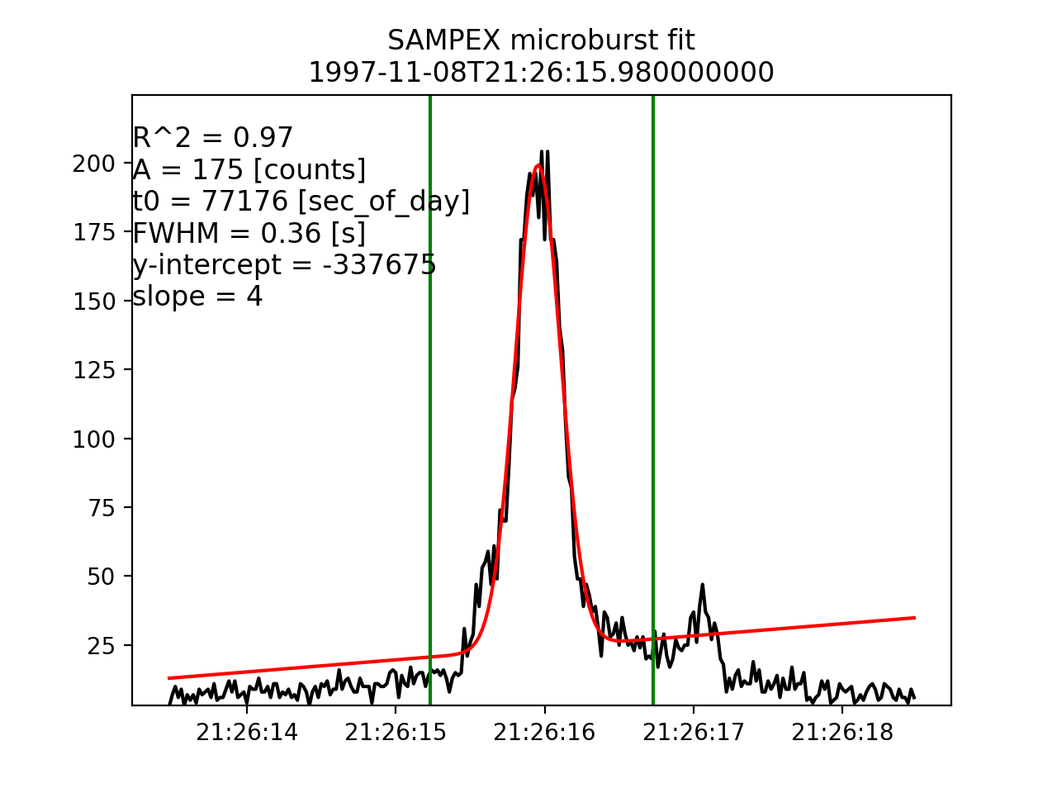
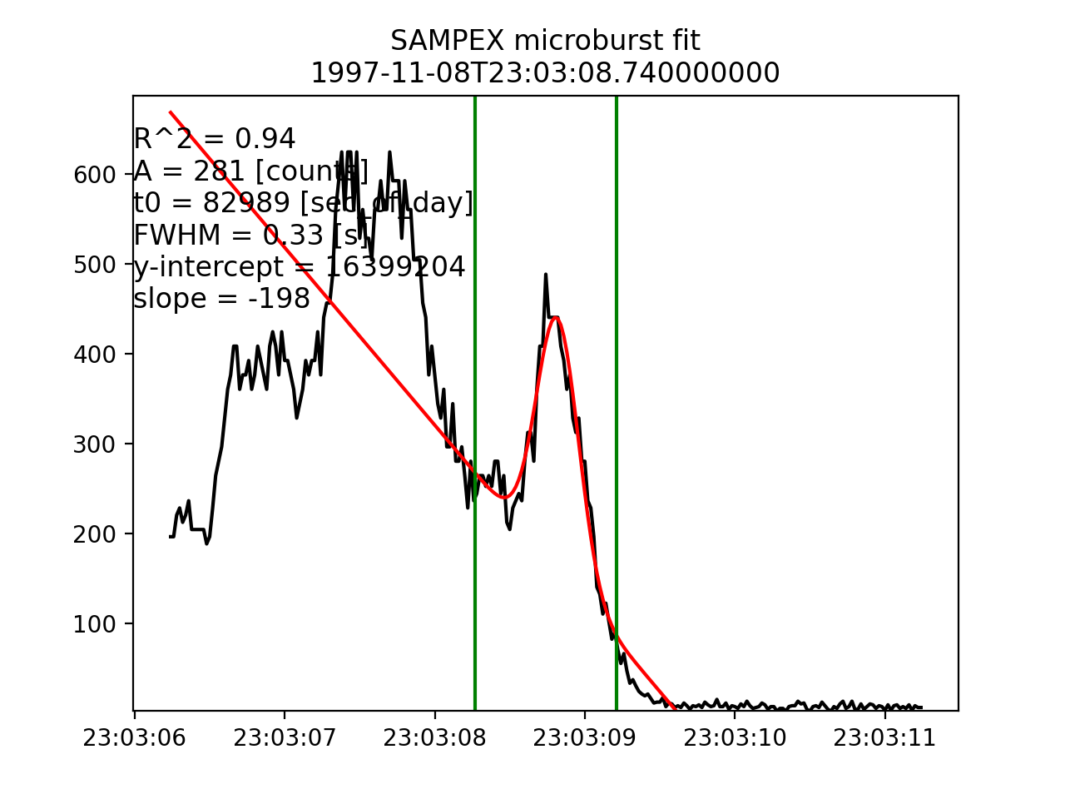
Results: Example microbursts with fits
Green: fit bounds
Red: Gaussian + linear trend

Slide 5
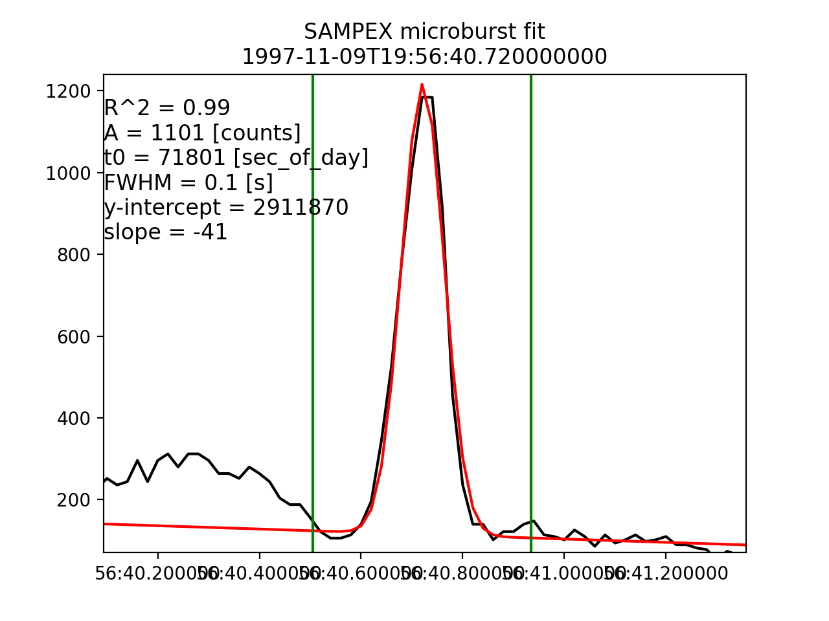
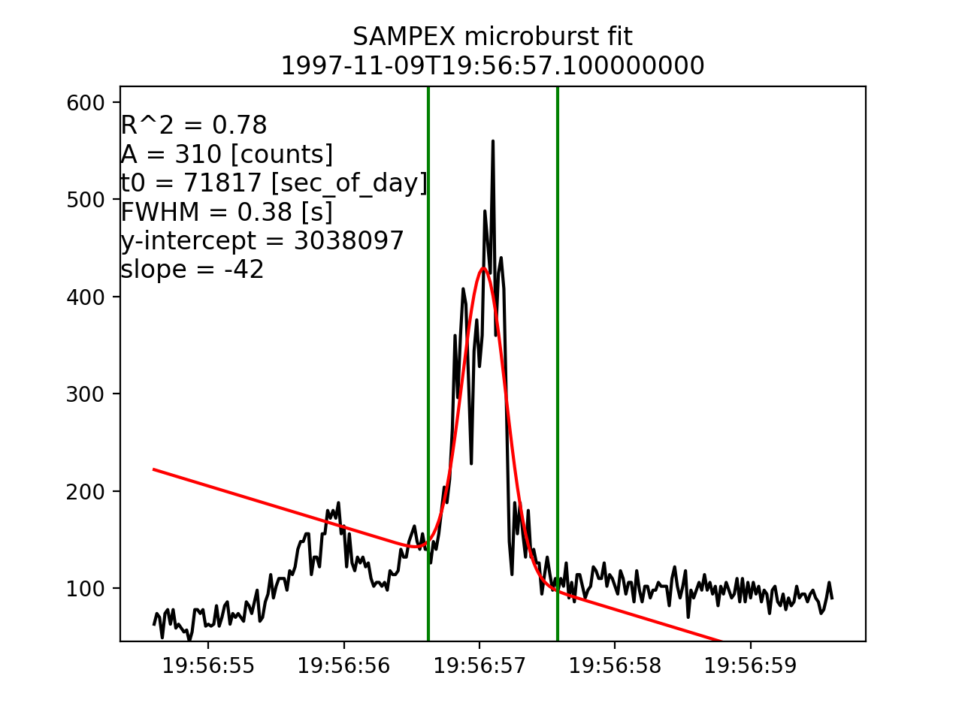
Results: Example microbursts with fits

Slide 6
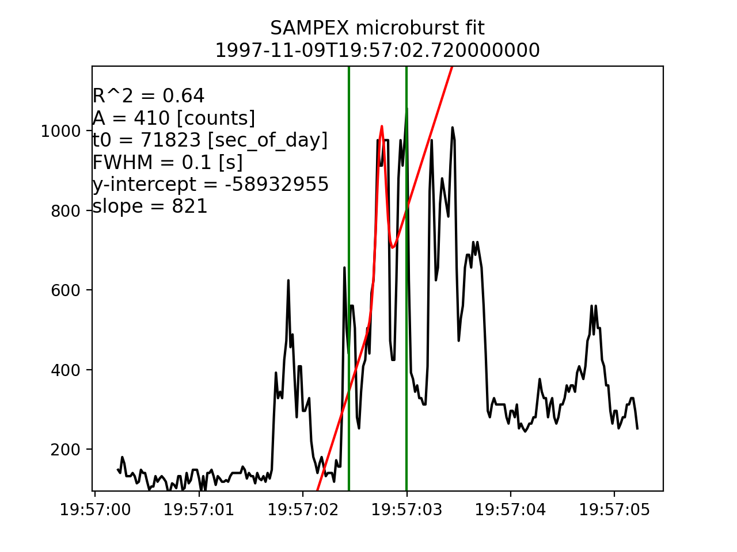
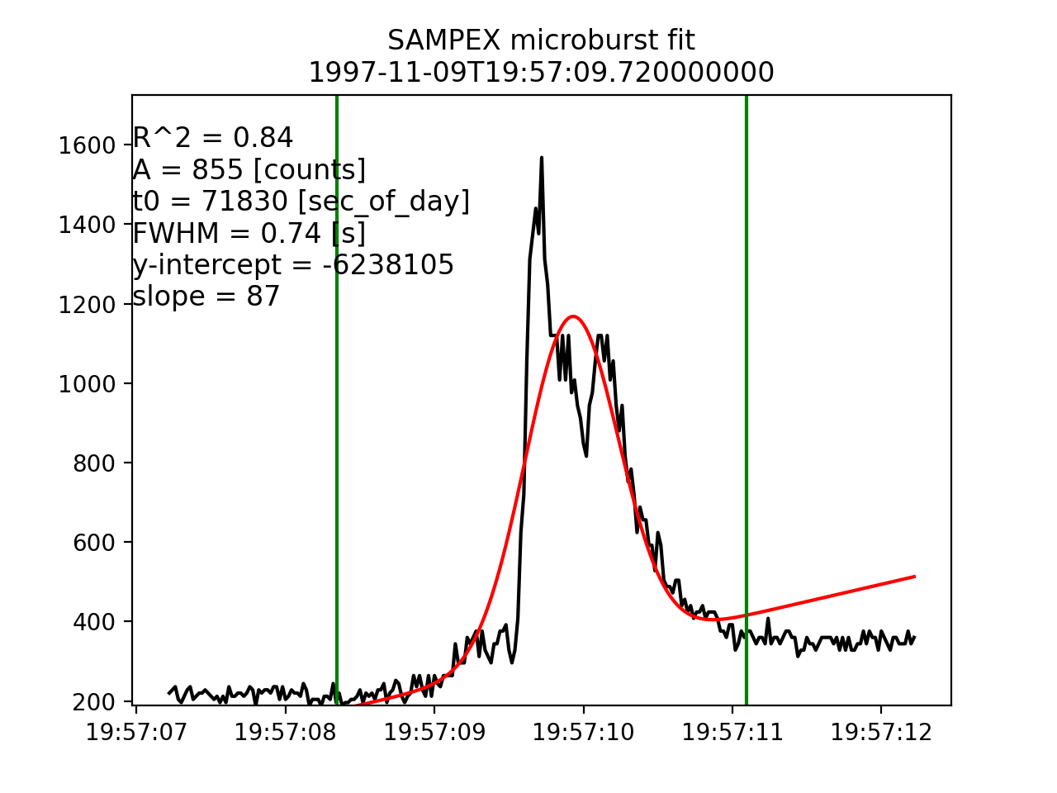
Results: Example microbursts with fits

Slide 7
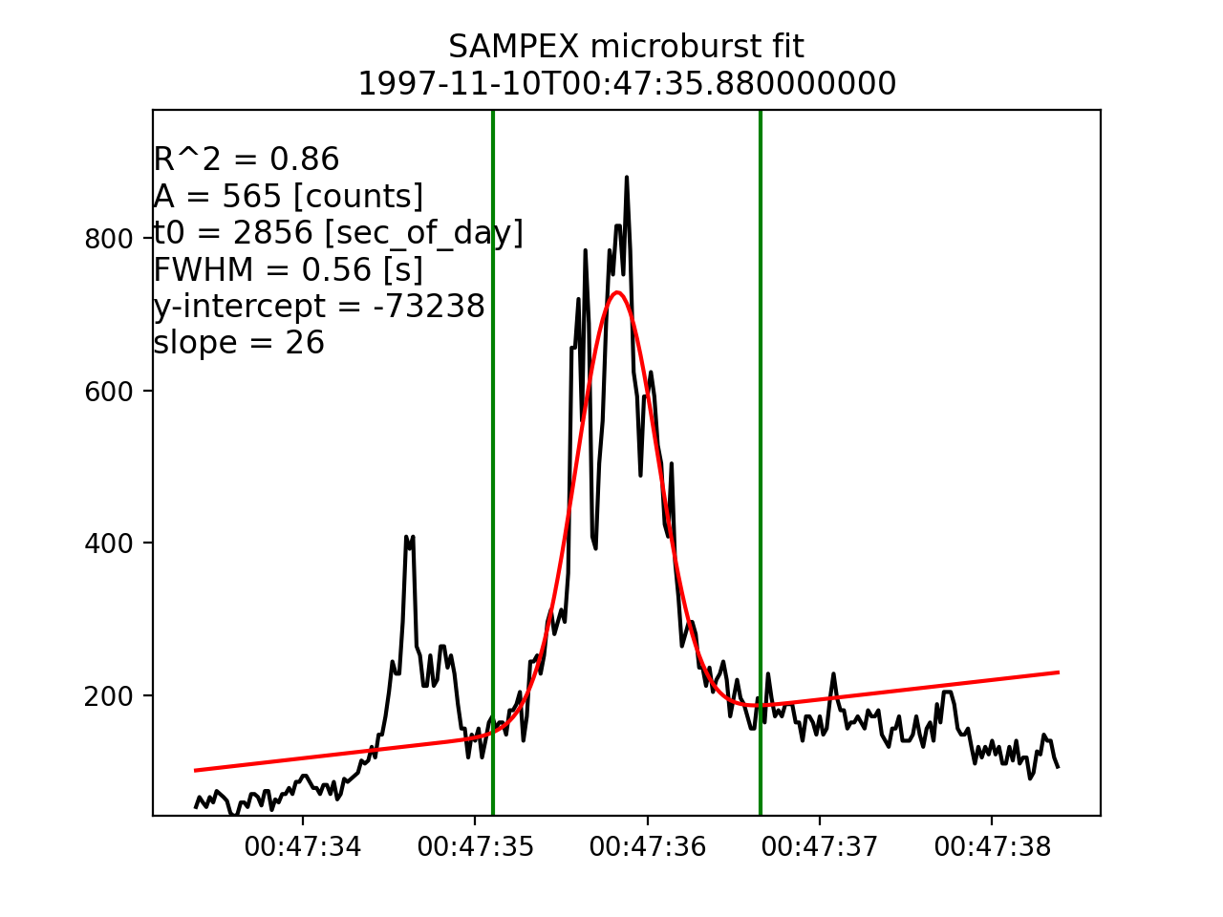
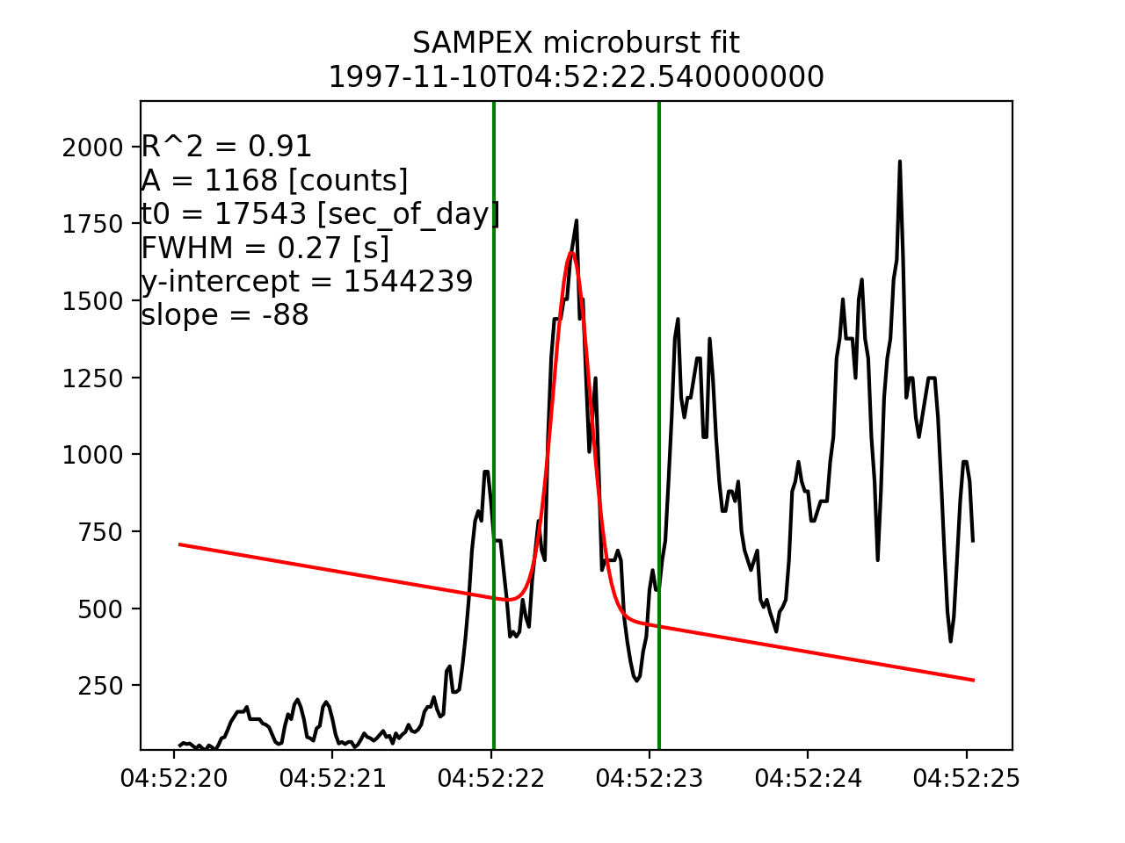
Results: Example microbursts with fits

Slide 8
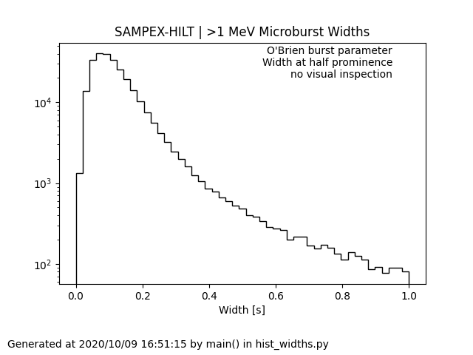
Results: Microburst width histogram

Slide 9
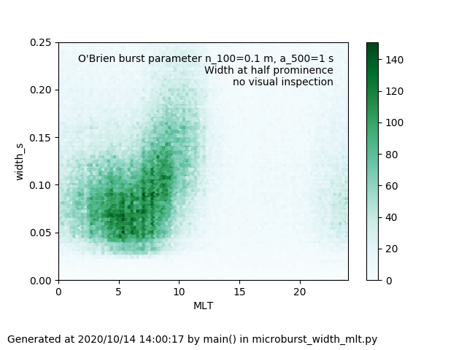
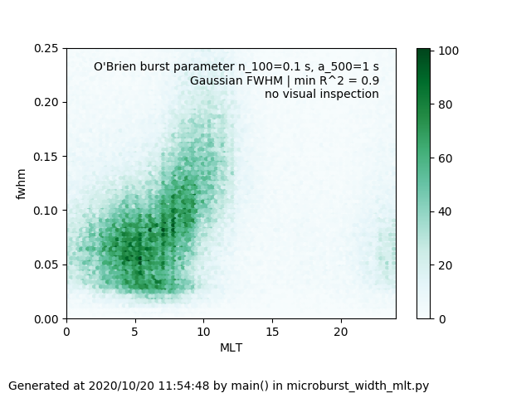
Results: width-MLT distribution
Width at half prominence
Gaussian fit with R^2 > 0.9

Slide 10
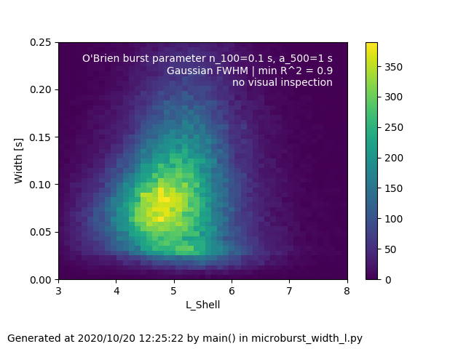
Results: width-L shell distribution

Slide 11
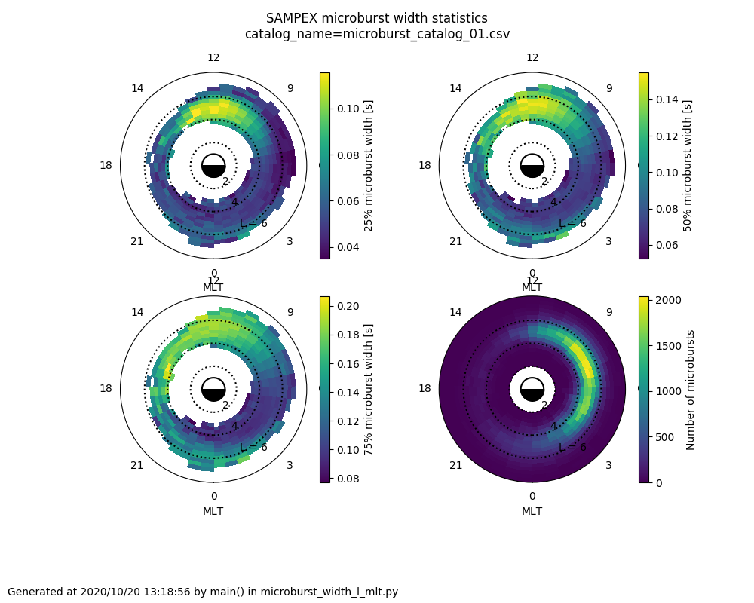
Results: L-MLT distribution

Slide 12
Up next
Finish documenting code

