Slide 1
MeV Dusk Microbursts
Mykhaylo Shumko
16 March 2023

Slide 2
Methodology
I wrote a program to generate summary plots of each microburst in the dusk MLTs that were poorly and well fit
The program is in a “202303_dusk” development branch of the “sampex_microburst_widths” package
Filtered the pre-existing microburst catalog (microburst_catalog_04.csv) by
16 < MLT < 22
“Good” fits which are adj_R^2>0.9
“Bad” fits which are adj_R^2<0.5
Stats:
16083 microbursts in mlt_range=[16, 22]
4515 microbursts in mlt_range=[16, 22] and with adj_R^2>0.9
2047 microbursts in mlt_range=[16, 22] and with adj_R^2<0.5
I produced the ~6500 plots and I upload them to Google Drive. Take a look at your leisure!

Slide 3
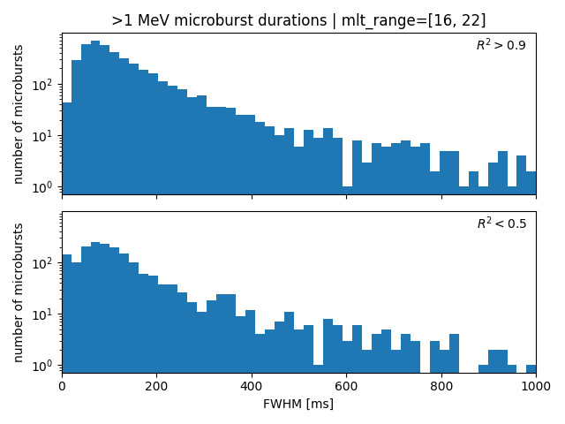
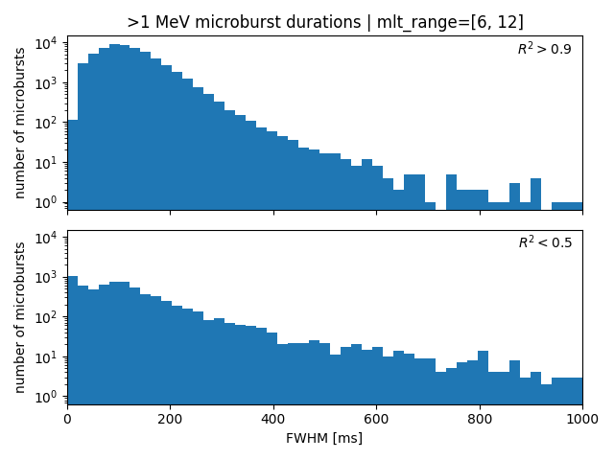
Compare good vs. bad fits & dawn vs. dusk

Slide 4
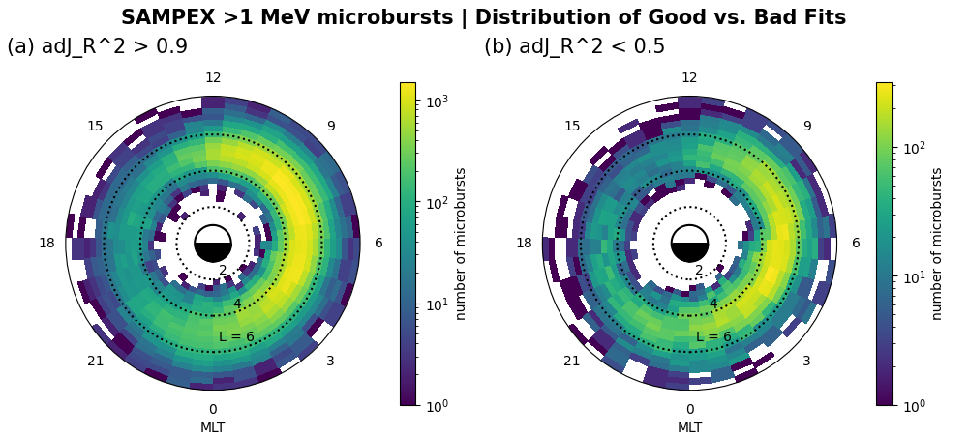
Where are the bad fits?
No obvious difference between the good and poor fit distributions.

Slide 5
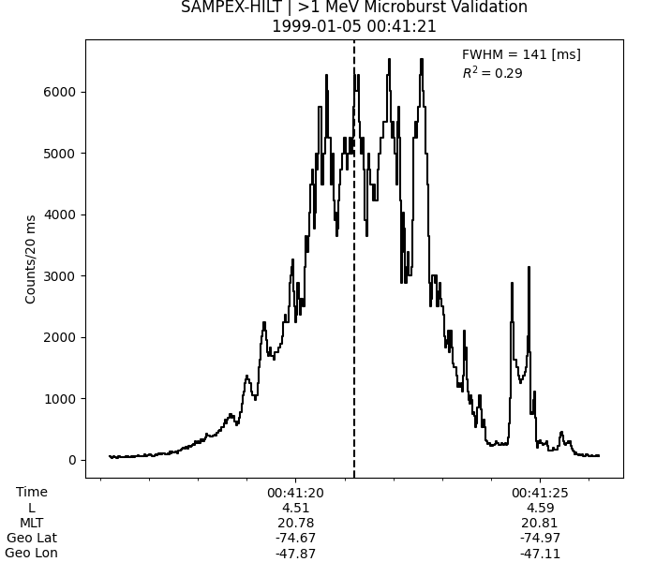
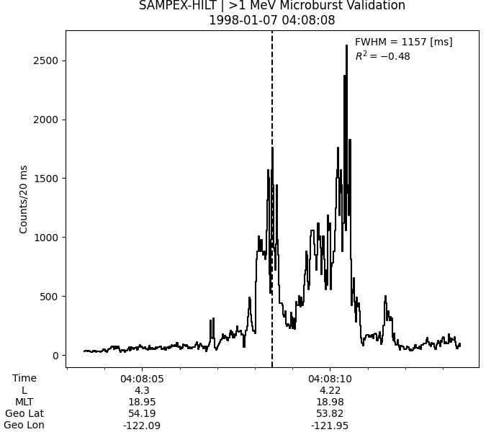
Interesting poor fits

Slide 6
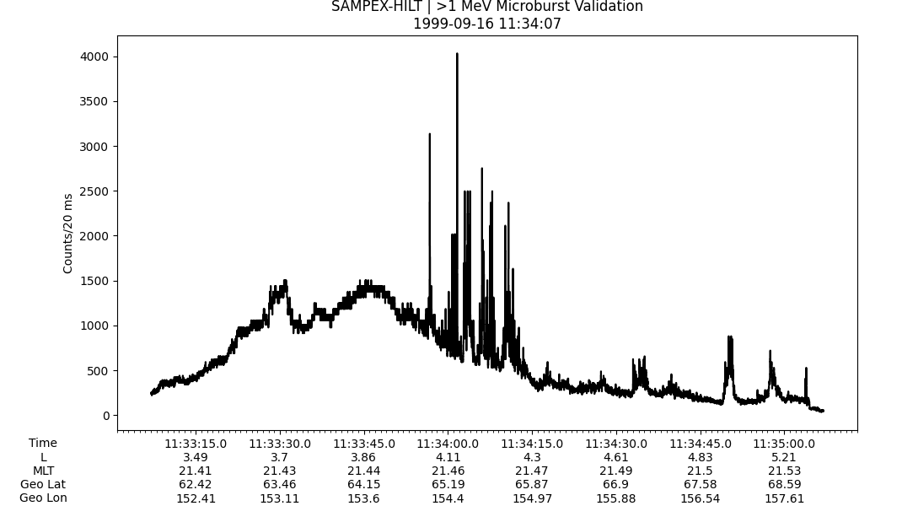
Interesting short microbursts

Slide 7
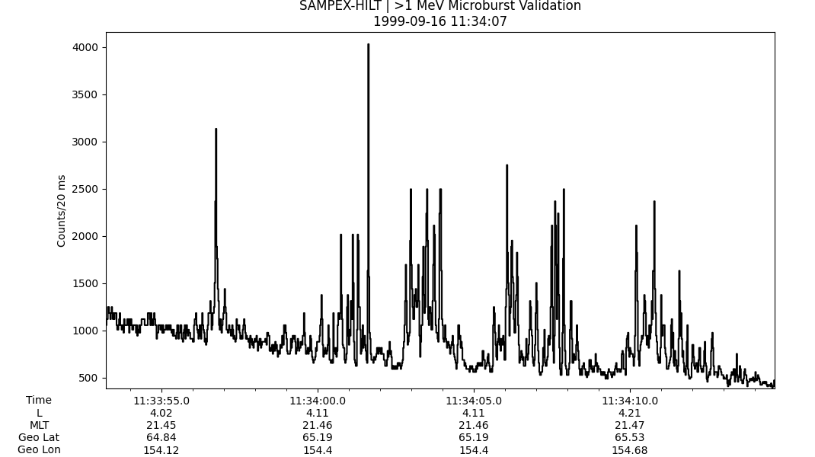
Interesting short microbursts

Slide 8
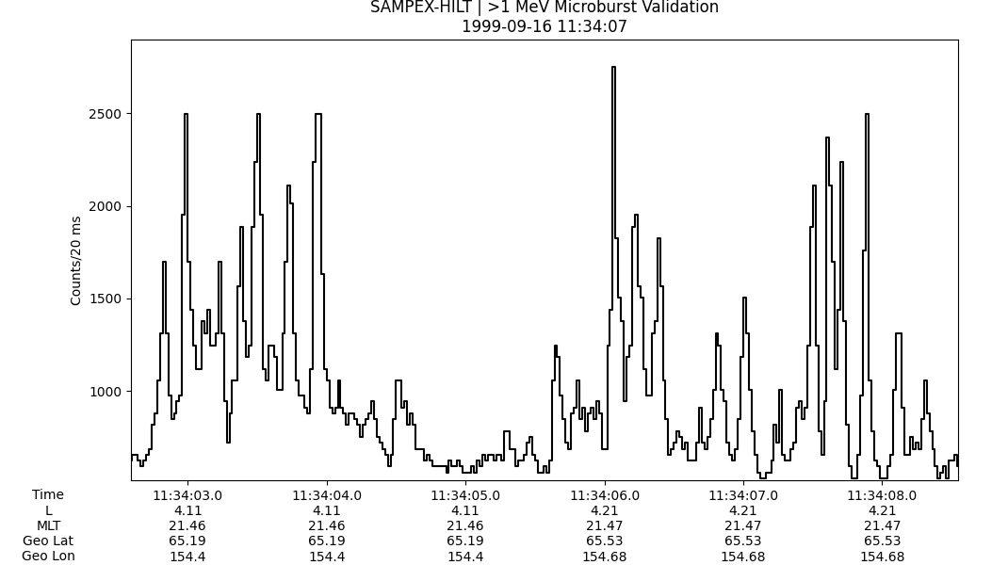
Interesting short microbursts

Slide 9
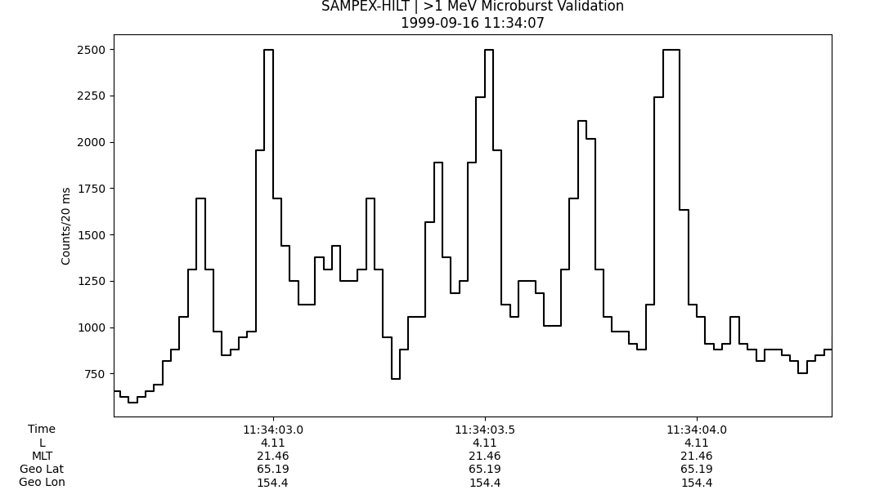
Interesting short microbursts

Slide 10
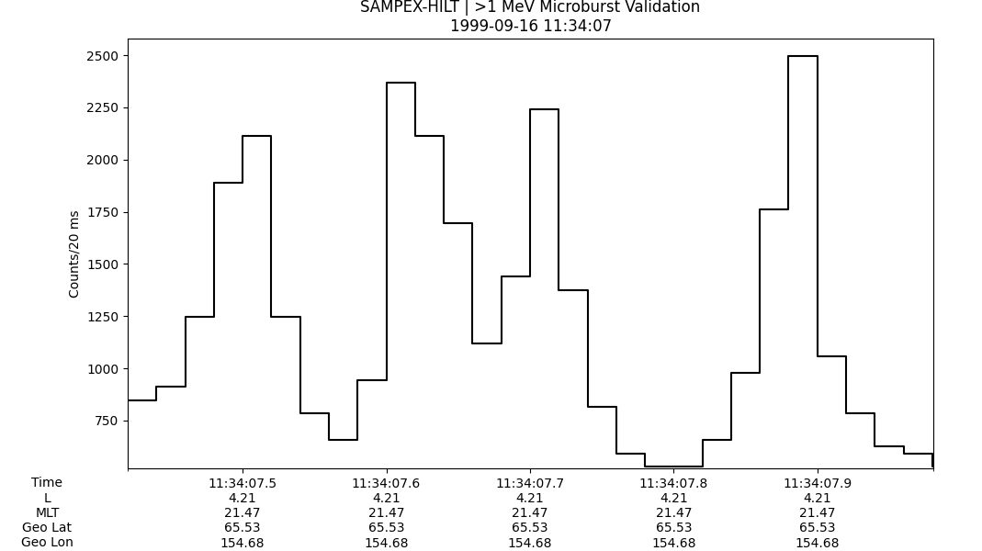
Interesting short microbursts
Each x-axis tick is 100 ms!
… I recall finding these dusk microbursts using the FIRBEIRD-II data too

Slide 11
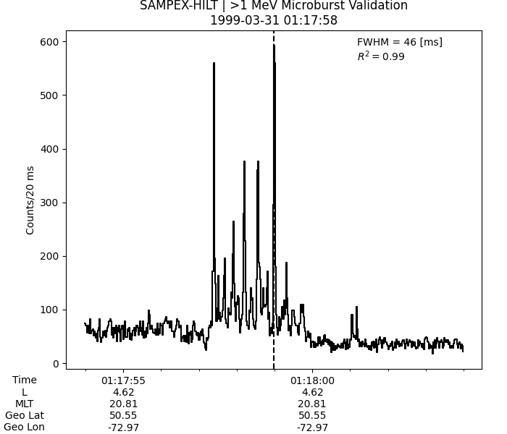
More short microburst examples…

Slide 12
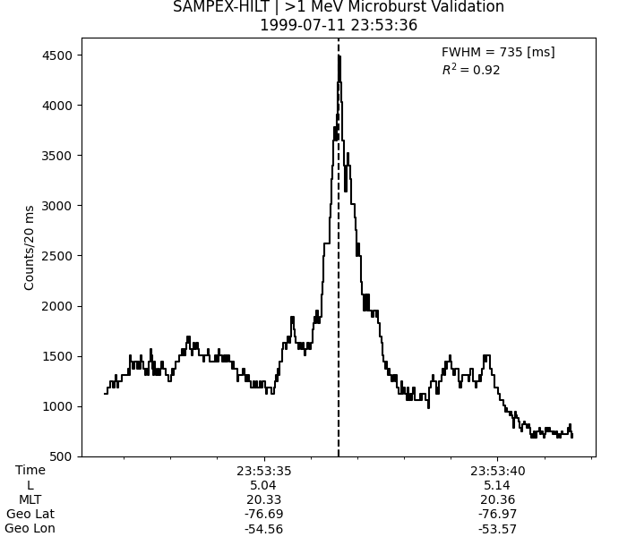
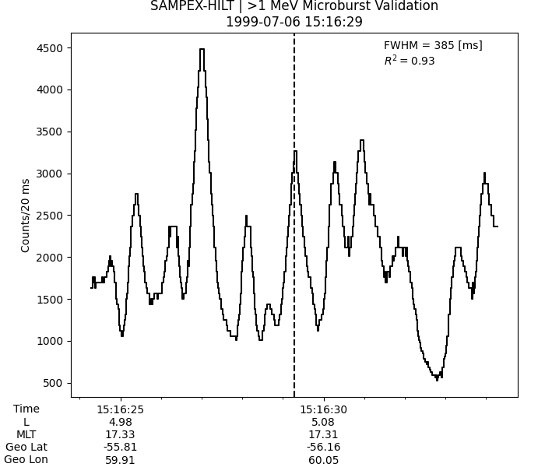
Did I rediscover precipitation bands, or are these still microbursts?

