Slide 1
Duration of Individual Relativistic Electron Microbursts: A Probe Into Their Scattering Mechanism
Mike Shumko, Lauren Blum, and Alex Crew

Slide 2
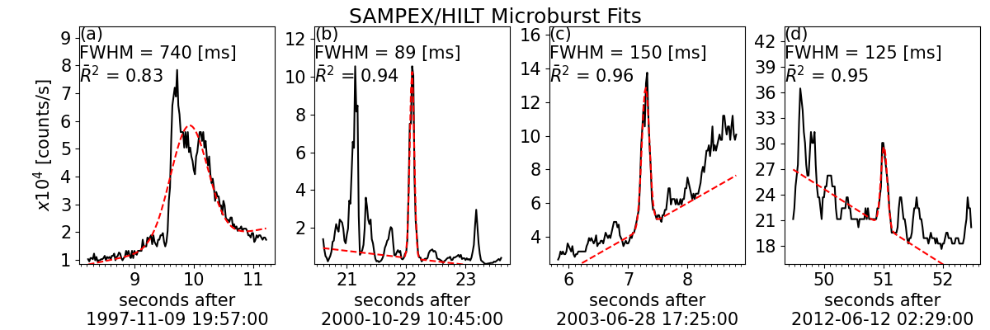
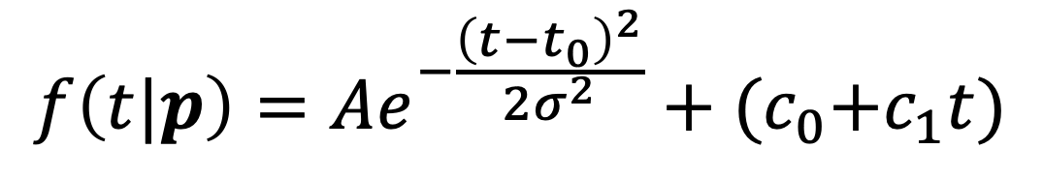
We automatically identified microbursts and estimated their duration.
$$f\left(t|p\right)=Ae^{−\frac{{\left(t−t_{0}\right)}^{2}}{2σ^{2}}}+{(c}_{0}+c_{1}t)$$

Slide 3
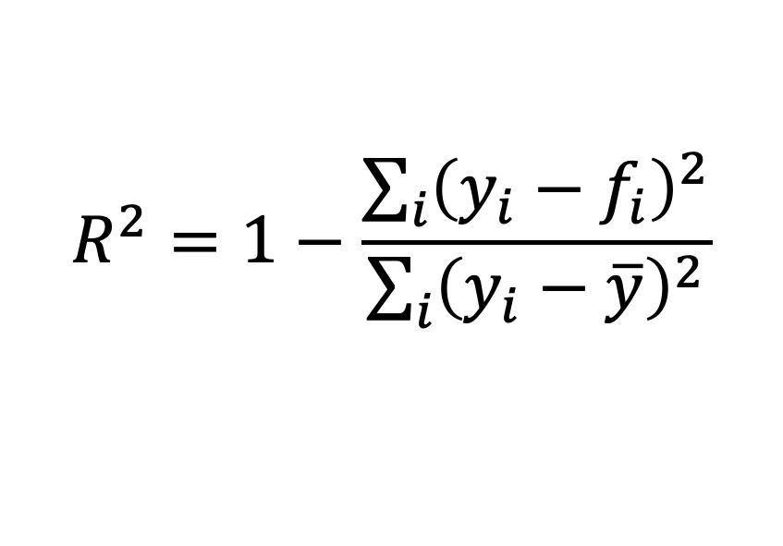
We automatically identified microbursts and estimated their duration.
$$R^{2}=1−\frac{\sum_{i}{{\left(y_{i}−f_{i}\right)}^{2}}}{\sum_{i}{{\left(y_{i}−\overline{y}\right)}^{2}}}$$

Slide 4
We automatically identified microbursts and estimated their duration.
$$R^{2}=1−\frac{\sum_{i}{{\left(y_{i}−f_{i}\right)}^{2}}}{\sum_{i}{{\left(y_{i}−\overline{y}\right)}^{2}}}$$

Slide 5
We automatically identified microbursts and estimated their duration.
$$R^{2}=1−\frac{\sum_{i}{{\left(y_{i}−f_{i}\right)}^{2}}}{\sum_{i}{{\left(y_{i}−\overline{y}\right)}^{2}}}$$

Slide 7
Strong MLT dependence---median microburst duration doubles from 80 to 160 ms

Slide 9
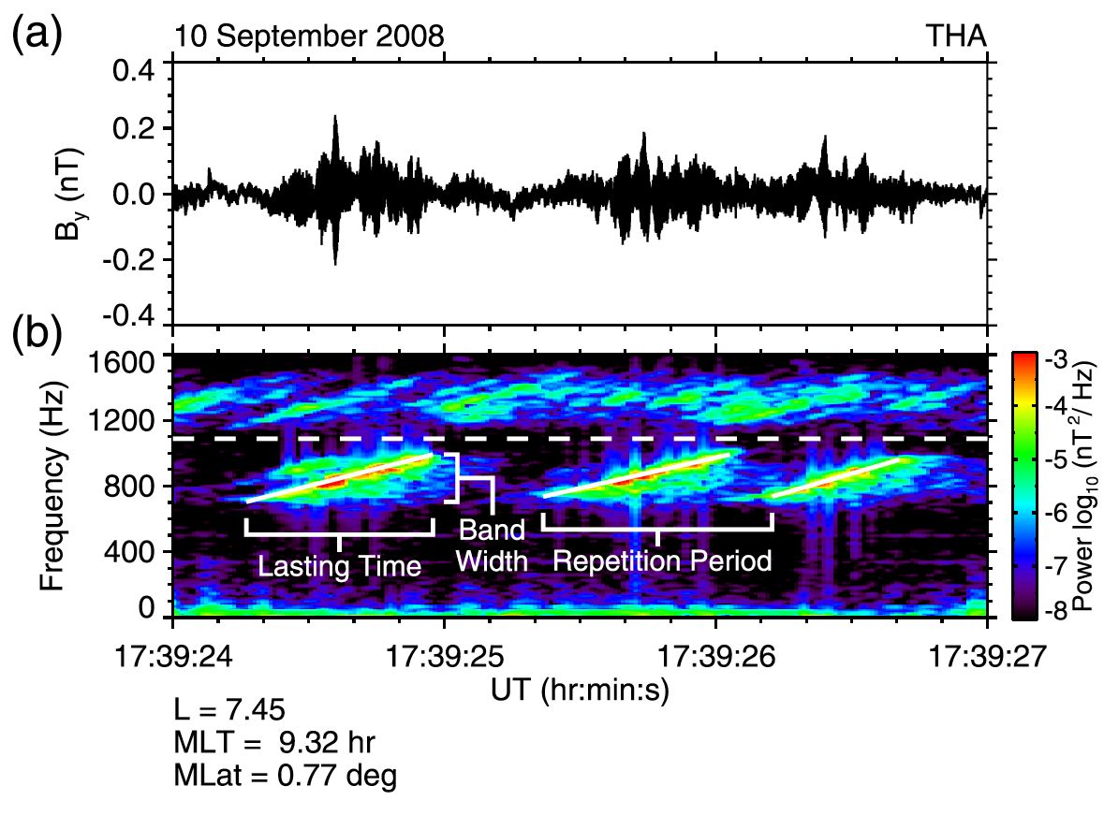
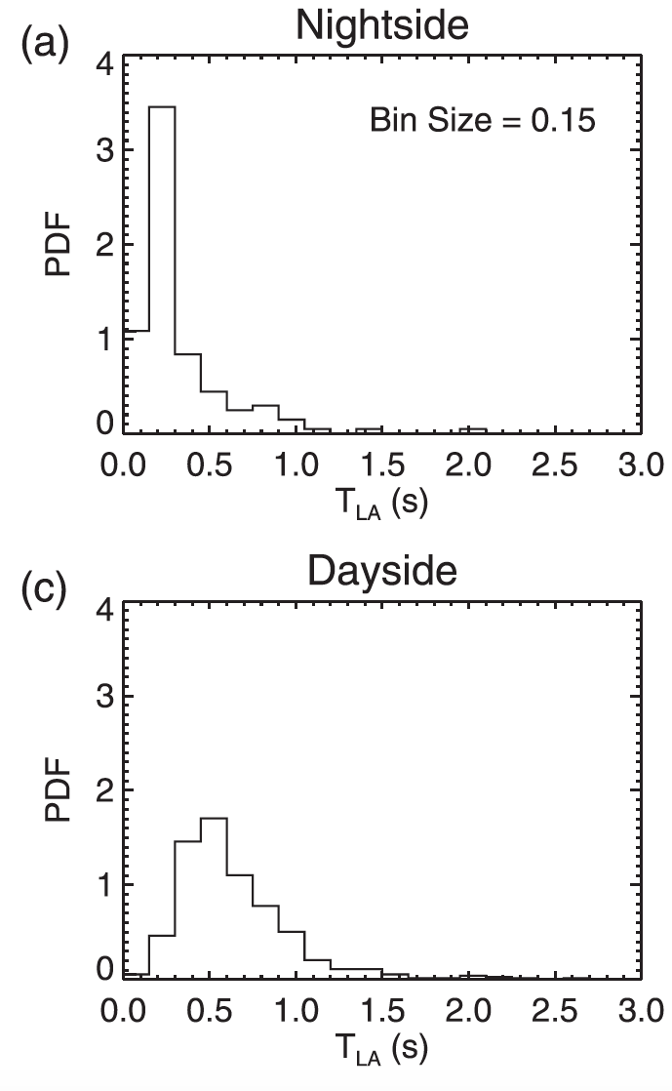
The chorus rising tone element duration follows a similar pattern.
Median: 0.3 s
Median: 0.6 s
Shue et al., 2019

Slide 10
How to the chorus and microburst duration distributions compare?
Chorus
Microbursts
Median: 0.3 s
Median: 0.6 s
Shue et al., 2019

Slide 11
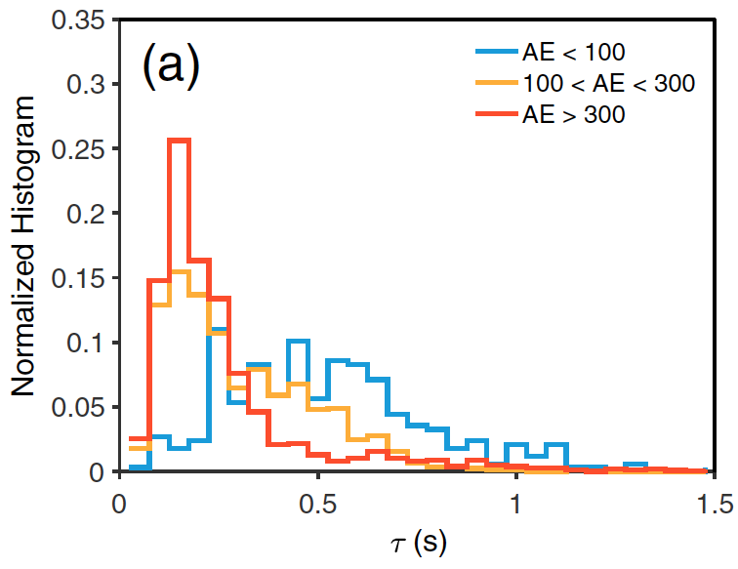
Teng et al., 2017 found that chorus rising tone elements also shortened with increasing AE.
Chorus
Microbursts

Slide 12
Question to consider:
The chorus-microburst durations follow a similar MLT trend, but why are chorus wave durations 3x longer?

