Slide 1
Dusk MeV Microbursts
Mykhaylo Shumko
16 March 2023

Slide 2
Plots
Wrote code to generate summary plots of each microburst.
Code is in a “202303_dusk” development branch of the “sampex_microburst_widths” package.
Microburst catalog filters
16 < MLT < 22
“Good” fit adj_R^2>0.9
“Bad” fit adj_R^2<0.5
16083 microbursts in mlt_range=[16, 22]
4515 microbursts in mlt_range=[16, 22] and with adj_R^2>0.9
2047 microbursts in mlt_range=[16, 22] and with adj_R^2<0.5
I generated the ~6500 plots and I plan to upload them to Google Drive (LINK)

Slide 3
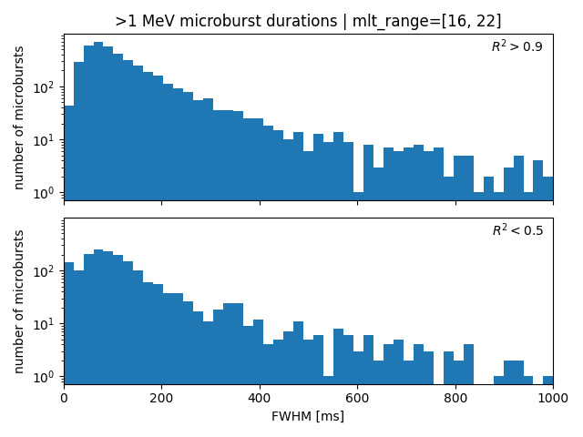
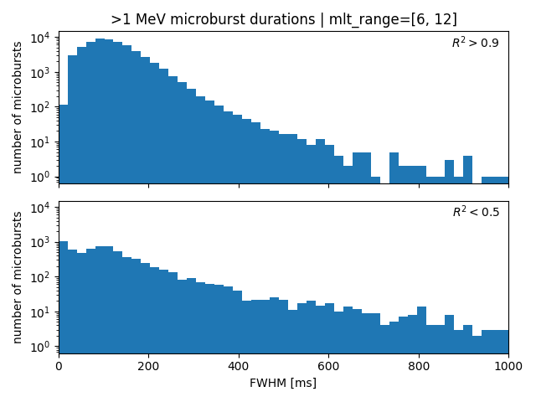
Compare good vs. bad fits & dawn vs. dusk

Slide 4
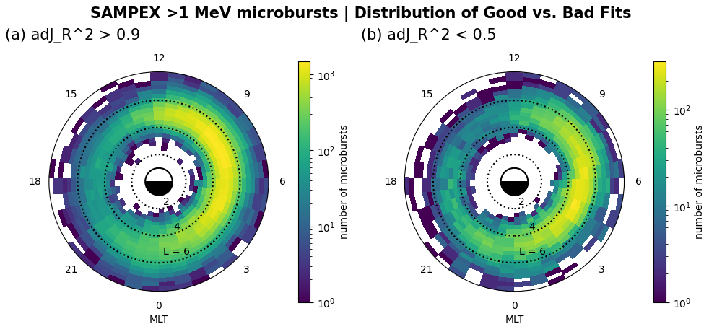
Where are the bad fits?

Slide 5
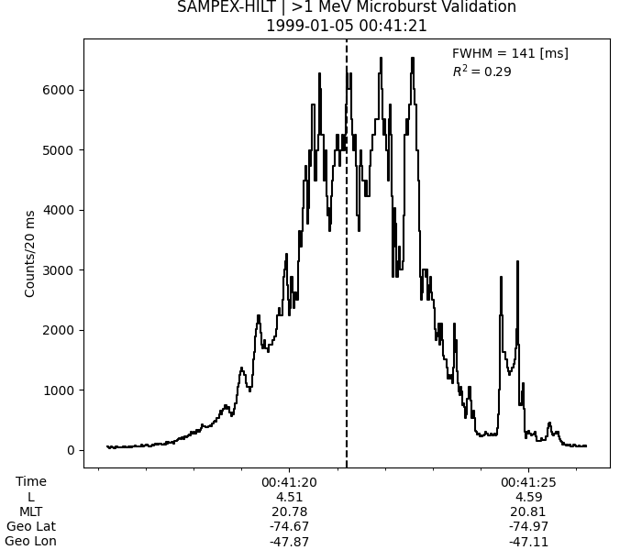
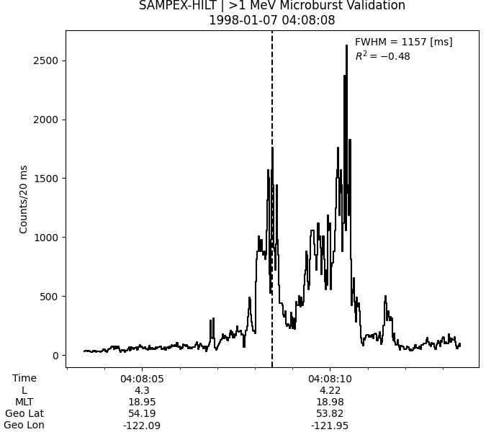
Interesting poor fits

