Slide 1
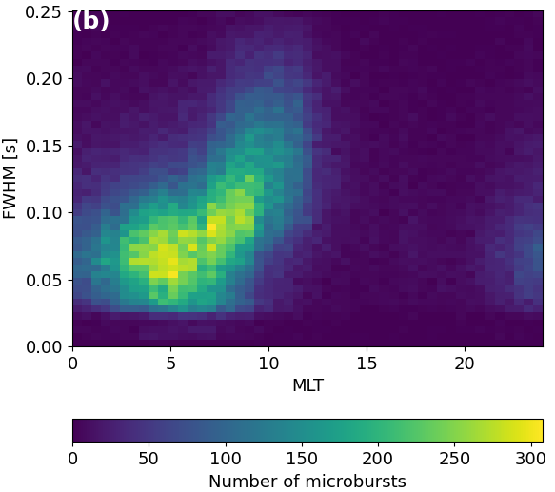
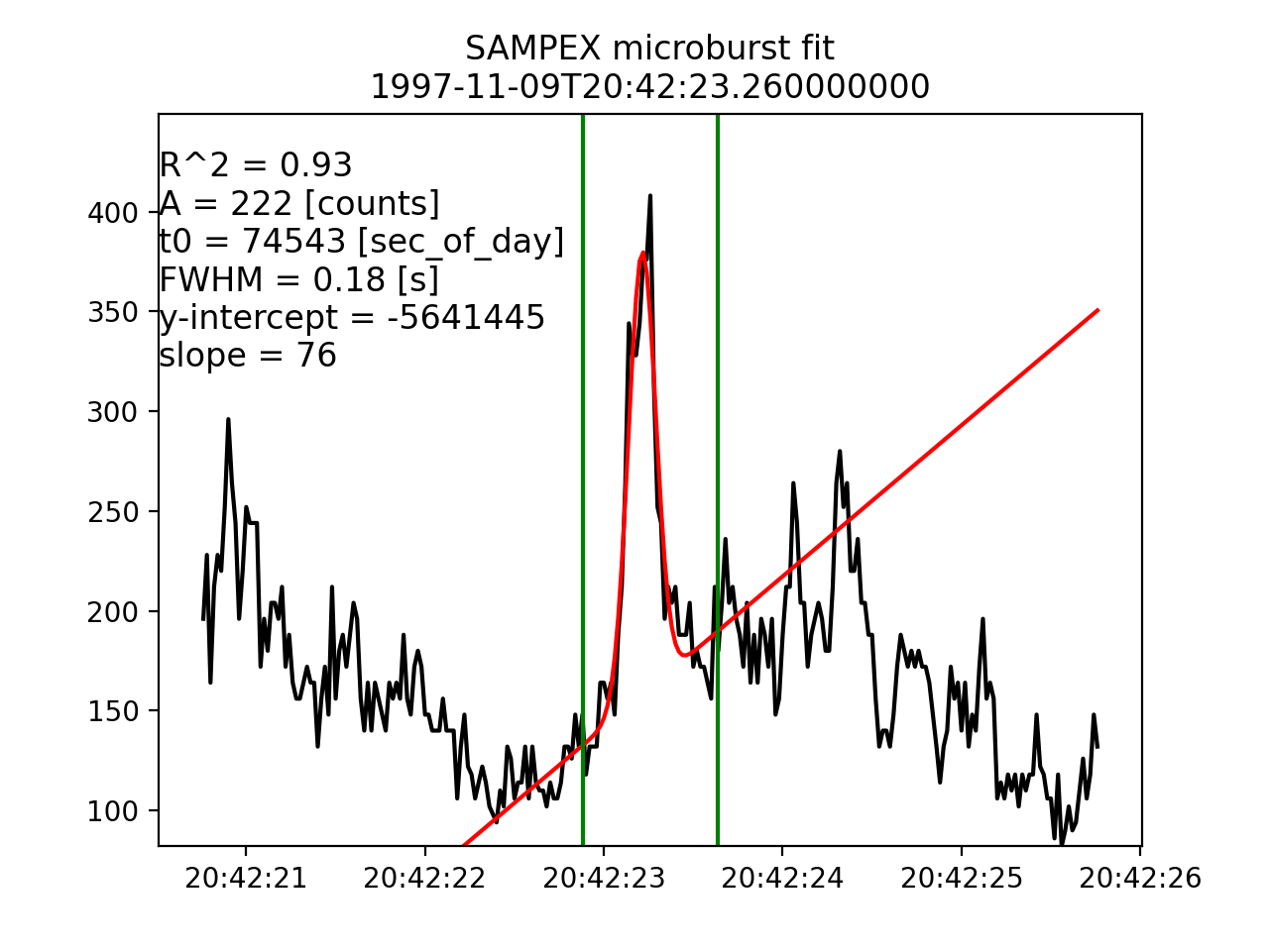
Duration of Individual Relativistic Electron Microbursts: A Probe Into Their Scattering Mechanism
Mike Shumko, Lauren Blum, and Alex Crew

Slide 2
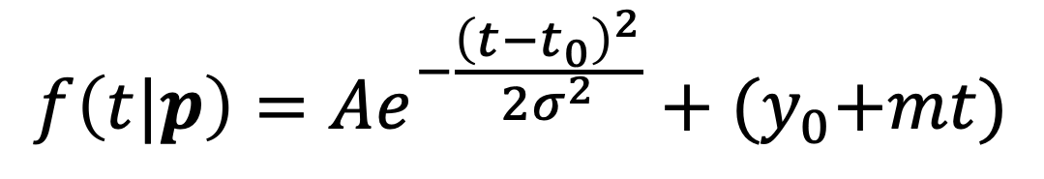
We automatically identified microbursts and estimated their duration.
$$f\left(t|p\right)=Ae^{−\frac{{\left(t−t_{0}\right)}^{2}}{2σ^{2}}}+{(y}_{0}+mt)$$

Slide 3
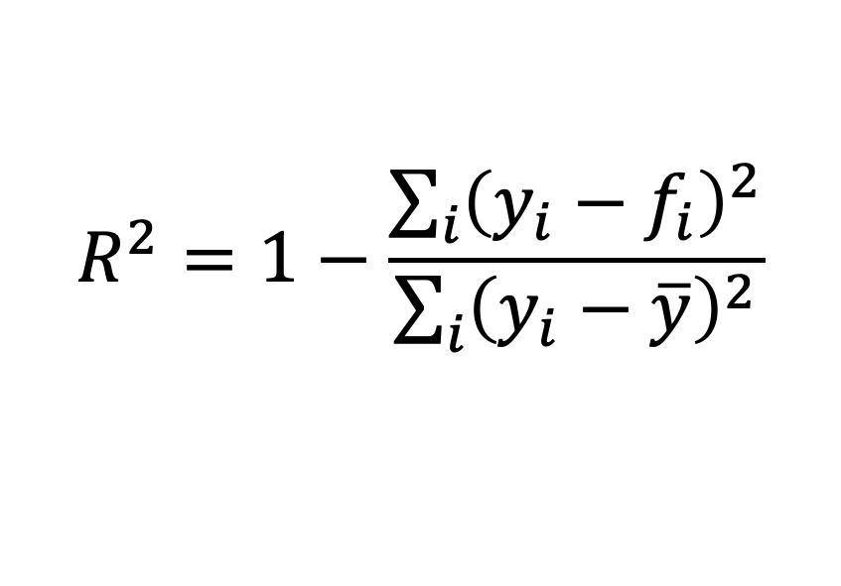
We automatically identified microbursts and estimated their duration.
$$R^{2}=1−\frac{\sum_{i}{{\left(y_{i}−f_{i}\right)}^{2}}}{\sum_{i}{{\left(y_{i}−\overline{y}\right)}^{2}}}$$

Slide 4
We automatically identified microbursts and estimated their duration.
$$R^{2}=1−\frac{\sum_{i}{{\left(y_{i}−f_{i}\right)}^{2}}}{\sum_{i}{{\left(y_{i}−\overline{y}\right)}^{2}}}$$

Slide 5
We automatically identified microbursts and estimated their duration.
$$R^{2}=1−\frac{\sum_{i}{{\left(y_{i}−f_{i}\right)}^{2}}}{\sum_{i}{{\left(y_{i}−\overline{y}\right)}^{2}}}$$

Slide 6
The microburst duration is smallest at midnight and increases towards noon MLT. The trend is independent of the distribution quantiles.
Median: 80 -> 160 ms.

Slide 7
The microburst duration is smallest at midnight and increases towards noon MLT. The trend is independent of the distribution quantiles.
Median: 80 -> 160 ms.

Slide 8
The trend is most pronounced in MLT

Slide 9
The width distribution as a function of AE is similar, but the distribution becomes more peaked at 0.1 s at higher AE.

Slide 10
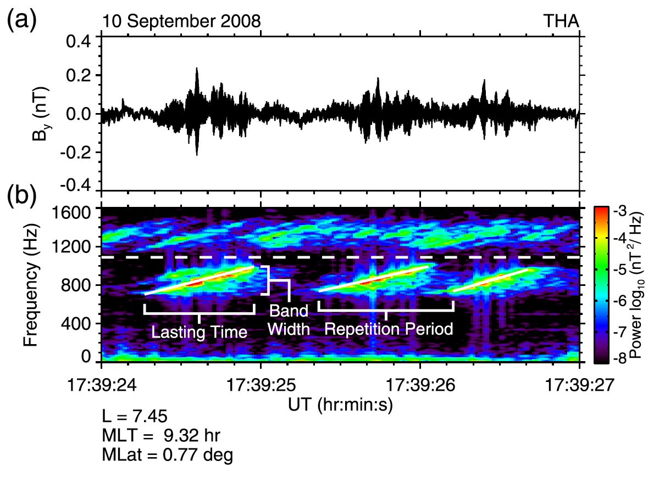
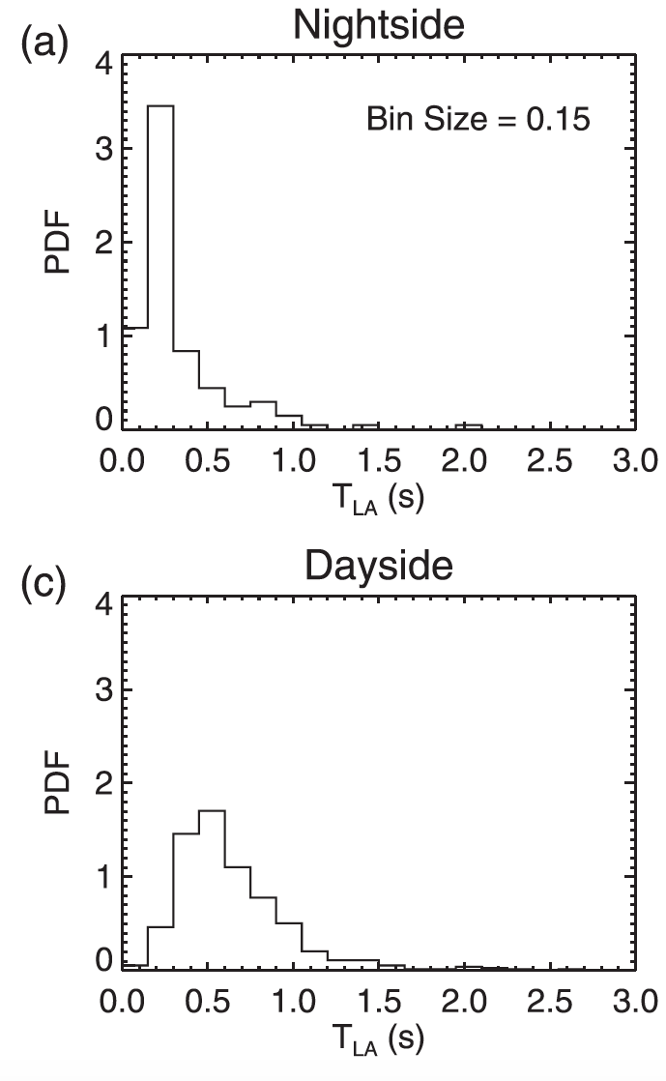
The chorus rising tone element duration follows a similar pattern.
Median: 0.3 s
Median: 0.6 s
Shue et al., 2019

Slide 11
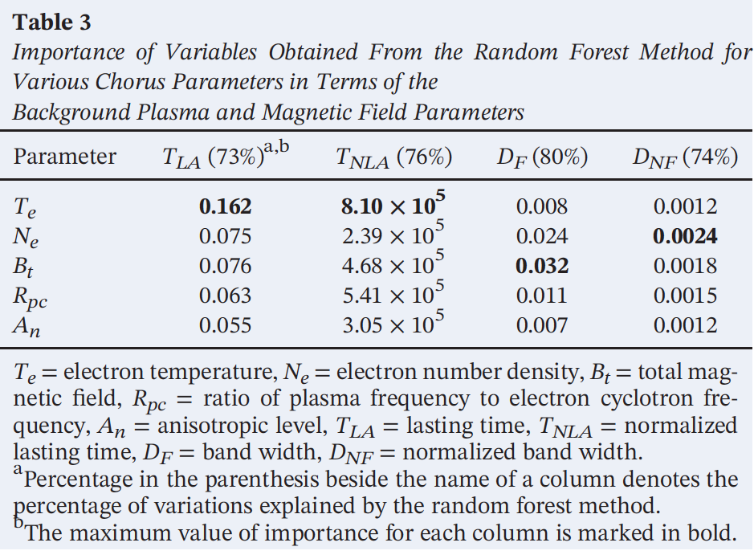
Shue at al., 2019 used a random forest classifier and found that the chorus rising time is most strong anticorrelated with the electron temperature Te.
Te was calculated using the THEMIS ElectroStatic Analyzer (ESA). Few eV-30 keV energy.

Slide 12
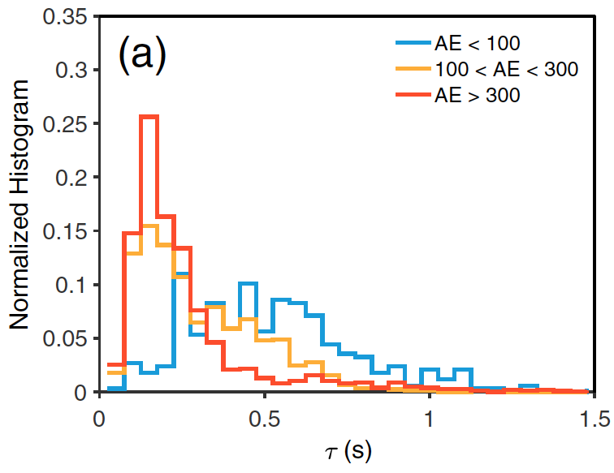
Teng et al., 2017 found that chorus rising tone elements also shortened with increasing AE.

Slide 13
Further investigation is necessary, but this is a good start.
Question to ponder: The chorus-microburst durations follow a similar trend, but why are chorus wave durations longer?
Questions?

