Slide 1
Using Natural Language Processing in Generative Adverserial Network
Team Members :
Mohammad Sabik Irbaz (160041004)
Abir Azad (160041024)
Anika Tasnim Preoty (160041044)
Tani Barkat Shalanyuy ( 160041083 )

Slide 2
Working Frame-work
TextGAN-PyTorch (by Facebook AI)
TextGAN is a PyTorch framework for Generative Adversarial Networks (GANs) based text generation models, including general text generation models and category text generation models. TextGAN serves as a benchmarking platform to support research on GAN-based text generation models.

Slide 3
Text generation with GAN using RNN using TensorFlow (by Google AI)
They can generate text using a character-based RNN.
But the model doesn’t yet understand meaning of words so there is many grammatical and semantic error.
Let’s look over the inputs and outputs

Slide 4
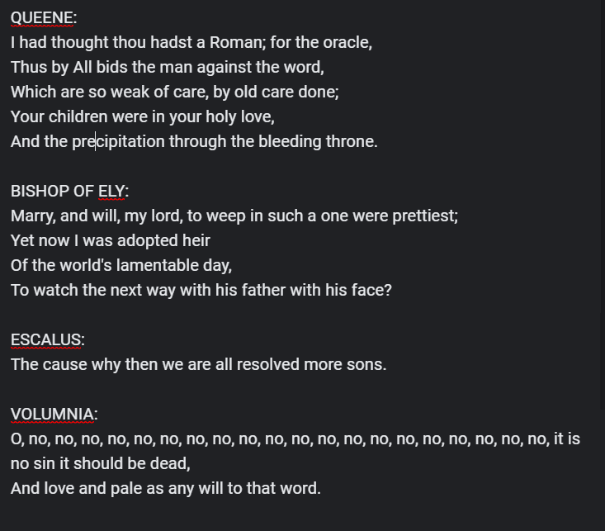
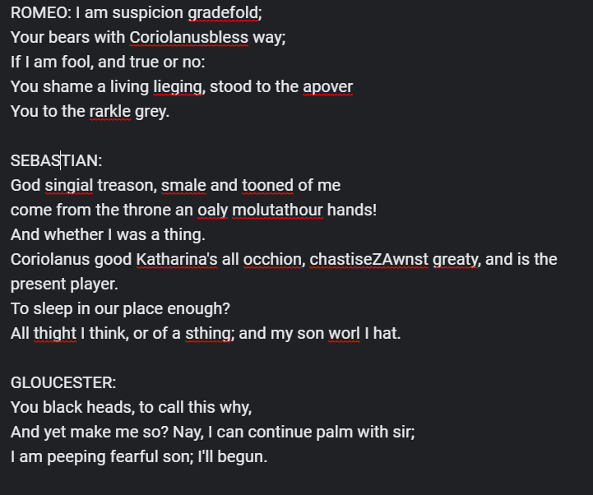
INPUT
OUTPUT

Slide 5
THANK YOU

