Slide 1

Python101
Mico Siahaan

Slide 2
Collection
List

Slide 3
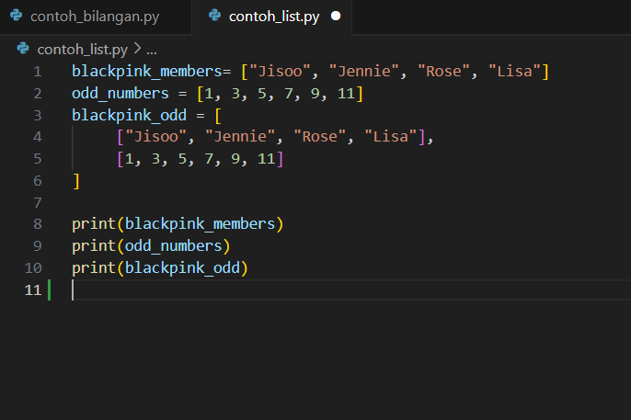
List, Python Workhorse
Collections
Can contain other data types: string, numbers, even lists

Slide 4
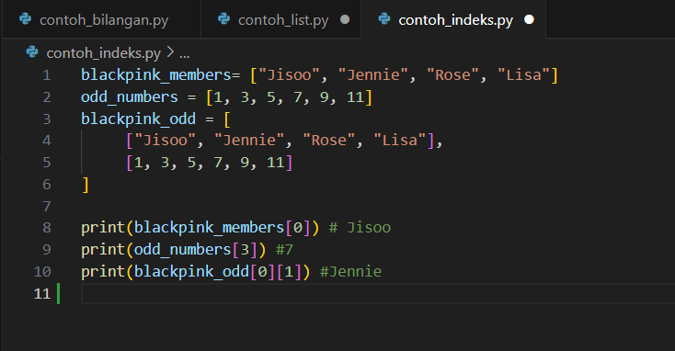
Index
Accessing member of list
Index start from 0

Slide 5
Collection
tuple

Slide 6
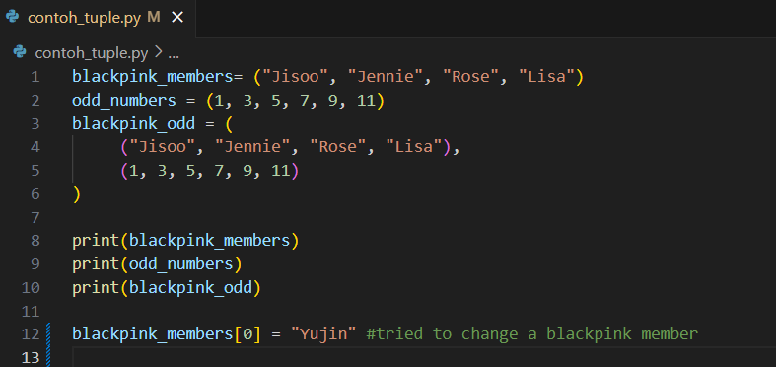
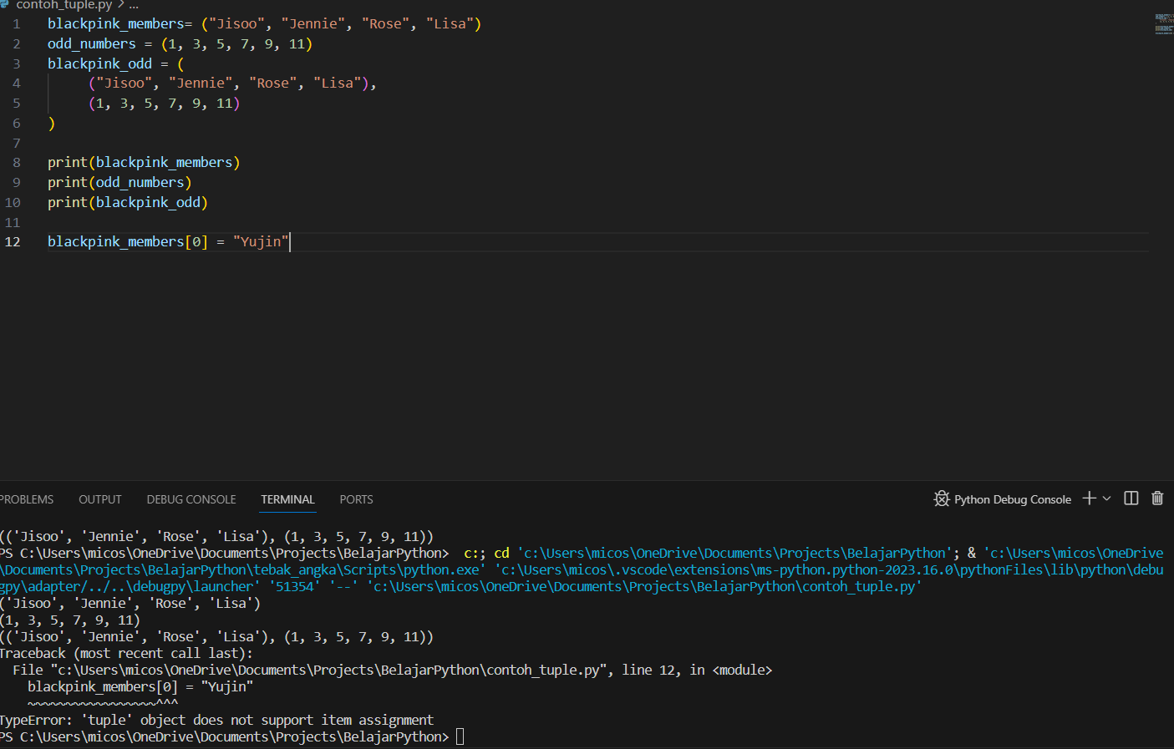
Tuple
Collection
Can contain other data types: numbers, strings, lists, even collections
Immutable

Slide 7
Collection
SET

Slide 8
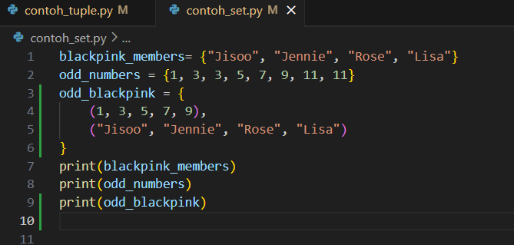
SET
Collection
Can contain other data types: strings, numbers, but can’t contain lists or
Unique member

Slide 9
Collection
Dictionary

Slide 10
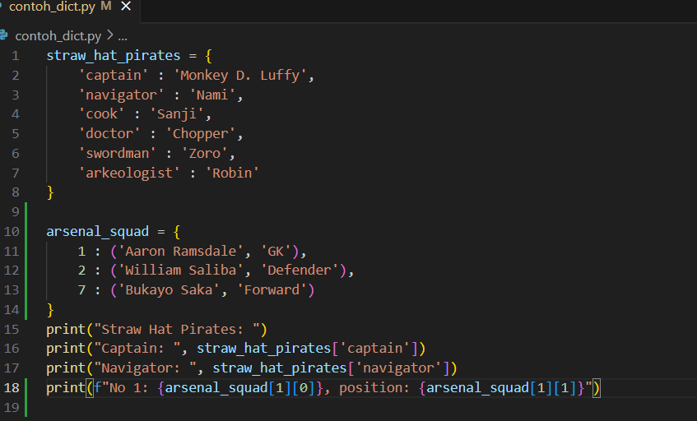
Dictionary
Collection
Can contain other data types: strings, numbers, other collections
Accessing dictionary’s member using ‘key’

Slide 11
LOOP
For, while

Slide 12
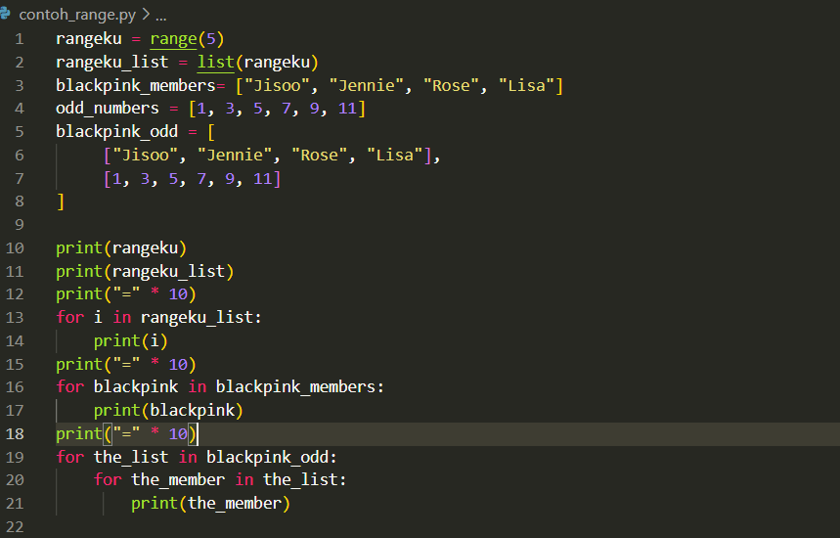
for dan range()
range(): built-in function to create ‘range’ object
for: to iterate member of an iterable object e.g. Collections (list, tuple, dictionary)

Slide 13
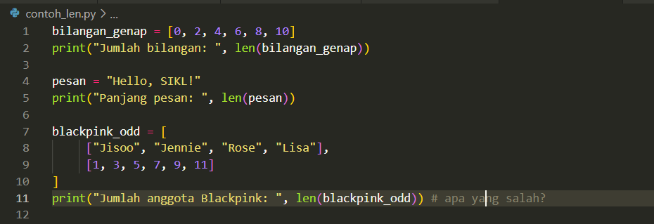
len()
len(): built-in function to show length of a colection

Slide 14
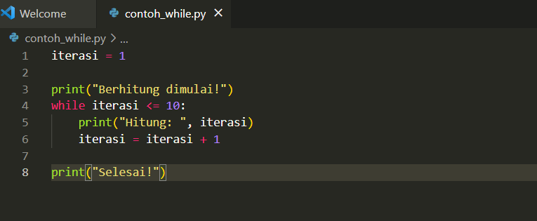
while …
Repeat as long a condition is True

