Slide 1
Python 101
Mico Siahaan

Slide 2
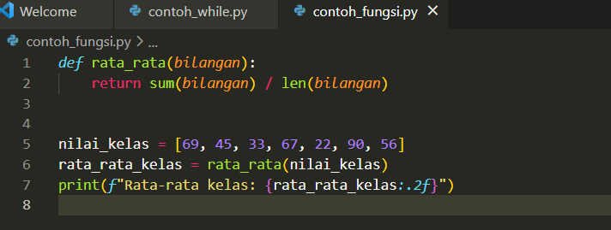
Function
Function: set of re-usable instructions .
Built-in functions: range(), len(), max(), min(), sum()
To define new function, use def keyword
Keywork return to returning control and or value(s) to calling function

Slide 3
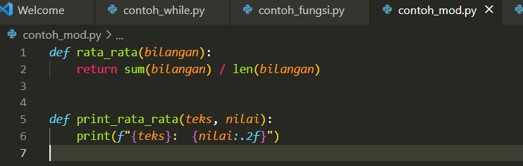
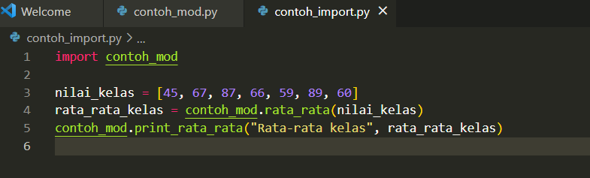
import
import: a keyword to insert/import objects from another file or module into our code.

Slide 4
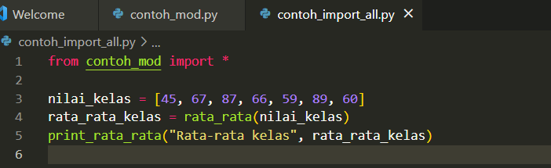
from mod import *
from mod import * : importing all objects into the source code
“.” not required explicitly

Slide 5
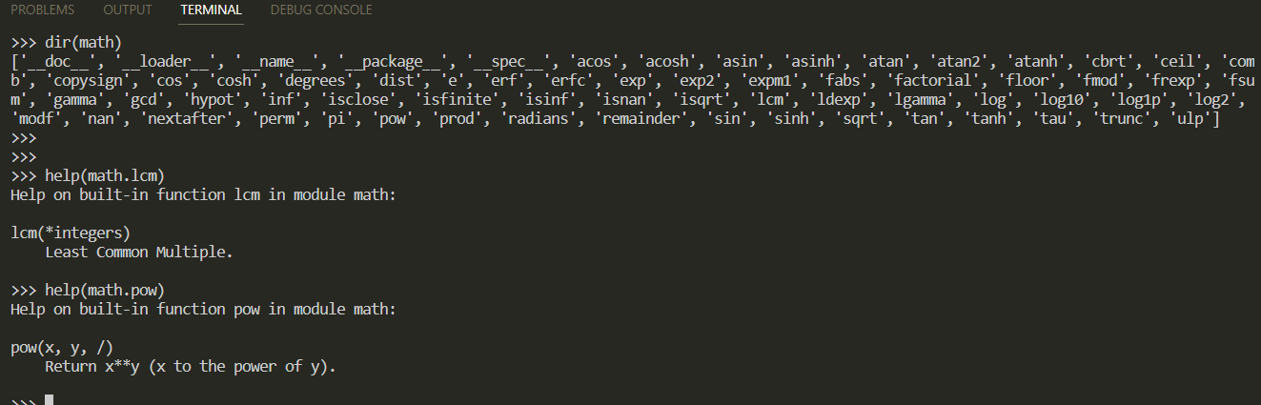
dir() dan help()
dir(): build-in function to check objects and functions/methods lists in an object.
help(): built-in function to read a object’s documentation/help

