Slide 1
Python 101
Mico Siahaan

Slide 2
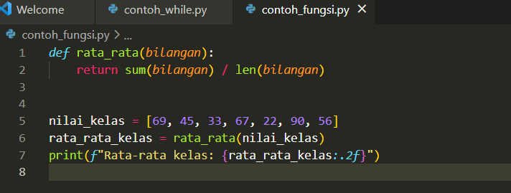
Function
Function: set of re-usable instructions .
Built-in functions: range(), len(), max(), min(), sum()
To define new function, use def keyword
Keywork return to returning control and or value(s) to calling function

Slide 3
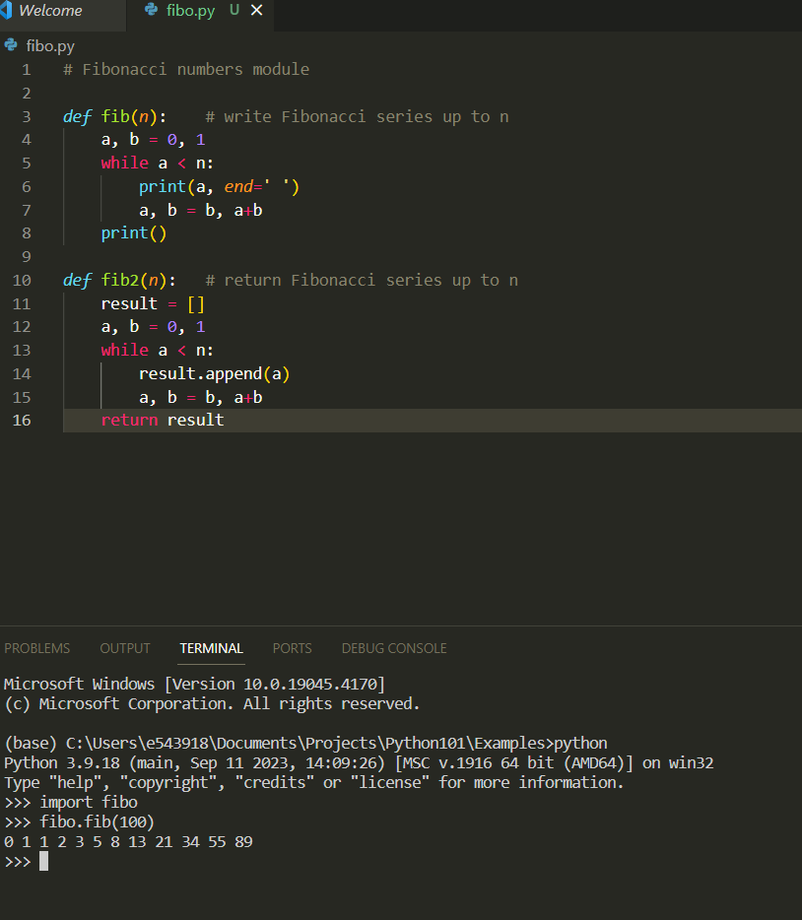
Module
A file containing Python definitions and statements

Slide 4
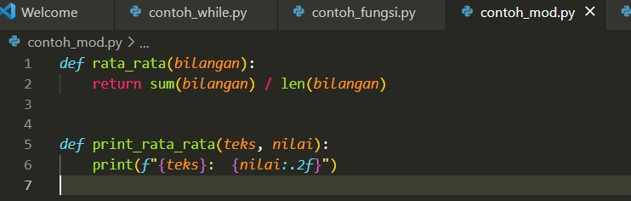
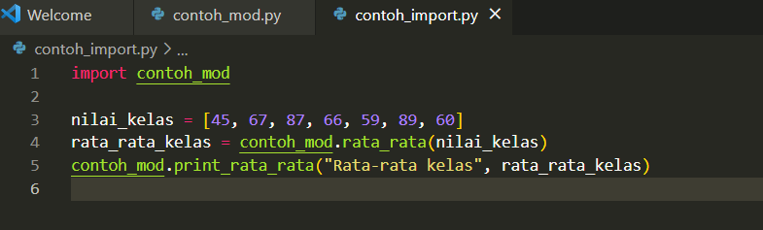
import
import: a keyword to insert/import objects from another module into our code.

Slide 5
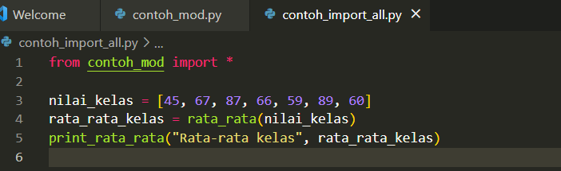
from mod import *
from mod import * : importing all objects into the source code
“.” not required explicitly

Slide 6
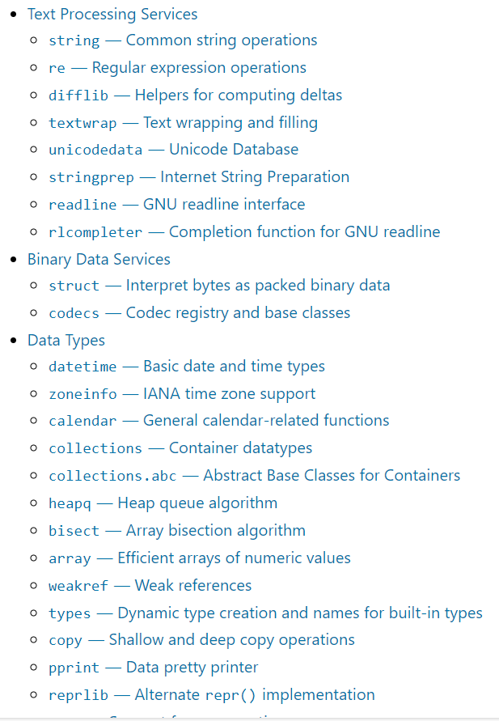
Python Standard Library
Python comes with a library of standard modules
https://docs.python.org/3/library/index.html

